Slide 1


Construction Management and Inspection Services Santa Ana PFAS Treatment at John Garthe Reservoir
Mandatory Pre-Proposal Meeting
August 5, 2025, at 10:00 AM PT

Slide 2
Agenda
Project Team
OCWD Background
Project Location
Construction Scope of Services
CM&I Scope of Services
CM&I Qualification Requirements
Procurement Schedule
Questions

Slide 3
Project Team
OCWD
Laurence Esguerra – Project Manager
City of Santa Ana Public Works Agency – Water Resources
Fallon Franklin – Project Manager / Senior Engineer
Heidi Chou – Principal Civil Engineer
Design Engineer
Tetra Tech
Contractor
To be Determined

Slide 4
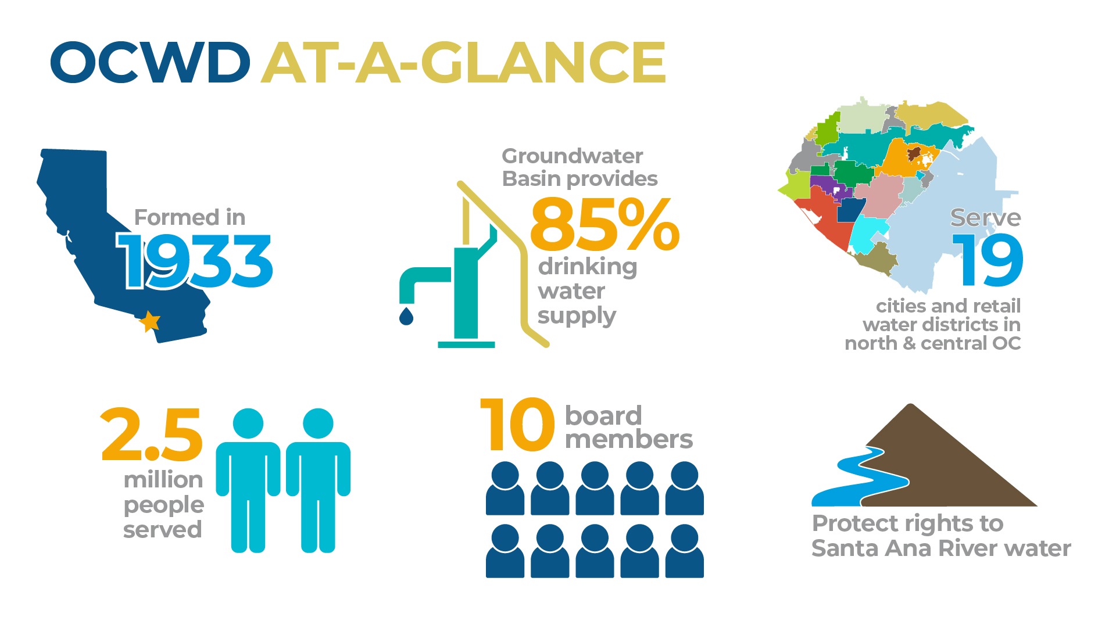

Slide 5
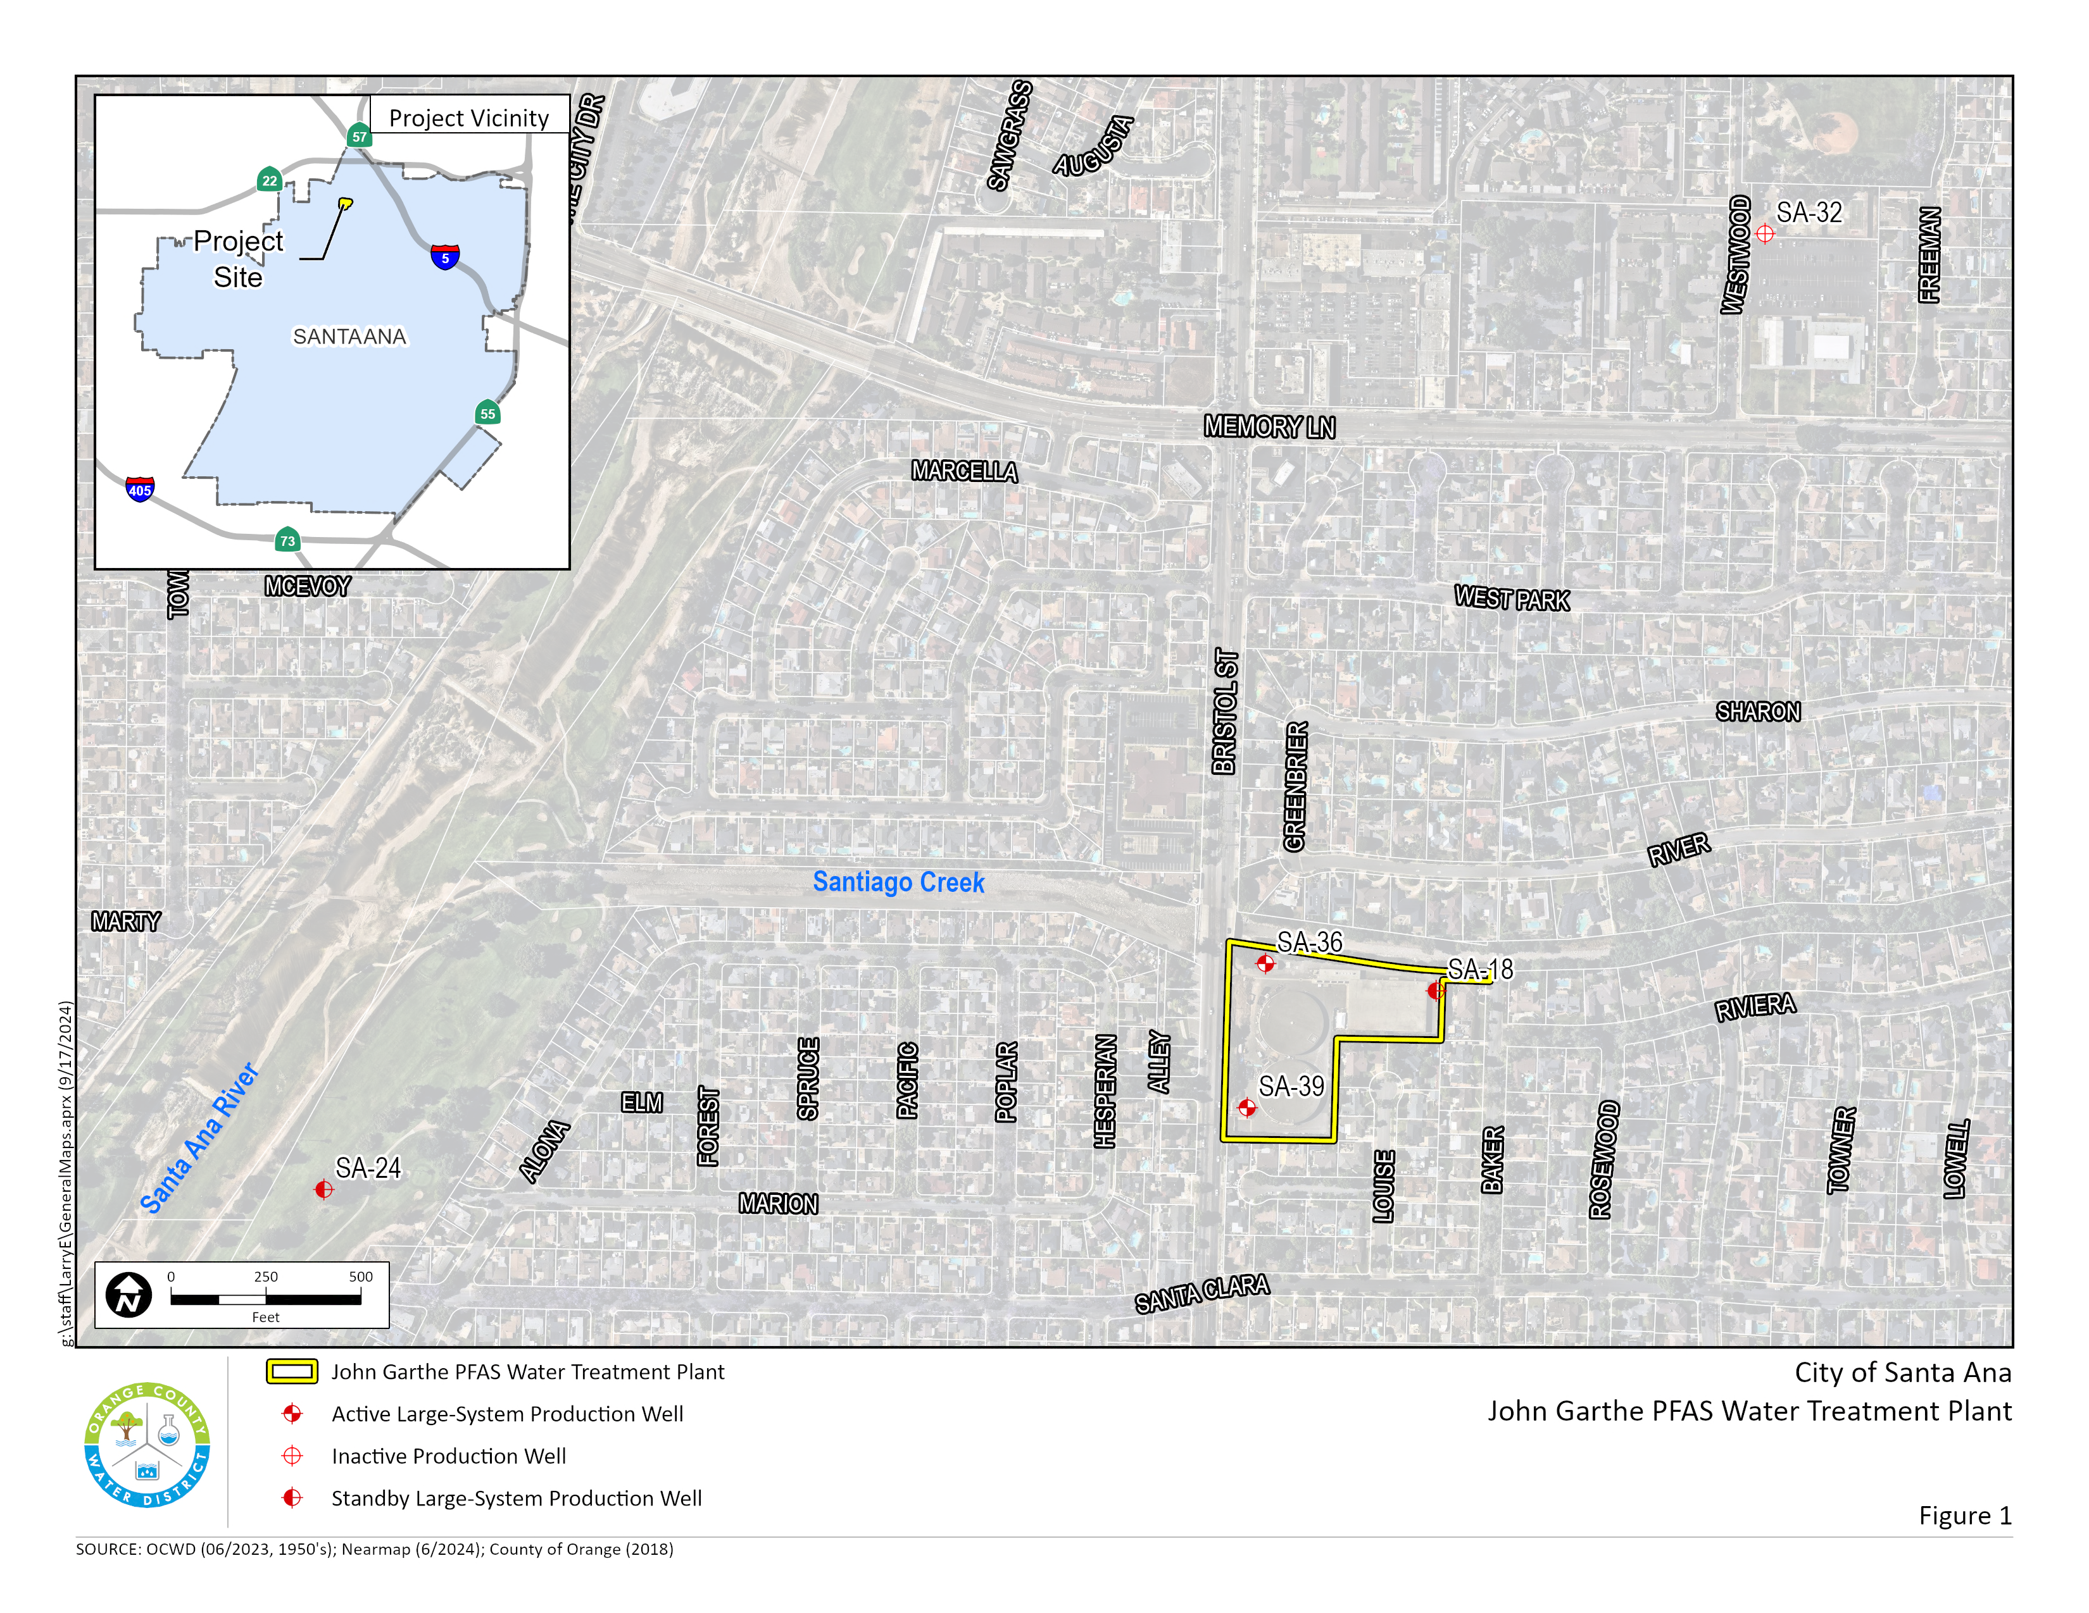
Project Location

Slide 6
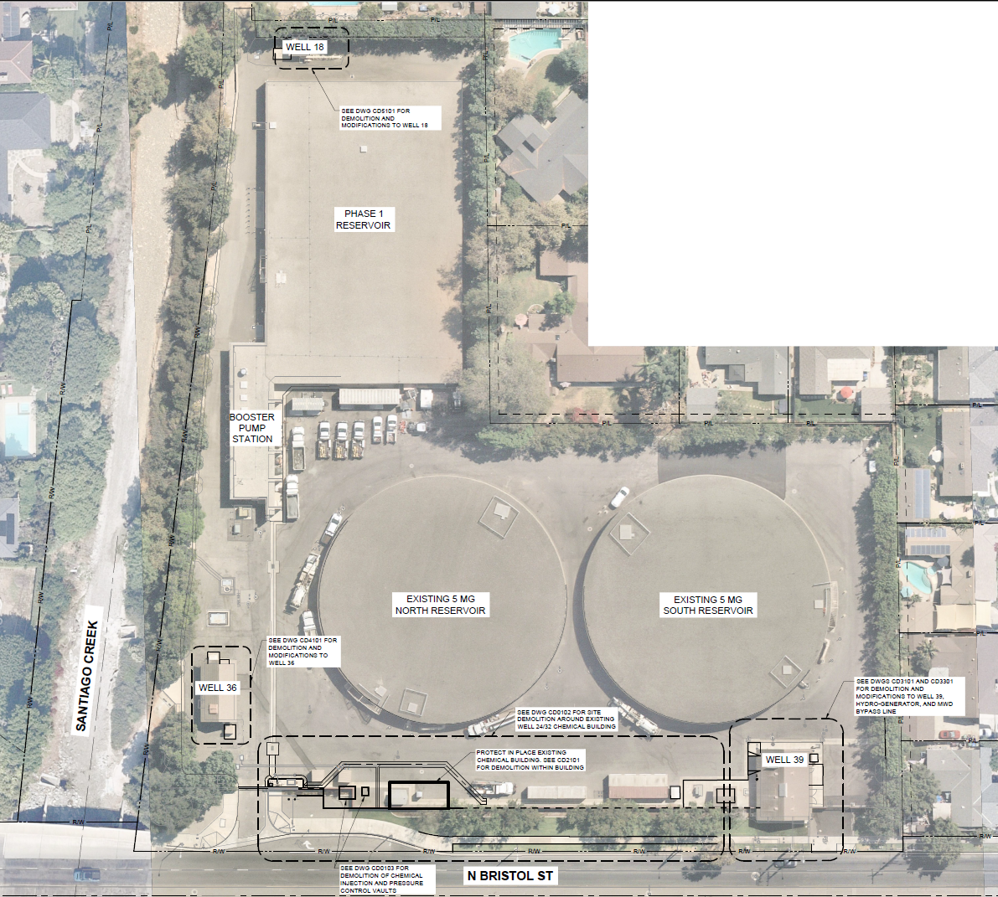
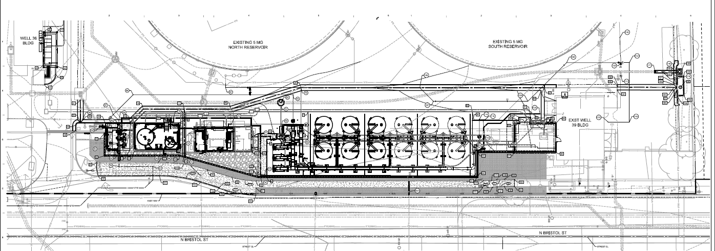
Project Location

Slide 7
Construction Scope of Services
District seeking qualified firms to provide construction management and inspection services throughout the Santa Ana PFAS Treatment at John Garthe Reservoir. Work includes but is not limited to:
New PFAS Treatment facility consisting of three (3) multi-filter cartridge filter pressure vessels, six (6) ion exchange adsorption trains; each train consists of two (2) 12-ft diameter pressure vessels and a valve manifold and a new chemical injection location
Yard piping improvements to combine Wells 18, 36, 32, and 24 to headworks of the treatment site
Expansion of the existing sodium hypochlorite generation system
Site improvements including grading, paving, sidewalks, piping, storm drain treatment, masonry walls, landscaping, etc.
Improvements to Wells 18, 36, and 39 including replacement of the existing hydro-generator at SA-1
General electrical improvements and facilities, installation of VFDs, instrumentation equipment, and instrumentation and control systems
Construction Duration – 840 Calendar Days
Working Hours – 7:00AM – 6:00PM, Monday through Friday
Engineer’s Estimate: $35 million

Slide 8
CM&I Scope of Services
Project Coordination Services
Services include but are not limited to coordination with the District’s and City’s Project Manager, the General Contractor, the Design Engineer, and Project Shareholders.
Resident Engineering Duties
Duties include but are not limited to:
Pre-construction services
Document Control – Procore
Project Correspondence
Construction Progress Reports and Meetings
Contractor’s Change Orders and Disputes.
Payment Requests

Slide 9
CM&I Scope of Services (Cont.)
Resident Engineering Duties (Cont.)
Special Testing
Record Drawings
Schedules
Project Closeout
Perform Construction Inspection Duties
A qualified/certified inspector will ensure the Contractor’s work is under compliance of the contract documents and prepare daily reports of activities, conditions, materials and equipment, etc.. Inspectors may not authorize or approve work that deviates from the contract documents.
Supplemental Services
Evaluation of Contractor Construction Bids
Specialty Inspecting and Materials Testing
Site Safety and Clean-Up
General Start Up and Testing

Slide 10
CM&I Qualification Requirements
The selected firm, firm’s Resident Engineer (RE), and firm’s inspector shall possess at least five (5) years of experience in providing construction management and inspection services on a regular basis for civil works projects and water infrastructure.
The RE shall be a registered engineer in the State of California.

Slide 11
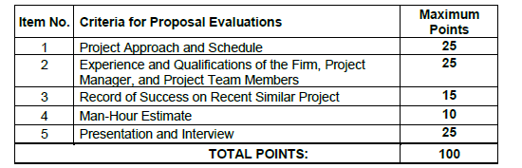
CM&I Proposal Evaluations
Proposals scoring Top 3 in points out of 75 possible points for the sum of Criteria for Proposal Evaluations Item Nos. 1 through 4 will be invited to provide a presentation and interview.
*Tentative Interview Dates - September 16 to 18, 2025*

Slide 12
Procurement Schedule
RFB, Plans and Specifications posted on the OCWD website located at: https://www.ocwd.com/working-with-us/rfp-contracts/
Questions due no later than Friday, August 15, 2025 at 12:00 PM PT
All questions must be directed to Ashlie Valencia at procurement@ocwd.com
Response to questions will be posted on the OCWD website
Proposals due no later than Wednesday, August 27, 2025 at 2:00 PM PT
Three (3) hard copies and one (1) electronic flash drive must be received in a sealed envelope
Include Fee in separate sealed envelope
Anticipated Award Date – October 2025
Anticipated Start of Construction – January 2026

Slide 13
Questions?

Slide 14


Thank You!
Orange County Water District
18700 Ward Street, Fountain Valley, CA 92708 (714) 378-3200
procurement@ocwd.com
www.OCWD.com
@OCWaterDistrict

