Slide 1


Stable Value Fund Options for the
Orange County Water District
Defined Contribution Plans
Presented by:
Scott T. Sutherland
managing director – Investments
SENIOR Institutional CONSULTANT
Institutional plan fiduciary consultant

Slide 2
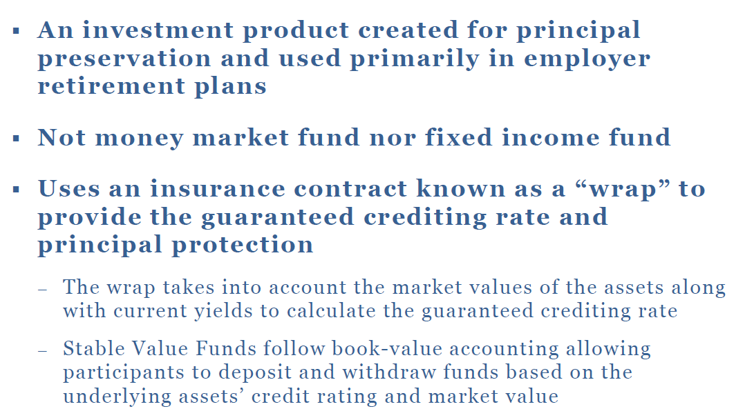
What is a Stable Value Fund?

Slide 3
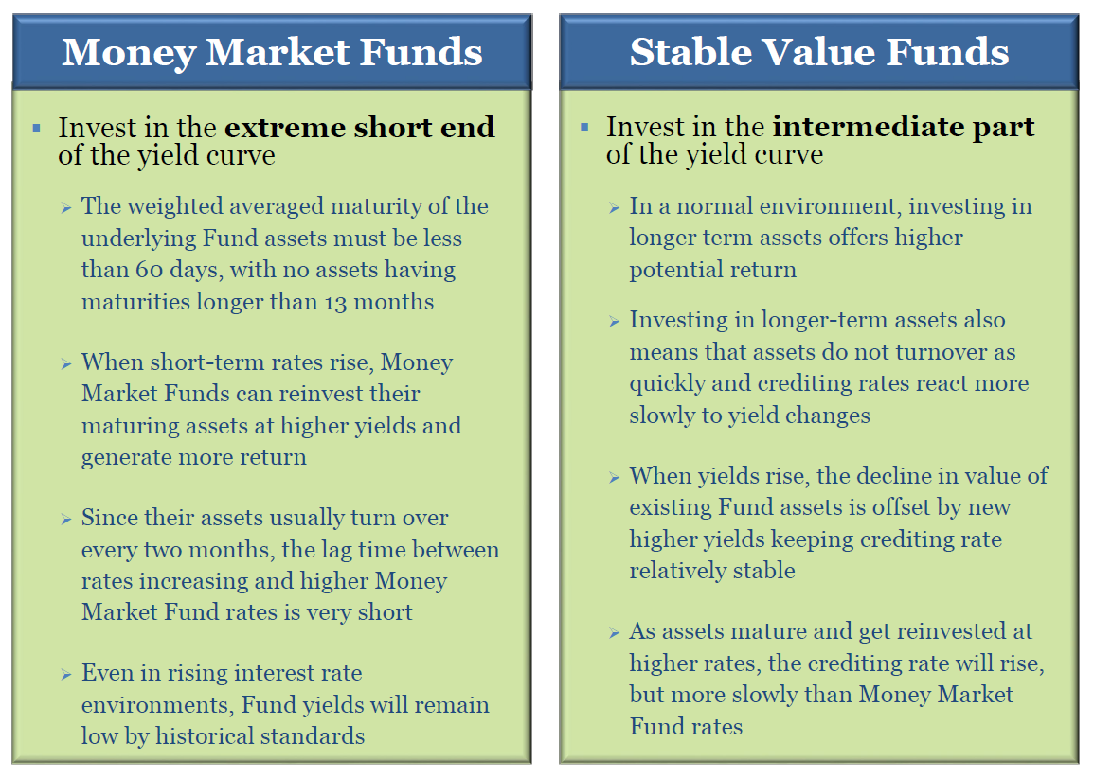

Slide 4
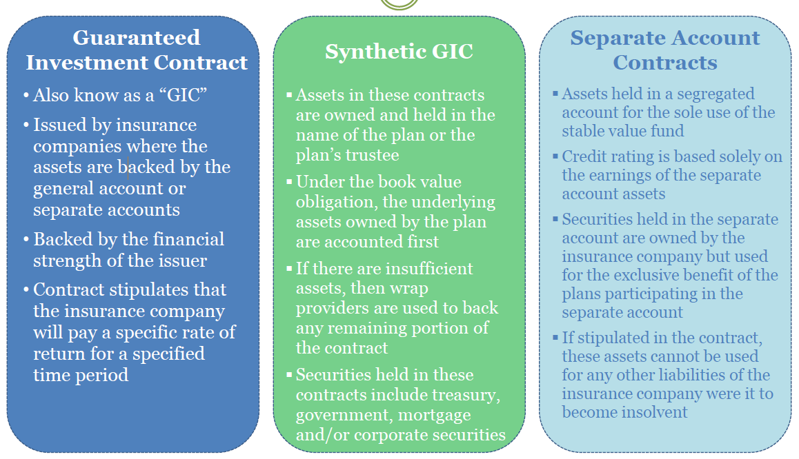
Types of Stable Value Products

Slide 5
RFI Responses
Responses From:
John Hancock
Invesco
Morley via Principal
Columbia via Ameriprise
MetLife via Great Gray
New York Life
The Standard
Federated Hermes
T. Rowe Price
RFI Sent To:
John Hancock
Morley via Principal
Columbia via Ameriprise
MetLife via Great Gray
Galliard
New York Life
Putnam-Franklin-Templeton
The Standard
Goldman Sachs
Federated Hermes
T. Rowe Price
PIMCO
Invesco

Slide 6
Round One - Eliminations
Lack of track record
Limited asset base
Great Gray / MetLife
The Standard
John Hancock
Federated Hermes
Duration too short-term
Questionnaire non-responsive
Benefit responsiveness is questionable

Slide 7
Remaining Bidders
T. Rowe Price
Columbia / Ameriprise
Invesco
New York Life
Morley / Principal

Slide 8
All Bidders Have the Following Features
Available on Fidelity’s record keeping platform
Are not affiliated with Fidelity
Are benefit-responsive to participant withdrawals and exchanges
Exit provision is a 12-month put. Money released at book value with up to a 12-month delay after written notice.
1
2
3
4

Slide 9
All Bidders Have the Following Features
Are portable to other recordkeeping platforms
Have at least 10 years experience in the tax-exempt market
Allow OCWD to continue to offer Vanguard Federal Money Market (VMFXX)
Product is zero revenue share
5
6
7
8

Slide 10
Round Two – Select Finalists
T. Rowe Price
Invesco
Columbia/Ameriprise
New York Life
Morley/Principal
  ___________
  ___________
  ___________

Slide 11
Committee’s Decisions Today
1) The first Empower GIF wire of 50% of the balance will occur on 11/1/24. We need to decide the fund that will receive that wire: a) New Stable Value or b) Vanguard Fed Money Market
2) Despite a thorough vetting through a written RFI, the Sutherland Retirement Group is not comfortable selecting a winner from the 5 remaining bidders without seeing presentations from their management teams. We recommend narrowing to 3 finalists today and scheduling presentations.
3) We also need to decide when to add the new Stable Value option as Fidelity’s deadline to add new funds for 11/1/24 is early September.

Slide 12
Features for the Committee to Consider
Single Providers vs. Wrap Providers
Highest credit ratings vs. more credit risk
Total Stable Value assets currently managed
Expense Ratio / Wrap Expense
Current Yield and Yield to Maturity
Market Value to Book Value
Portfolio Duration

Slide 13
Features for the Committee to Consider
Experience of Firm in Stable Value
Experience of Management Team
Inception Date of Stable Value Fund
Depth of Research Resources
Strength of Parent Company
Internal Management vs. Sub-advisors
Portfolio Composition

Slide 14
