Slide 1

Santa Ana River Trail and Parkway Update
Orange County Water District
Board of Directors
Item No. 6
Ian Achimore
SAWPA Senior Watershed Manager
November 5, 2024

Slide 2
Original Purpose of Santa Ana River Trail and Parkway (SARTP) Partnership
In 1976, the Secretary of Interior deemed portions of the trail in Orange and San Bernardino counties as the “Santa Ana River National Recreational Trail”.
In 2000, the Santa Ana River Symposium backed by the Wildlands Conservancy, National Park Service, and San Bernardino County was held.
In 2006, a MOU was executed to facilitate planning, project implementation, reporting and accountability between SAWPA, the three counties along the Santa Ana River, and the Wildlands Conservancy.
Through the MOU, a policy advisory group (PAG) of elected officials was created, as well as a technical advisory committee of staff. The MOU has been extended two times and expired per direction from PAG in 2018.

Slide 3
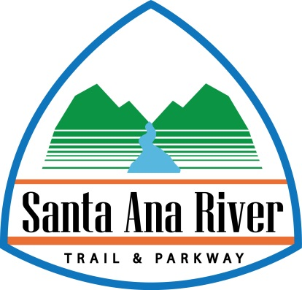
In 2014, Senate Bill 1390 created the Santa Ana River Conservancy (SARCON) which is taking an active role in SARTP completion.
SARCON (administered by the California Coastal Conservancy), is charged with developing a SARTP implementation plan and creating an Advisory Group comprised of local leaders that have decision-making authority.
SARTP Implementation Plan was released in 2018 with feedback from SAWPA, member agencies, counties, cities, non-profits and state/federal agencies.
New Purpose of SARTP
Partnership
Notes:
The Conservancy began actively working on development of the Santa Ana River Trail and Parkway since passage of the Safe Drinking Water, Water Quality and Supply, Flood Control, River and Coastal Protection Bond Act of 2006 (Proposition 84), which made $45,000,000 available to the Conservancy for projects developed in consultation with local government agencies to expand and improve the parkway.

Slide 4
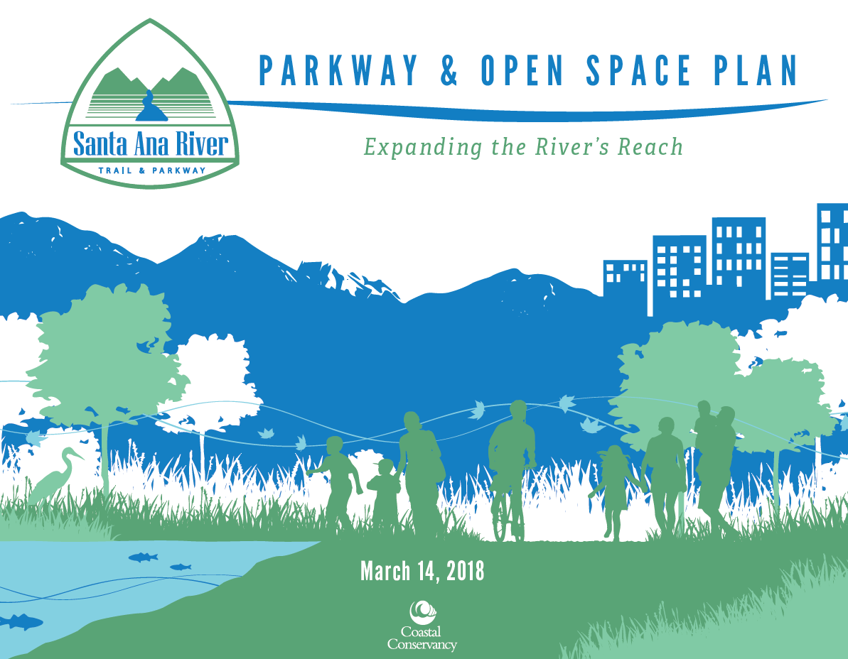
About the SARTP Partnership Advisory Group
The Advisory Group, which meets quarterly and has no limit to the number of members, provides two major functions:
    Provides local decision-making authority and expertise to guide the Coastal Conservancy as the State agency implements the SARTP Plan and funds various projects that have been highlighted in the SARTP Plan
    Provides feedback and information to the Legislature on SARTP funding or assistance as well as existing projects underway
SARTP Plan Cover
4 |

Slide 5
Advisory Group Members (Approved April 2024)
Advisory Group (AG) Member | Title | Representing
Patricia Lock Dawson, Chair | Mayor | City of Riverside
T. Milford Harrison, Vice Chair | Commissioner | SAWPA
Ray Hiemstra, Secretary | Associated Director | Orange County Coastkeeper
Doug Chaffee | Supervisor, 4th District | County of Orange
Dawn Rowe | Supervisor, 3rd District | County of San Bernardino
Karen Spiegel | Supervisor, 2nd District | County of Riverside
Jim Steiner | Councilmember | Corona City
Erin Edwards* | Councilmember | Riverside City
Denise Davis | Councilmember | Redlands City
Stephen Faessel | Councilmember | Anaheim City
Rod Butler | City Manager | Jurupa Valley City
Beahta Davis | Director | San Bernardino Regional Parks
Pam Passow | Director | Orange County Parks
Kyla Brown | Director | Riverside Regional Parks
Frazier Haney | Executive Director | The Wildlands Conservancy
Nicole Padron | Co-Executive Director | Rivers and Lands Conservancy
Rebecca O’Conner | Co-Executive Director | Rivers and Lands Conservancy
Michael Wellborn | Board President | Friends of Harbors, Beaches and Parks
*Not currently on City Council
5 |
Notes:
As of April 23, 2024

Slide 6
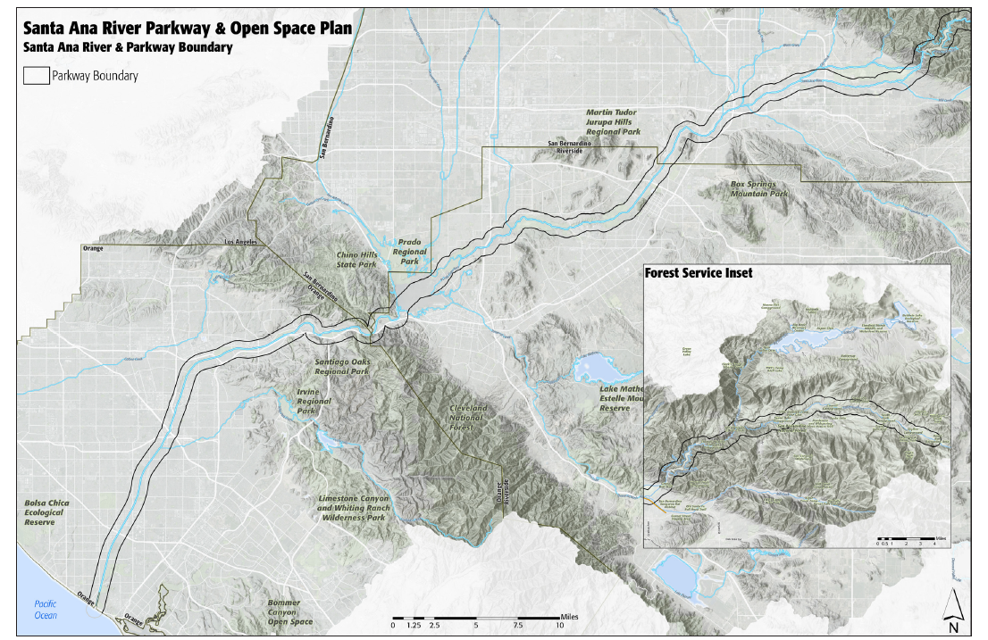
Trail and Parkway Boundary
Santa Ana River Parkway defined as the lands within 0.5-mile of the main stem of the Santa Ana River
6 |

Slide 7
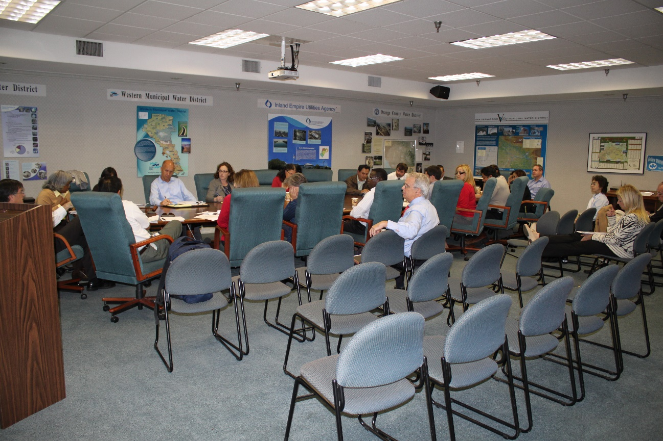
SAWPA’s Previous Role
In 2006, SAWPA hosted a website on the trail partnership.
SAWPA worked on a recreational trails map for the entire length of the Santa Ana River.
Staff-level workgroup coordinated on Prop 50 grant funding in 2006 (Riverside County received grant).
SAWPA hosted Santa Ana River Trail and Parkway staff-level workgroup meetings in 2012.
7 |

Slide 8
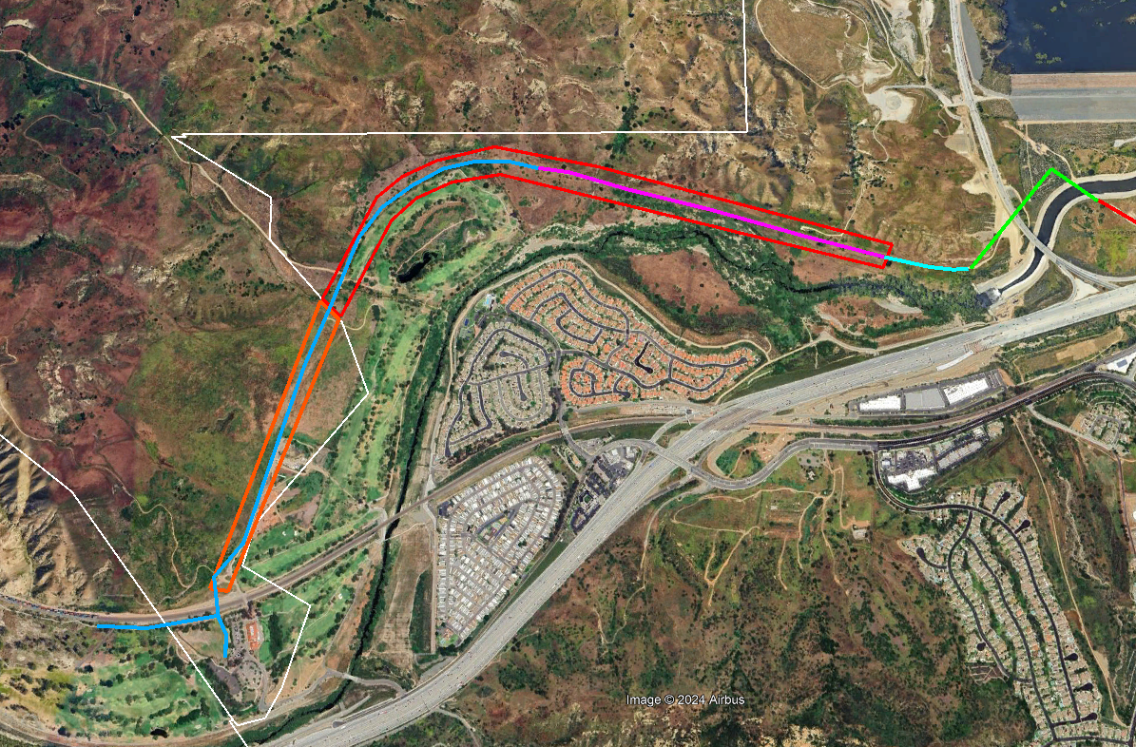
SAWPA’s Current Role
San Bernardino County
Riverside County
N
Member on the Advisory Group to the Coastal Conservancy (Commissioner Milford Harrison of SBVMWD)
In 2014, signed an O&M agreement with RivCo Parks for the segments of the trail (see map)
Coordinates with RivCo Parks on trail segment (shown in map as blue lines) construction
In 2024, approved license agreements with AT&T and SCE to assist in relocation of utilities within SAWPA property
SAWPA Easement
Chino Hills State Park
SAWPA Property
Extents of 2014 Agreement
(SAWPA owned property and easement)
Orange Co.
Map of Prado/Green River Golf Course Segment of SARTP
8 |

Slide 9


Trail Segments Remaining to Be Constructed
Completion Date of Overall Trail To Be Determined
Orange County = 3 miles
Riverside County = 10 miles
San Bernardino County = 20 miles

Slide 10
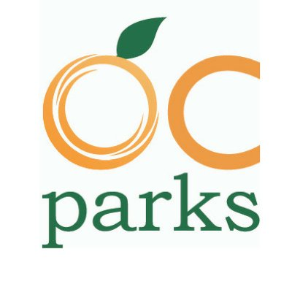
Trail Map – Orange County
SART Extension Project
(in Orange County)
Several segments (known as the “SART Extension Project”) near Yorba Linda and the Green River Golf Course (design completed in January 2022)
Orange Count Parks submitted a grant application (Sept 2024) to Coastal Conservancy for $250K to fund phasing plan, cost estimate, and regulatory permits for the Extension Project
Construction schedule of the Extension Project is TBD
County will apply for future funding to cover construction costs
Green River Golf Course

Slide 11
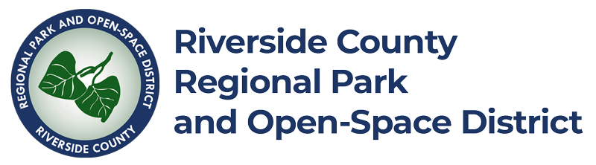
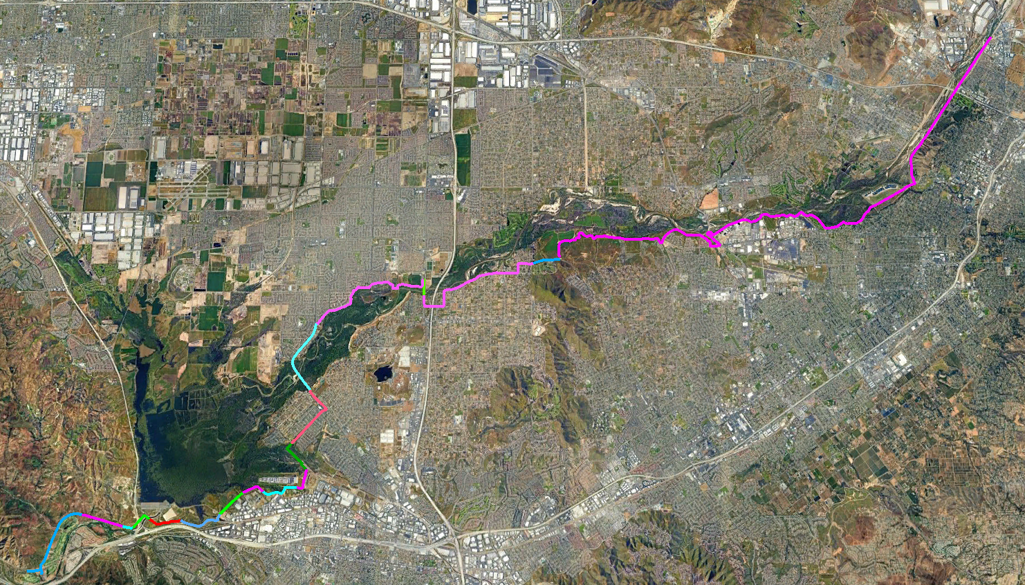
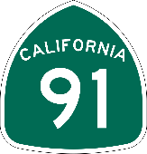
Trail Map – Riverside County
Riverside County Parks estimates $100M needed to finish construction of Trail on the non-completed segments.
To Be Planned
Under Construction
To Be Planned
Completed
Completed
Completed
To Be Planned
More Detail on These Segments Next Slide
In Design
In Design

Slide 12
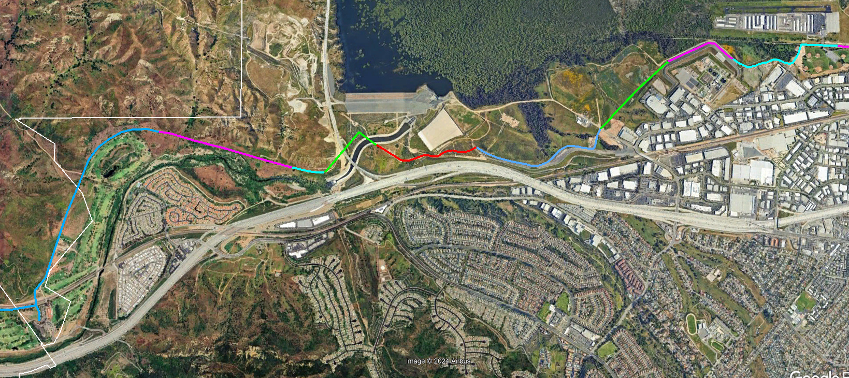
Santa Ana River Trail – Prado Area
Completed
Riverside County
In Design
San Bernardino County
Completed
Concept
In Design
In Design
Orange Co.

Slide 13

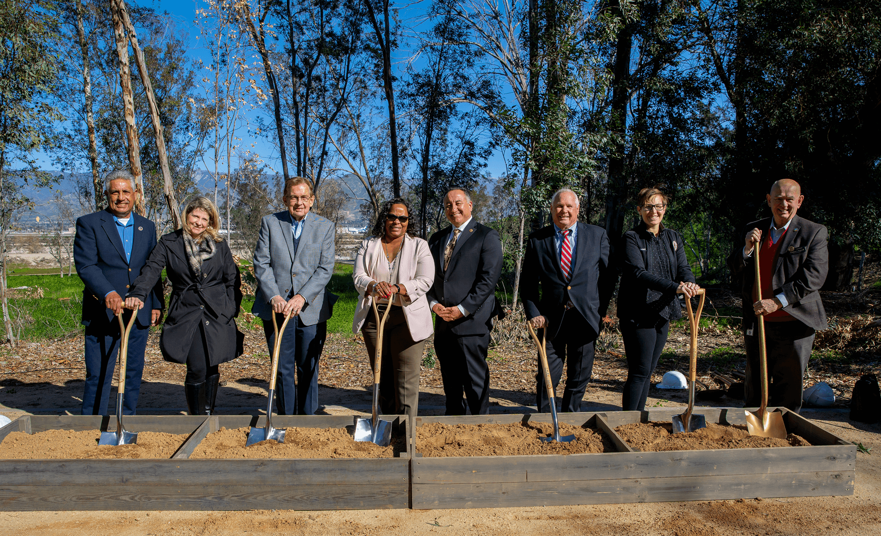
Santa Ana River Trail – San Bernardino County
SART 3 (3.8 miles): Construction resumed after bird nesting season this September and is anticipated to be finished in December 2025.
SART 4A (3.9 miles): Currently the plans are at approximately 35%. Project completion is estimated in 2026.
SART 4B and C – (3.3 miles): SB Regional Parks is waiting on the outcome of its Active Transportation Program grant application. The outcome is expected to be received in 2025.
SART 4D and E: No work has been started.
Santa Ana River Trail Groundbreaking Ceremony
(January 31, 2024)
Notes:
The Active Transportation Program consolidated various transportation programs into a single program and was originally funded at about $123 million a year from a combination of state and federal funds. The goals of the ATP include, but are not limited to, increasing the proportion of trips accomplished by walking and biking, increasing the safety and mobility of non-motorized users, advancing efforts of regional agencies to achieve greenhouse gas reduction goals, enhancing public health, and providing a broad spectrum of projects to benefit many types of users including disadvantaged communities.

Slide 14
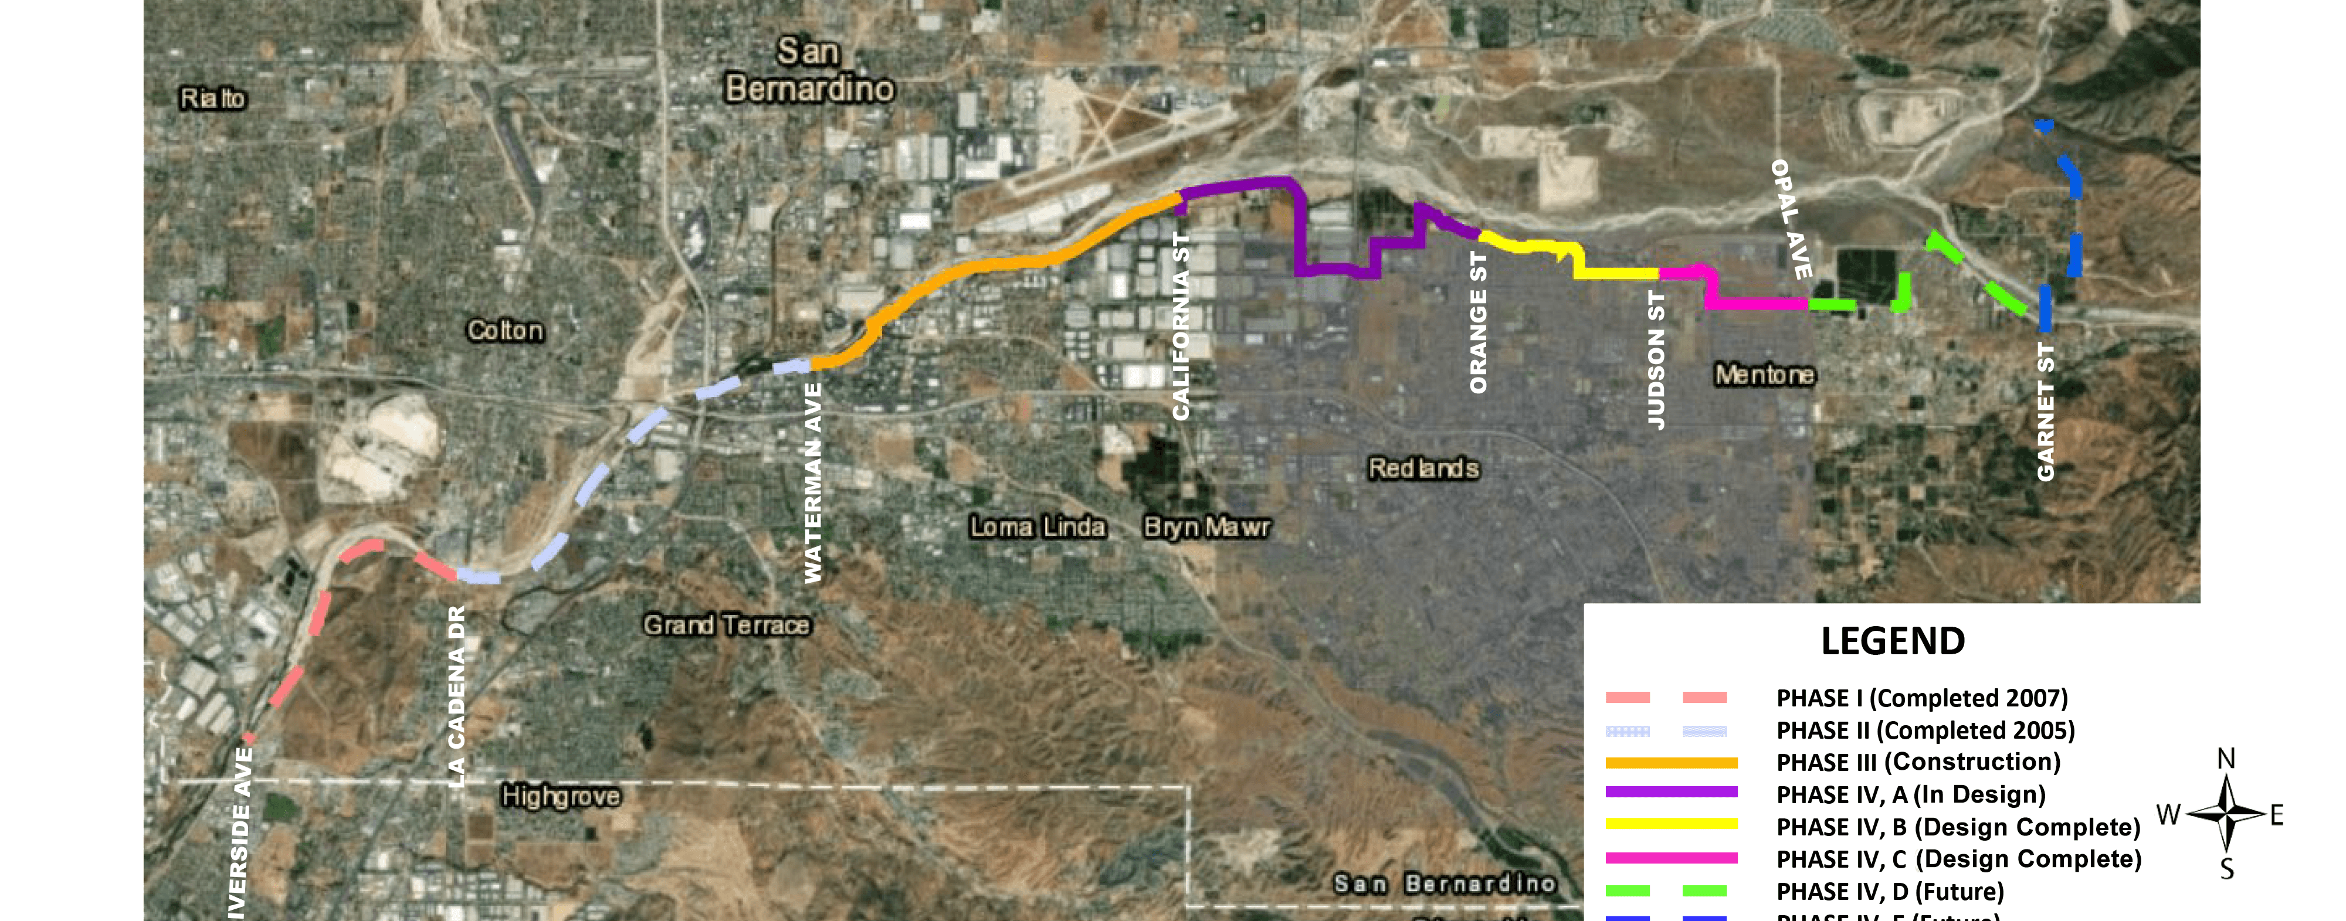
Trail Map – San Bernardino County
Seven Oaks Dam
4A
Santa Ana River
4E
3
4D
4C
Completed
Mill Creek
2
4B
Completed
1
SART 3: Construction resumed after bird nesting season this September and is anticipated to be finished in December 2025.
SART 4A: Plans are at approximately 35%. Completion in 2026.
SART 4B and C: SB Regional Parks is waiting on grant. Expected in 2025.
SART 4D and E: No work has been started.
14 |

Slide 15
Potential Future Role for SAWPA
Review SARTP projects before the Advisory Group for opportunities to expand the multi-benefit aspects of the projects (including benefits related to water resources)
Assist with grant applications
Assist counties with coordination with water agencies on trail construction
Development of a future SARTP website
Notes:
The Santa Ana River Conservancy has awarded more than $40 million in grants to nonprofit organizations, public agencies, and tribes for Trail and Parkway projects with funding from Proposition 84, Proposition 68, and the state General Fund. In addition, the Explore the River grant program awards small grants to programs that provide experiences for systemically excluded communities and youth to explore and enjoy the Santa Ana River and its tributaries.

Slide 16




Thank You
Ian Achimore
Santa Ana Watershed Project Authority
Office (951) 354-4233
ian@sawpa.gov
sawpa.gov
@sawpa_water
@sawpatube

