Slide 1



OC Water Summit Update
Children’s Water Education Festival Update
Communications and Legislative Liaison Committee
May 2, 2024
Communications & Legislative Liaison Meeting
June 6, 2024

Slide 2
2024 Festival Close Out
Festival budget: $265,000
2024 final costs: ~$263,406.38
Final sponsorship: $60,673.96
Largest costs:
  James Events (planning, staffing, set up, tents, tables, chairs, sound system, generators, electrical, announcement system, water, carts, security, first aid, restrooms, etc.): $124,200
  UC Irvine (facilities, parking, security, etc.): $89,105.71

Slide 3
2025 Festival Planning
Staff are researching 60+ locations
Held at UC Irvine since 2014
  Limitations: UCI may have construction in 2025 and increasing costs
Top location selections:
  Huntington Beach Sports Complex (Huntington Beach)
  Oak Canyon Park (Orange)
  Orange County Fairgrounds (Costa Mesa)
  UC Irvine (Irvine)
Date will vary based on location (March, April or May 2025)

Slide 4
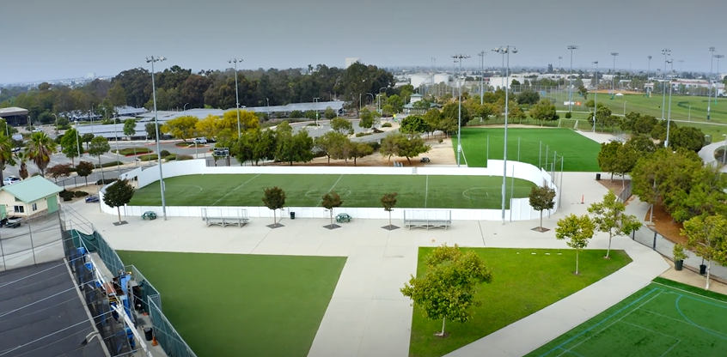
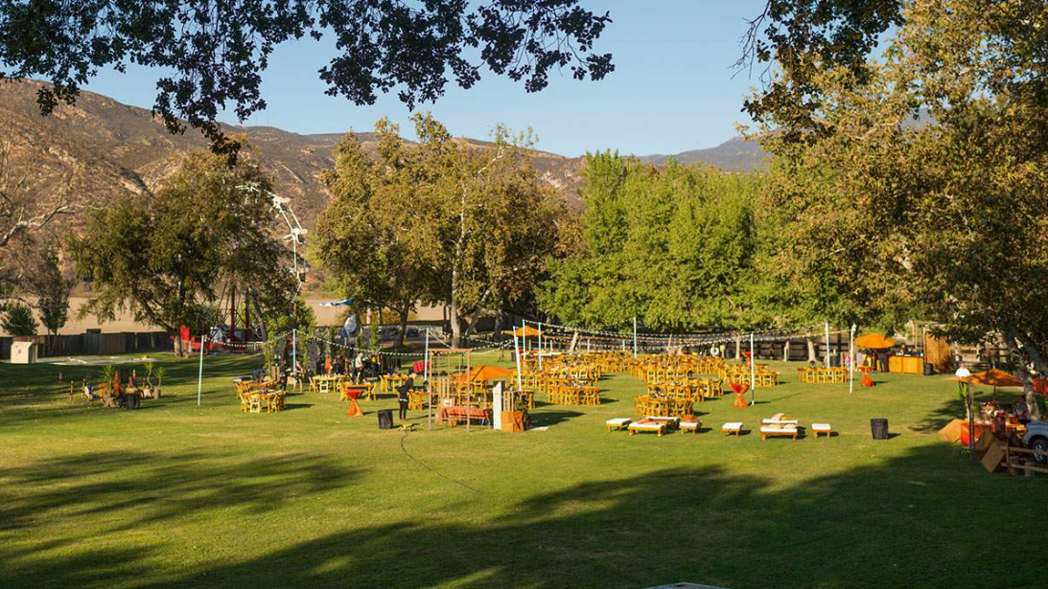
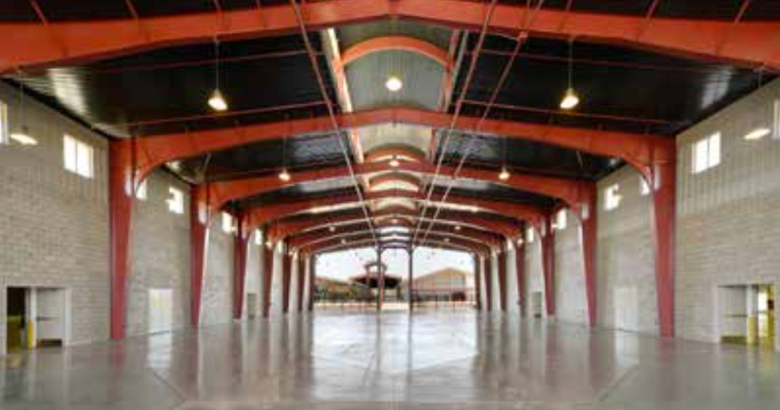
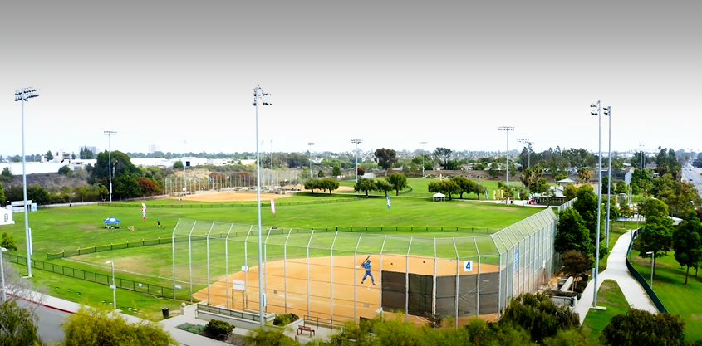
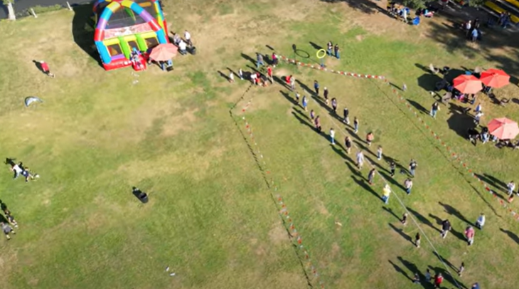
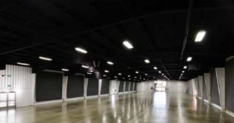
Huntington Beach Sports Complex
Oak Canyon Park
OC Fairgrounds

Slide 5
Next Steps
Continue to research locations and plan site visits
  Continue to coordinate with UCI Government Affairs and Marketing departments to determine venue feasibility and cost deductions
Staff will bring the following recommendations to a future Com Leg meeting:
  Location recommendation
  Date recommendation
Compile school contact information
Begin planning for registration opening (around September)
Updates to Festival website

Slide 6
OC Water Summit Update
OC Water Summit Update
Communications and Legislative Liaison Committee
May 2, 2024
Communications & Legislative Liaison Meeting
June 6, 2024

Slide 7
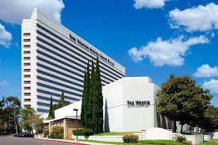

2024 Summit
Friday, September 27
Westin South Coast Plaza
Fritz Coleman returning as master of ceremonies
Theme = Liquid Logic: The Fusion of Finance, Tech and Water
Planning committee meeting monthly
  Next meeting: June 24

Slide 8
Summit Session Potential Speakers
Making Water a Priority at the Federal Level- Congressional candidates invited to speak about their plans for water
Steve Garvey, Senate Candidate
(Adam Schiff invited but declined)
Cyber Defense for Orange County's Water Infrastructure- Local and national look at the security risks to water infrastructure and how to safeguard it
Alberto Martinez, OC Intelligence Assessment Center
Colonel John Harris, Retired U.S. Army Cyber Command
Troy Laughlin, CEO, Enterprise Security
Kevin Morley, Manager of Federal Relations, American Water Works Association
Financing the Future of Water- How water districts can author their own water initiatives, public’s appetite for a bond, and innovative ways to finance water projects
Adam Probolsky, President, Probolsky Research
Robert Porr, Executive VP, Fieldman Rolapp
James Sutton, Election Law Attorney, Rutan & Tucker
Conservation as the California Way of Life? Environmental law perspective, farming perspective and policy perspective of ‘Making Conservation a California Way of Life
Moderator: Mark Arax, Author and Journalist (will also provide historical overview)
Jennifer Hernandez, Attorney, Holland & Knight
Ellen Hanak, Director of the Water Policy Center, Public Policy Institute of California
Darcy Villere, Cohost, We Grow California Podcast
The Shift to Clean Energy- Discuss new clean energy vehicle regulations and what they mean for water utilities
Representative, AQMD

Slide 9
OC Water Summit Update
Public Affairs Outreach
Communications and Legislative Liaison Committee
May 2, 2024
Communications & Legislative Liaison Meeting
June 6, 2024

Slide 10

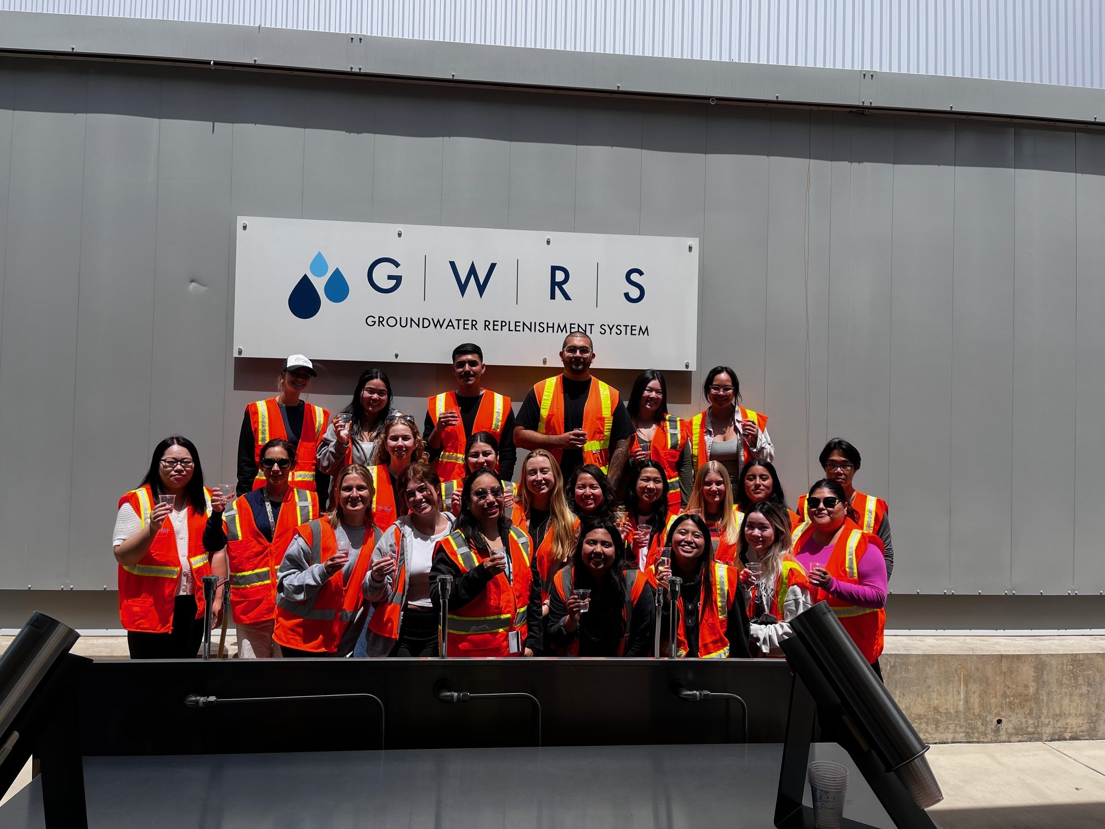


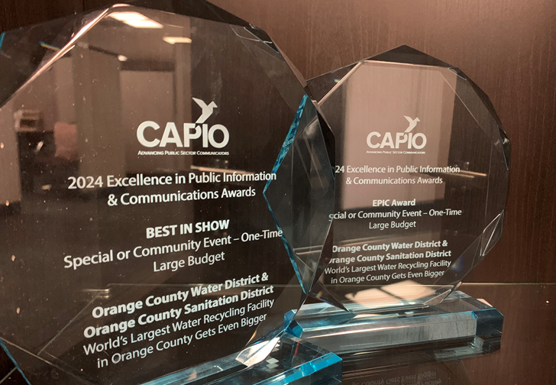

Community Engagement
Tours
11 tours and 167 tour guests
Updated on-demand technical & general GWRS tours
Speakers Bureau
9 speaking engagements
Awards
EPIC Award and Best in Show Award from the California Association of Public Information Officers
Digital Communications
Hydrospectives newsletter sent to 4,000+ subscribers
Cal State Long Beach nursing students tour the GWRS
OCWD and OC San won an EPIC Award and Best in Show Award from CAPIO for the GWRS Final Completion Dedication Event

Slide 11

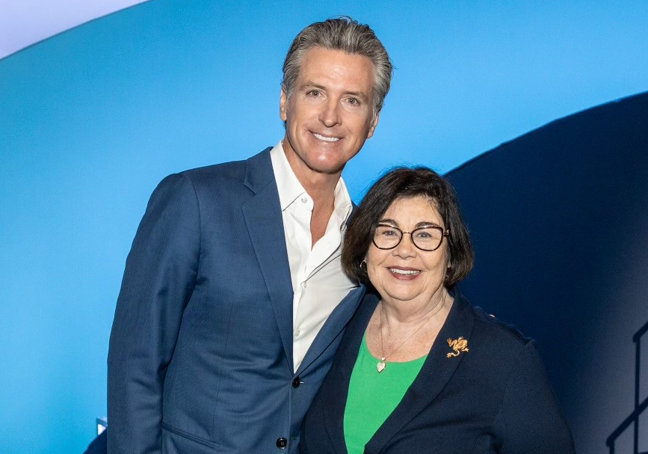
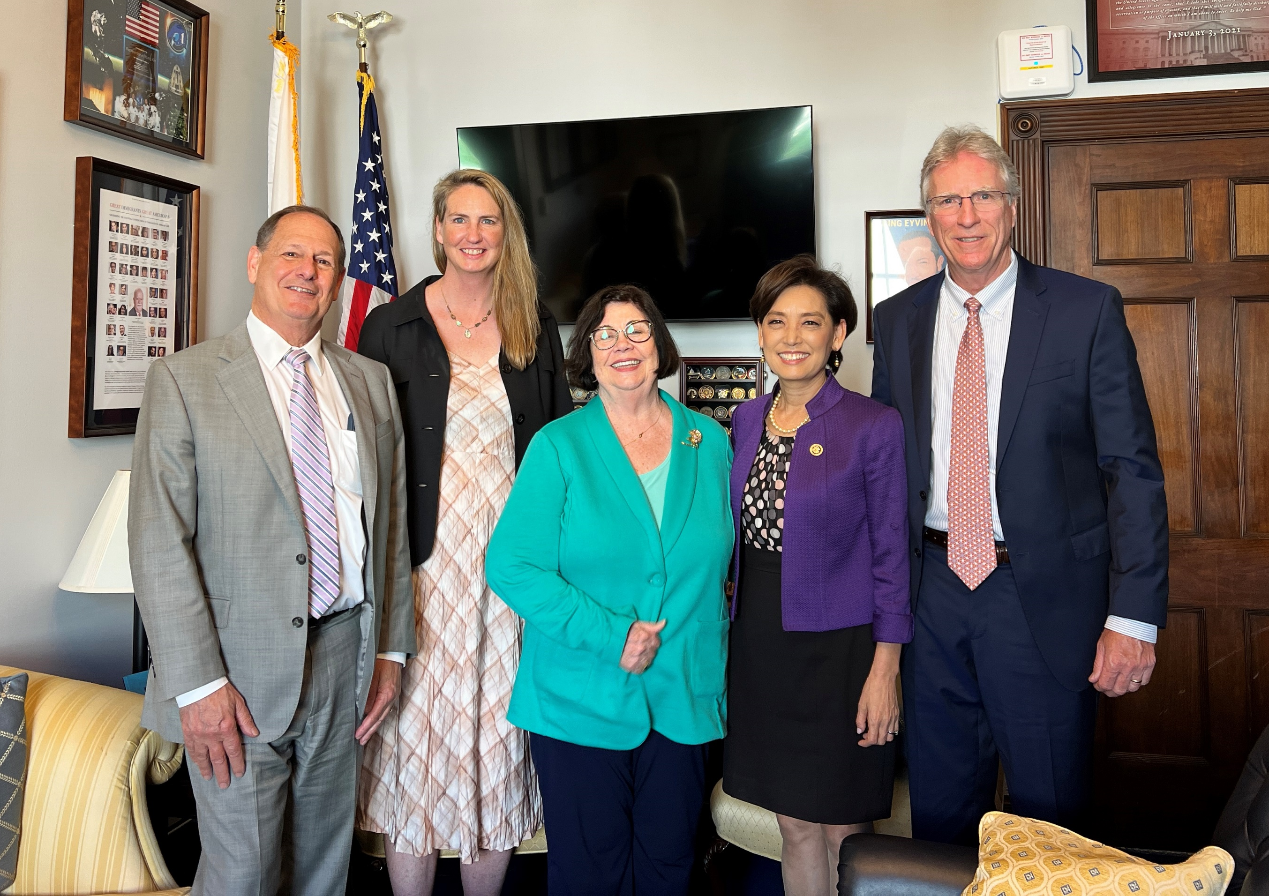
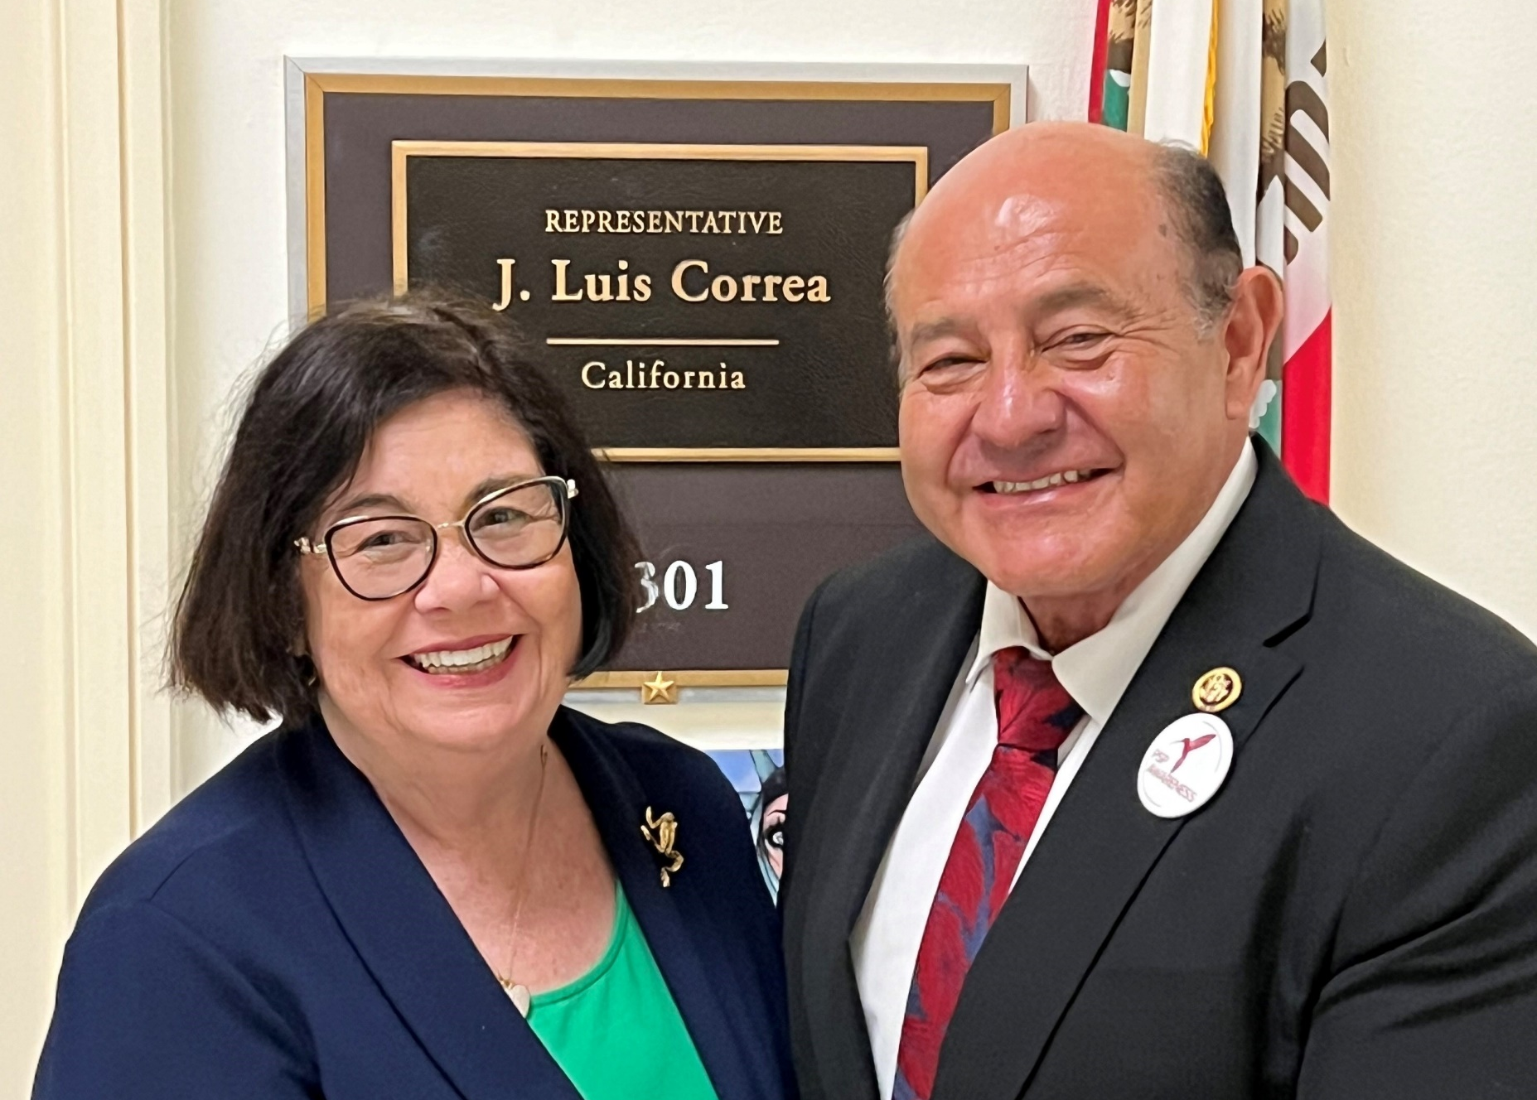
Legislative Engagement
President Cathy Green, John Kennedy, Alicia Dunkin, and Eric Sapirstein meet was Congresswoman Young Kim in Washington DC
May Activities
Meeting with Congressman Lou Correa
Meeting with Congresswoman Young Kim
Meetings with key committee, EPA and USACE staff
Meeting with Assemblymember Diane Dixon
President Cathy Green poses with Governor Gavin Newsom at the ACWA conference
President Cathy Green, John Kennedy, Alicia Dunkin, and Eric Sapirstein meet with Congresswoman Young Kim in Washington DC
President Cathy Green and Congressman Lou Correa during a meeting in Washington DC

Slide 12




Media & Stakeholder Engagement
17,900+
social media followers
  12.3 million
  global media reach
21,000+
website page views
18,000+
social media impressions

Slide 13
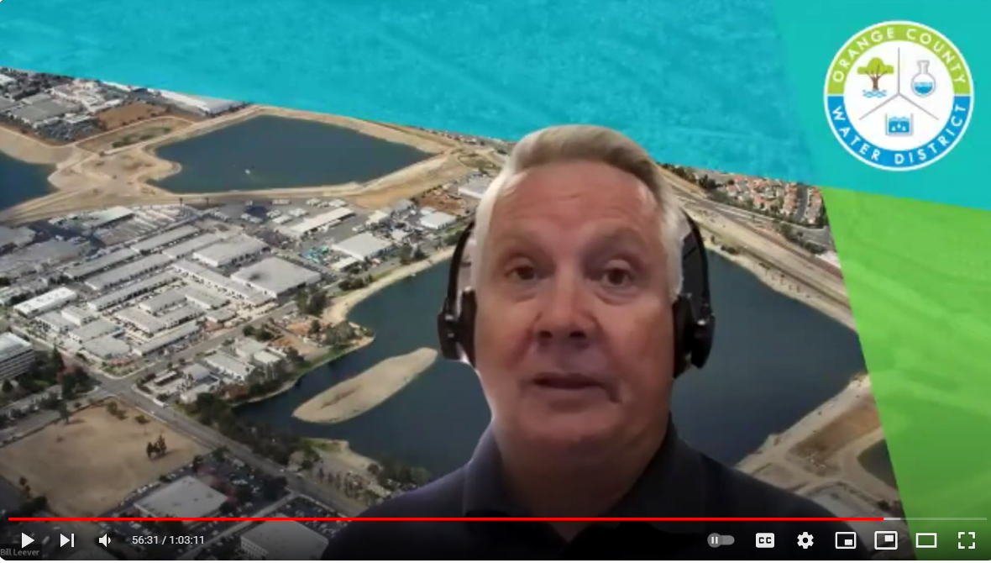
May Webinar Recap
Addressing Groundwater Contamination in the Southern Portion of the OC Groundwater Basin
Wednesday, May 22, 2024
170+ live and recorded views
Speakers:
Bill Leever, P.G., CHg
Principal Hydrogeologist
Orange County Water District
Angela Turner, P.G.
Engineering Geologist/Project Manager
Department of Toxic Substances Control
Mona Behrooz, Ph.D., P.E.
Site Cleanup Program Supervisor
Cal EPA-Santa Ana Regional Water Quality Control Board
OCWD’s Bill Leever takes questions from the audience during the May 22 South Basin webinar

Slide 14
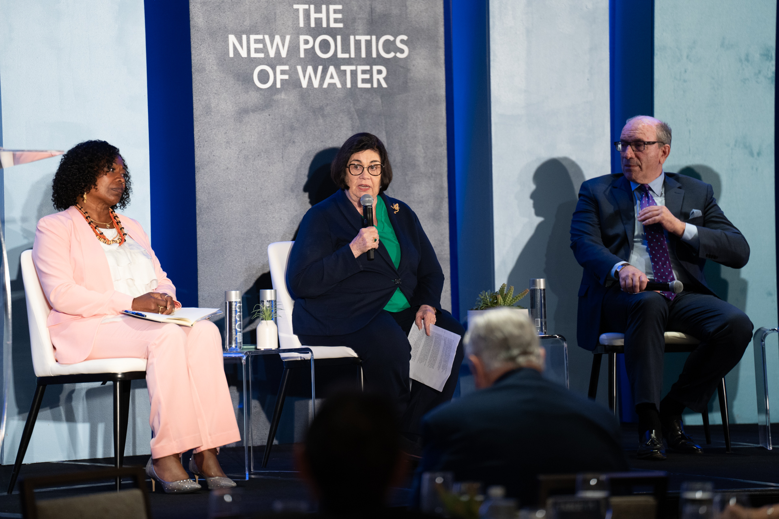
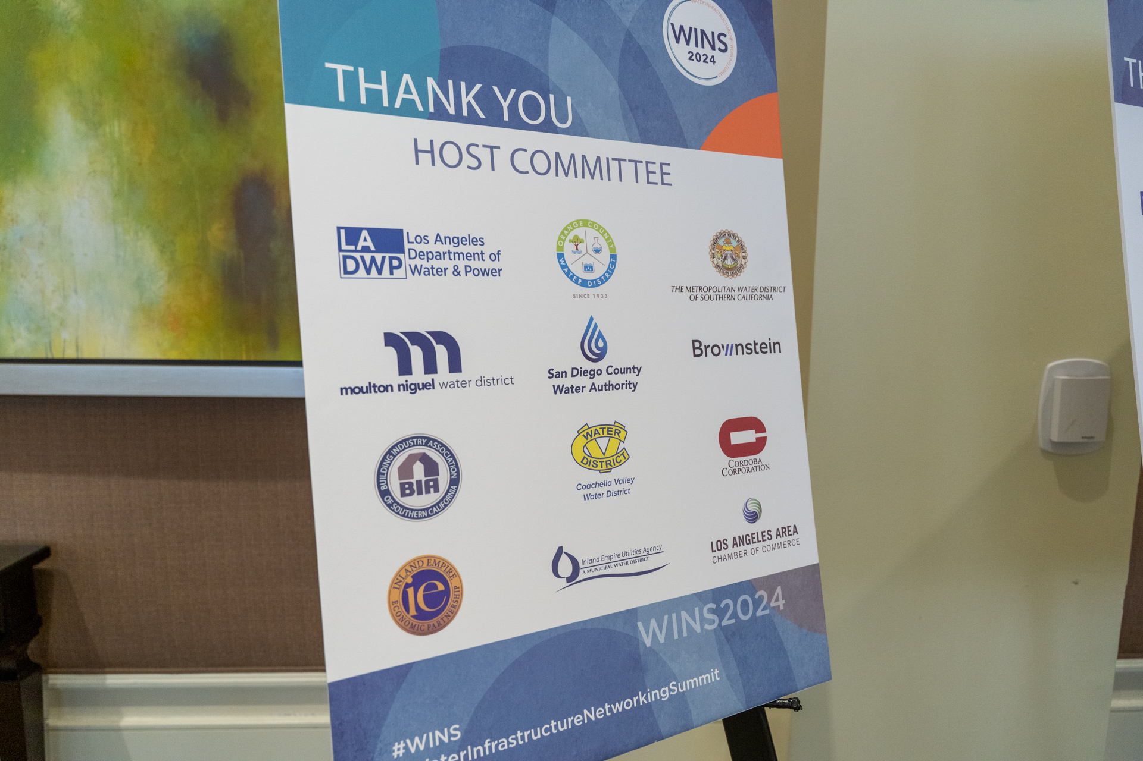
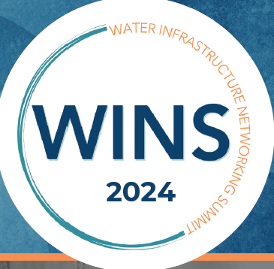
Water Infrastructure Networking Summit

Slide 15
Looking Ahead
Upcoming OCWD/ Community Events:
June 8: OC San Open House
June 8: Anaheim Public Utilities OC Green Expo
June 10/11: EPA PFAS Briefing and Tour
August 7: Flow Reversal Reverse Osmosis (FR-RO) Webinar
September 27: OC Water Summit
October 24: Groundwater Adventure Tour

Slide 16
PFAS Events
All producers have been offered the opportunity to hold a dedication ceremony
Past events:
Serrano Water District (9/22)
Yorba Linda Water District (5/22)
Garden Grove produced a video for broadcast its public access channel & its website
Future events:
East Orange County Water District
City of Santa Ana

Slide 17
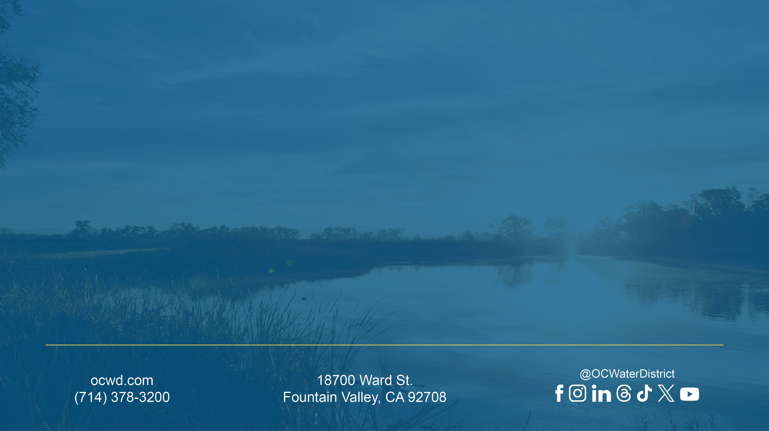
Thank You!
Notes:
Internal presentations – use this closing slide. Updated May 29, 2024

