Slide 1



Urban Runoff Optimization Study
Board Meeting
October 16th, 2024
Kevin O’Toole, Senior Planner

Slide 2
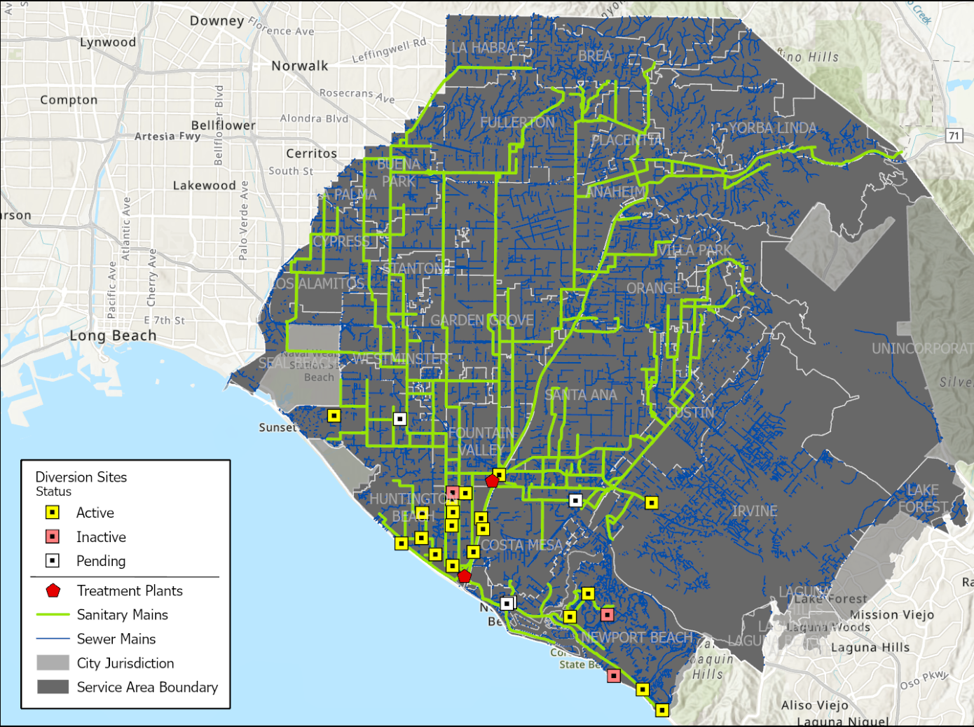
Program Background
Dry weather diversion program began in the early 2000s in response to beach closures in HB from elevated bacteria
Program expanded to allow up to 10 MGD of dry weather urban runoff to sewer
21 active diversions– currently 3 MGD diverted
Diverted urban runoff ultimately becomes inflow for GWRS

Slide 3
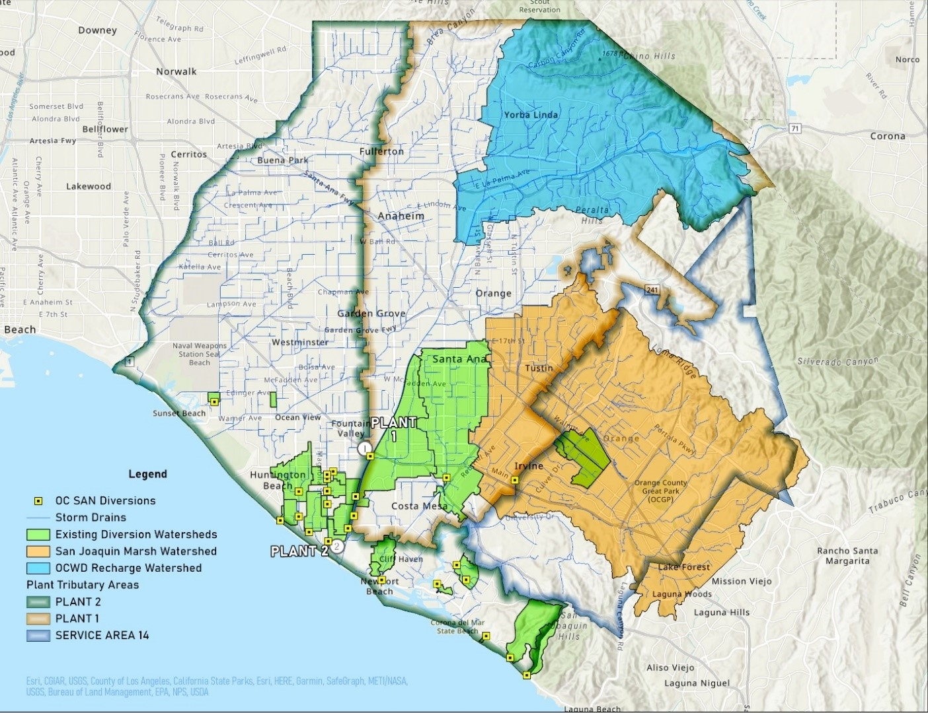
Study Goals
Unique opportunity for OC SAN, OCWD and OCPW to collaborate on regional solutions
1) Optimize how diversions function to increase runoff captured by existing infrastructure
2) Identify opportunities for new diversion projects with OCWD, OCPW, and other Orange County public agencies

Slide 4
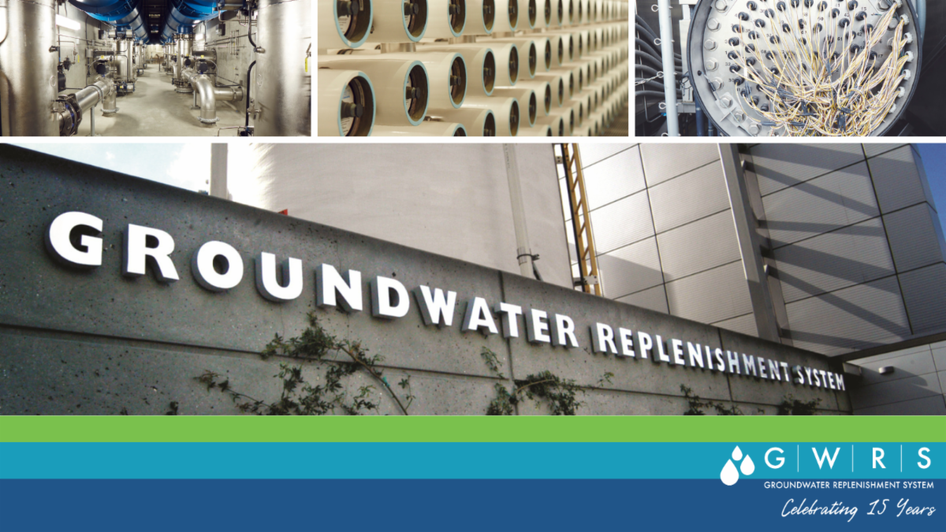
Why is OCWD Participating
OCWD views urban runoff as a valuable resource
Dry weather diversions are an opportunity to improve local surface water quality while simultaneously increasing water supply to GWRS (win-win)
OC SAN can currently supply GWRS adequate treated wastewater
Dry weather diversions are identified as potential project in the Resilience Plan should GWRS flows decline

Slide 5
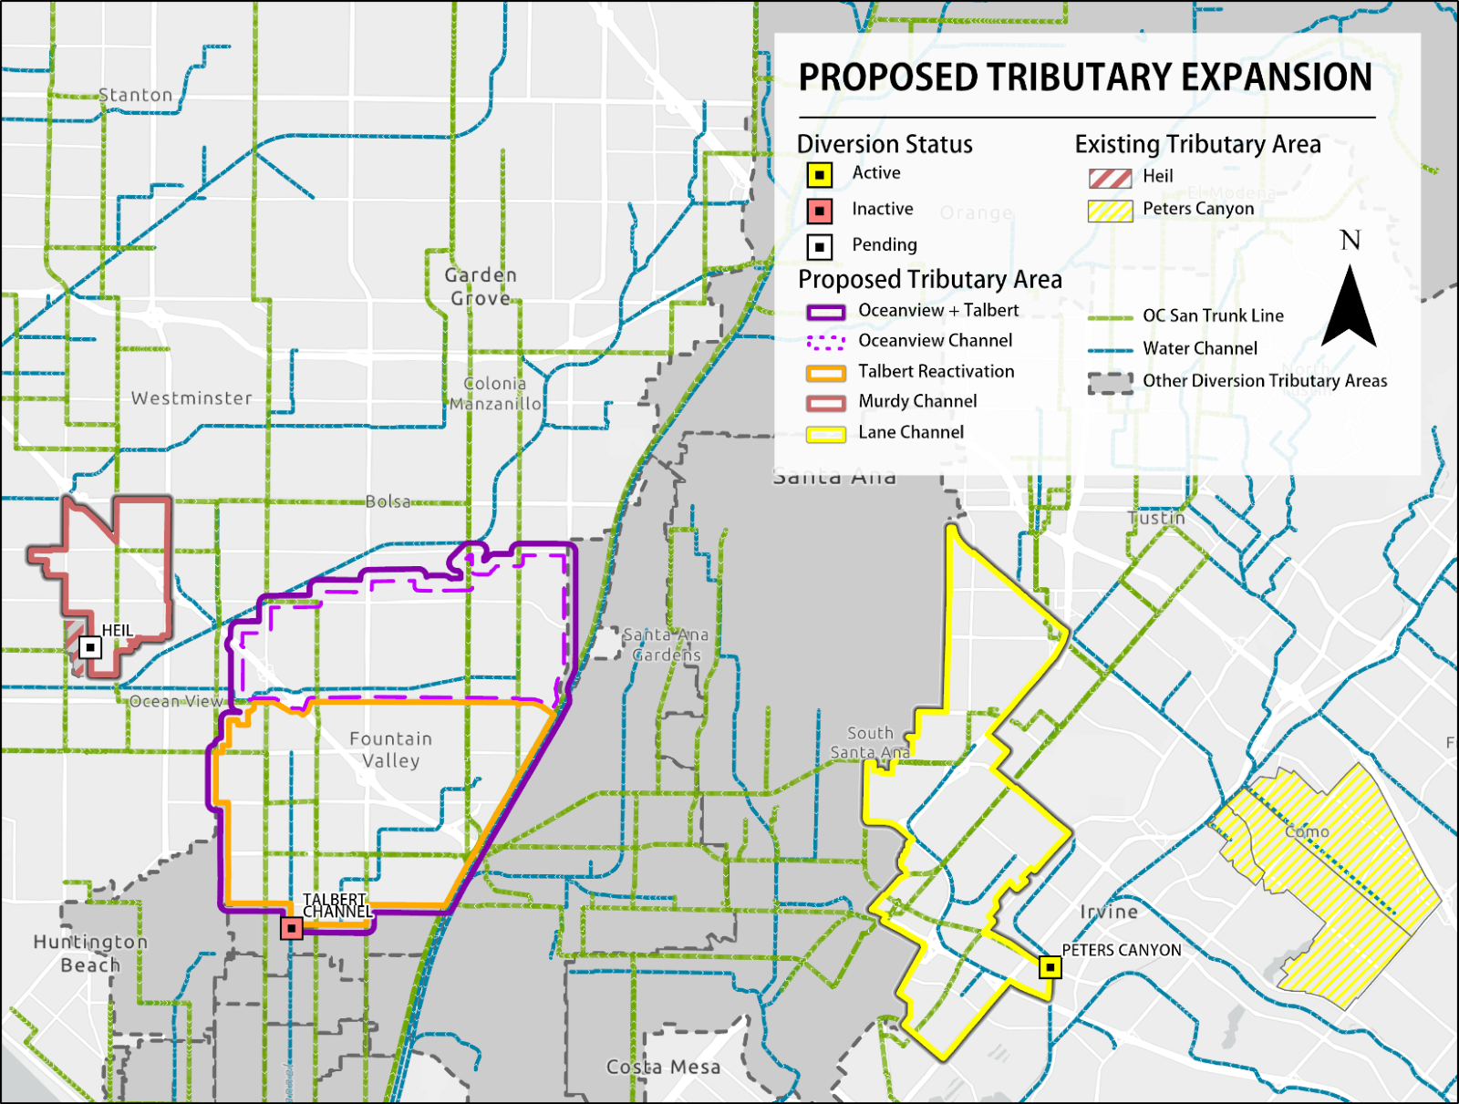
Optimization of Existing Diversions
Optimization Methods Evaluated
Decrease time diversions are offline
Reactivate decommissioned diversions
Expand tributary area
Modify diversion to connect with reclaimable line
Wet weather diversion locations evaluated (not currently OC SAN approved)

Slide 6
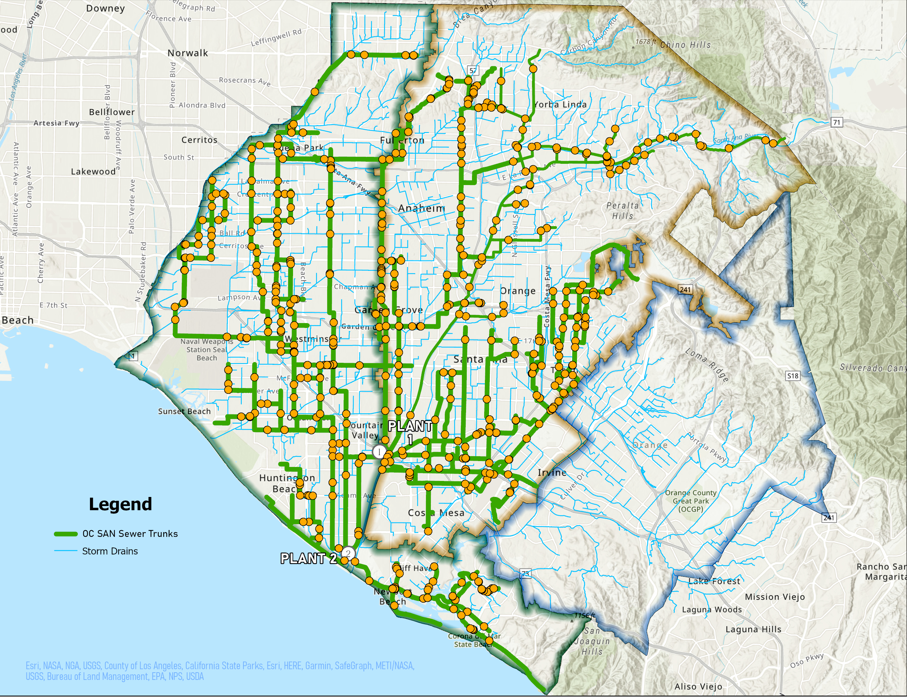
New Diversion Evaluation Process
Evaluated nearly 600 potential project locations (intersection of OC San and OCPW facilities)
Developed evaluation metrics
Dry Weather Volume
Water Quality (+/-)
Downstream Habitat
Tidal Influence
Project Cost
Scored and ranked viable projects

Slide 7
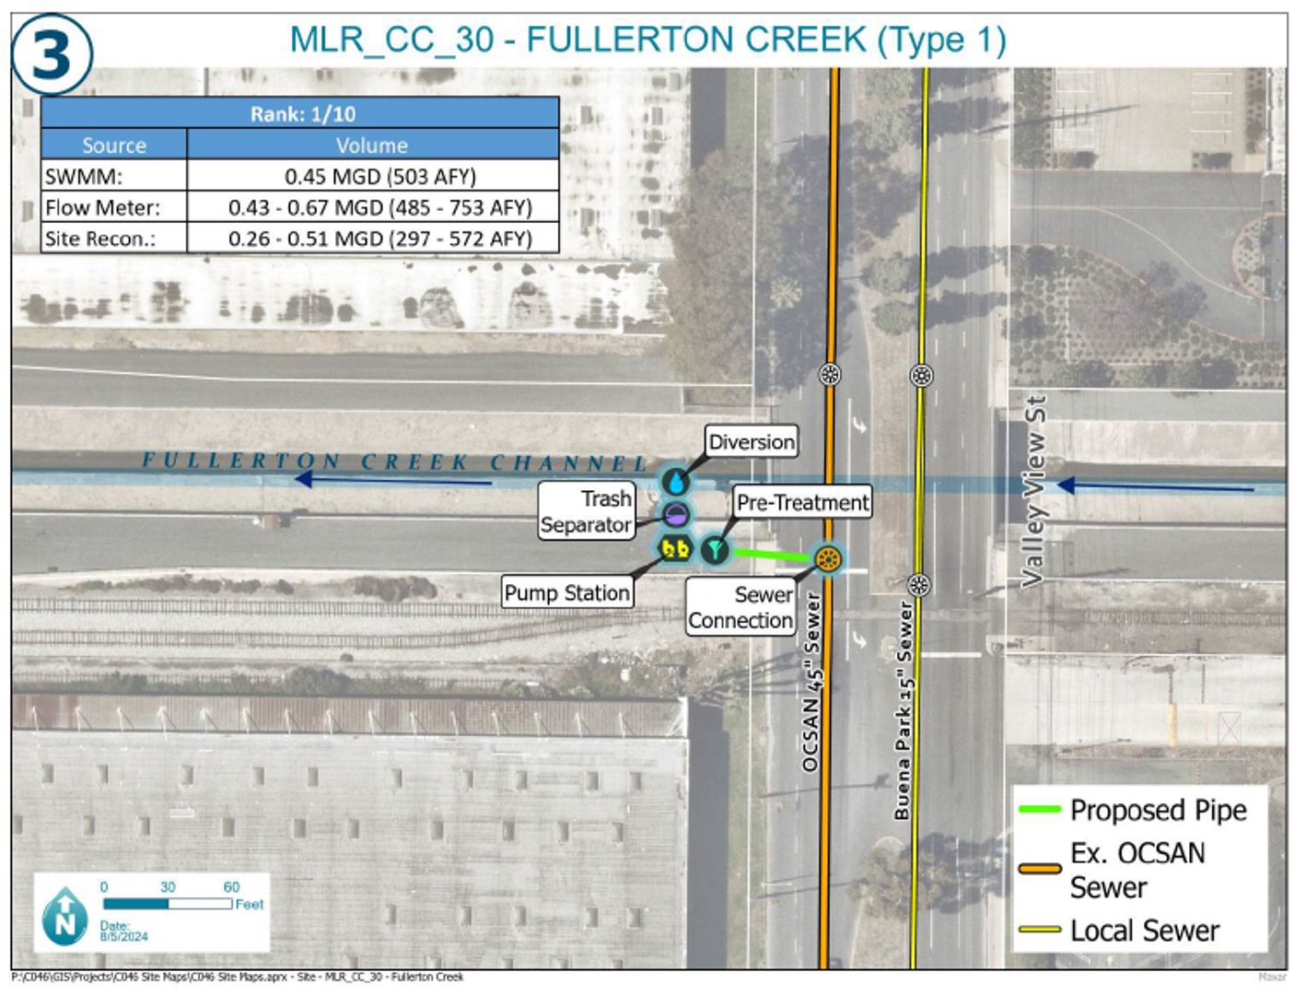
Highest Ranking Projects
Top ranking diversion projects proceeded to conceptual design (8)
Top ranking projects account for majority of remaining urban dry weather flow
If all top-ranking projects were constructed dry weather flow into OC San is estimated to double (6-7 MGD)

Slide 8
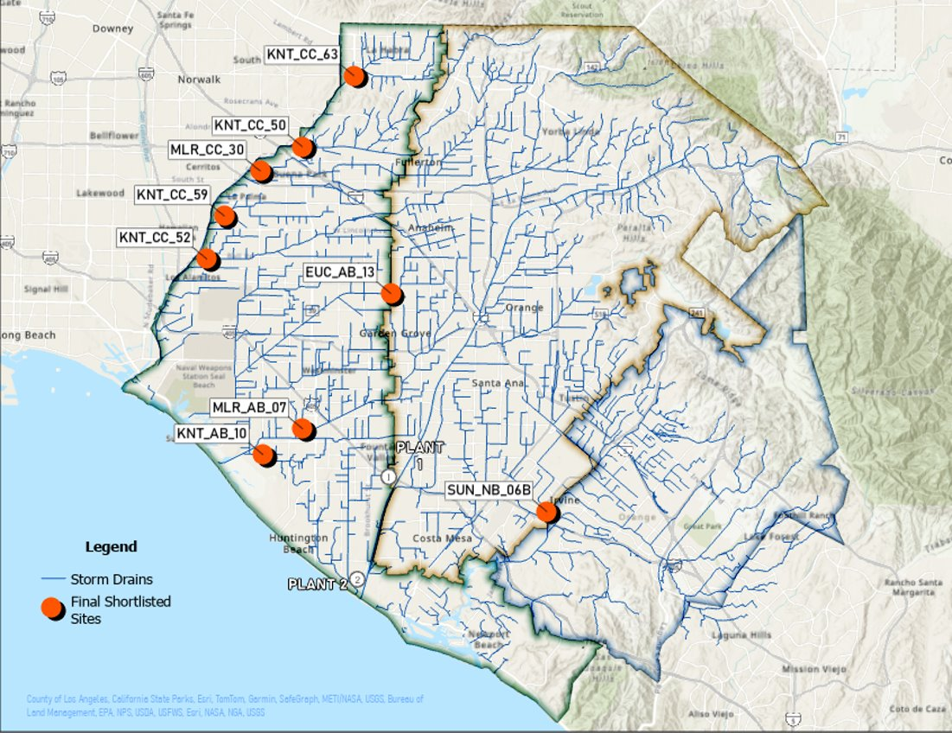
Next Steps
Finalizing conceptual designs for highest ranking dry weather projects
Create Cooperative Project Development Process
Develop Framework
Cost allocation
Funding opportunities
Develop OC San Ordinances
Final Report anticipated in 2025

Slide 9
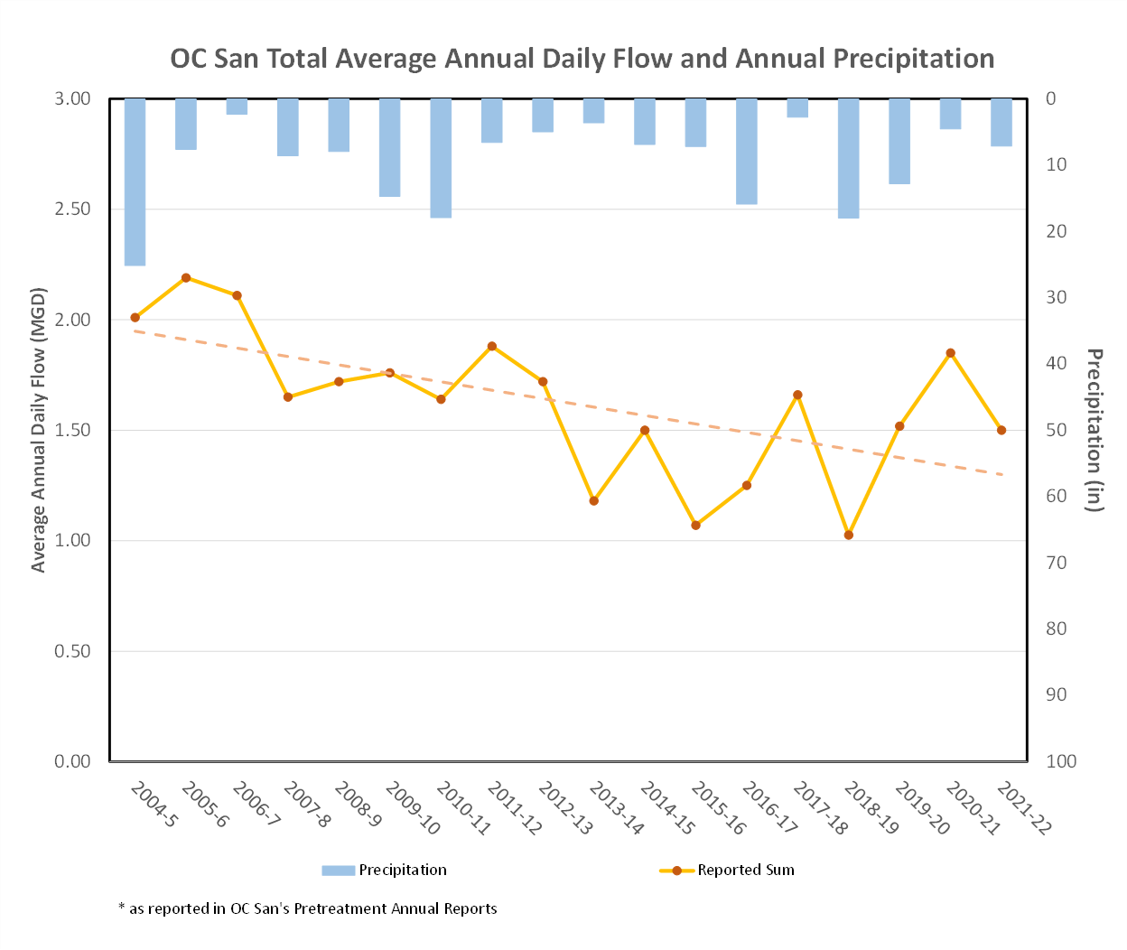
Important Reminders/Challenges
OC SAN can currently supply GWRS adequate volume of treated wastewater
Availability of dry weather urban runoff is decreasing
Obtaining 10 MGD of dry weather runoff likely not possible

Slide 10
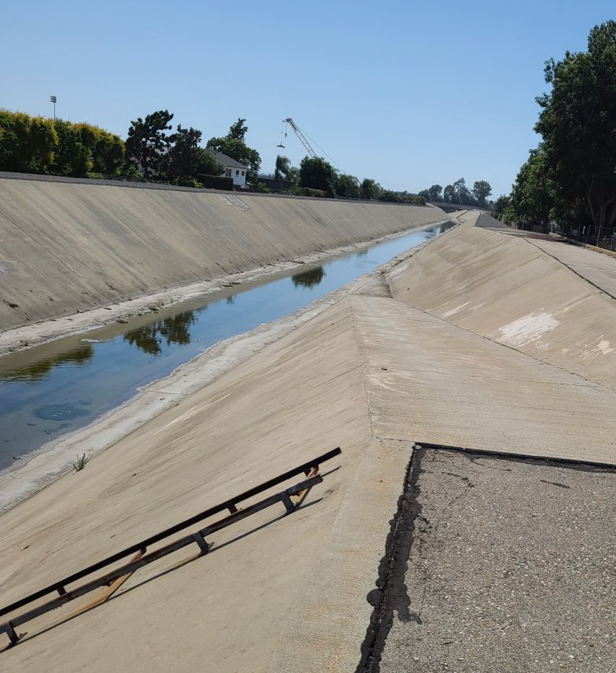
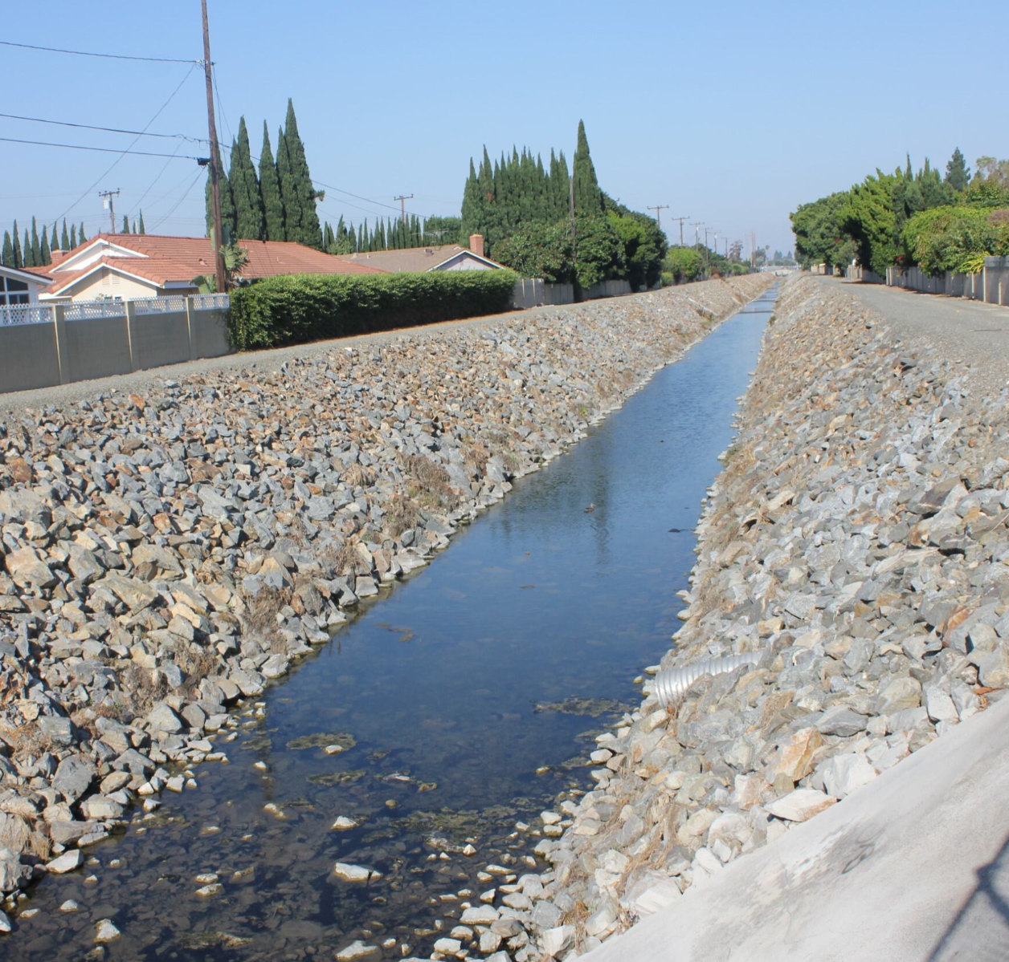
Summary
Dry weather diversions represent a potential GWRS source water should OC San flows decrease
Achieving 10 MGD of flow not likely
Report and conceptual design represents the first step in the process for potentially developing new diversions or optimizing existing diversions
OCWD will continue to advocate for urban runoff as a local water resource for groundwater recharge

Slide 11
Questions?
Kevin O’Toole
Senior Planner
Orange County Water District
KOToole@ocwd.com

Slide 12
Extra Slides

Slide 13
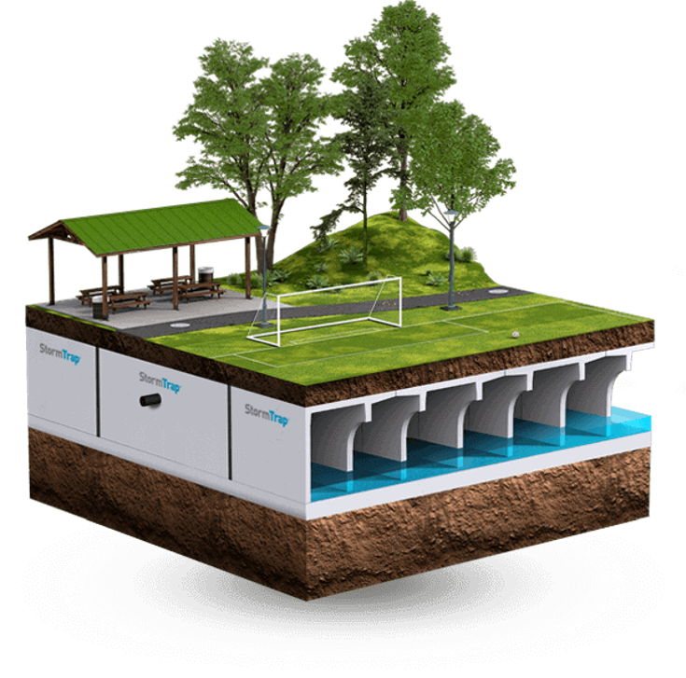
Wet Weather Diversions
Scoring and ranking system developed for wet weather diversions
Wet weather diversions would require storage infrastructure to hold and trickle into OC San – complicated and expensive
Many of the highest-ranking wet weather projects are also dry weather projects
Represents potential future study opportunity

Slide 14
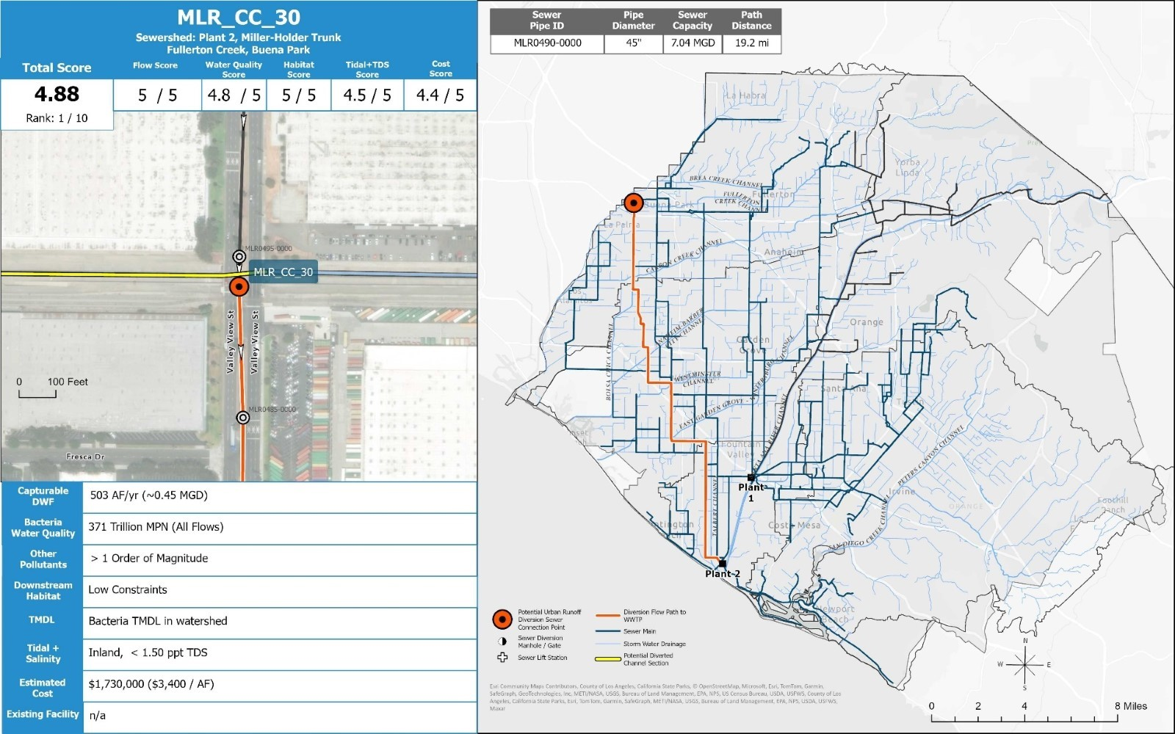

Slide 15
Urban Runoff Optimization Study Goals and Objectives
Promote water recycling, evaluate capacity of OC San and OCWD infrastructure, protect beneficial uses, improve water quality, and safeguard OC San's regulatory compliance
NOW
FUTURE
OC San
OCWD
MS4 Permittees
OCWD
MS4 Permittees
OC San
15

