Slide 1



Children’s Water Education Festival Update
Communications and Legislative Liaison Committee
August 7, 2025

Slide 2
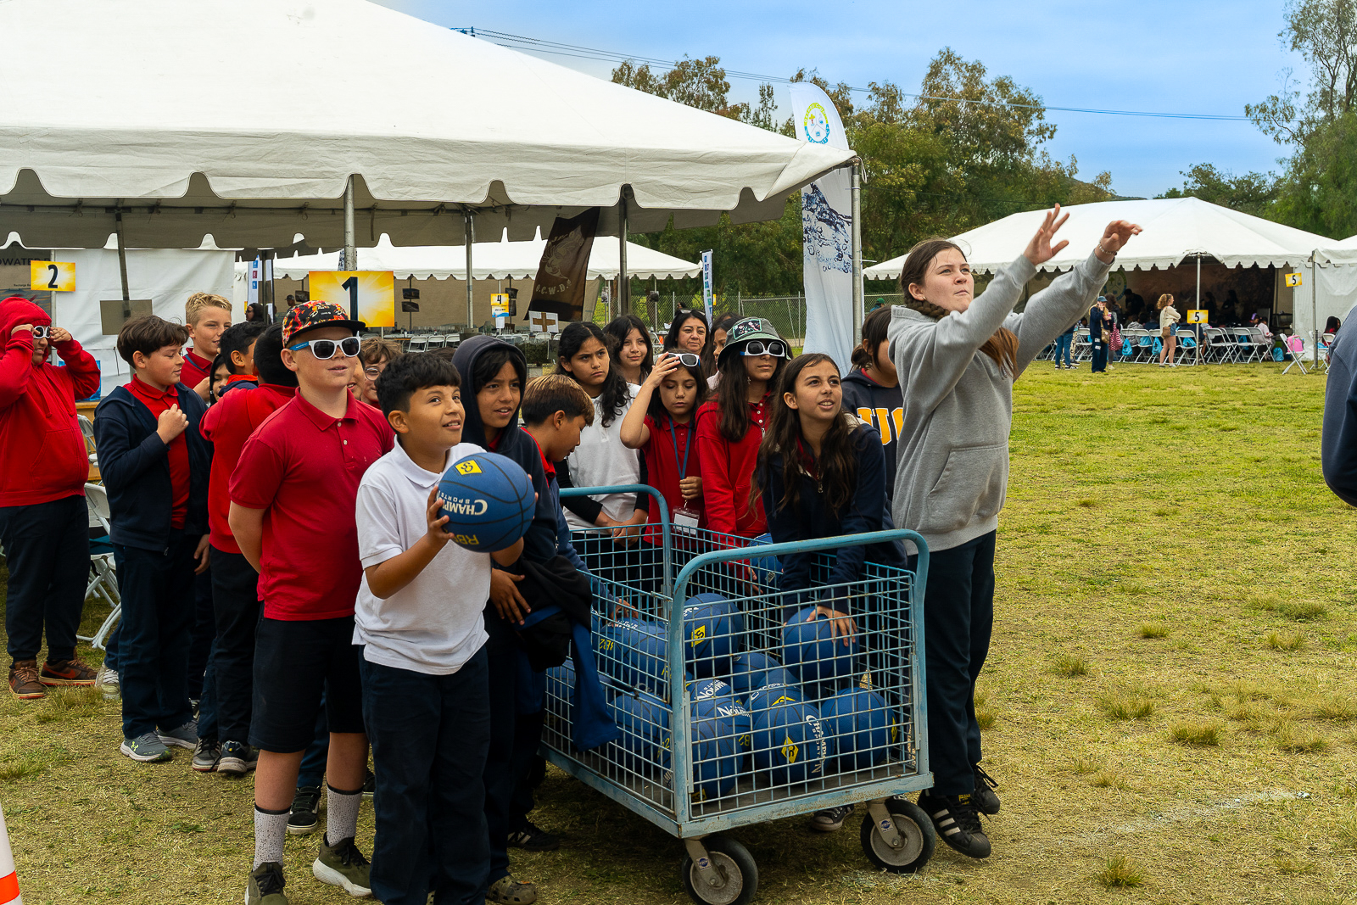
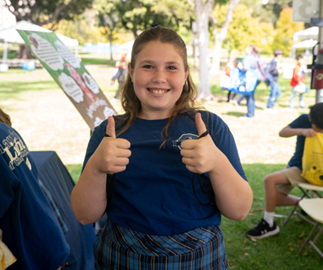
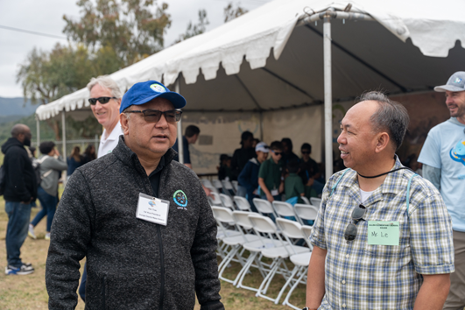
2026 Children’s Water Education Festival
OCWD’s largest event
  Over 158,00 students have attended since inception
29th anniversary
Structured field trip for 3rd, 4th and 5th grade students from schools across Orange County
  Students travel as a class to six presentations throughout the day
  Public, private, and home schools across Orange County

Slide 3
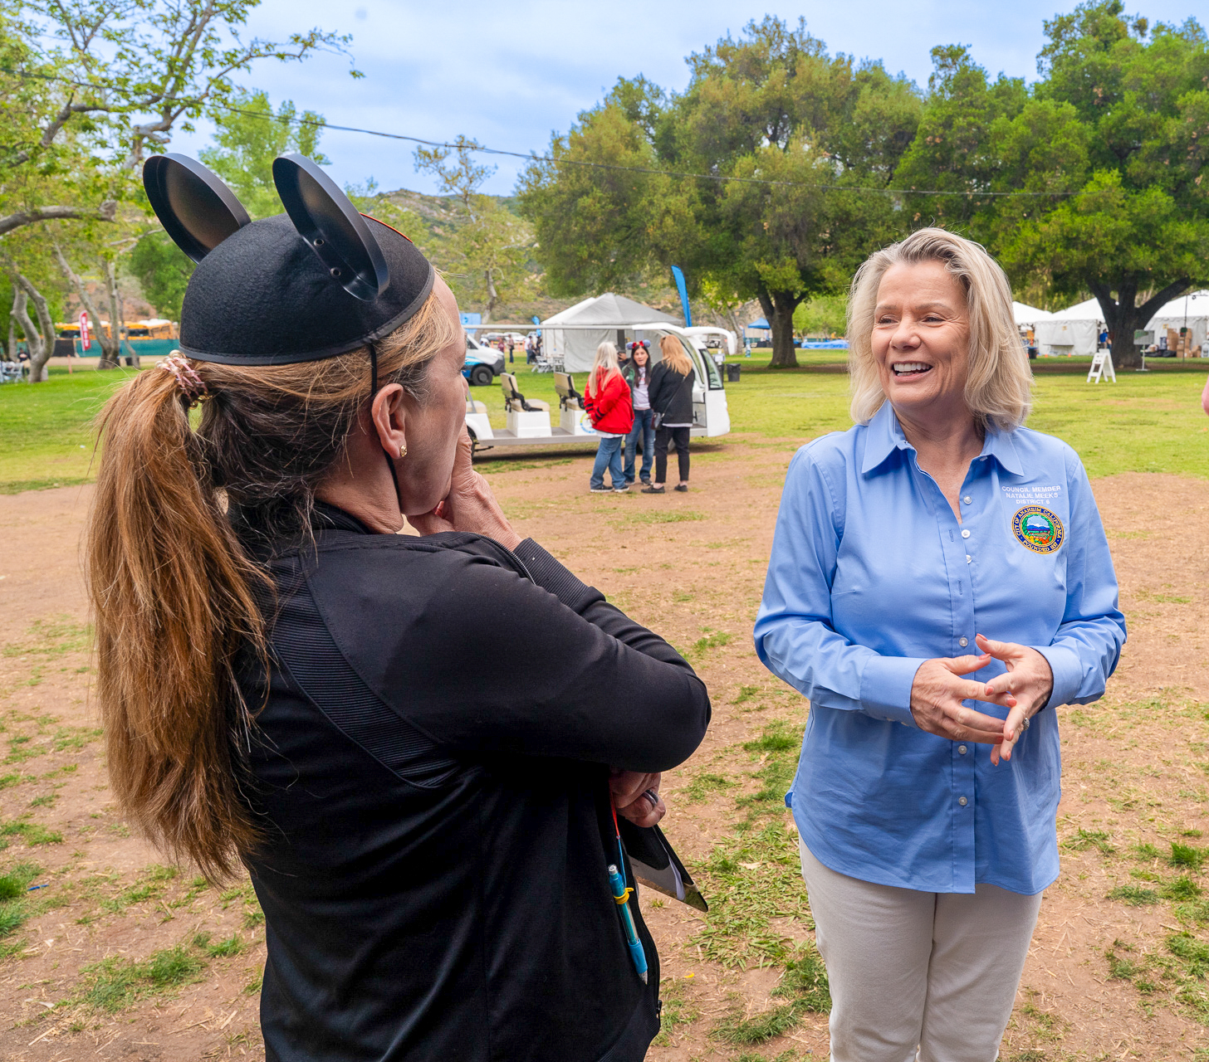
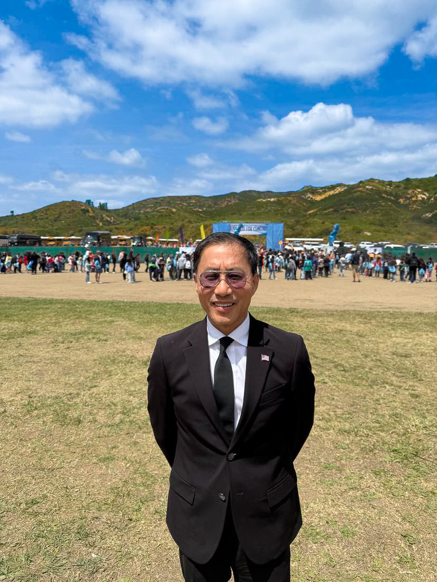
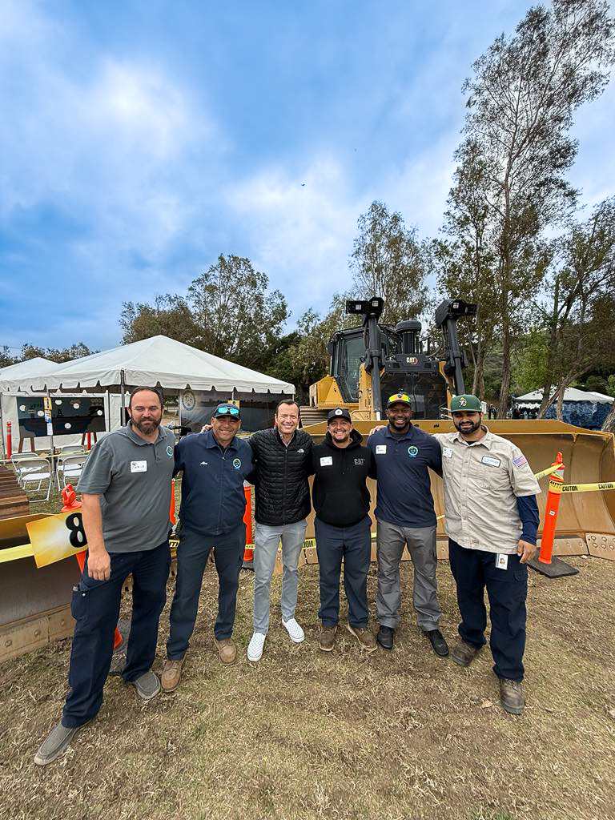
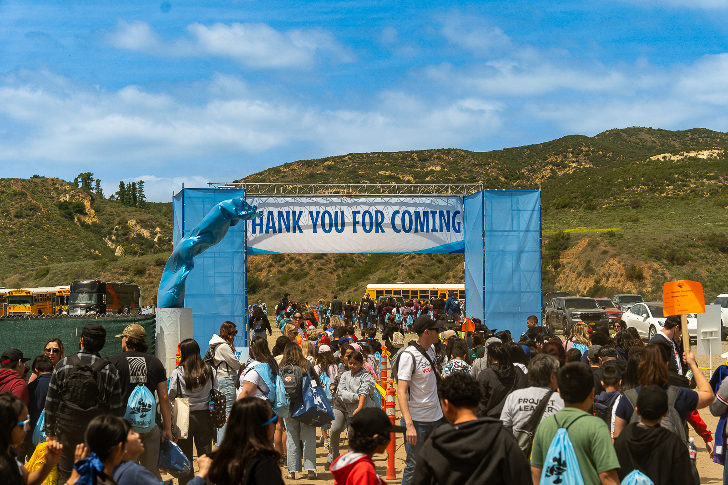
Venue Recommendation: Oak Canyon Park
Venue approved by the Board in 2024
Successfully hosted the 2025 Festival
Capacity for 7,500+ students and 1,600+ teachers, presenters, and volunteers
Ample bus and car parking
Scenic park setting
Venue available for preferred dates
Positive feedback

Slide 4
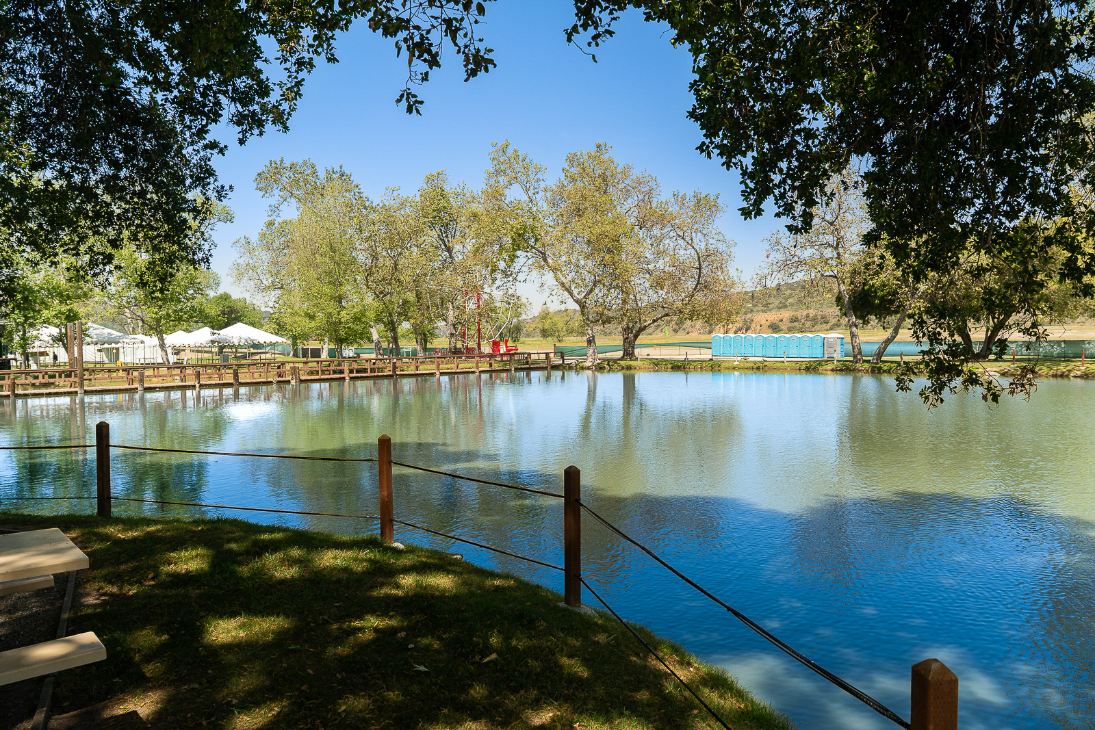
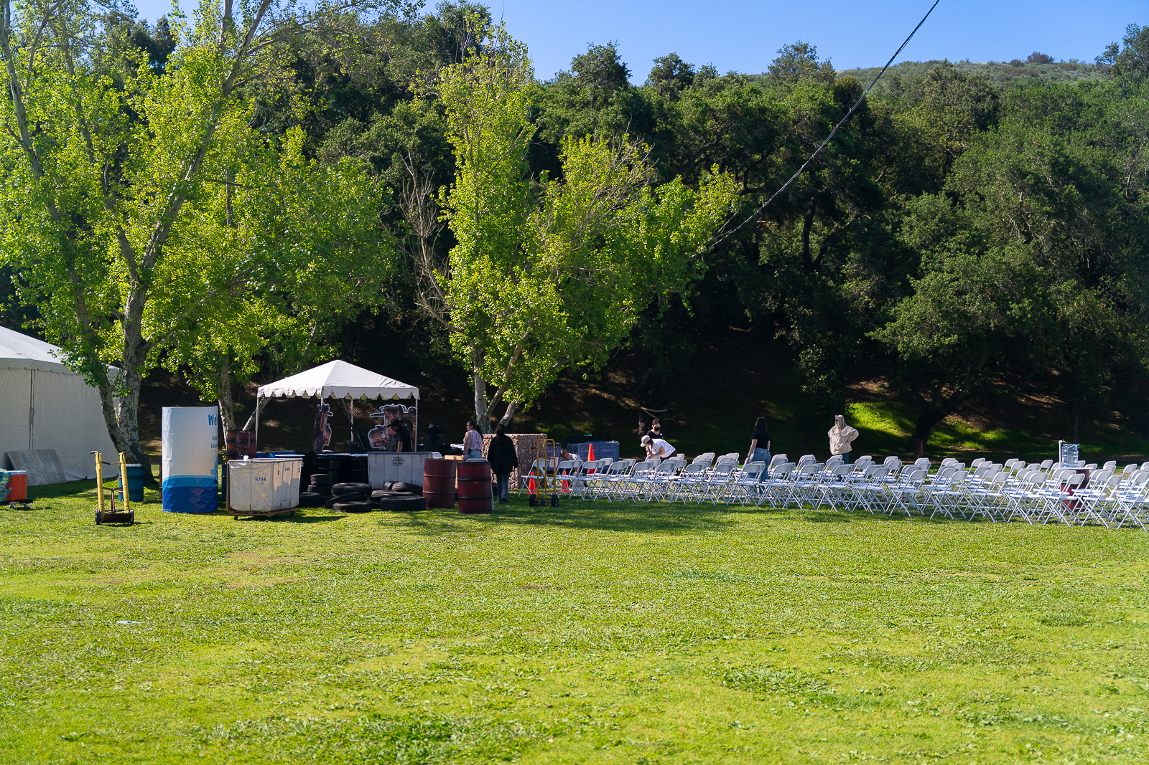
Event Services – James Events Productions, Inc.
Services include:
  Venue Management and maintenance
  Rentals (tents, tables, chairs, AV generators, golf carts, portable restrooms)
  Security, first aid
  Designated parking staff
  Onsite staffing during setup and event days
  Rain plan if necessary
  Year long planning support

Slide 5
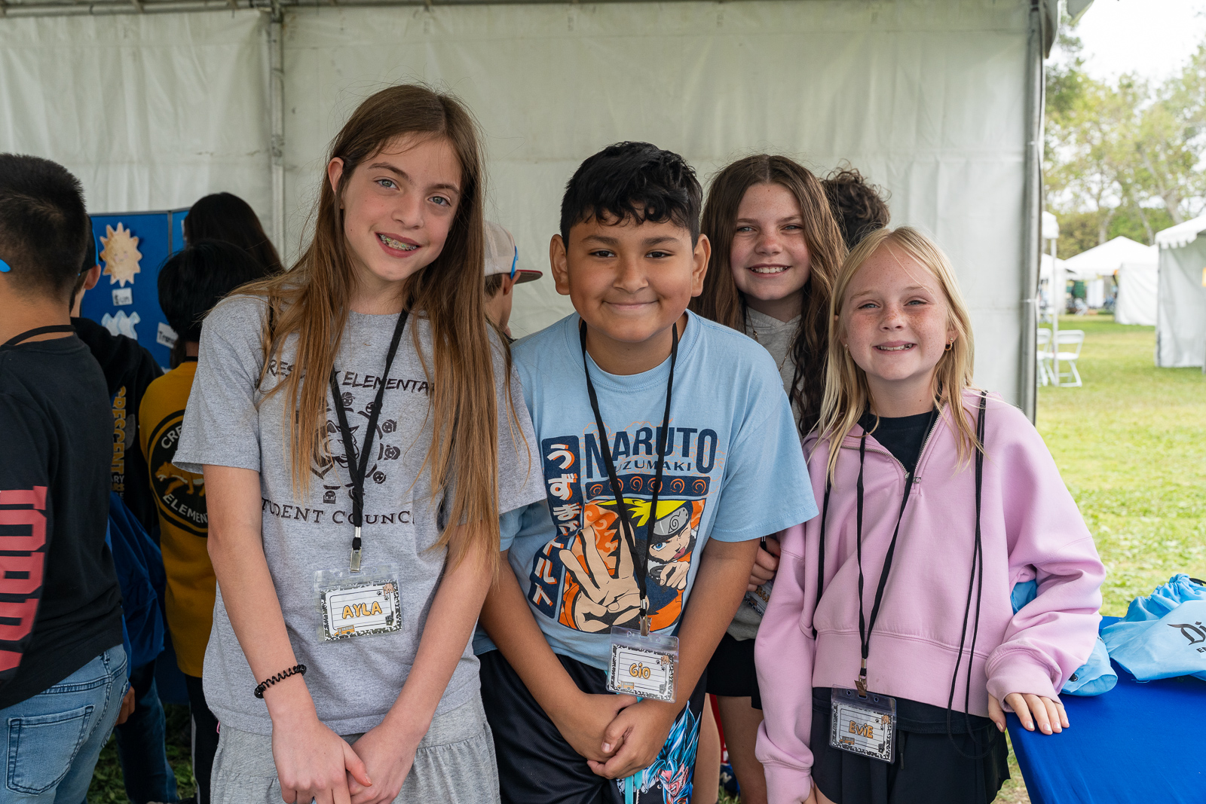
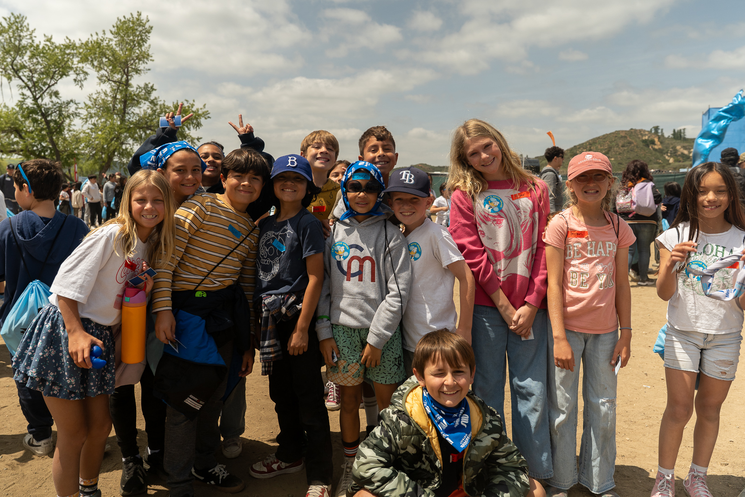
Date - Schedule Considerations
Proposed April 15-16 at Oak Canyon Park (Silverado)
Avoid spring breaks
Maximize school participation across all Board service areas
Staff reviewed over 100 public schools and previously attended private schools

Slide 6
Recommendation
Host the 2026 Festival at Oak Canyon Park on April 15-16
Authorize staff to execute an agreement with James Event Productions to provide rentals, event planning, and logistical support and services for the 2026 Festival for a combined total amount not to exceed $199,136
Authorize the general manager to approve an additional $25,000 to James Event Productions for a rain contingency plan, should extreme weather warrant it

Slide 7

OC Water Summit Update
Communications & Legislative Liaison Meeting
August 7, 2025

Slide 8
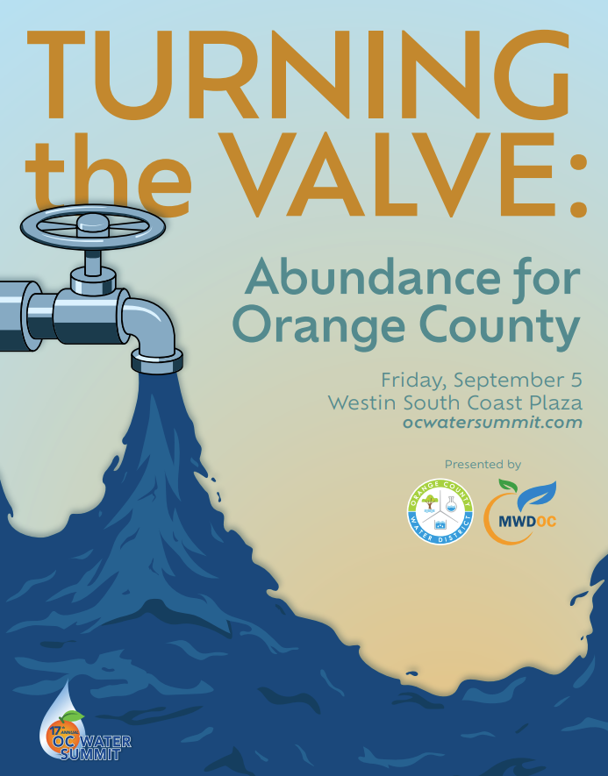
General Info
17th annual OC Water Summit
Friday, September 5
Westin South Coast Plaza
Theme: Turning the Valve: Abundance for Orange County
Master of ceremonies: Fritz Coleman
268 registrants
$50,400 raised in sponsorship

Slide 9
Sponsors
Presenting
OCWD
MWDOC
Luncheon
Mesa Water
Program
Irvine Ranch Water District
Audio Visual
Hazen
OC San
Associate
Butier Engineering
Exhibitor
ECORP Consulting, Inc.
Tripepi Smith
Speaker dinner
Rutan & Tucker, LLP
Tucker Ellis
Table
Anaheim Public Utilities
CDM Smith
Disneyland Resort
Dopudja & Wells Consulting
Irvine Ranch Water District
Metropolitan Water District
Michael Baker International
Moulton Niguel Water District
MWH Constructors
South Coast water District
WEEA Next Gen Workforce
Western Municipal Water District
Yorba Linda Water District

Slide 10
Program
7:00 Doors open / continental breakfast
8:00 Welcome
8:15 Session 1: Responding to PFAS: Balancing Protection, Policy & Practicality
9:15 Session 2: Is the State Prioritizing Abundant Water Supply?
10:15 Networking break
10:45 Session 3: Rethinking the Bay-Delta: Restoration with Benefits
11:45 Session 4: Getting Water on the Ballot
12:45 Networking lunch
1:30 Summit concludes

Slide 11
Speakers
Responding to PFAS: Balancing Protection, Policy & Practicality
Is the State Prioritizing Abundant Water Supply?
Moderator: Eric Sapirstein, president, ENS Resources
Sally Brown, PhD, research associate professor, University of Washington
G. Tracy Mehan, III, executive director, government affairs, AWWA
Jimmy Slaughter, principal, Beveridge & Diamond PC
Moderator: Craig Miller, general manager, Western Municipal Water District
Darcy Burke, board member, Elsinore Valley Municipal Water District
Ed Manning, partner, KP Public Affairs
Jennifer Pierre, general manager, State Water Contractors
Jason Phillips, chief executive officer, Friant Water Authority
Rethinking the Bay-Delta: Restoration with Benefits
Getting Water on the Ballot
Moderator: Stephen J. Faessel, board member, Metropolitan Water District
Emily Corwin, director of strategic initiatives, San Francisco Estuary Institute
Randall Neudeck, program manager, Bay-Delta, Metropolitan Water District
Curt Schmutte, consultant and Delta expert, Curt Schmutte Consulting
Moderator: Dr. Adam Probolsky, president, Probolsky Research
Jim Sutton, attorney, Rutan & Tucker, LLC
Ace Smith, partner, Bearstar Strategies

Slide 12
Public Affairs Outreach Report
Communications & Legislative Liaison Meeting
August 7, 2025

Slide 13
July Outreach Highlights
19,500+
social media followers
  111,560,000+
  global media reach
28,700+
social media post impressions
23,400+
website page views
5,000+
electronic reach
22,500+
virtual tour views (to date)
277
tour guests

Slide 14
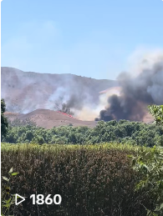

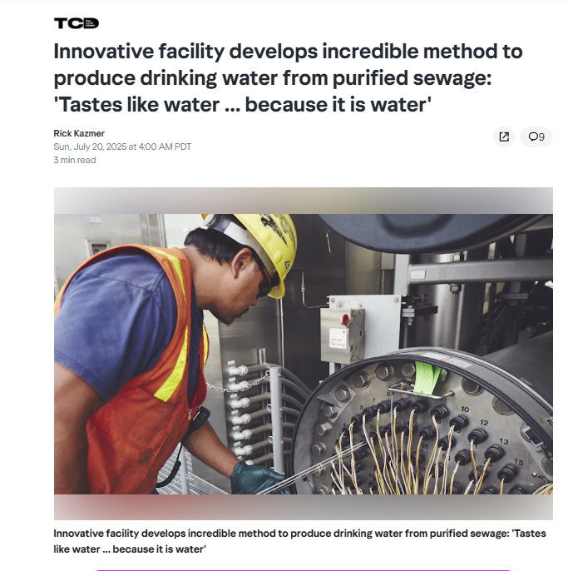

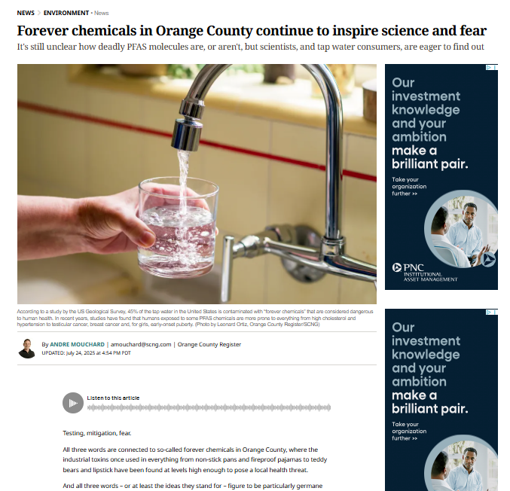


Media Highlights

Slide 15
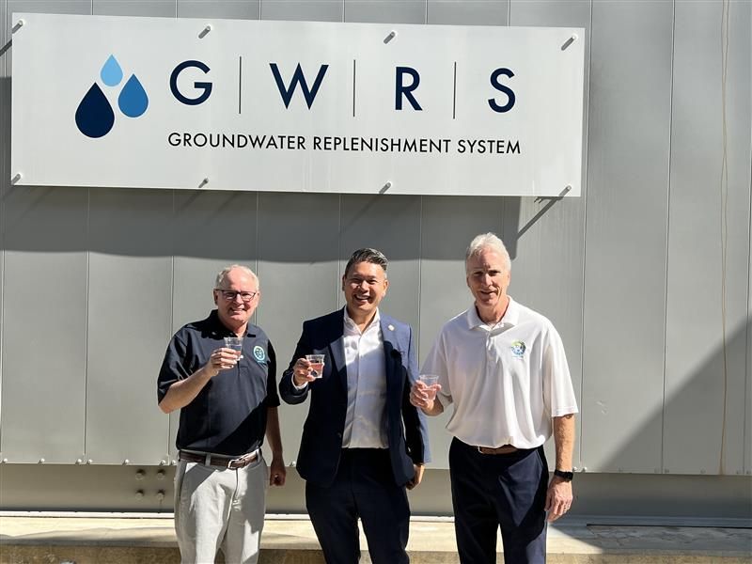
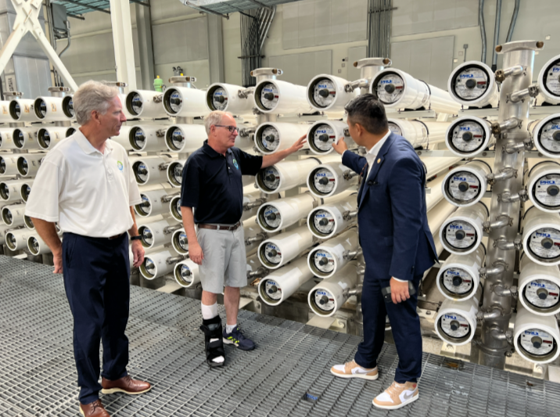
Congressman Tran Briefing and Tour

Slide 16
Upcoming Events and Meetings
August 18
September 5
DWR Briefing and Tour
OC Water Summit
September 19
September 25
IRWD PFAS Treatment Plant Dedication
Employee Groundwater Adventure Tour
October 20
October 23
Denis Bilodeau DC Visit
Public Groundwater Adventure Tour
October 28
Webinar on OCWD Monitoring Wells

Slide 17
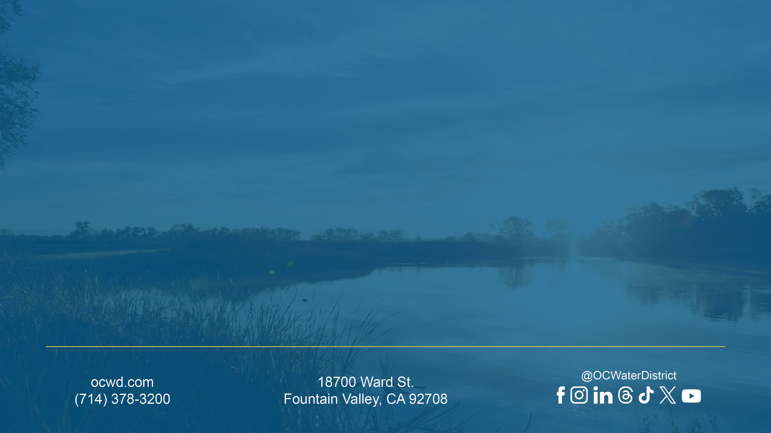
Thank You!
Notes:
Internal presentations – use this closing slide. Updated May 29, 2024

