Slide 1

Anaheim Lake House
October 24, 2025

Slide 2
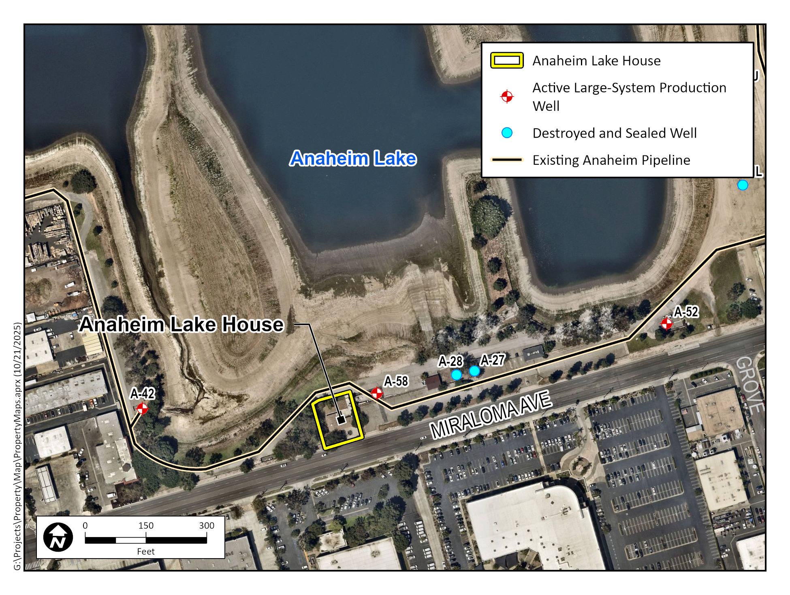
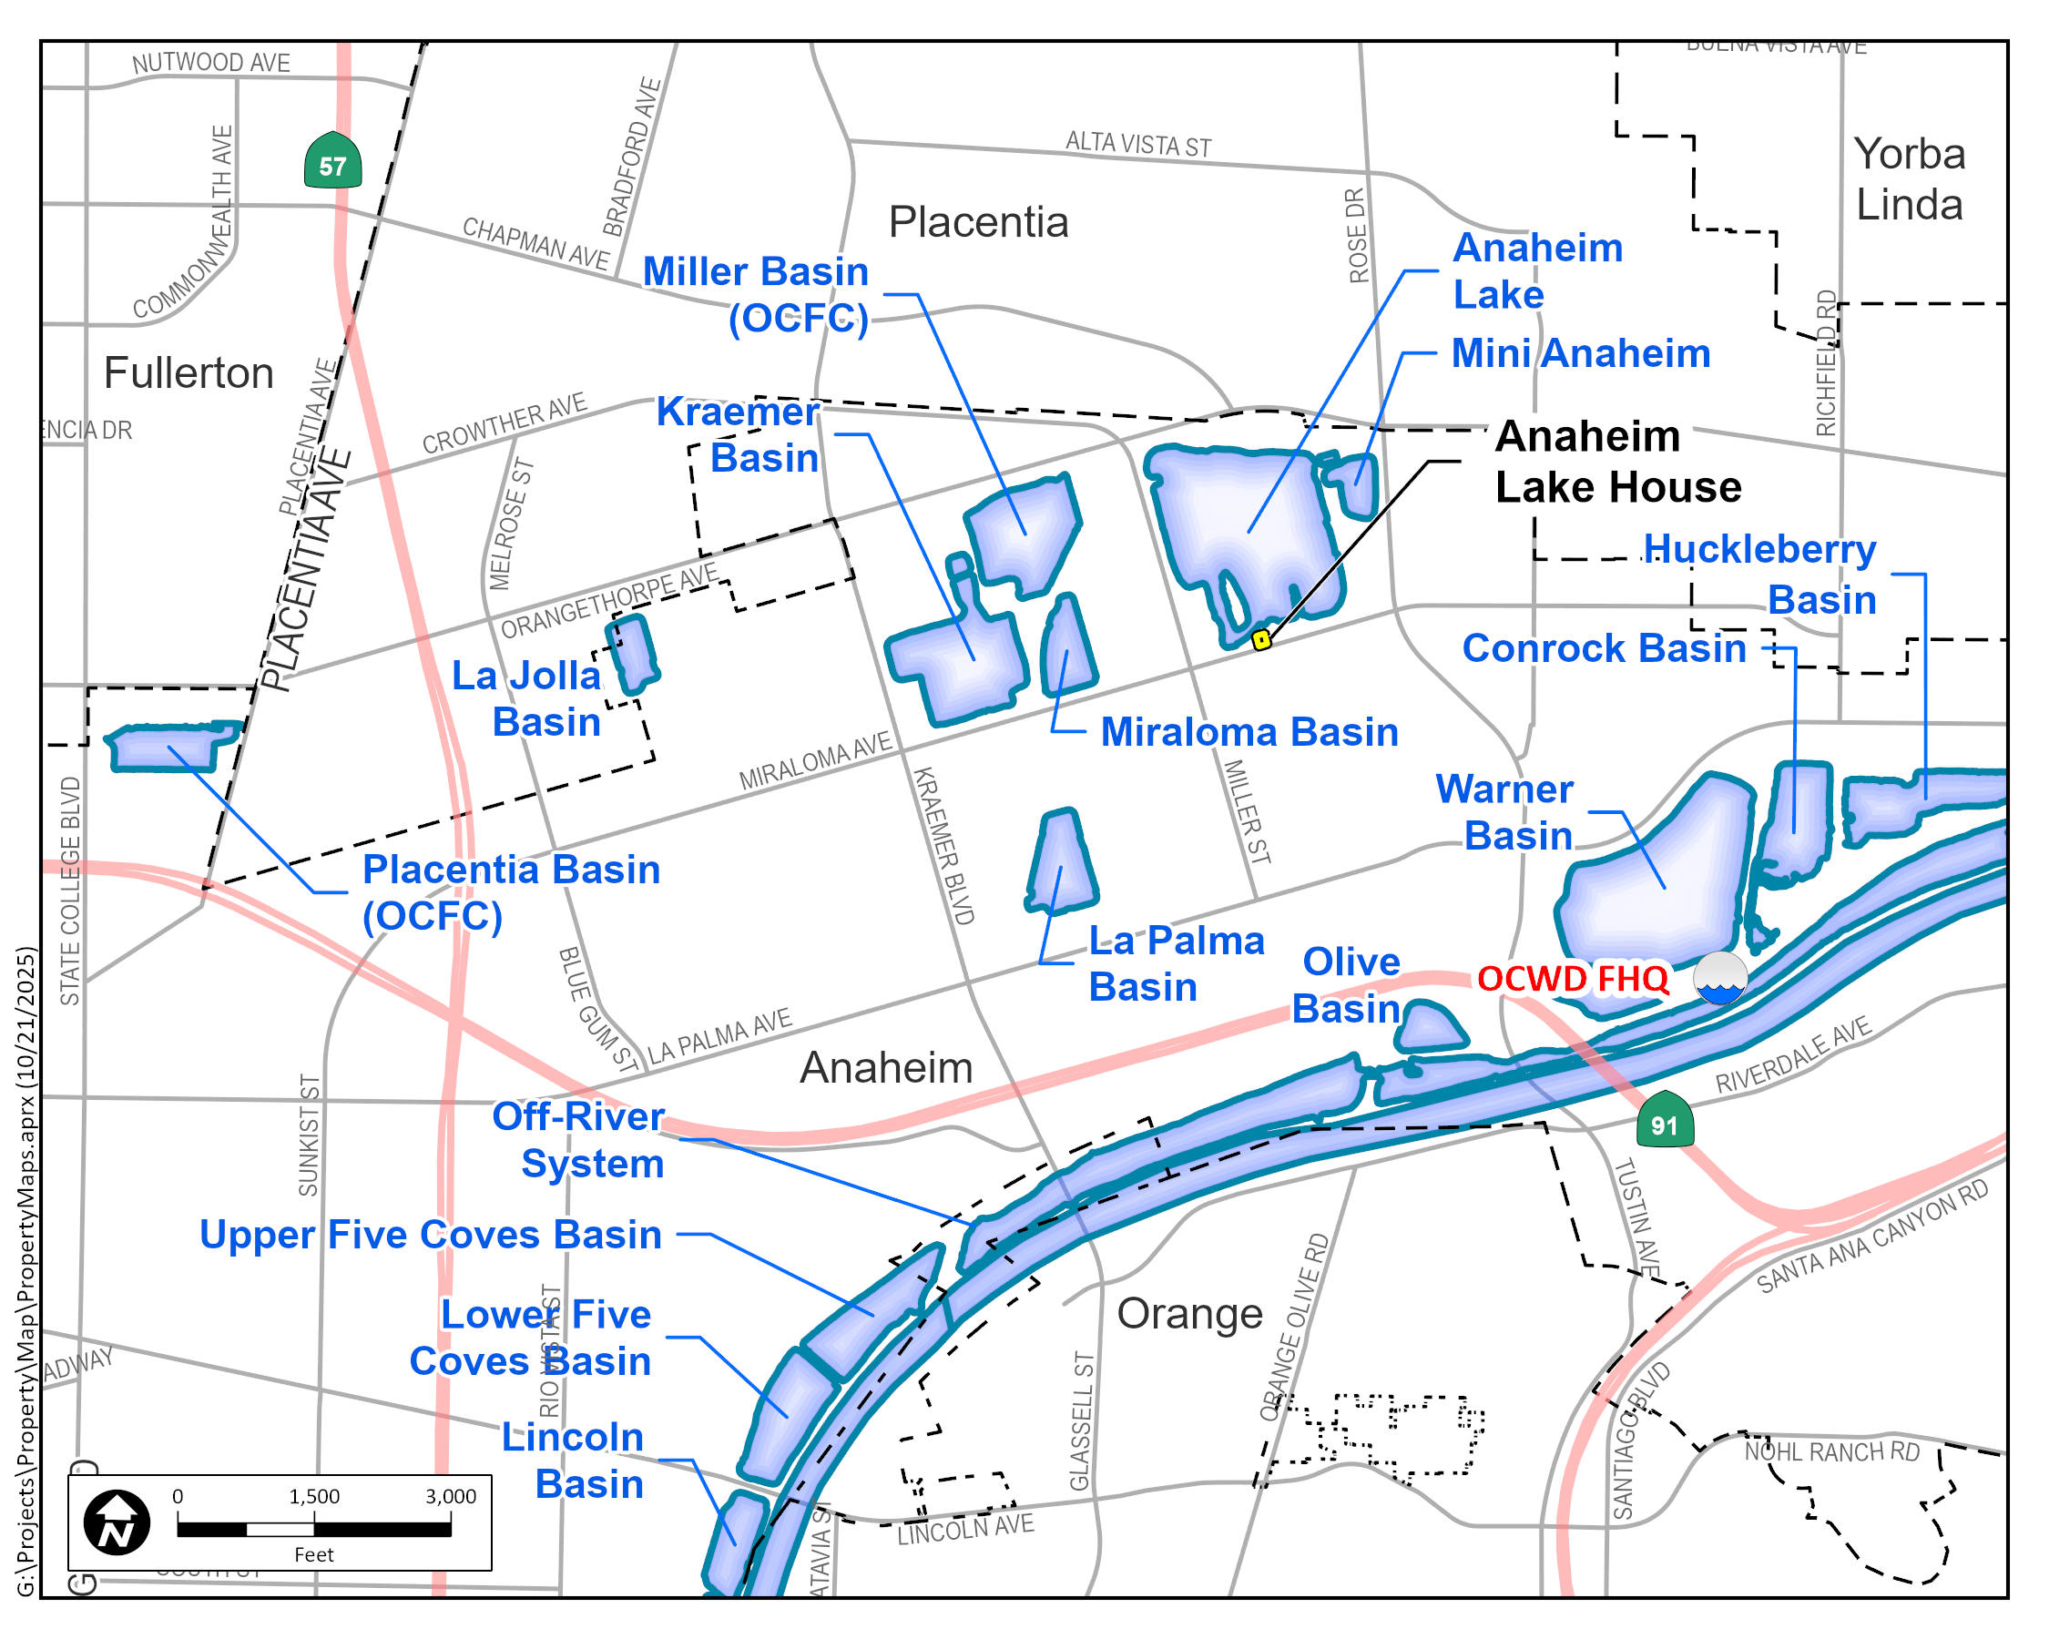
Property Background
Millions
District-owned vacant house at 3435 E. Miraloma Ave., Anaheim (APN 345-142-03)
~1,400 sq. ft., built 1958–59 for caretaker residence at Anaheim Lake
Leased to Corona Recreation, Inc. (2006–2020) for storage
Fiscal Year Ending

Slide 3
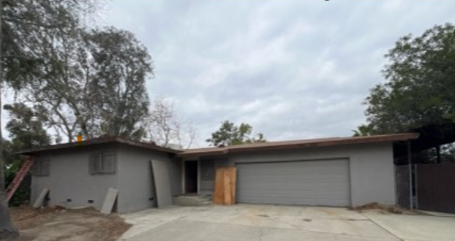
Vacant since 2020
2025 home inspection: Requires extensive repairs, high mold levels
Repair estimate: ~ $130,000 (likely understated)
Current Condition

Slide 4
Zoning FindingsElements
Zoning: DA-6 “Open Space/Water” (Anaheim Canyon Specific Plan)
No Residential and Commercial uses are limited under DA-6
Residential use may be allowed as a nonconforming use if the property's last permitted use was residential
City Building Division: no permits found →

Slide 5
City Guidance
Without documentation, structure treated as new construction
Future use must comply with current zoning & building codes
Public agency use may allow greater flexibility
Private use (commercial) must align with DA-6 permitted uses

Slide 6
Potential Options
Option | Description
1. Repair & Lease | Rehabilitate for DA-6 permitted uses low-impact recreation, automotive parking, caretaker unit, R&D facility) Conditional Uses (animal boarding and grooming, warehousing and storage, wholesaling, plant nurseries, restaurants)
2. Demolish & Landscape | Remove structure; landscape or basin-support features
3. Variance/Zoning Change | Request amendment for uses not listed in DA-6

Slide 7
Potential Next Steps
Clarify intended use to guide path forward
Initiate Project Evaluation Permit (PEP) – starting fee: $355
City inspection to confirm building code and zoning compliance or required permits and/or removal of structures
Direct staff as appropriate

Slide 8
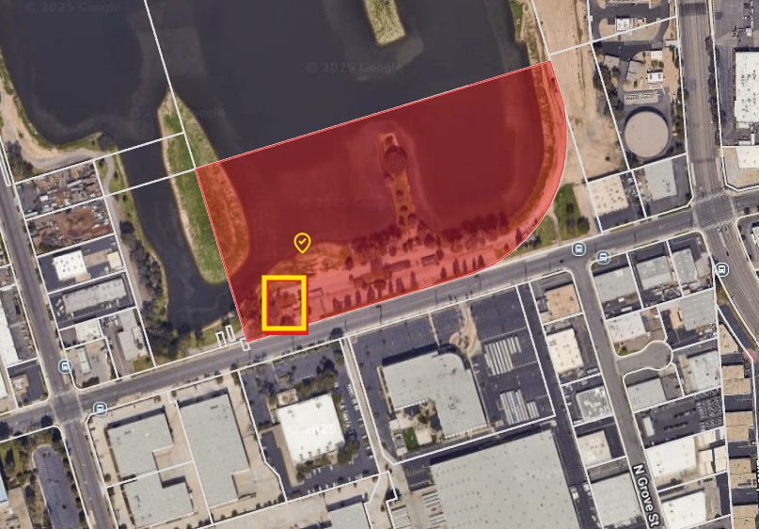
Parcel Map

