Slide 1


Update on R&D Activities
Board of Directors Meeting
February 21, 2026

Slide 2
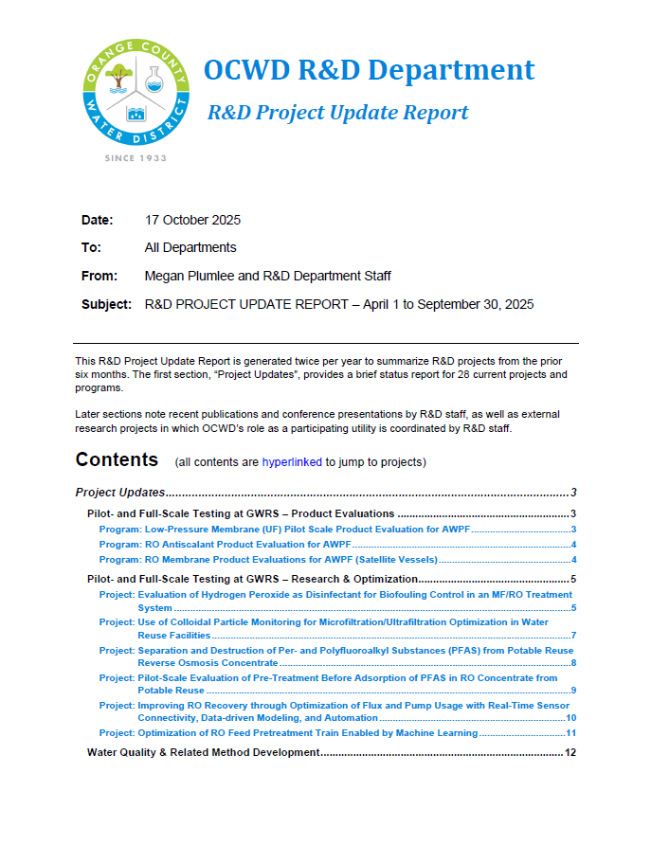
Biannual R&D Summary Report
Issued most recent Biannual Report in October →
Attached to staff report for this item today
Highlights 28 current programs and projects
Programs: recurring, continuous efforts
Projects: studies lasting typically 1 to 3 years
Notes:
R&D Department work can be categorized as: PROGRAMS and PROJECTS

Slide 3
Current Programs
Low Pressure (UF) Membrane Product Evaluations
RO Membrane Product Evaluations (Satellite Vessels)
RO Anti-Scalant Product Evaluations
PFAS Removal Media (Adsorbent) Product Evaluations for Producer Treatment Systems
Notes:
Program = sustained area of testing or study that we’ll maintain so long as it continues to be useful; whereas, projects (NEXT SLIDE) are one-off’s 1-3 years each

Slide 4
Current Projects
Membrane Performance Optimization for Potable Reuse
Evaluation of Hydrogen Peroxide as Alternative to Chloramine Disinfectant for MF/UF/RO (OCWD, Stanford U.)
Colloidal Particle Monitoring to Optimize MF/UF (OCWD, Kennedy Jenks, Hyperion Analytical)
Platform for Dynamic Monitoring & Characterization of RO Biofouling (U Texas Austin, Rice U., OCWD)
Hydrocyclone/Coagulant Pilot for Pretreatment of RO Feedwater (UCLA, CA State U San Bernardino)
PFAS – Treatment and Measurement
Separation and Destruction of PFAS from Potable Reuse Reverse Osmosis Concentrate (OCWD, Ovivo, Kennedy Jenks)
MIEX Pre-Treatment Before Adsorption of PFAS in Reverse Osmosis Concentrate (Kennedy Jenks, OCWD, Valley Water, CO School of Mines)
Scaling Up a Field-Deployable Water Sampling Device to Rapidly Screen Adsorbable Organic Fluorine In Situ (Forever Analytical, OCWD)
Estimating PFAS using Total Fluorine Methods in Pilot-Scale Adsorption for Drinking Water (Groundwater) (OCWD, DDW)
Supercritical Water Oxidation (SCWO) Destruction of PFAS Concentrated Spent Media (OCWD, various vendors)
Groundwater Recharge & Optimization
In-Situ Removal of PFAS During Managed Aquifer Recharge (OCWD, CO School of Mines, Kleinfelder)
Online Dashboard for Groundwater Recharge: Monitoring Flow and Pond Level At-a-Glance (OCWD)
Digitalization of Water Treatment to Improve Efficiency and Reliability
GWRS RO Plant Dashboard Trial with RO Recovery Modeling and Optimization (Hazen, OCWD)
GWRS RO Plant Dashboard Development Incorporating Shewhart Sign Test Statistical Approach for Evaluating Water Quality for TOC LRV (Carollo, OCWD)
Process Twins for Decision-Support and Dynamic Energy and Cost Prediction in Water Reuse Processes (UC Irvine, OCWD)
PFAS Treatment Facilities Dashboard (OCWD)
Water Quality & Regulatory Compliance for Potable Reuse
Advancing Traditional Microbial Monitoring using the MinION Long-Read DNA Sequencer (OCWD)
Evaluating MF / UF Virus Log Removal Measured Using Quantitative Polymerase Chain Reaction (qPCR)
Soil Aquifer Treatment (SAT) Virus Log Removal Values (LRVs) for Project-Specific GWRS Credit (OCWD)
Notes:
As of 4/2025. FR-RO not shown since recently completed / “done” from R&D perspective

Slide 5
Today’s Highlighted Updates
New research grant awarded for GWRS microbial water quality study
PFAS Treatment Facilities data dashboard
Ongoing project to demonstrate PFAS destruction using vacuum UV (VUV)

Slide 6
Modernizing Microbial Monitoring in Potable Reuse
Research grant from USBR

Slide 7
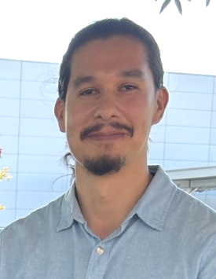
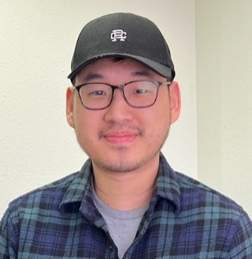



New grant: Modernizing Microbial Monitoring for Potable Reuse
District R&D Team
USBR Desalination and Water Purification Research Program ‘Pitch to Pilot’
16-mo project initiated December 2025 ($200,000)
Project team:
Objective: modernize microbial monitoring via advanced molecular biology techniques (eDNA sequencing & ddPCR), to improve characterization of microbial populations and measure virus log removal across GWRS
Julio Polanco
Andrew Huang
Virus Indicators:
PMMoV (pepper plant virus)
crAssphage (bacterial virus)
x
x
x = Non-detect (ND)
x = Non-detect (ND)
* = Non-detect (ND)
Notes:
Dr. Kyle Bibby (University of Notre Dame) and Dr. Amy Pruden (Virginia Tech).
we will be reporting log removals of PMMoV, crAssphage, adenovirus and MS2.
For this study, ddPCR data will include both PMMoV and crAssphage data with lower detection limits.

Slide 8
PFAS Data Dashboard
In-House Collaboration of R&D and IS Departments

Slide 9
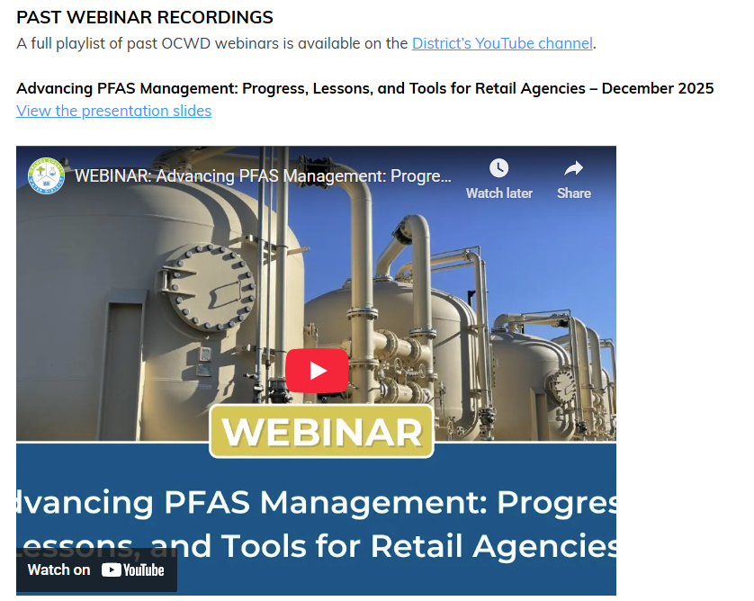
OCWD webinars
https://www.ocwd.com/news-events/water-webinars/

Slide 10

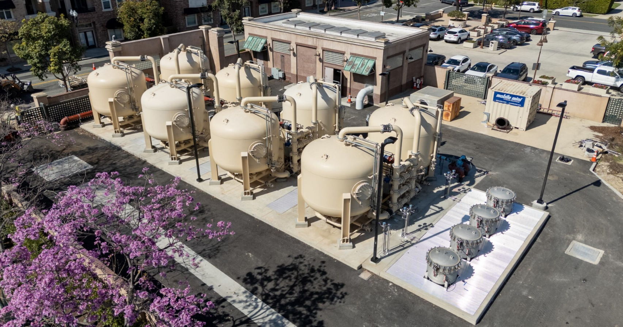
Improving PFAS data accessibility via in-house dashboard
District R&D Team
Andrew Huang
With several PFAS facilities in operation, managing and analyzing large volumes of monitoring data has become increasingly complex
Staff built a PFAS “dashboard” in-house to enhance staff workflow efficiency and data accessibility
City of Tustin – Centralized Plant

Slide 11
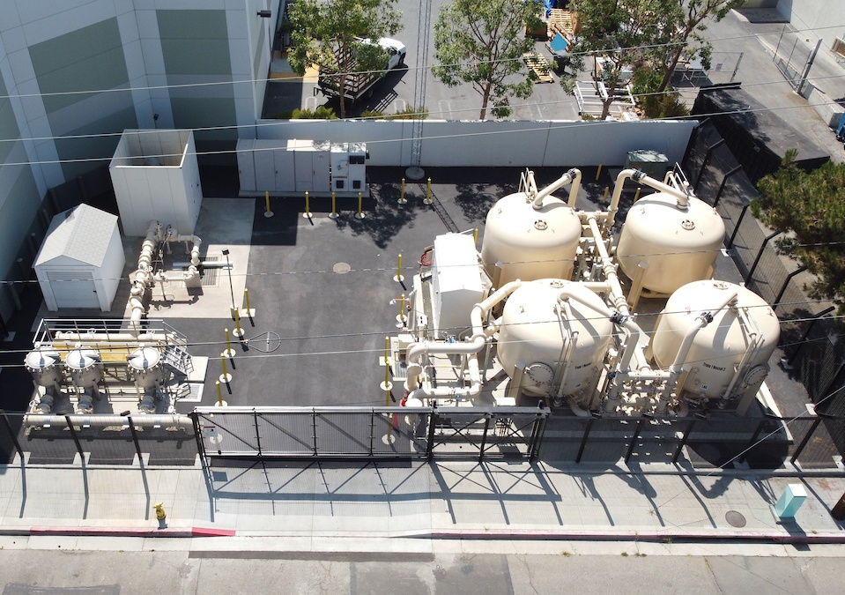
PFAS Treatment Facilities Configuration
Treatment vessels are loaded with IX or GAC media
OCWD Lab analyzes permit-required samples collected by WQ Department to monitor treatment performance
Water goes through two treatment vessels in series, called a lead-lag configuration
Lead vessel monitoring serves as an indicator for when to replace the media
LEAD
LAG
Notes:
Treatment vessels are loaded with ion exchange media which has a finite adsorbent capacity
Lead vessel serves as an indicator. Ion exchange media is changed when lead vessel is exhausted of its adsorptive capacity

Slide 12
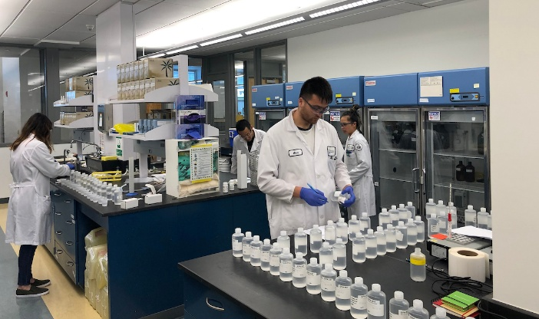
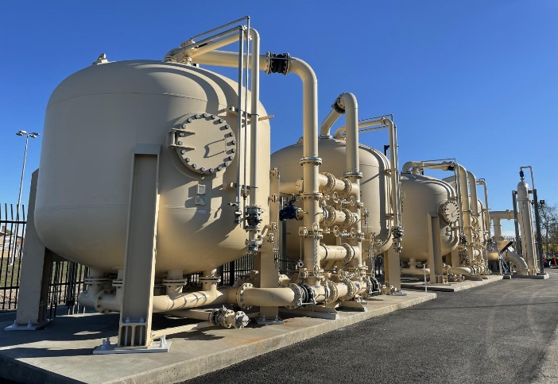
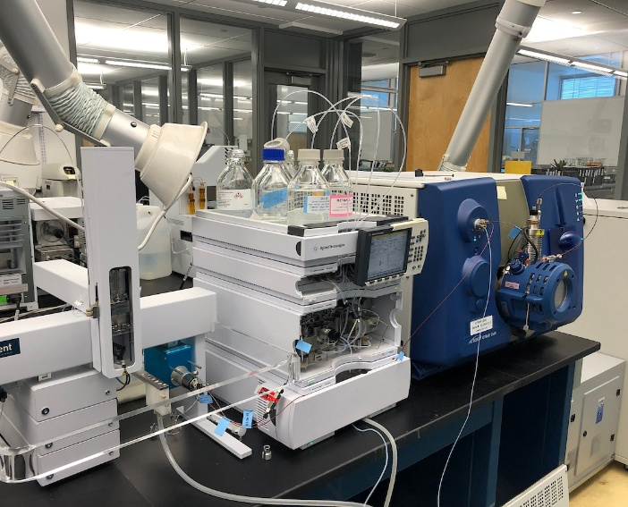
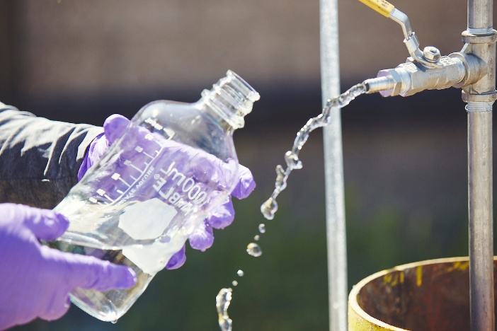
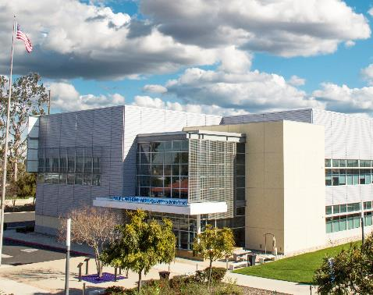
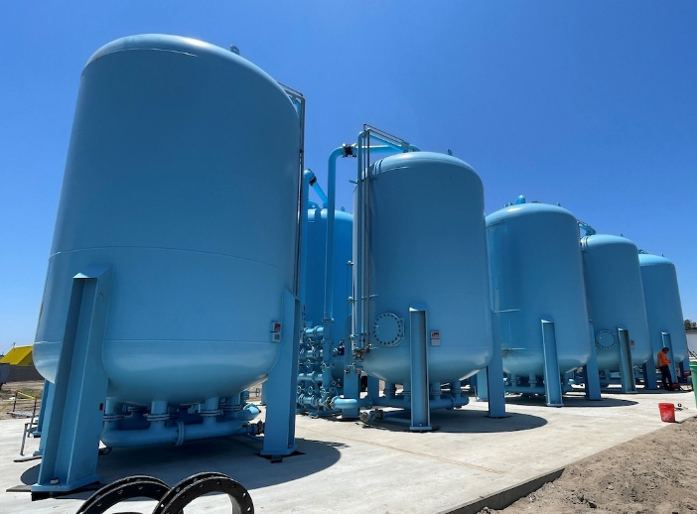
PFAS Monitoring Program
27 PFAS treatment facilities operational
68 facilities total at final build-out
WQ Department staff monitoring
Monthly sampling of leads and combined effluent.
Quarterly sampling of all points in treatment train.
Samples analyzed OCWD main lab for 25 different PFAS analytes
Notes:
With the number of treatment facilities, multiple treatment trains per facility, monthly and quarterly sampling, and number of analytes measured, we’re constantly generating a huge amount of PFAS data

Slide 13
The Data Challenge
27
Treatment Plants
(68 Planned)
25
PFAS Analytes Tested
Up to 22
Treatment Vessels Per Facility
Monthly + Quarterly Sampling
=
~100,000 Individual PFAS datapoints annually

Slide 14



Digital Solution: PFAS Treatment Facilities Dashboard
Created in-house using free open-source tools (R Shiny) and deployed on internal servers
Data is pulled from District’s existing WRMS database
Intent: quick, at-a-glance, high-level overview with the ability to drill down deeper if necessary – to improve efficiency
User-friendly interface
Improves access to data at all levels of organization
Notes:
created using R Shiny and deployed on internal servers

Slide 15
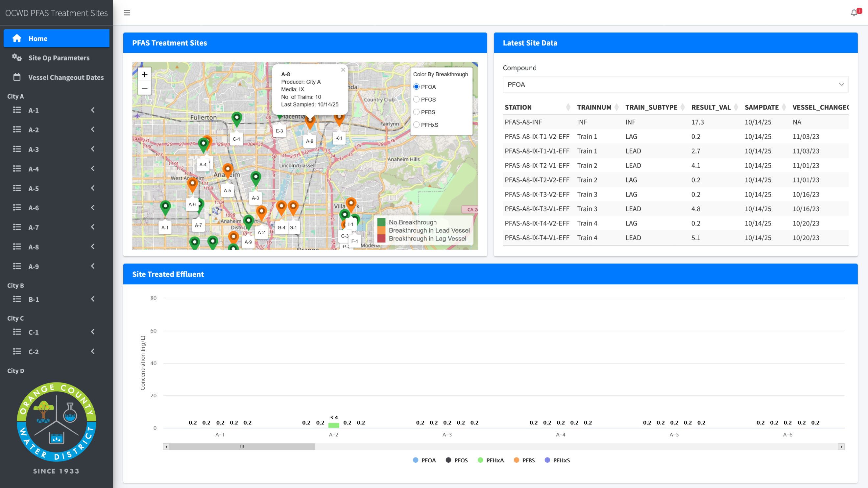

Slide 16
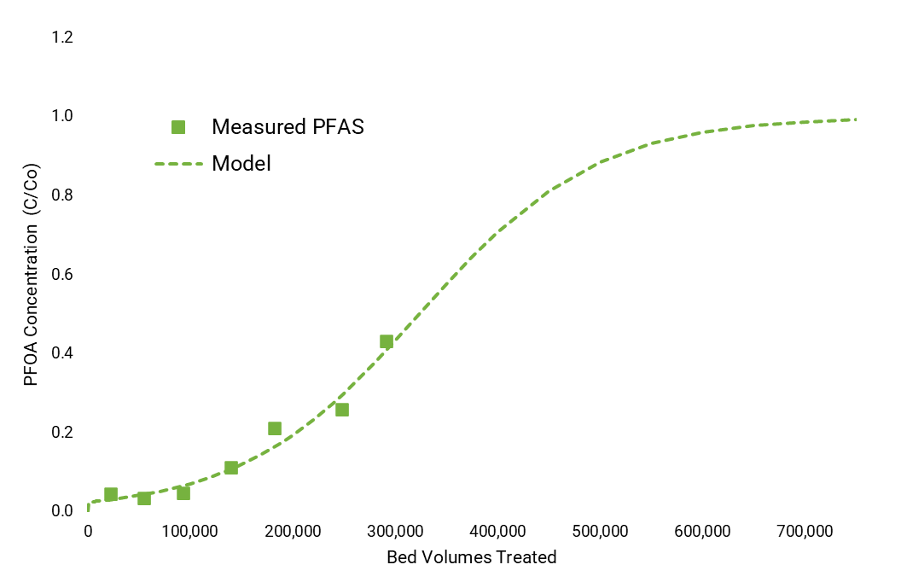
Next Steps for PFAS Dashboard
Continue soliciting feedback from user community (District staff) to improve and add functions and views
Integrate other water quality data
Consider incorporating analytics to forecast PFAS breakthrough
Evaluate direct Producer access options

Slide 17
Pilot-Scale Destruction of PFAS in Groundwater for Drinking Water Treatment Using Vacuum UV
Water Illumination, Inc. Trial at OCWD

Slide 18
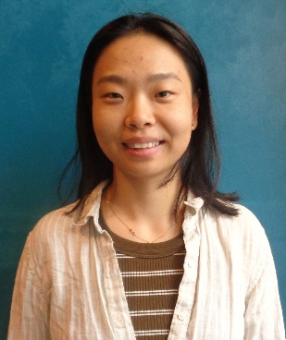
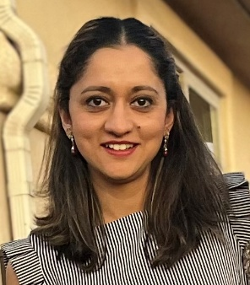

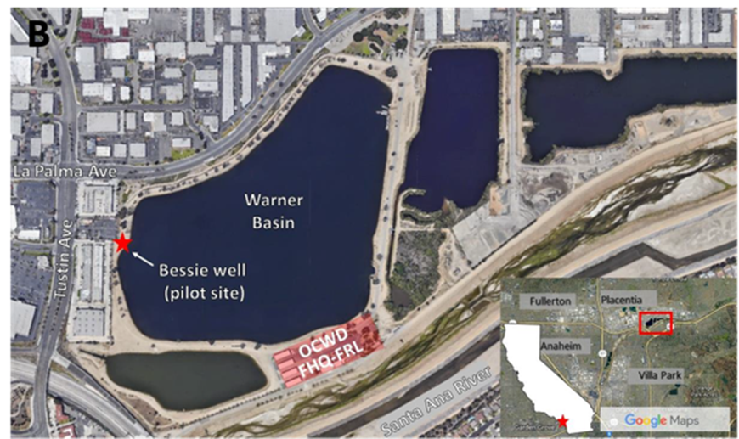
District Serving as Testbed to Demonstrate VUV Technology
District R&D Team
Sophie Sun
Meeta Pannu
Bios courtesy of Water Illumination
PILOT SITED IN SHED THAT PREVIOUSLY HOUSED OUR PFAS MEDIA PILOT
Notes:
Trojan Technologies is the world’s largest UV water treatment company

Slide 19
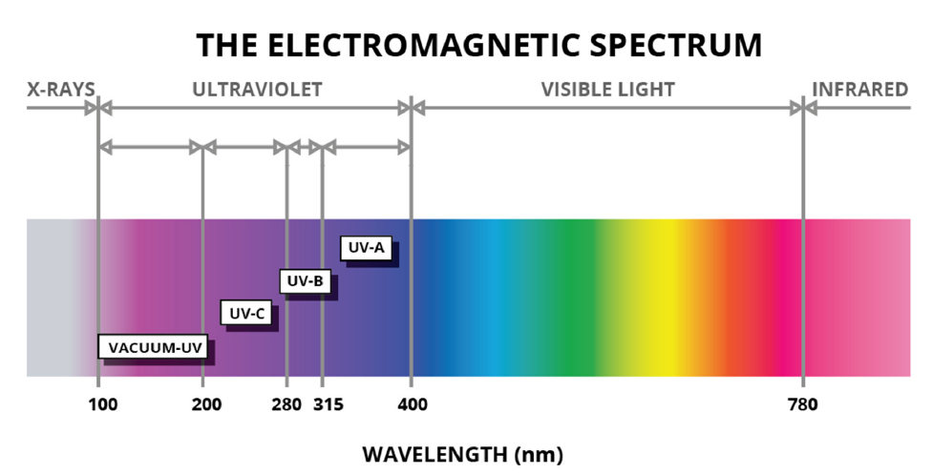





VUV Chemistry to Destroy PFAS
Patented chemistry uses:
vacuum UV (VUV)
tuning gas
alkaline pH
VUV photons at wavelengths < 200 nm
Slide credit: modified from Water Illumination.
Spectrum: https://marktechopto.com
Notes:
High energy light is key to kicking off a series of chemical reactions beginning with the light reacting with the water itself, to ultimately break down PFAS (forms OH radicals and hydrated electrons, optimized if the water is deoxygenated via gas addition)

Slide 20
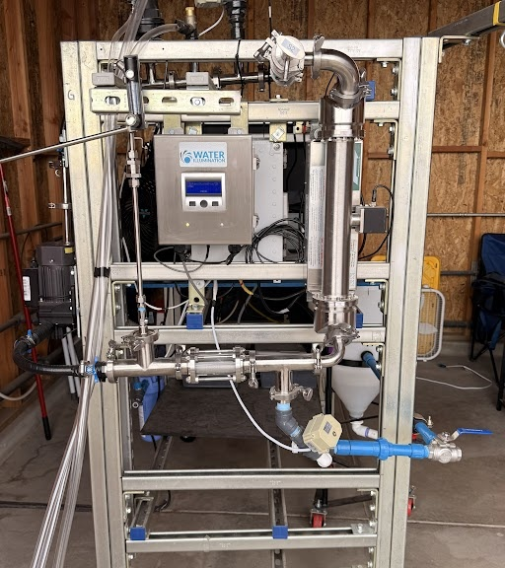
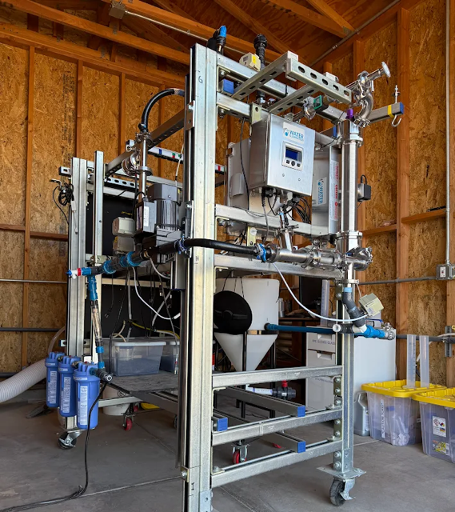
Flow
UV
Flow
Gas Sparging
Out

Slide 21
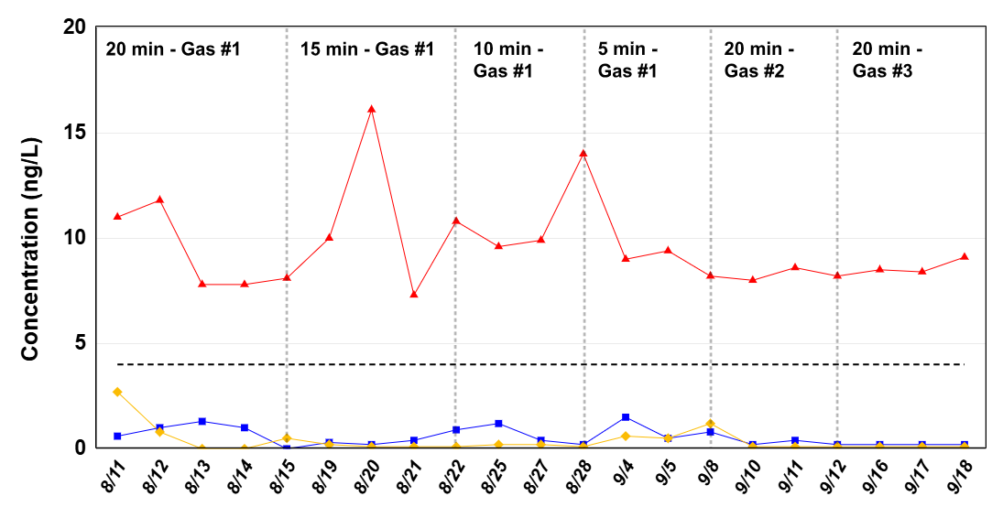
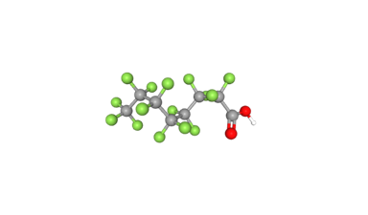
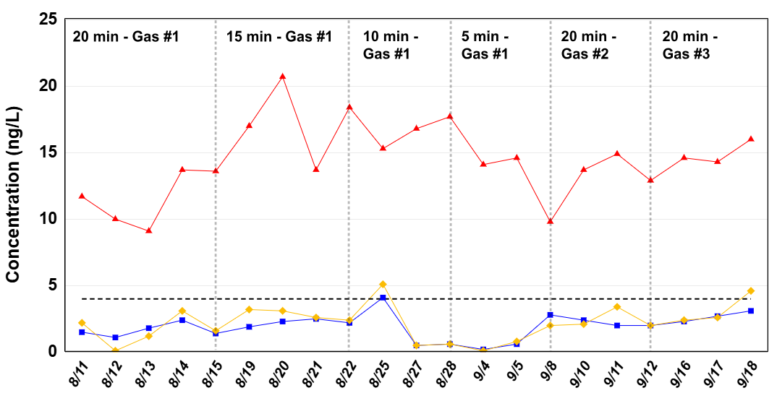
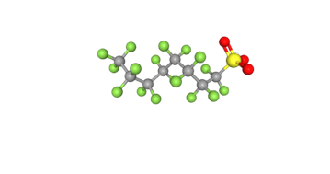
Preliminary Findings Demonstrate PFAS Destruction
PFOA
Next steps
Much faster destruction is necessary for economical scale-up → more research needed
Removal of sulfonates and short chain PFAS more challenging -- requires optimization
Water Illumination is constructing a 2nd-generation pilot with higher power density
PFOS

Slide 22


Thank You!
Questions?
@OCWaterDistrict

