Slide 1
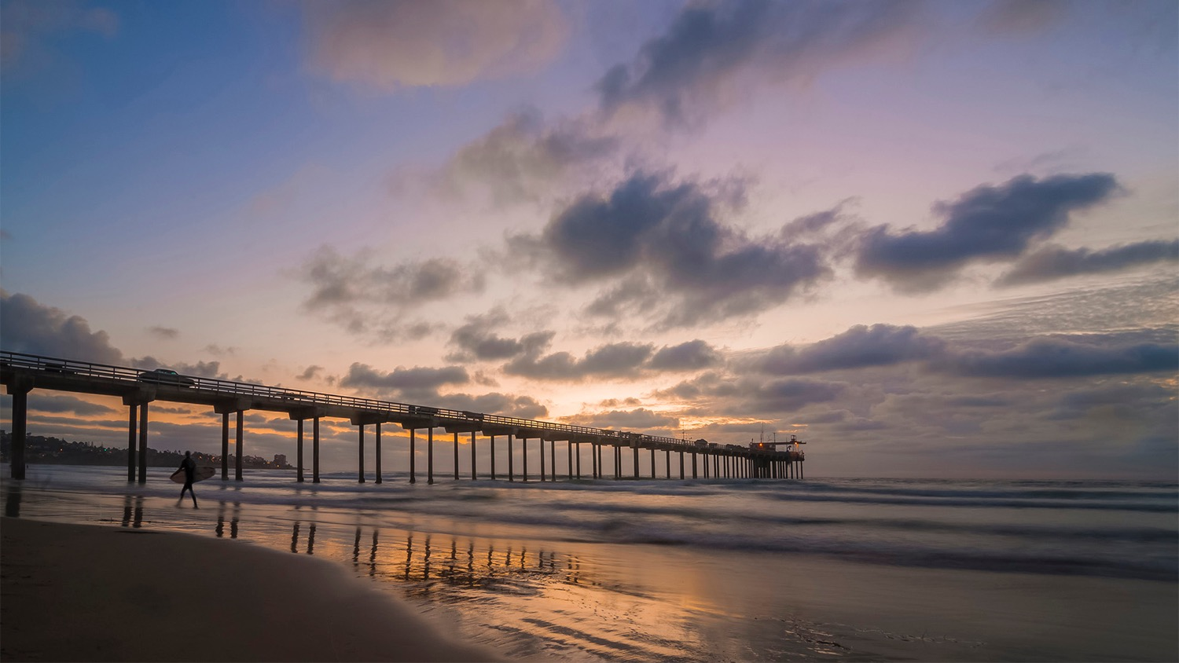


FIRO And Atmospheric Rivers Project: Next Steps and Recent Storms
F. Martin Ralph*, Ph.D.
*Director, Center for Western Weather and Water Extremes (CW3E)
at UC San Diego/Scripps Institution of Oceanography
*PI Prado FIRO, Lead Scientist and Principal Investigator, FIRO Phase III (National Expansion Pathfinder), AR Program and Atmospheric River Reconnaissance
OCWD Board Meeting
21 February 2024
Contact
F. Martin Ralph
mralph@ucsd.edu

Slide 2
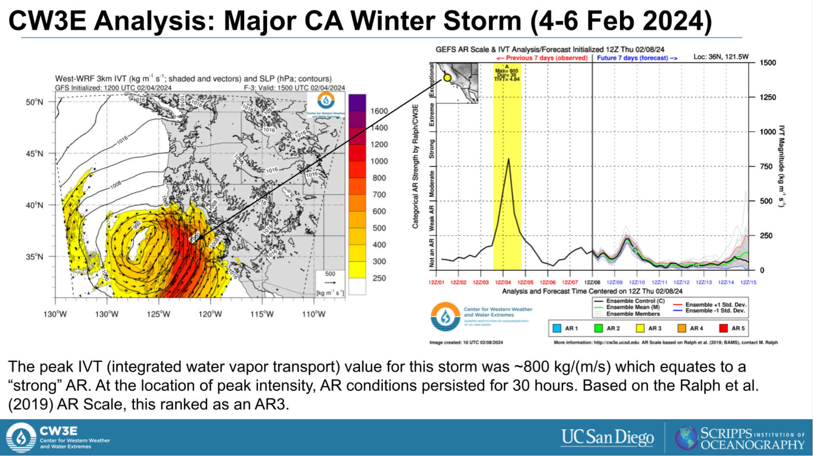
Outline
Context: National FIRO Program Status
FIRO Final Viability Assessment for Prado Dam
Next steps on Implementation of FIRO at Prado
Summary of recent storms and 10-day outlook

Slide 3
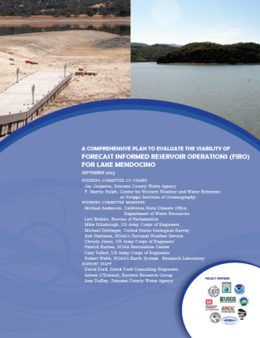
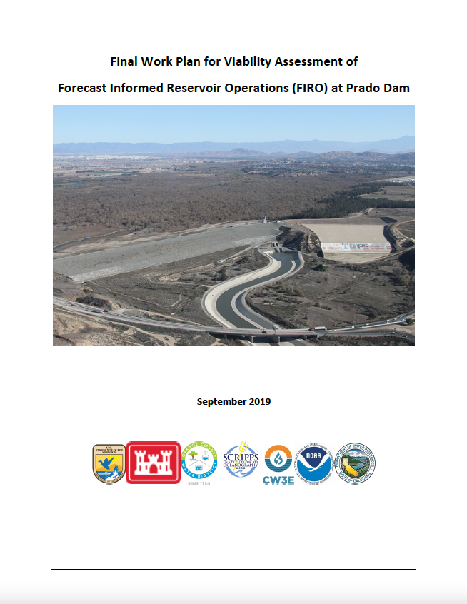
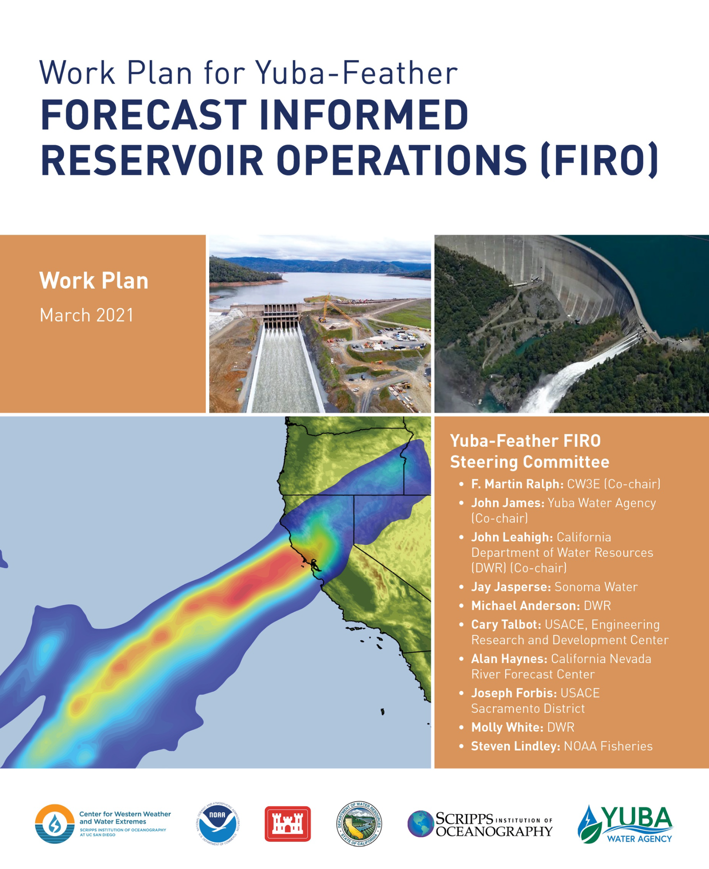
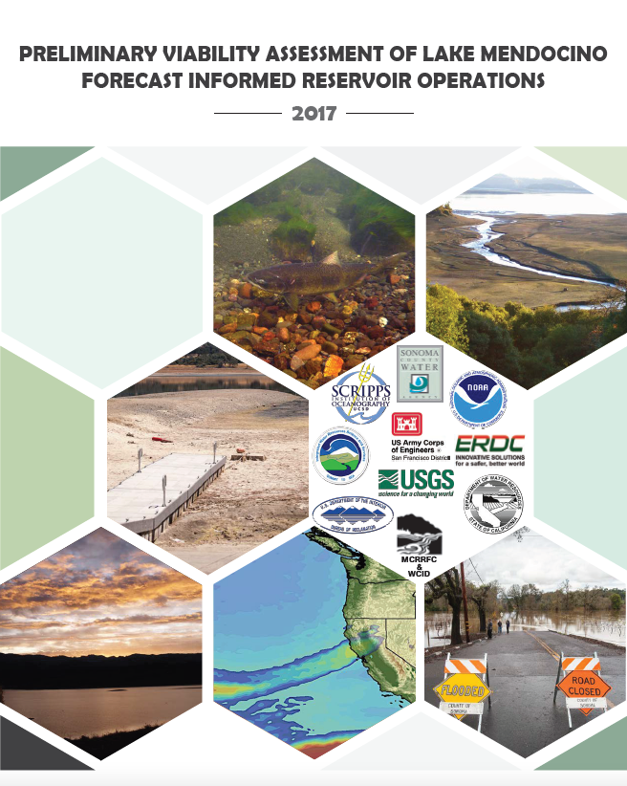
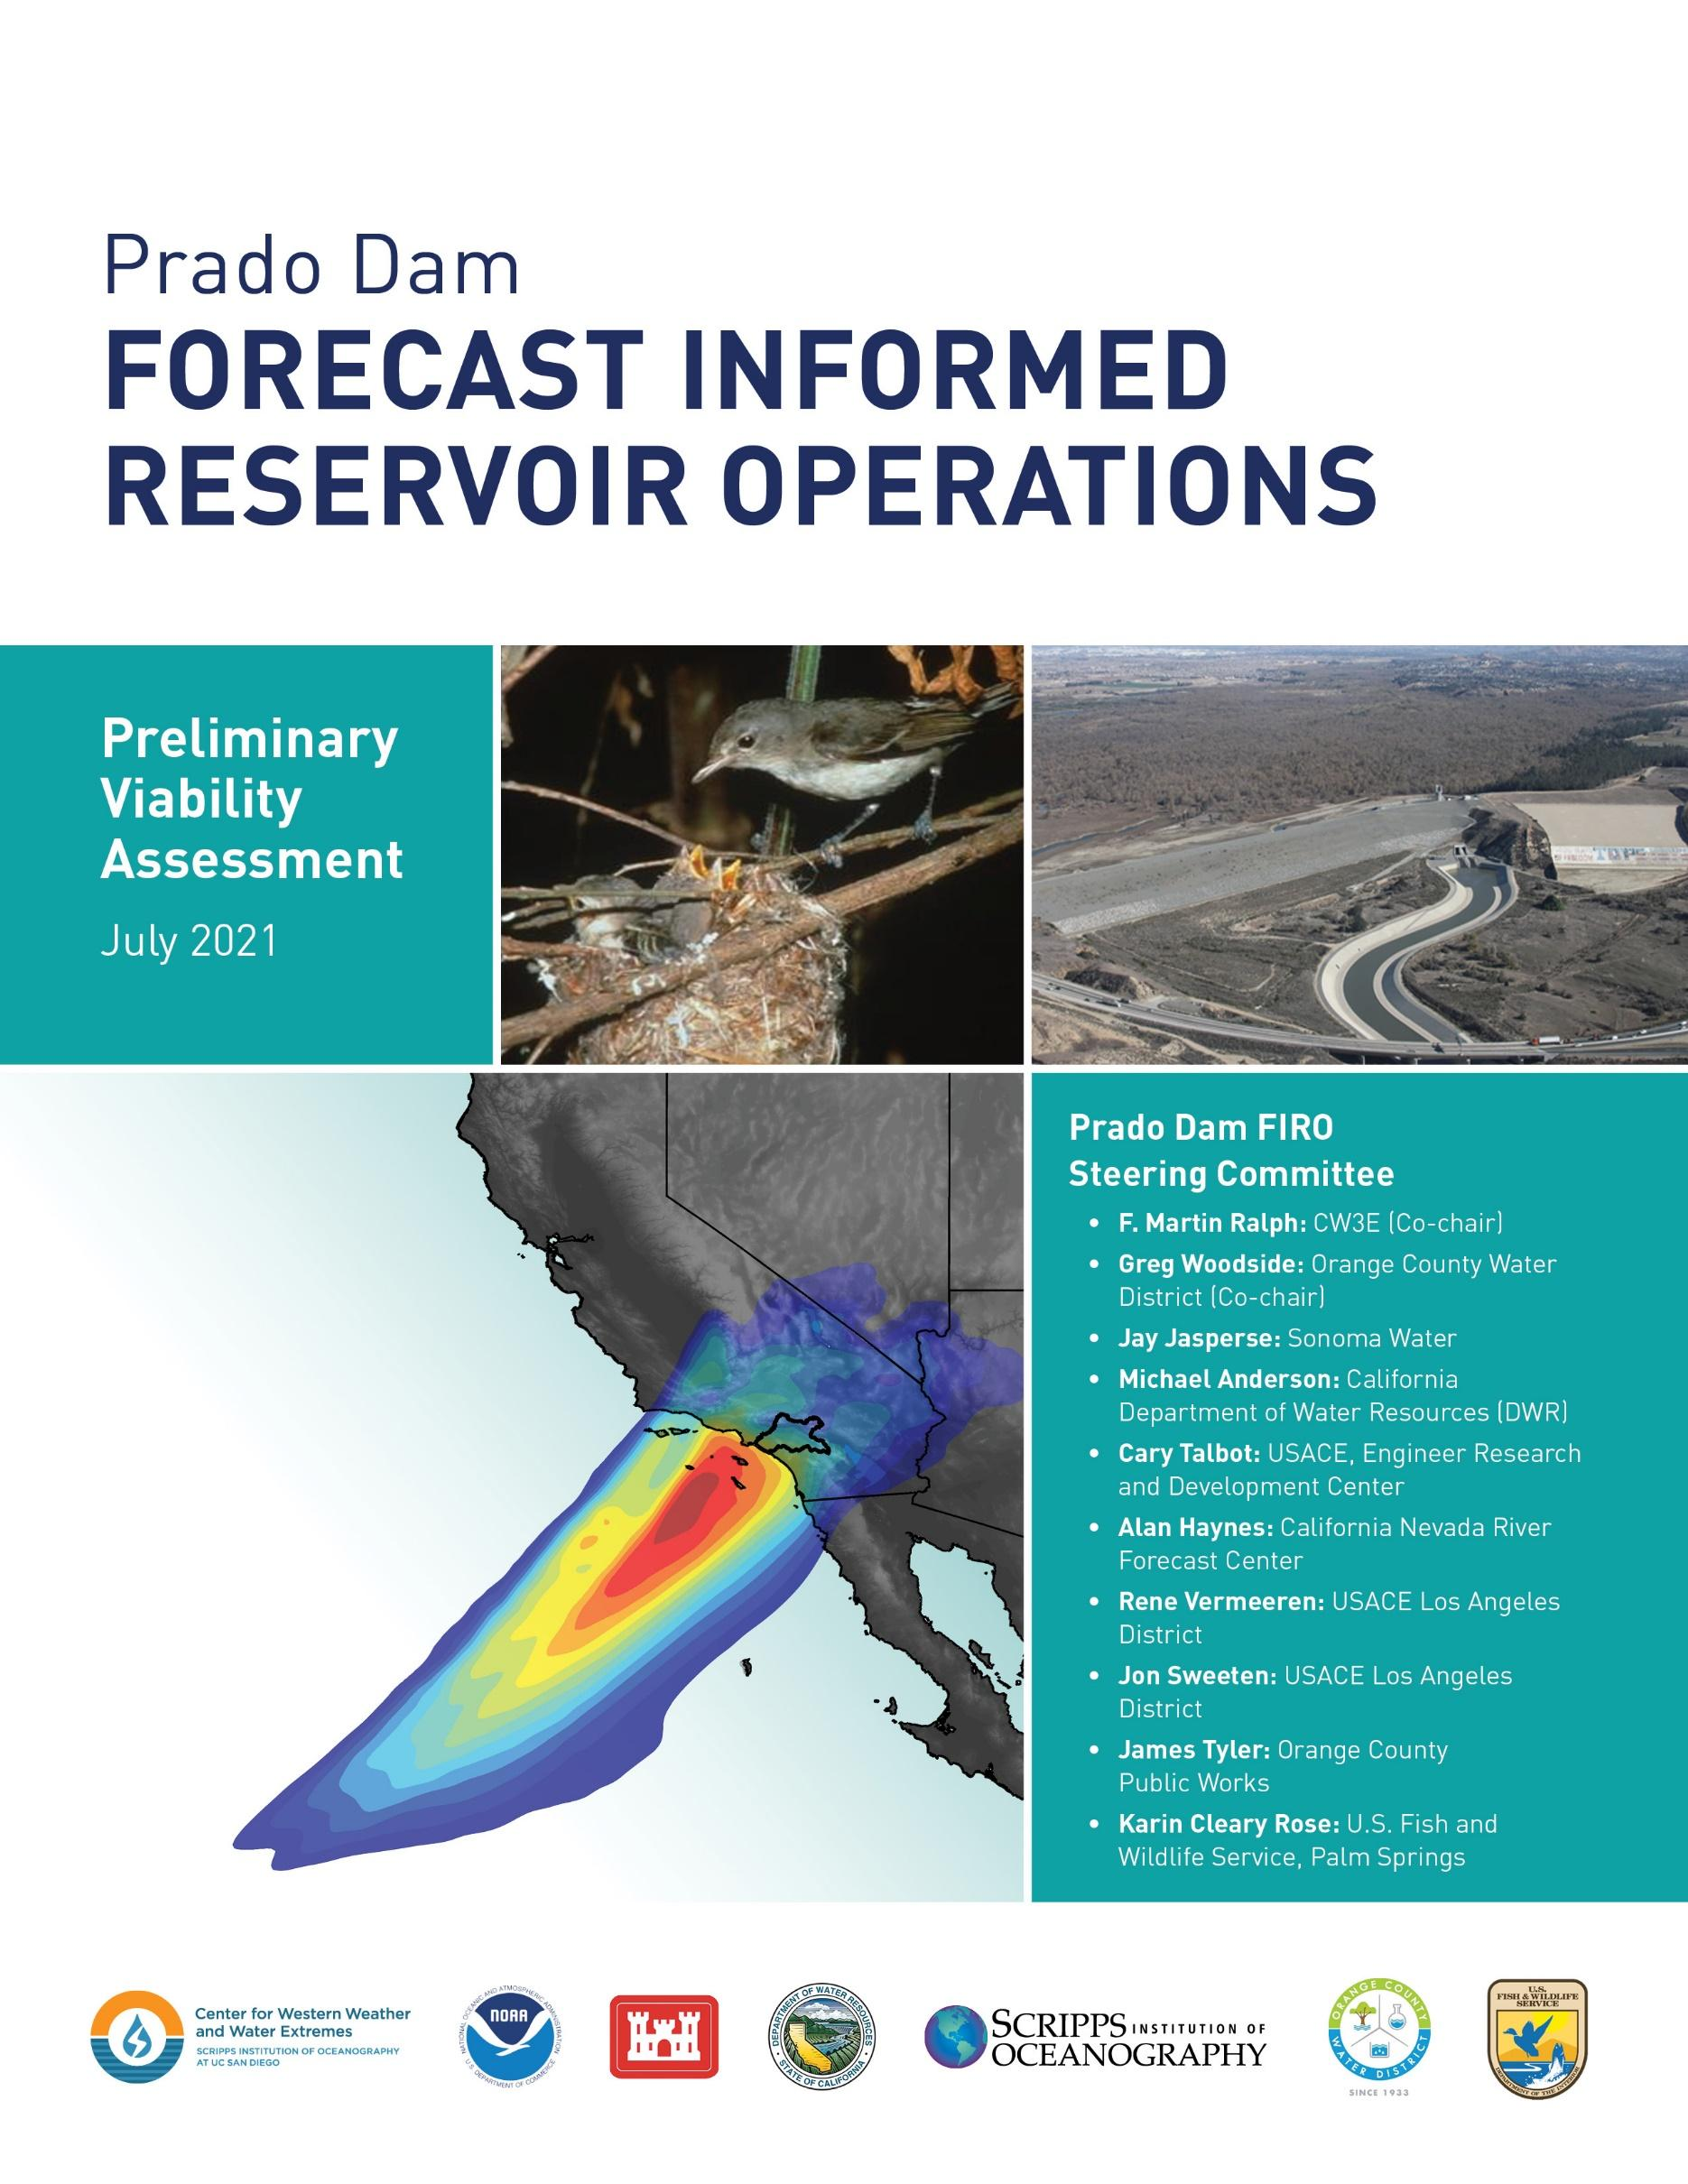
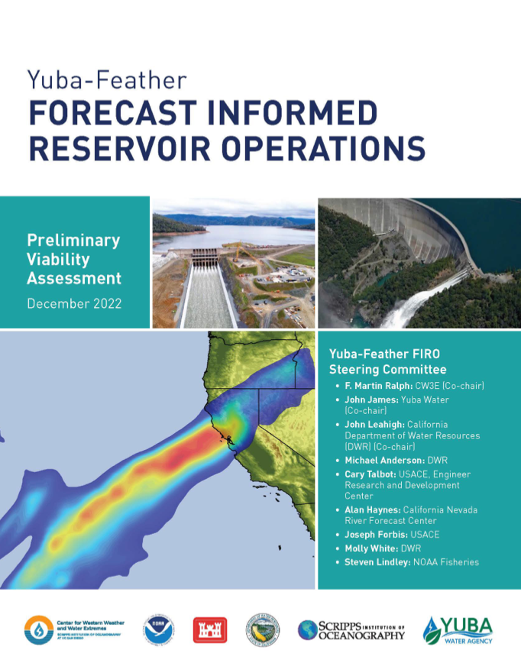
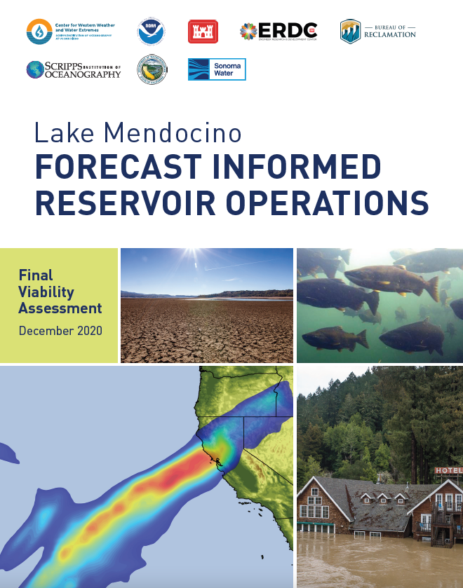
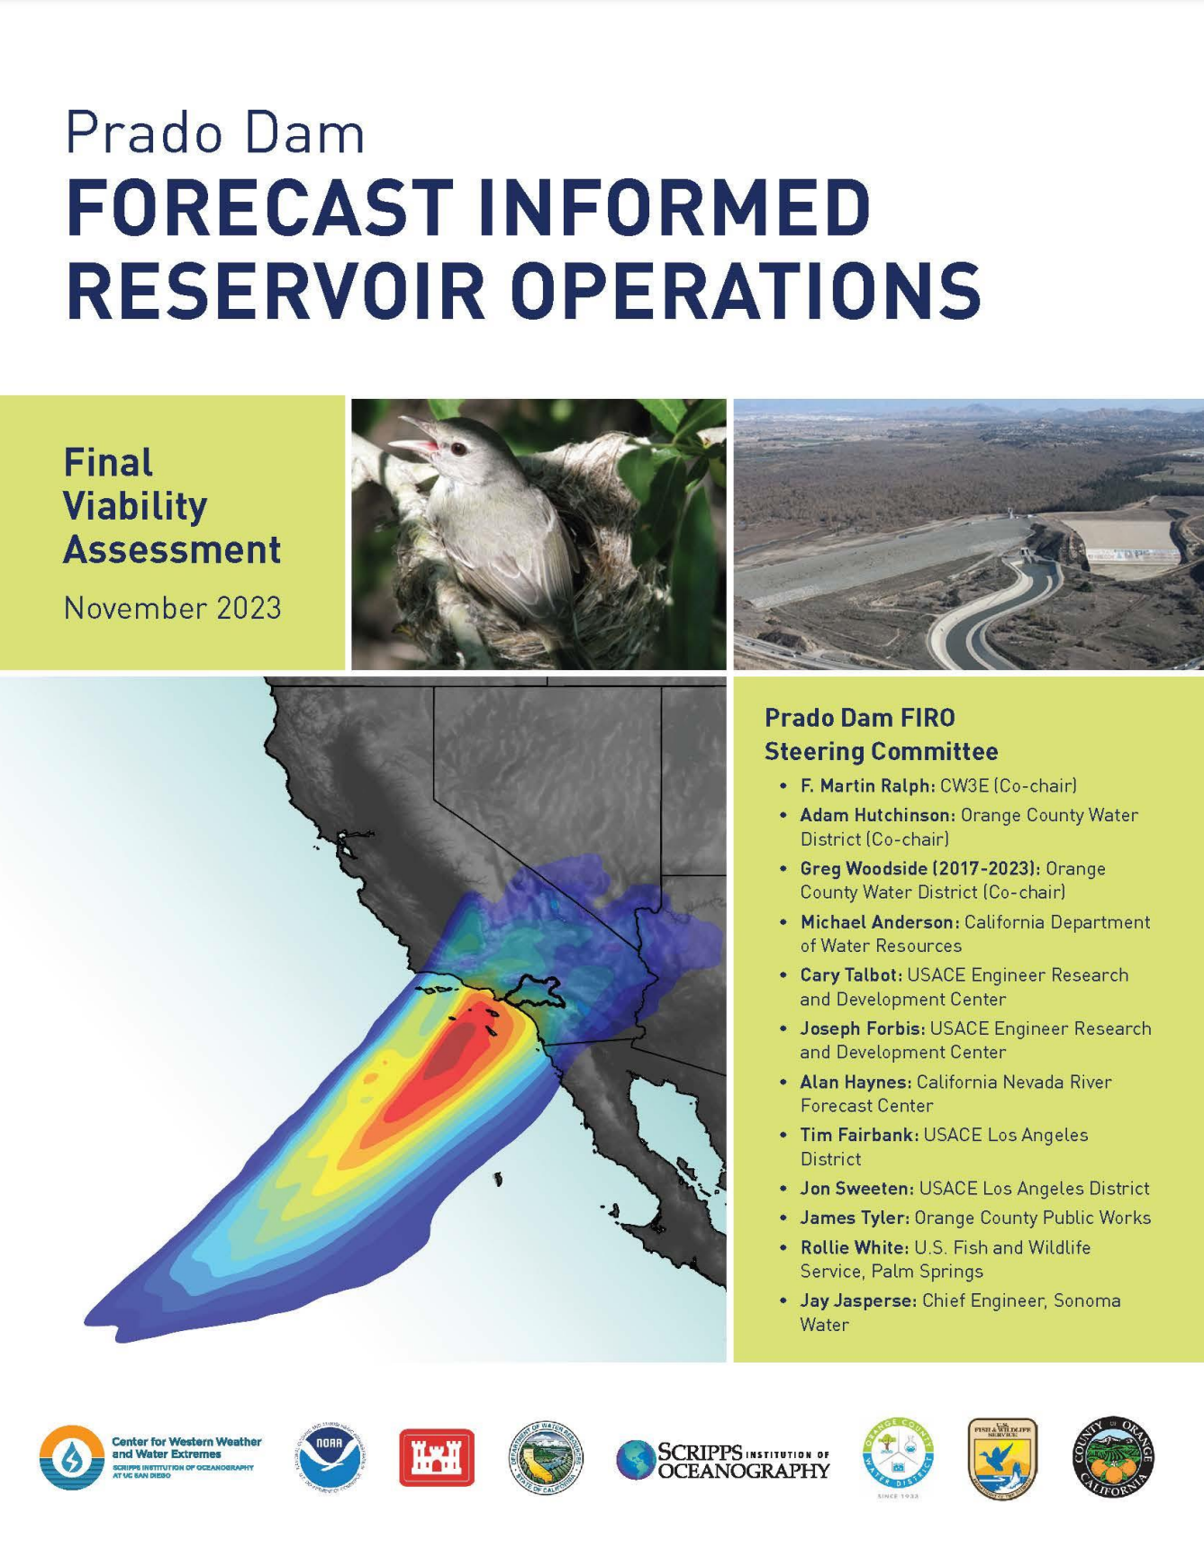
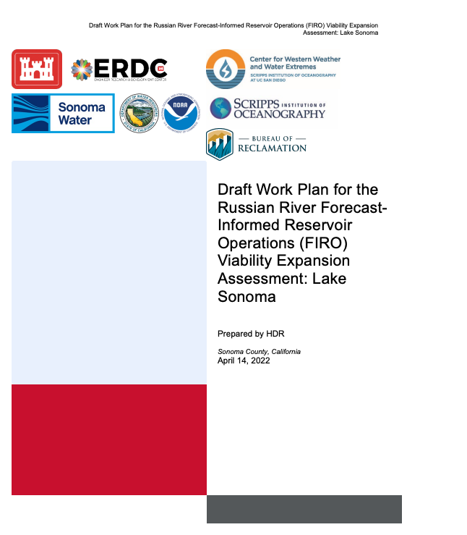
FIRO Project work products - Workplans, PVAs, FVAs
Lake Mendocino Workplan: September 2015
Prado Workplan: September 2019
Yuba-Feather Workplan: March 2021
Lake Mendocino PVA:
July 2017
Prado PVA:
July 2021
Yuba-Feather PVA:
October 2022
Lake Mendocino FVA: December 2021
Prado FVA:
November 2023
Yuba-Feather FVA:
In Progress (Mar 2024)
Russian River (Lake Sonoma) Workplan: April 2022

Slide 4
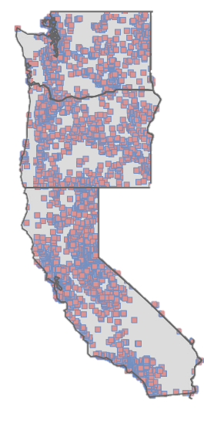
FIRO – PI Marty Ralph Co-PI Luca Delle Monache
Phase I – Pilot (FY15 – FY19)
Initial pilot study at Lake Mendocino
Phase II – Transferability (FY19 – FY23)
Expanded effort to other pilots
Prado Dam / Seven Oaks Dam (added FY22)
New Bullards Bar / Oroville Dams
Howard Hanson Dam (added FY22)
Screening Process Development
USACE South Pacific Division dams as testbed
(85 dams in total)
Phase III – National expansion pathfinder (FY23 – FY28)
National forecast skill assessment and improvement
Support planned Water Control Manual updates
Expand effort at more complex sites (system of dams)
Apply screening process nationally (~ 700 dams)
Howard Hanson Dam
Green River
120,000 ac-ft
Willamette Valley, Oregon
National expansion
Oroville Dam
Feather River
3,538,000 ac-ft
Lake Mendocino
Russian River
116,500 ac-ft
New Bullards Bar Dam
Yuba River
966,000 ac-ft
Lake Sonoma
Russian River
381,000 ac-ft
Folsom Dam
Seven Oaks Dam
Santa Ana River
145,000 ac-ft
Prado Dam
Santa Ana River
174,000 ac-ft

Slide 5
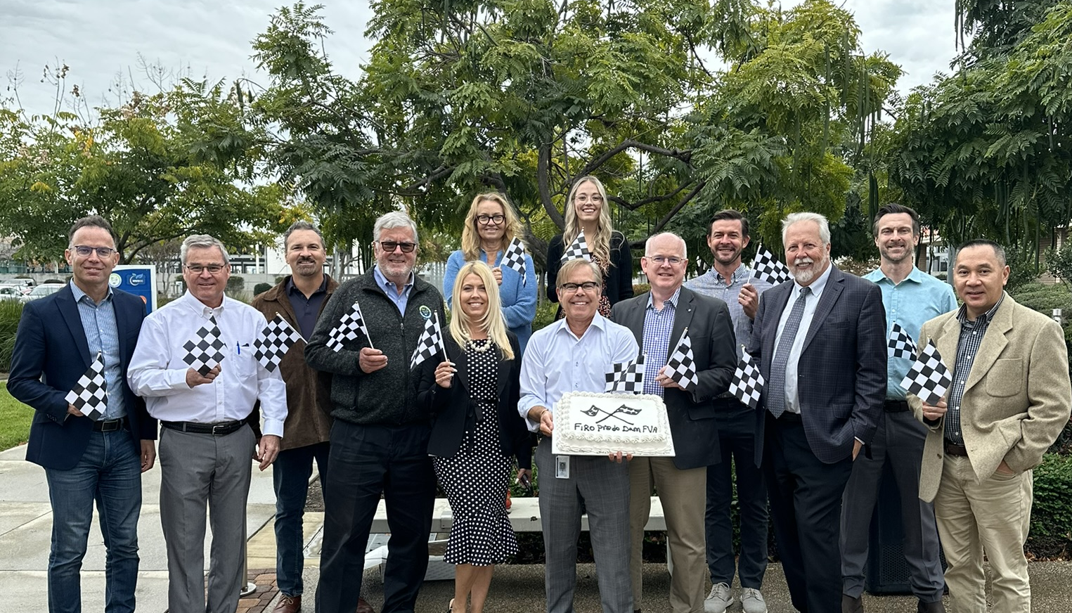







The FIRO study on Prado was a collaborative effort led by the Prado Dam Steering Committee that began in 2017.
The steering committee was comprised of senior representatives from stakeholder agencies and academic partners
Mix of engineers and scientists from research, operations and regulatory perspectives
Each agency responsible for supporting their engagement

Slide 6

The FVA was completed in Nov 2023, and found that FIRO is viable at Prado Dam.
Key Findings
Raising the maximum water level to 510 or 512 ft msl would yield approximately 4,000 to 6,000 acre of feet of additional recharge
FIRO has a slightly positive impact on flood risk management
Enough for 16,000 – 24,000 people for a year

Slide 7
Prado Dam and FIRO are critical to capture storm water with drier and wetter conditions predicted to occur.
6X
Average

Slide 8


Charging ahead!
Test FIRO for five years by holding water up to elevation 508 ft msl (2024-2029)
Continue to develop FIRO decision support tools
Develop tools to understand environmental benefits and impacts of increased water conservation
Update USACE Water Control Manual to incorporate FIRO as a permanent feature (Est. 2028)

Slide 9
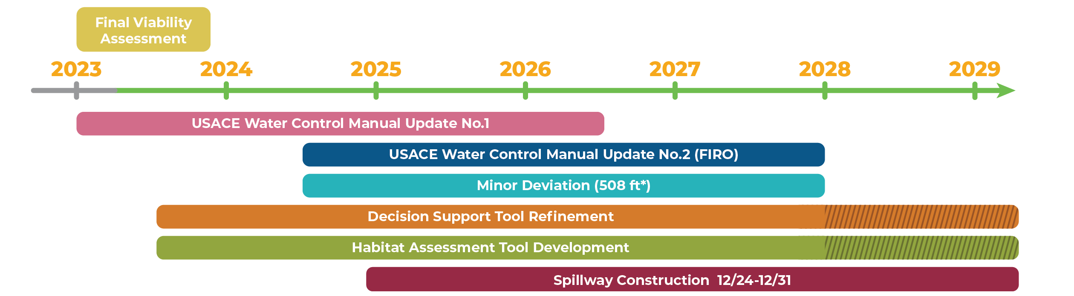
Prado Dam: FIRO Implementation Support (July 2024 – June 2027)
Goal: FIRO is considered fully in the Prado Dam Water Control Manual update process.
CW3E Tasks
3-year scope
July 2024 to June 2027
1: Leadership Team and Associated Activities
2: Support FIRO implementation
3. Support during water year operations
4. Environmental considerations
5. Coordination with Seven Oaks FIRO

Slide 10
CW3E Analysis of the Major Storm of 4-6 Feb 2024:
It was an Atmospheric River that ranked as an AR3

Slide 11
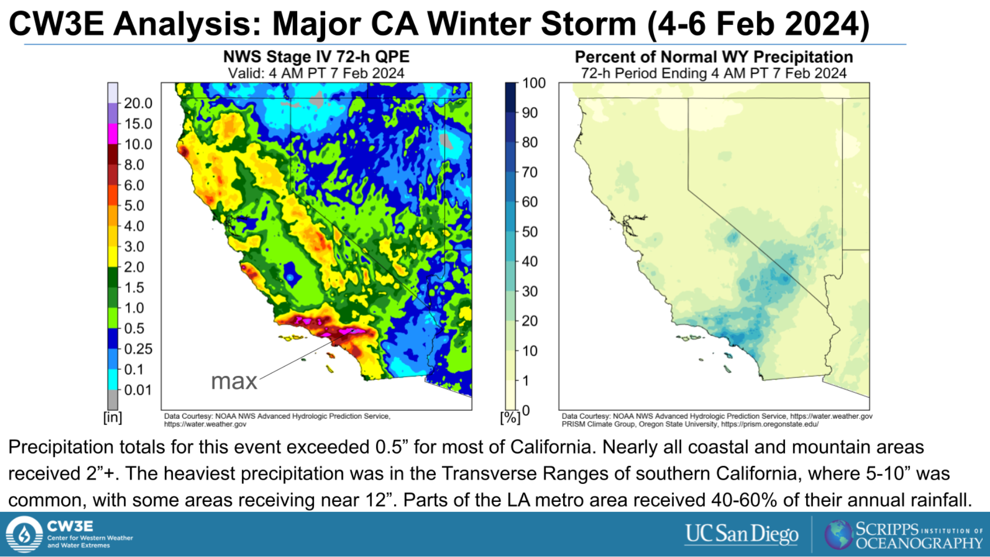
Some areas
received HALF
of an average year
rain in 3 days from this AR storm

Slide 12
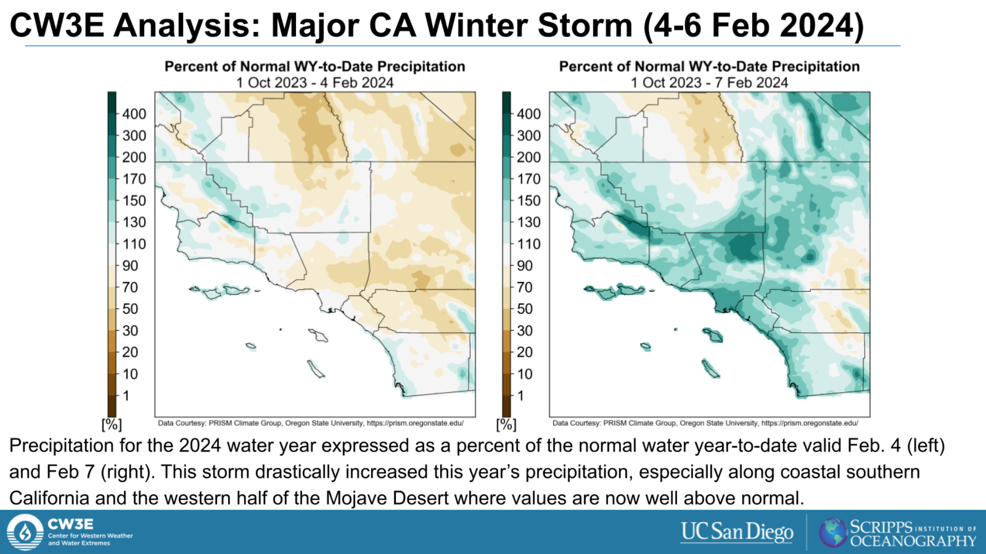
70-100% of normal to date BEFORE the storm
>150% of normal to date AFTER
the storm

Slide 13
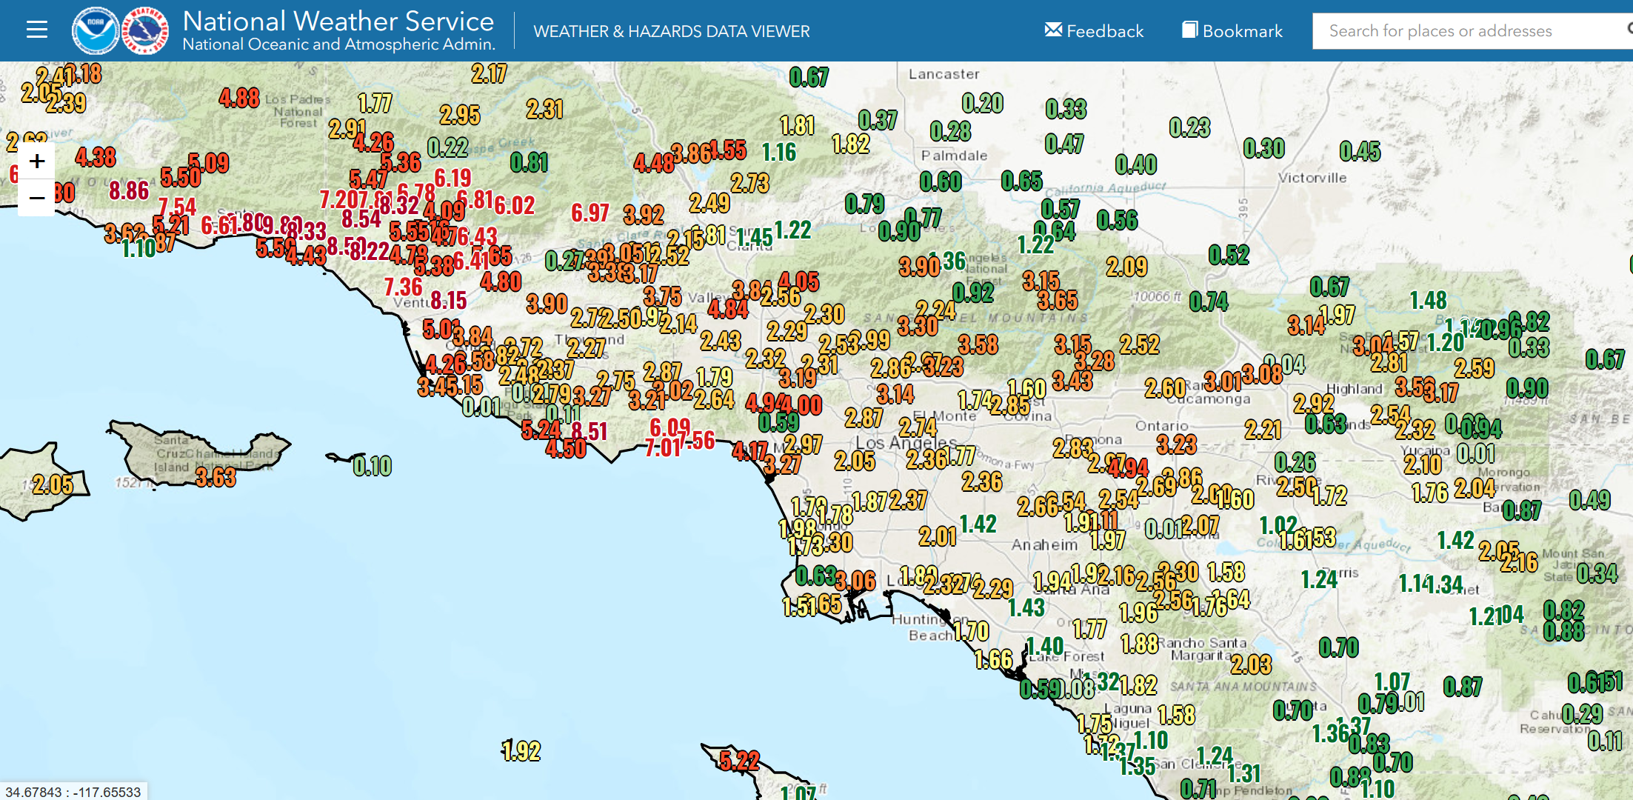
3-day storm total precipitation (inches), ending 600 AM Wed 21 Feb 2024
Only about 100 miles
>6 inches at many locations, up to 10 inches
Mostly 2-4 inch totals

Slide 14
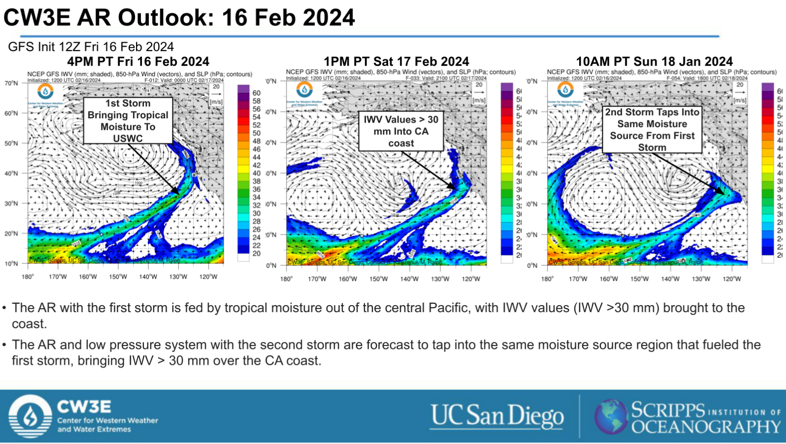
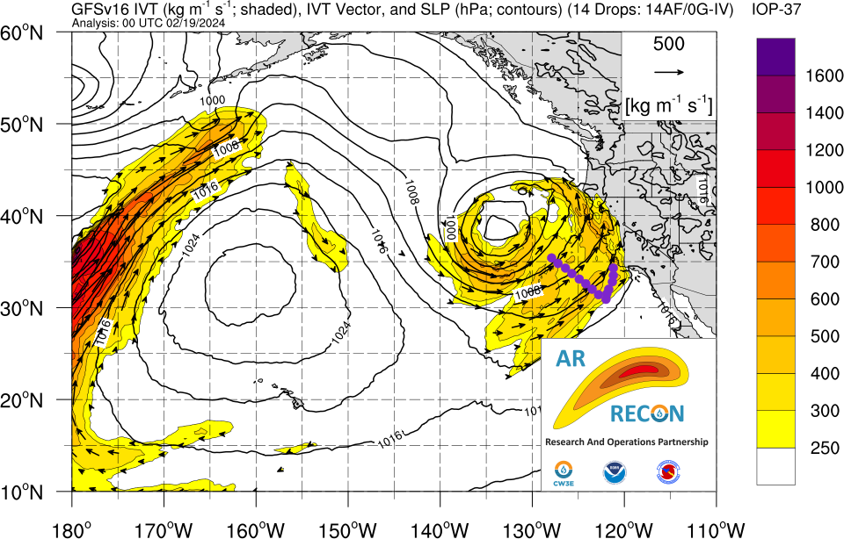
Current Storm is also an Atmospheric River
Vapor Transport shows AR conditions
Water vapor shows classic AR structure
4 PM PT Sun 18 Feb 2024
10 AM PT Sun 18 Feb 2024

Slide 15
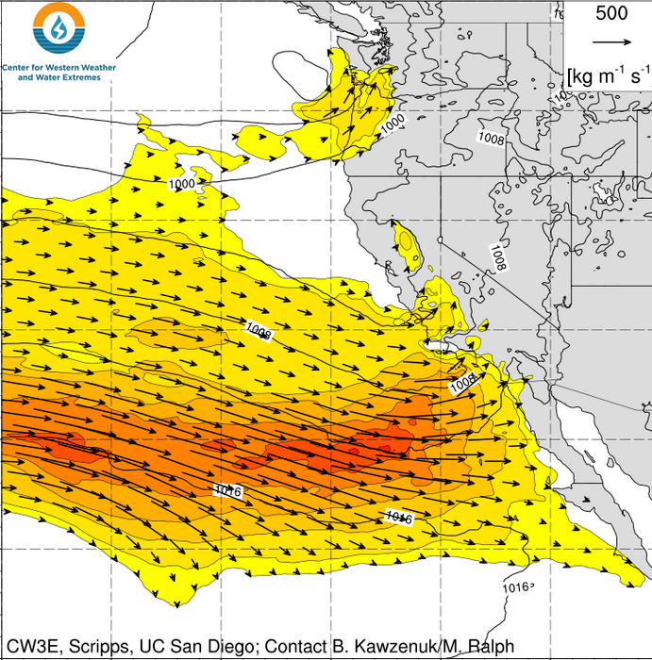
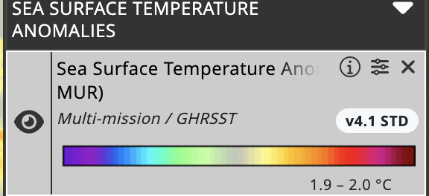
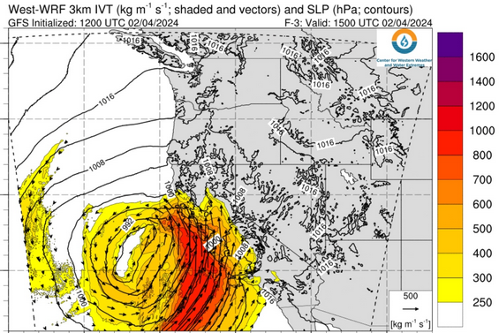
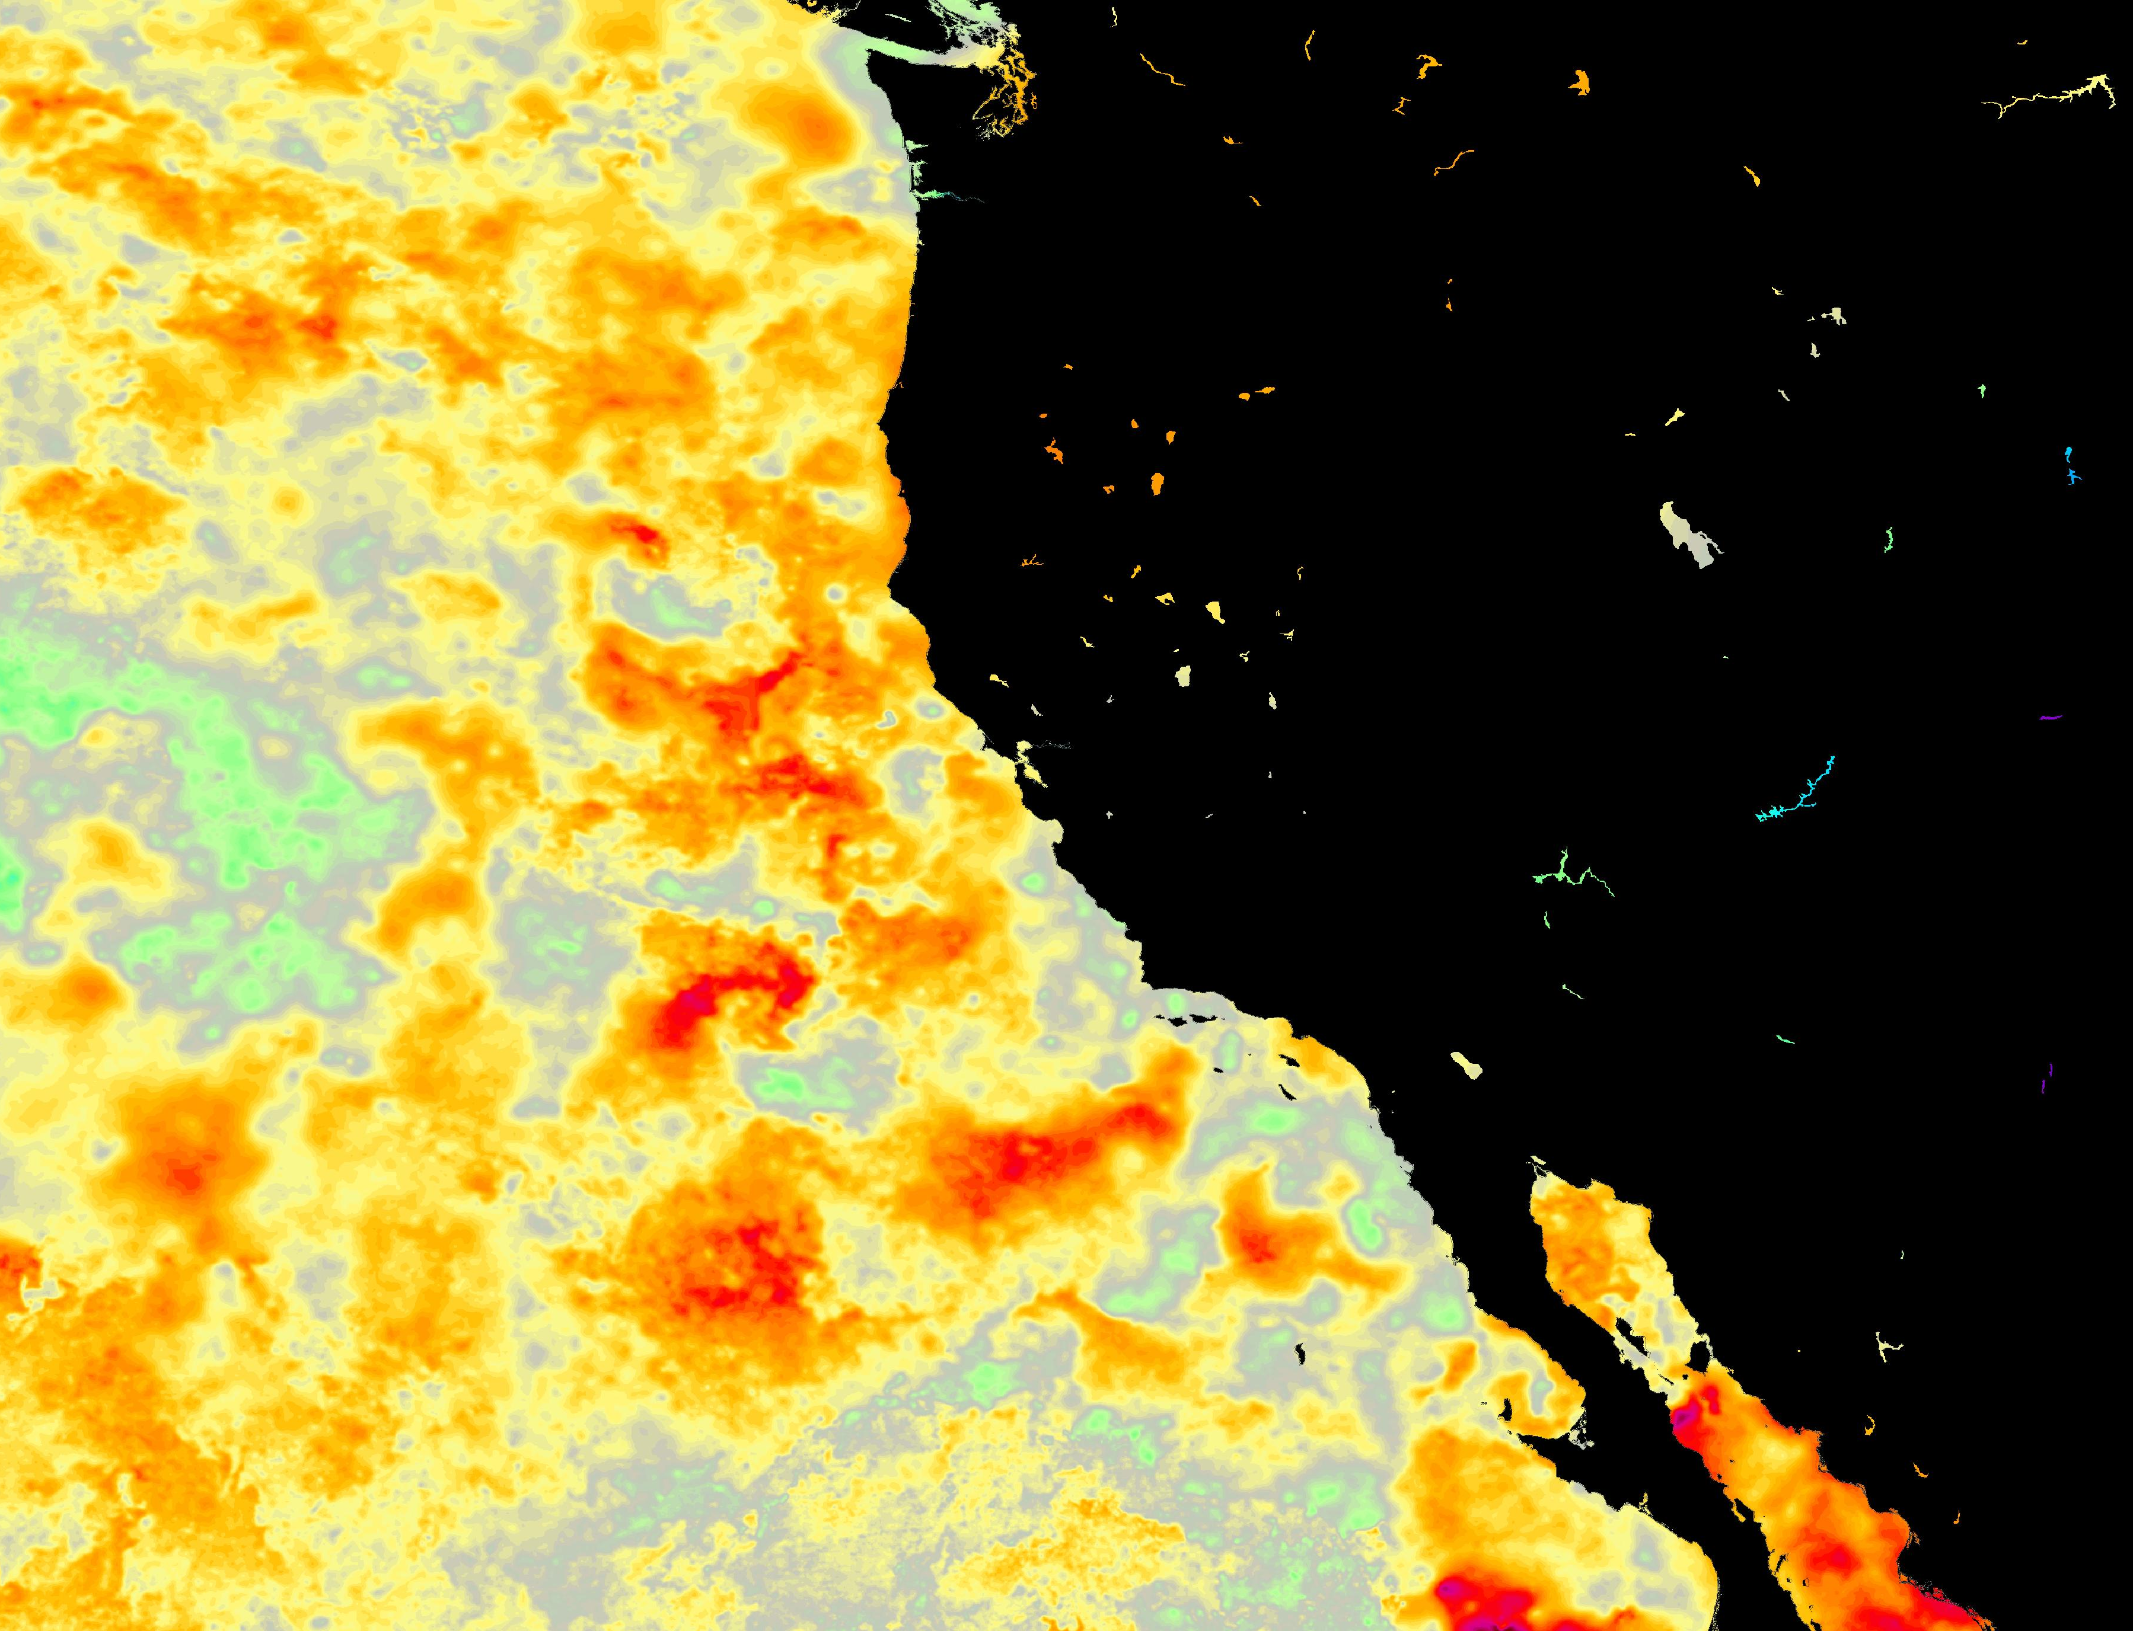
Warm Ocean Surface Temperatures Off California Worsened Flooding
22 Jan 2024 (AR 1)
San Diego Flood
This process was described by Persson et al. 2005 (Mon. Wea. Rev.) for a strong AR storm that struck Santa Barbara in the strong El Nino of 1998.
The Atmospheric Rivers that hit California in late January and early February were strengthened by the warm water associated with El Nino.
Atmospheric River Intensity (IVT, kg m⁻¹ s⁻¹)
This, worsened impacts, e.g., - heavy rain
- wind
- flooding
- landslides
4 Feb 2024 (AR 2-3)
California Flood, Wind, Landslides
Airflow in the 22 Jan atmospheric river
San Diego
Ocean: 2-4 F warmer than normal
SSTs on 22 January 2024

Slide 16
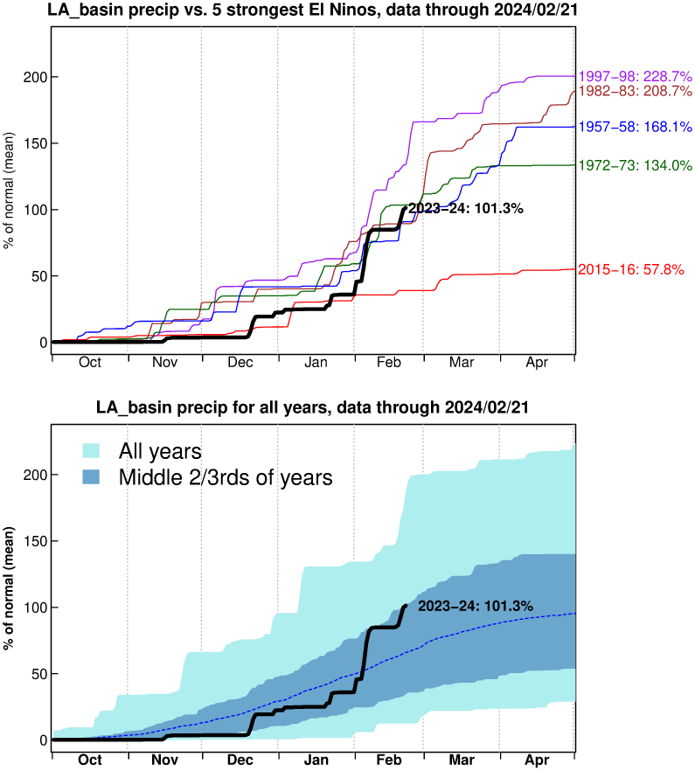

Slide 17
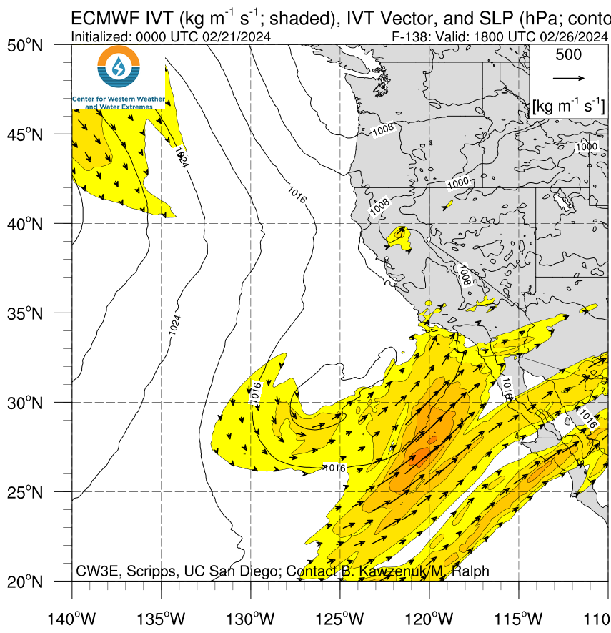
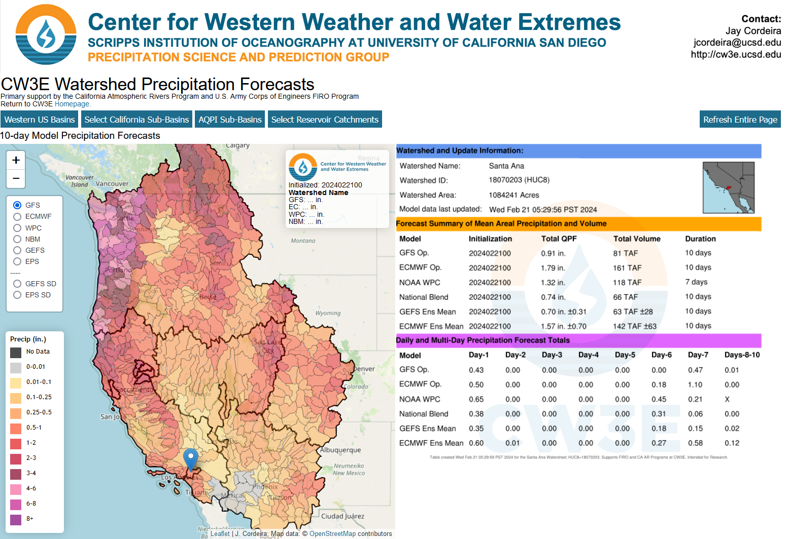
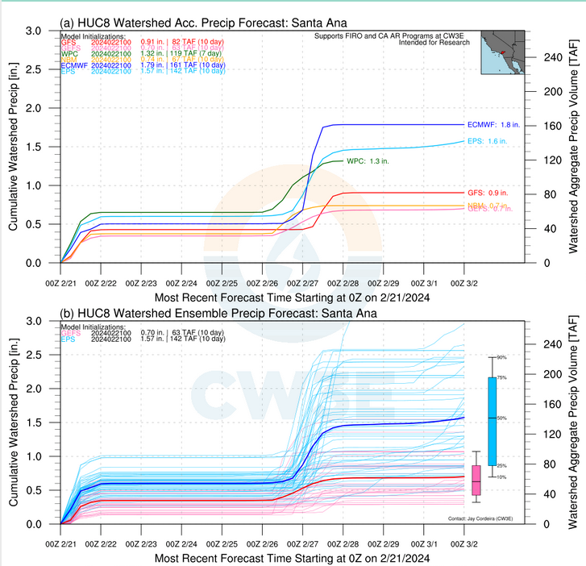
Small to modest storm 25-27 Feb (Sun-Tue)
Will AR conditions remain just offshore?
Stay tuned!

Slide 18

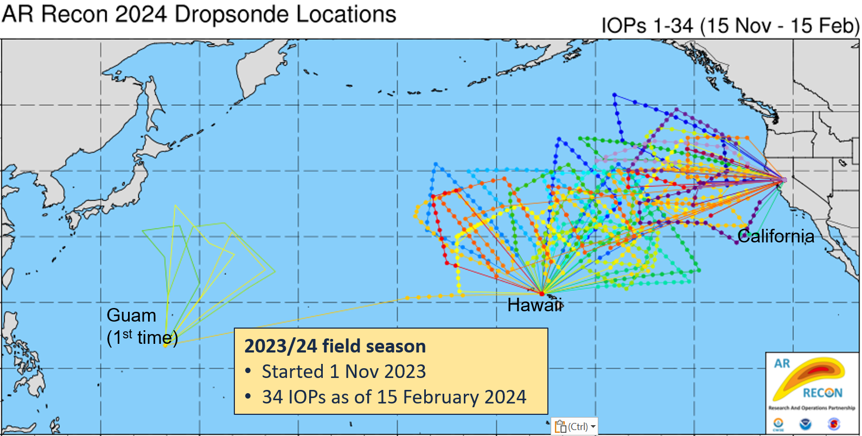
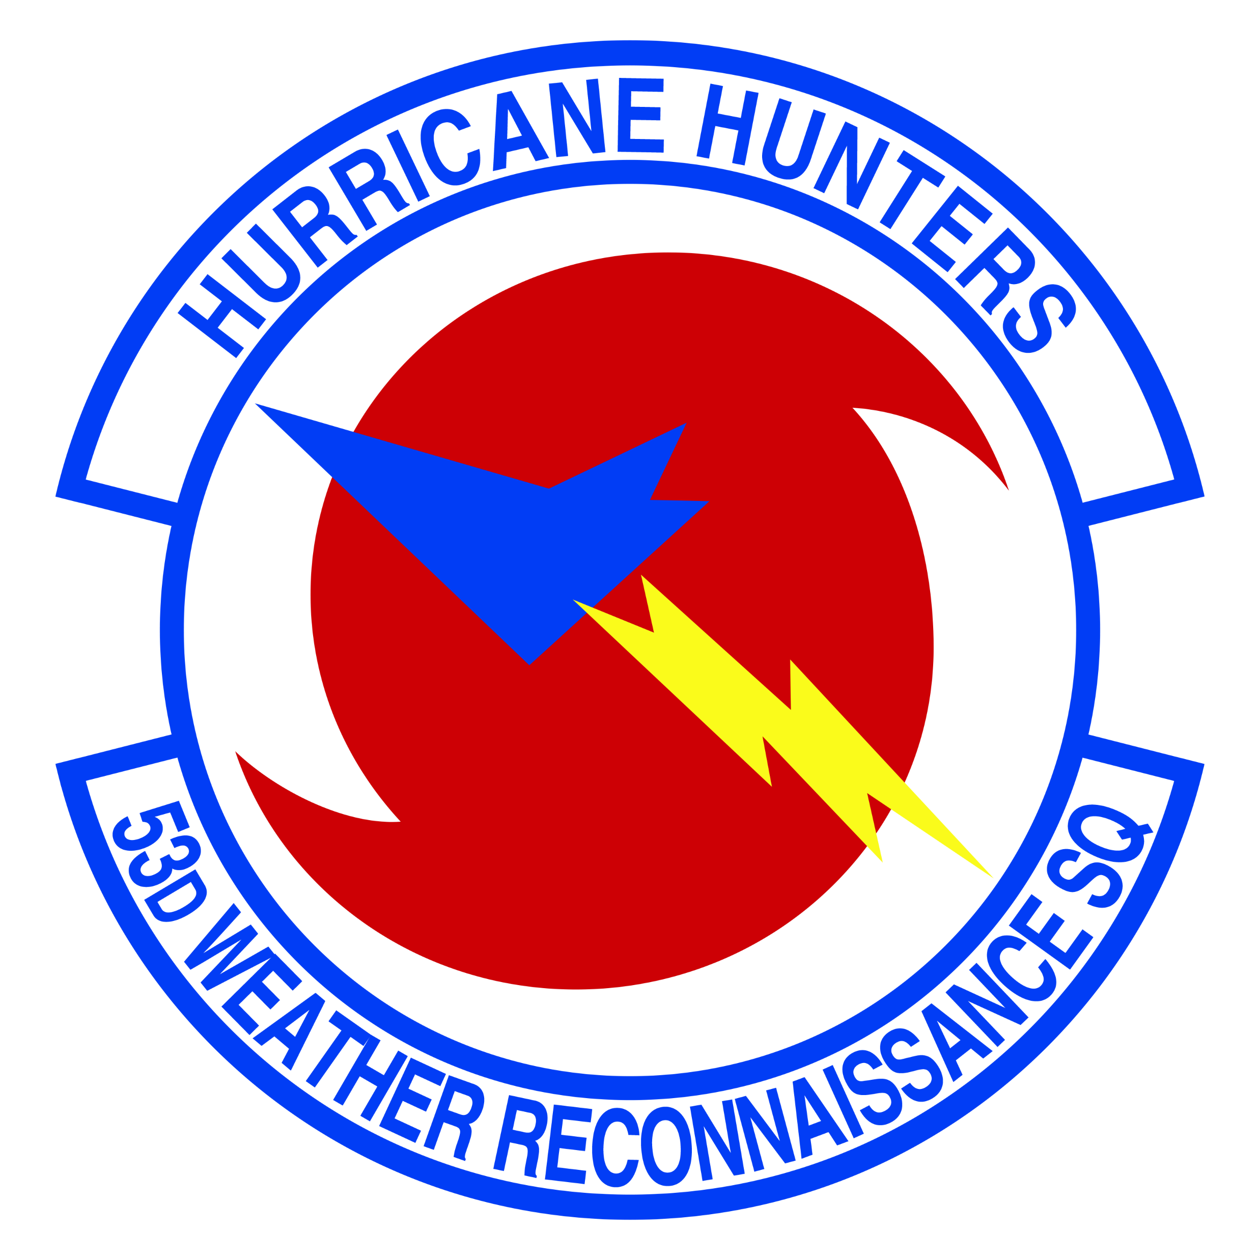
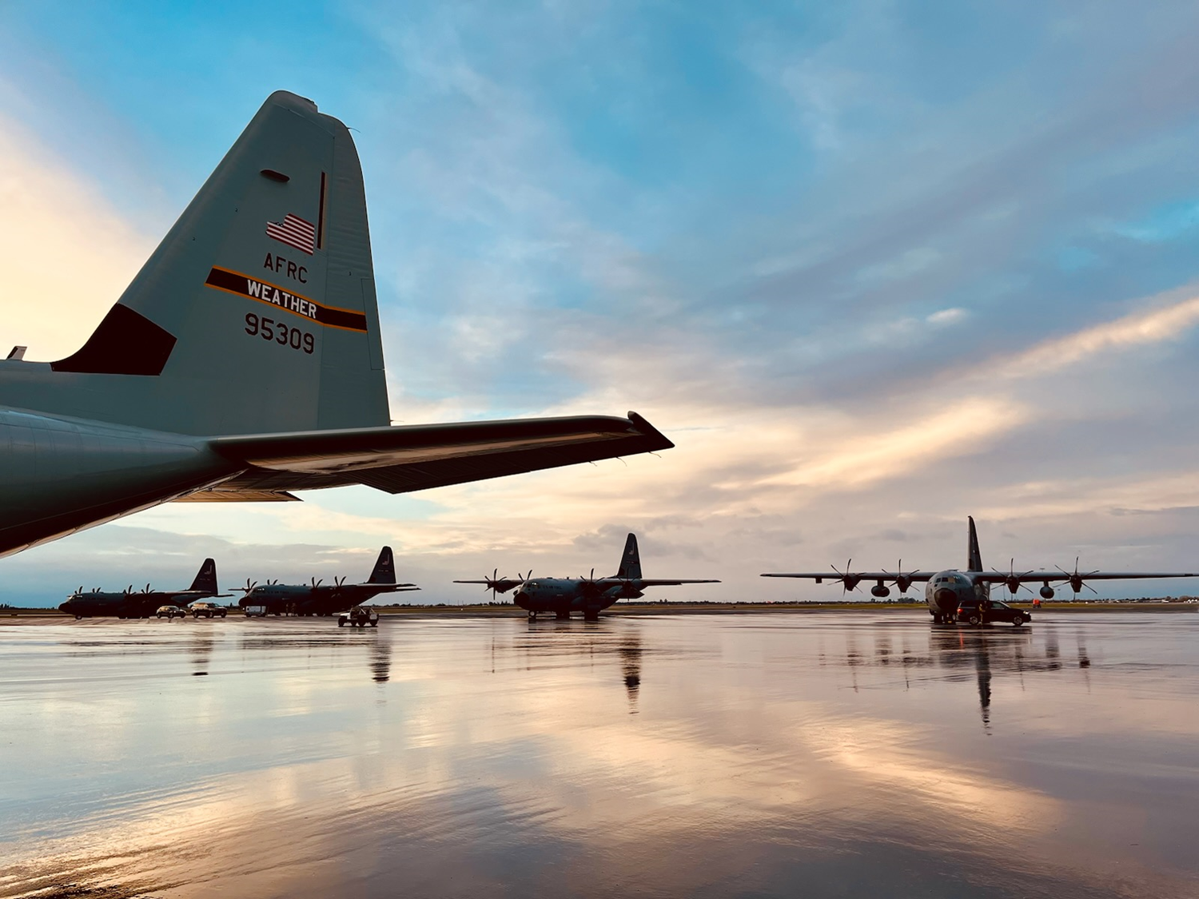

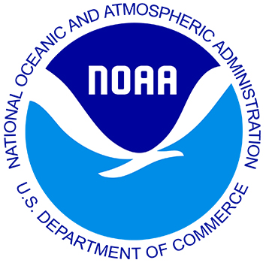


AR RECON 2023/24
AR Recon is a Research and Operations Partnership
NOAA, Air Force, CA DWR, UC San Diego Scripps Oceanography, other Universities
“Atmospheric River Reconnaissance, Observations and Warnings” (ARROW) (within 2024 NDAA) calls for AR Recon expansion to support managing western weather and water extremes.
Air Force C-130
NOAA G-IV
*IOP = Intensive Observing Period, indicate days when AR Recon flights are flown
Key support from California Department of Water Resources/AR Program and US Army Corps of Engineers/FIRO Program
F. Martin Ralph, PI (UC San Diego/SIO/CW3E)
Vijay Tallapragada, Co-PI (NOAA/NWS/NCEP)

Slide 19
Extra Slide

Slide 20

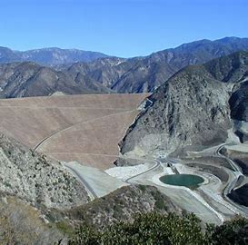
Key FVA Recommendations
Explore maximum water level of 510 to 512 ft msl
Continue to develop and tailor AR tools, observations, and precipitation forecast products to the Santa Ana River watershed to support real-time operations at Prado Dam
Consider coordinated FIRO operations with upstream Seven Oaks Dam
Work to evaluate potential improvements and advances in meteorological and hydrologic forecasting models should continue for additional FIRO benefit.
Seven Oaks Dam

