Slide 1
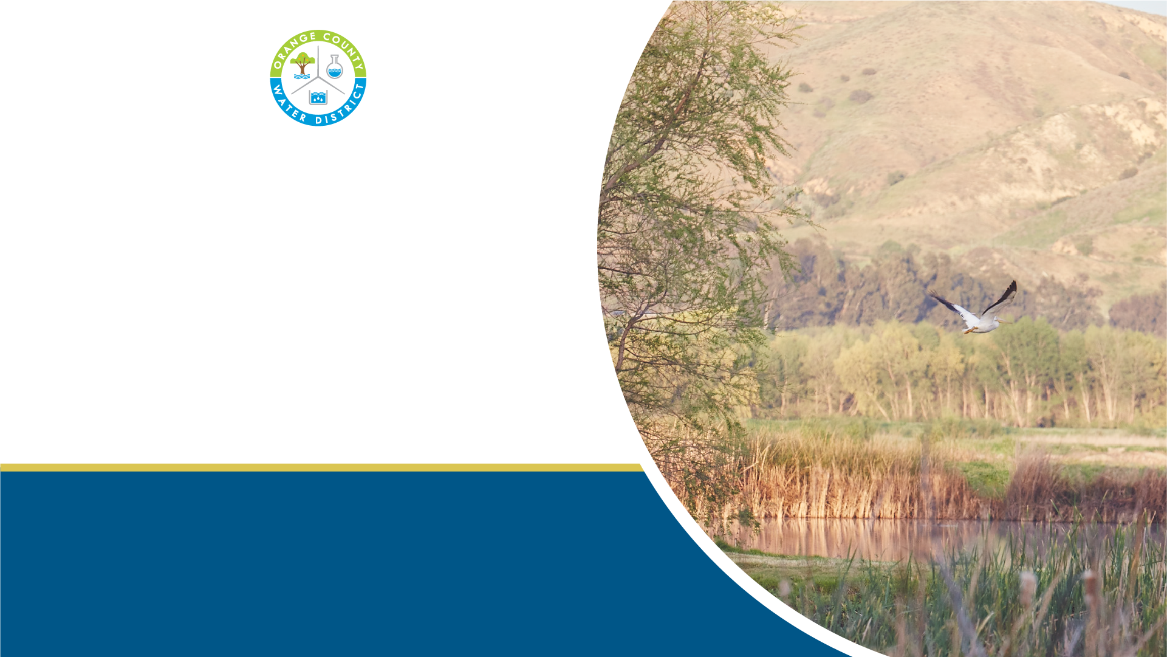
Future of the Prado Wetlands
Sheryl Parsons
Director of Natural Resources
Board of Directors Meeting
August 6, 2025
Notes:
Good evening, I’m here to give an update on our plans for the future of the Prado wetlands. Our Executive Director of Planning and Natural Resources, Lisa Haney, presented our rough plans a few months ago, and we’ve taken that time to refine those efforts, as you will see today.

Slide 2
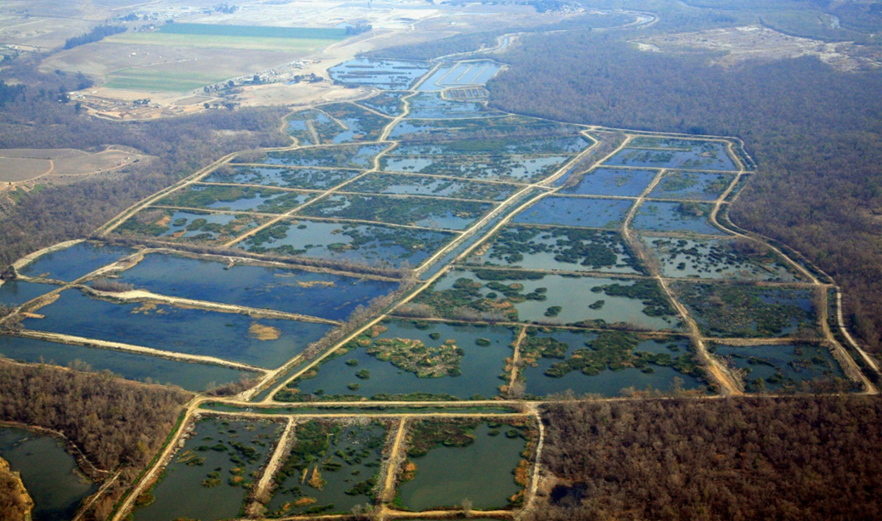
Prado Constructed Wetlands
Background:
45-pond constructed wetlands in Corona
Converted in 1990s to remove nitrogen from SAR
Water is recharged downstream of Prado Dam
Requires large maintenance commitment from operations staff
Notes:
For some quick context, the Prado Constructed Wetlands are a series of 45 treatment ponds, owned and operated by OCWD, in Corona out in Riverside County. They were originally built as duck hunting ponds, but in the 1990s, they were converted into treatment wetlands to remove nitrogen from the Santa Ana River before it is recharged downstream in Orange County.
Over the years, we’ve learned that to optimize nitrogen removal, the ponds need to be maintained at a ratio of about 50% vegetation, 50% open water. This requires a large maintenance commitment from our Operations staff, as they must clear out a third of all the ponds each year in a very tight maintenance window, bracketed by the end of nesting season (which can last as long as September 15th) on one end and by the start of the rainy season (which can start as early as October) on the other.

Slide 3
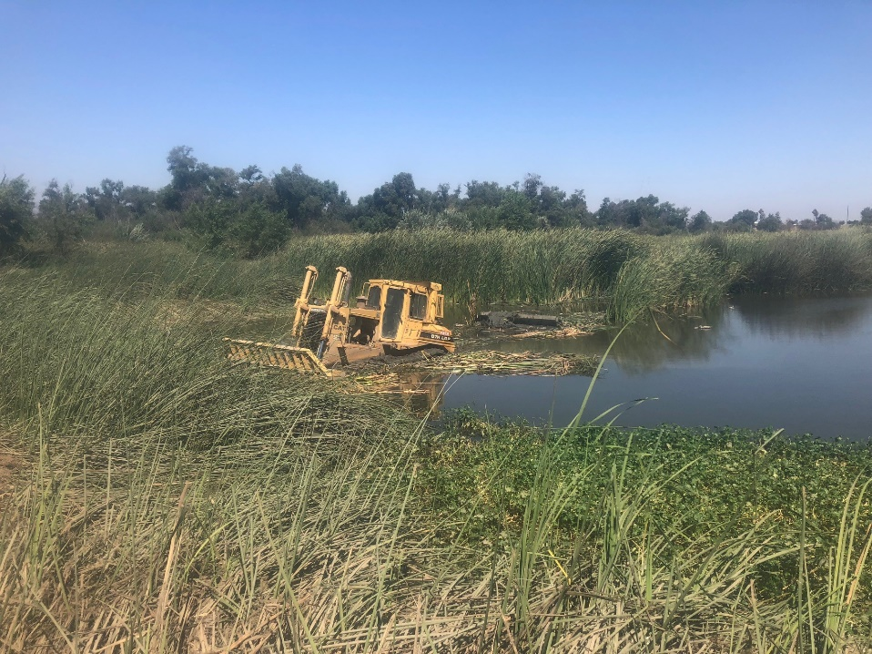
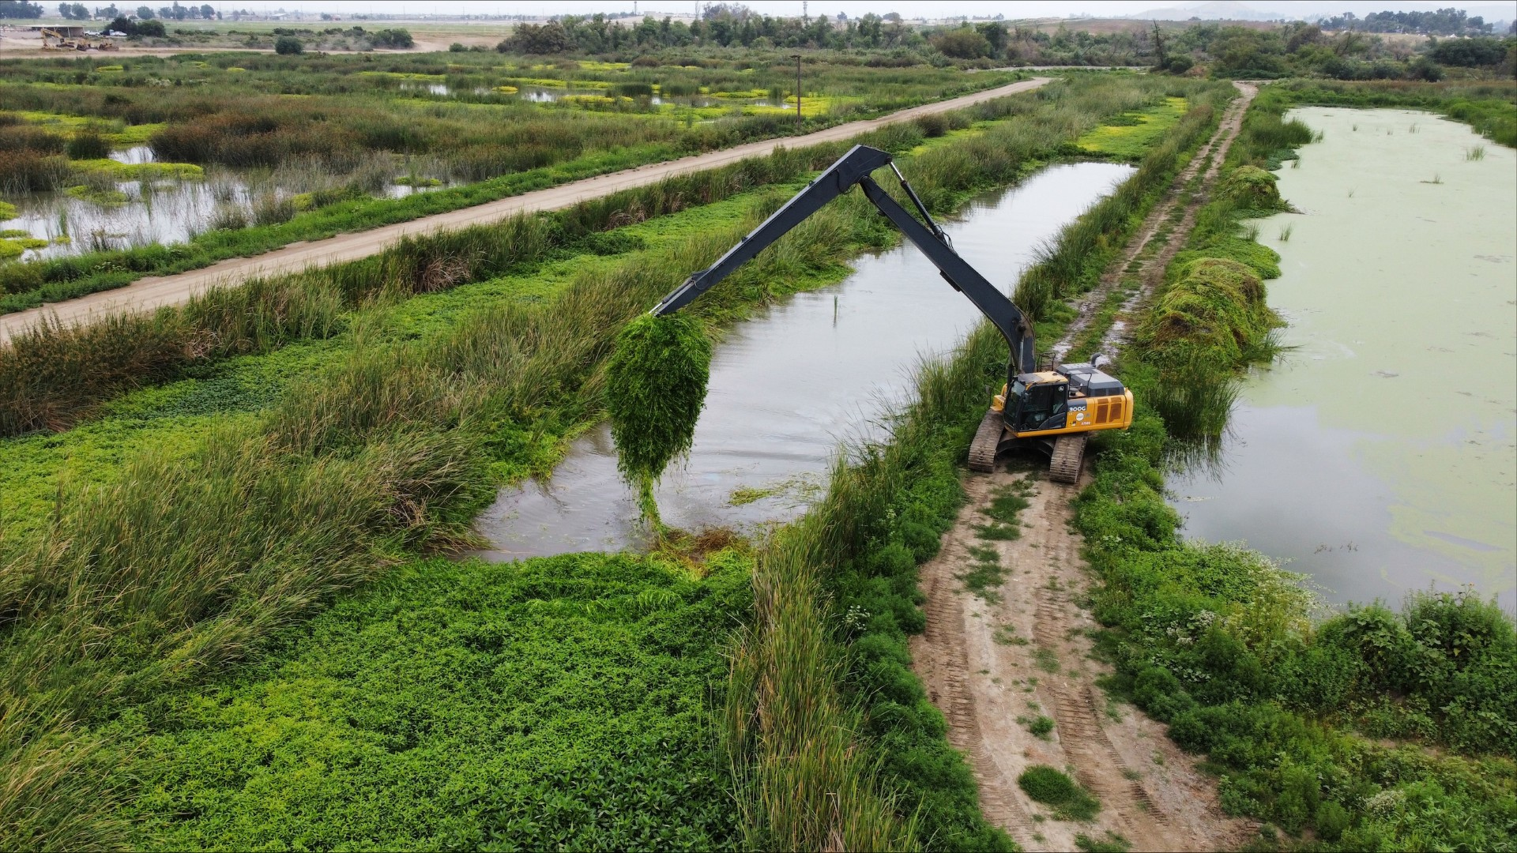
Prado Maintenance
Narrow window of opportunity results in “all hands on deck” approach to maintenance in the fall
Staff:
7 operators
1 supervisor
Equipment:
Excavators, bulldozers, rock trucks, water truck, motor grader
Pulled from doing recharge work in Anaheim
Operations staff unable to complete all recharge facilities maintenance tasks
If Prado maintenance demands were decreased, Operations staff could further refine recharge operations, resulting in millions of dollars worth of additional water recharged
Notes:
This narrow window of opportunity results in an “all hands on deck” approach to maintenance of the ponds in the fall. Though normally Prado is staffed with 1 supervisor and 2 operators, an additional 5 operators are pulled from our Anaheim crew to help clear out the vegetation as soon as possible. There’s a large equipment cost as well, including some equipment that must be rented specifically for this clearing. These resources are pulled from doing recharge work in Anaheim, leaving the Operations team unable to complete all recharge facilities maintenance tasks, meaning recharge operations are not optimized, resulting in water being lost to the ocean. If Prado maintenance demands were decreased, Operations staff could further refine recharge operations, resulting in millions of dollars worth of additional water recharged.

Slide 4
Nitrogen loads have significantly declined (dairy closures, water recycling)
Modeling shows wetlands no longer needed to meet nitrogen standards
Projected Basin Nitrate Range: 2.85-2.78 mg/L
Current Ambient Basin Nitrate: 2.95 mg/L
Notes:
And we do have an opportunity to reduce maintenance demand that stems from the fact that nitrogen levels within the watershed have significantly declined over the past three decades, largely due to the closure of local dairies and improvements in upstream wastewater recycling. Recent modeling confirms that we no longer need to operate the ponds for nitrogen removal to meet water quality standards downstream. This creates an opportunity to rethink how we operation and maintain the Prado Wetlands in order to reduce the maintenance burden on our staff, while preserving the site’s economic, educational, and research values.
**historically regularly between 3-6 mg/L, but up to 12 mg/L

Slide 5
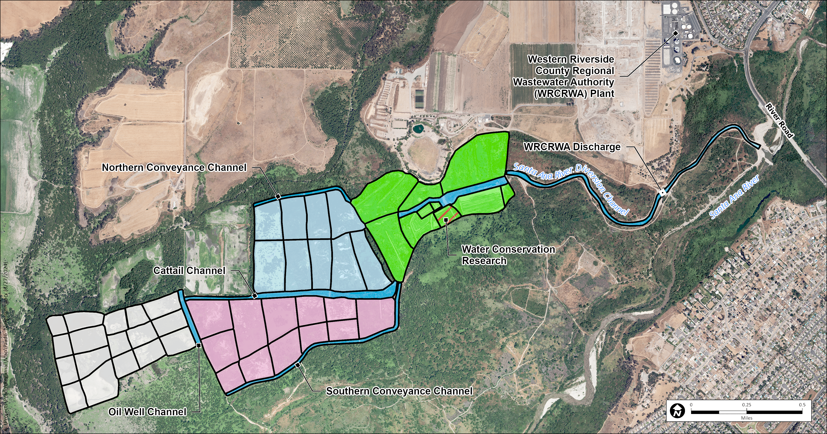
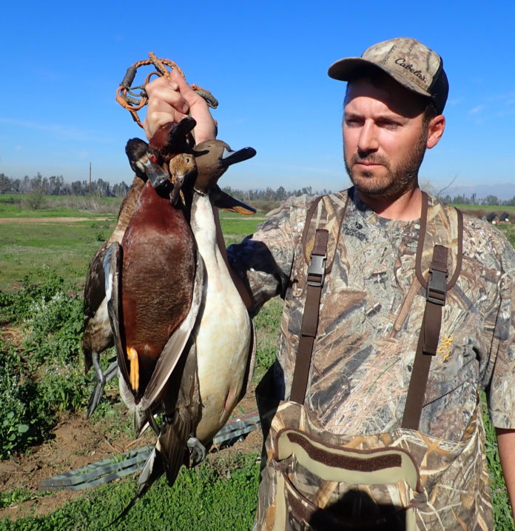
Duck hunting continues through lessee
Lessee takes on pond maintenance of North, South, and West ponds w/ OCWD biological oversight (starting 2026)
East
North
OCWD maintains operation and maintenance of the East ponds, which will transition away from nitrogen treatment.
South
West
Notes:
However, while we no longer need to operate the wetlands for nitrogen removal, the wetland ponds still require maintenance for duck hunting. We do have a lessee who operates a duck hunting concession within the wetlands, and though we are eager to reduce our operational burden, we are still mindful of their needs. So our solution has been to allow the lessee to take over the maintenance of the ponds. Starting in 2026, the lessee will rent their own equipment to maintain the north, south, and west ponds in a way that meets their hunting needs, but aligns with OCWD’s environmental permit requirements. All proposed work requires OCWD approval and will be supervised by OCWD natural resources biologists to ensure protection of riparian habitat and nesting birds. Maintenance of access roads and repairs and maintenance of any water infrastructure will still be conducted by OCWD, but the maintenance demand on the OCWD Operations crew will be significantly lightened. But, I’ve mentioned they’ll be taking over the North, South, and West ponds – what will happen to the East Ponds. OCWD will maintain operation of the East ponds, but will transition them away from nitrogen treatment and into a design that supports a decreased maintenance demand and can help make touring of the Prado Wetlands a more engaging and comfortable experience for our visitors

Slide 6
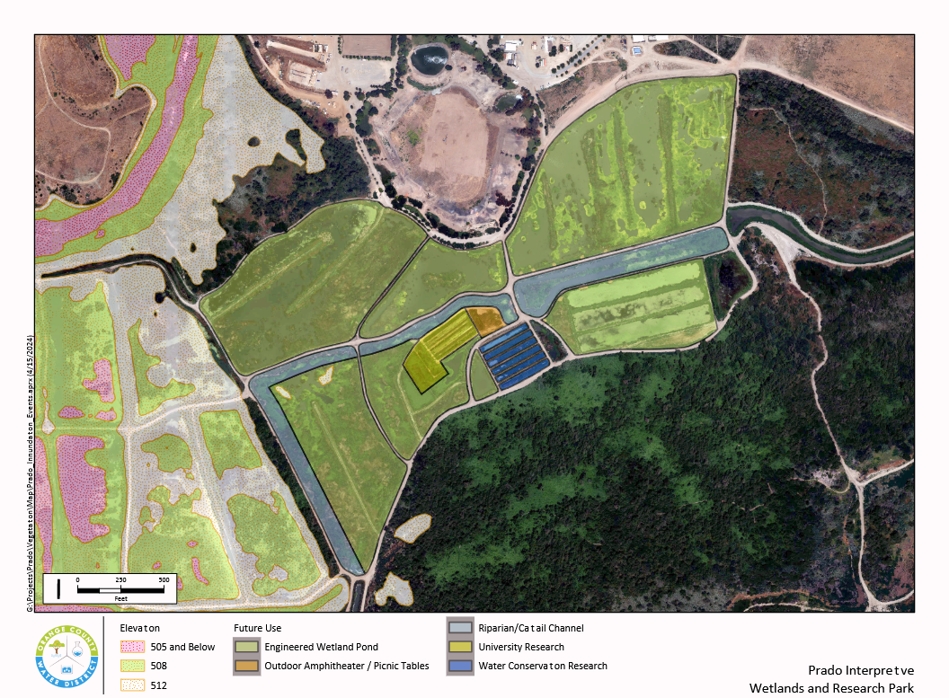
Future of the Wetlands
Goals for the East Ponds:
Further decrease OCWD maintenance needs
Provide space for water conservation research for UCI
Public Affairs-led expansion of educational and interpretive infrastructure
Notes:
We have three main goals for how we would like to approach the East Ponds, and I’ll break them down further on their own subsequent slides. First, we’d like to find a way to further decrease OCWD maintenance needs. Even if our lessee is maintaining most of the ponds, these east ponds will still need that full maintenance effort – it would take less time and resources, but it would still be occurring, so our first goal is to decrease that level of maintenance even further. The second goal is to provide space for water conservation research – research that could help justify holding more water behind Prado Dam to our regulatory agencies. And our third goal is to expand our educational and interpretive infrastructure out at Prado to make tours more engaging for our visitors as well as upgrading amenities. Let’s look at each of these goals a little bit closer and talk about how we plan to meet them.

Slide 7
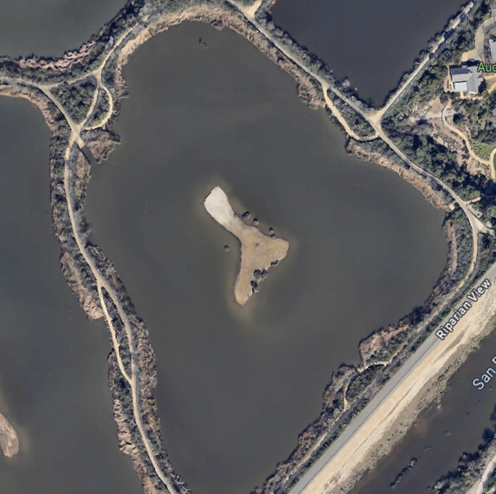
1. Further Decrease OCWD Maintenance Needs
Example
By increasing depth of ponds, we can limit vegetation growth
OCWD operations staff to spend less time on vegetation management of ponds
Notes:
First, we’re looking to further reduce maintenance demands by redesigning the ponds’ shape and depth to discourage rapid vegetation growth. You can do this by making the slopes steeper and the ponds themselves deeper – too deep for wetland vegetation to grow. This would require significantly less maintenance each year, while still maintaining an aesthetic appearance of the ponds. This would require a bit of upfront engineering and construction, but OCWD operations staff would again be able to spend more time down in OC, maintaining those core recharge facilities, getting more water into the ground.

Slide 8
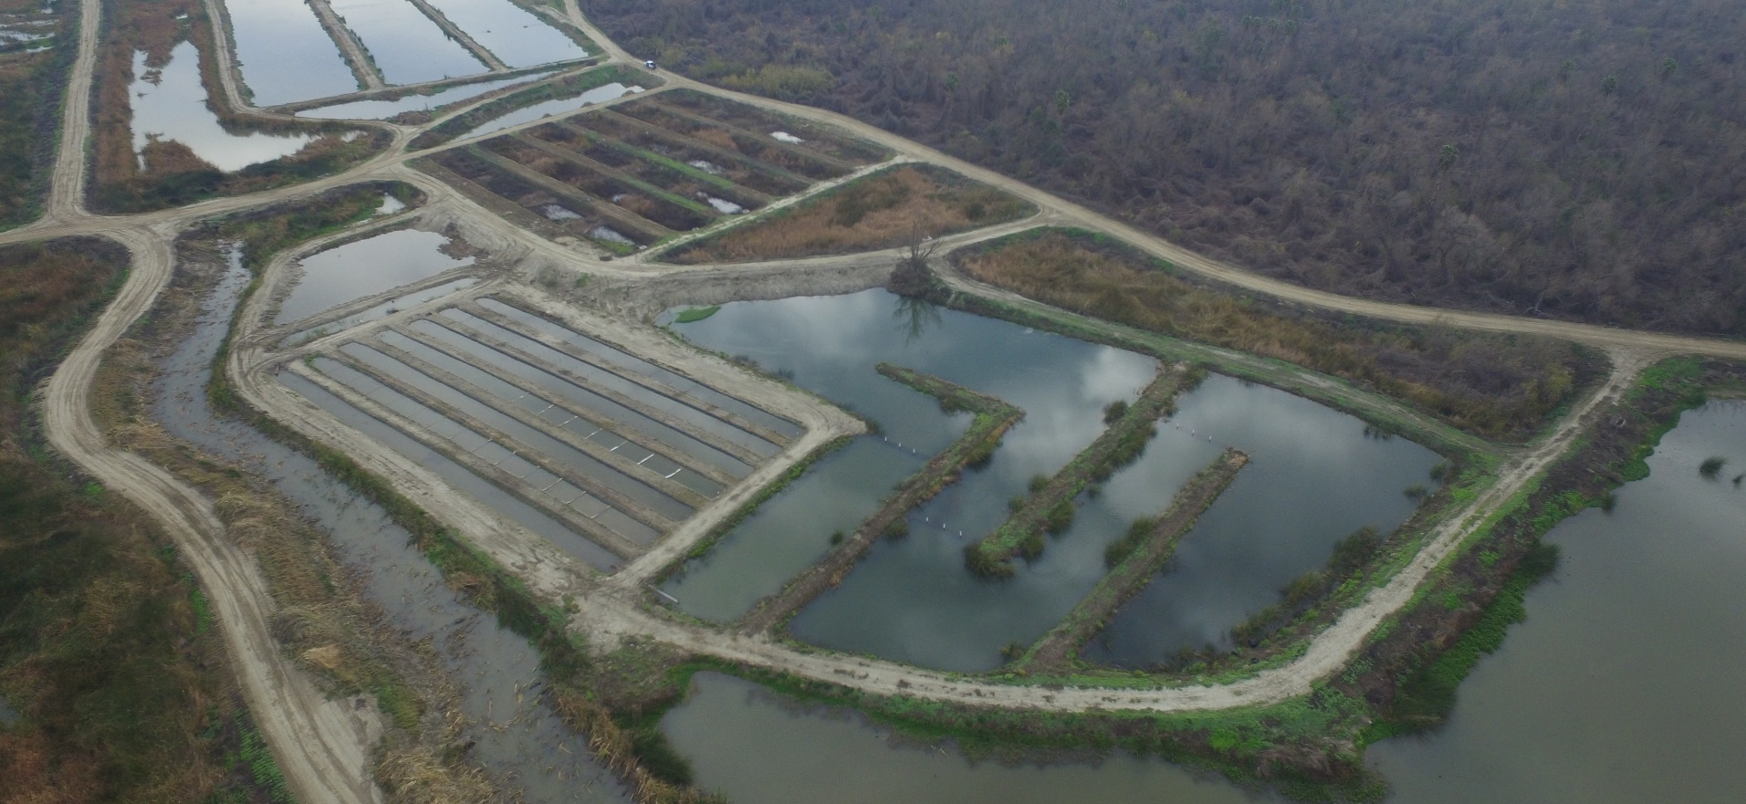
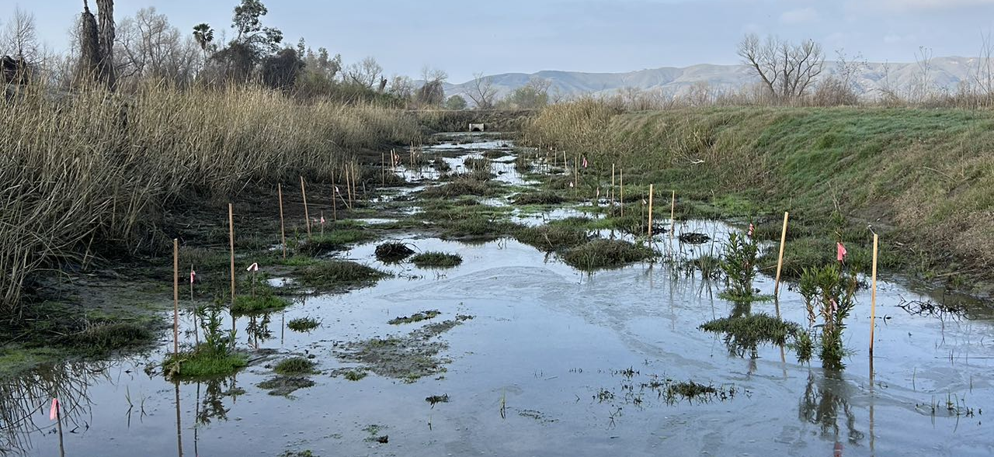
2. Provide Space for Water Conservation Research for UCI
Capstone projects to support increased water conservation
Example – Effects of inundation on riparian habitat study
Notes:
Second, we will provide space for water conservation research, specifically in renewing our partnership with UCI’s Masters in Conservation and Restoration Science capstone program. This means provide space for research such as their ongoing project to study the effect of inundation on riparian habitat, which will help inform management of water levels behind Prado Dam. Water storage behind Prado provides 40-45% of our water supply, but maintaining the benefit requires us to protect the riparian habitat and endangered species in the area. This research will play a key role in demonstrating to regulatory agencies that our operations have minimal environmental impact.

Slide 9
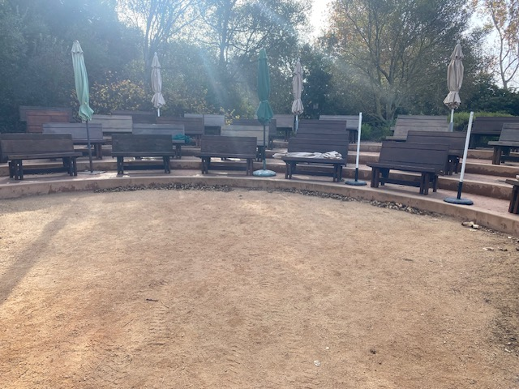
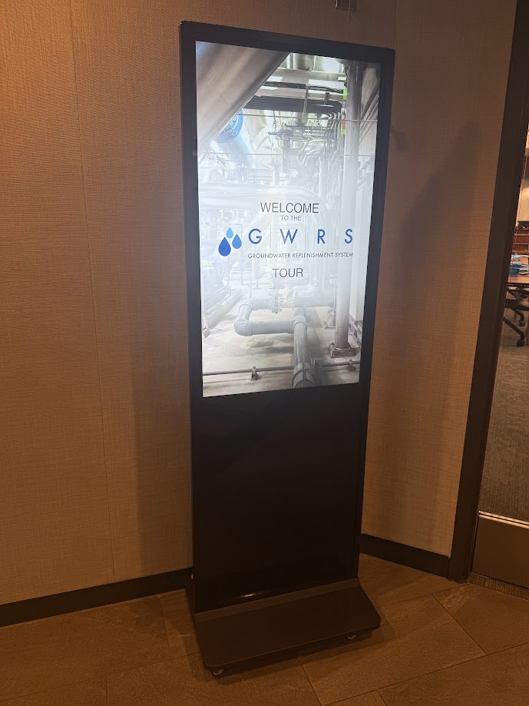
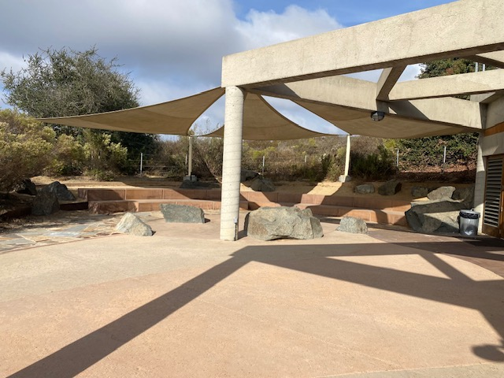
3. Educational and Interpretive Infrastructure
Public Affairs-led
Shade structures
Improved seating
Outdoor audiovisual displays
Actively promote OCWD’s Natural Resources Program
Notes:
Third, in collaboration with our Public Affairs team, we aim to expand the site’s educational and interpretive infrastructure. Currently at Prado, we don’t have anywhere for large groups to gather for tours and sit in the shade – we have three plastic picnic tables that are a little worse for wear and some benches and a shade structure that falls apart in the wind and requires frequent repairs, or any audiovisual capabilities to give presentations or show videos – that capability is limited to either our conference room which can fit maximum 12 people, or to a small wheelable TV that is only good for small groups. In terms of amenities, we’ve got one portapotty or the staff bathrooms for toilets, and drinking water is limited to the water cooler in the employee breakroom. And our educational features are, shall we say, a bit low budget, limited to a few labels on our taxidermy or in our native plant garden and some homemade signs by our interns over the years. The facilities could really use an update in order to accommodate larger groups – such as our Groundwater Adventure Tour – which will make it easier for all our key stakeholders to see OCWD’s work first hand, and provide a forum to really brag about OCWD’s Natural Resources Program and it’s environmental stewardship efforts. We’ve got a great story about how we’ve managed to provide safe clean drinking water to so many people without harming the environment, and we need a great space to tell that story.

Slide 10
Future of the Wetlands
Goals:
1. Further decrease OCWD maintenance need
2. Provide space for water conservation research for UCI
3. Public Affairs-led expansion of educational and interpretive infrastructure
Next Steps:
Explore opportunities for grant support
Engage consultant for conceptual design of enhancements
Improved seating, shading, and outdoor audiovisual displays
Decrease maintenance needs by redesigning ponds
Water conservation research ponds
Notes:
Next steps: For our first goal of decreasing OCWD maintenance demand by redesigning the ponds – we’re going to hold off on doing that for a while and reassess in a year. This gives us time to assess the changes in maintenance in the North, South, and West ponds and confirming our modeling estimates that water quality would not be affected, before jumping in with both feet into completing changing operations of the entire wetlands in one go. This also gives us time to explore opportunities for grant funding, if available. In terms of water conservation research, we commit to not changing these research ponds in blue and yellow for the time being and continuing conducting research in partnership with UCI that could benefit our water conservation goals. Thirdly, we’re looking to engage a consultant to develop a conceptual design plan for the improvements and enhancements to our educational and interpretive infrastructure and amenities.

Slide 11
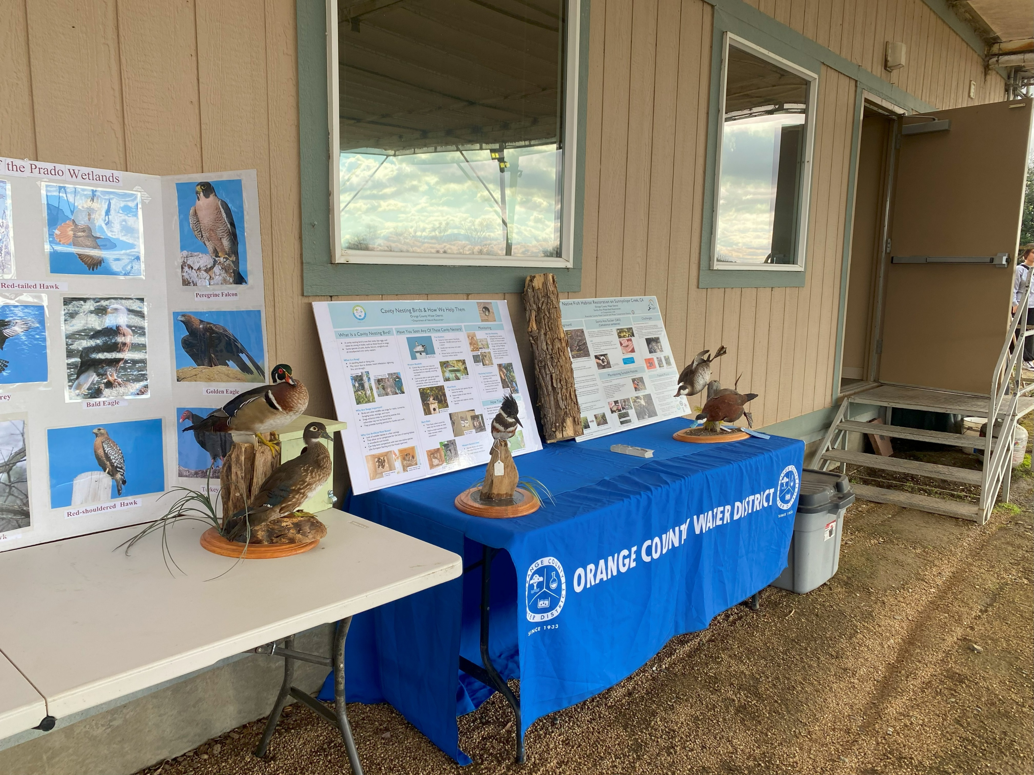
Consultant RFP Scope of Work
Enhance educational and interpretive infrastructure at Prado Wetlands and Field Office.
Improve visitor experience by enhancing seating and providing shading, restrooms, and water stations to improve comfort and safety.
Estimated Design Cost: $60,000-$100,000
Notes:
We’ve drafted a scope of work which was included in the board packet this evening which asks for an architectural consultant to design elements that would enhance 1) the educational and interpretive infrastructure at the Prado Wetlands and Field office to include improved signage on topics relevant to OCWD operations, including the historical use of the wetlands as nitrogen treatment ponds, the groundwater recharge process and the role that Prado Dam plays in that (such as FIRO and holding water behind the Dam), invasive species removal like Arundo donax and how removing that invasive plant provides us with additional drinking water, and other environmental stewardship efforts, such as our work bringing back the least Bell’s vireo, protecting the Santa Ana sucker and planting habitat behind Prado Dam. This could also include improved usage of the taxidermy displays that we have at Prado and the native plant garden on site. Additionally, we’d like them to design improvements to amenities at the site, such as improved seating and shading, outdoor bathroom facilities, water bottle refilling stations and outdoor audiovisual capabilities, to improve the comfort and safety of our visitors. We’re estimating these design costs to be between $60,000 and $100,000 and plan on looking for grant funding to help pay for the cost of implementation and construction of these designs.

Slide 12
Recommendation
Discontinue use of North, South, and West ponds as treatment ponds; and
Issue Request for Proposals (RFP) for a consultant to develop a conceptual design plan for enhancements that support and expand the site’s touring capabilities.
Notes:
That brings us to our recommendations for today which are to allow our lessee Mike Raahauge Shooting Enterprises to maintain the North, South, and West Ponds, and to issue an RFP for a consultant to develop a conceptual design plan for enhancements that support and expand the site’s touring capabilities.
Thank you, and I’m happy to take any questions

Slide 13
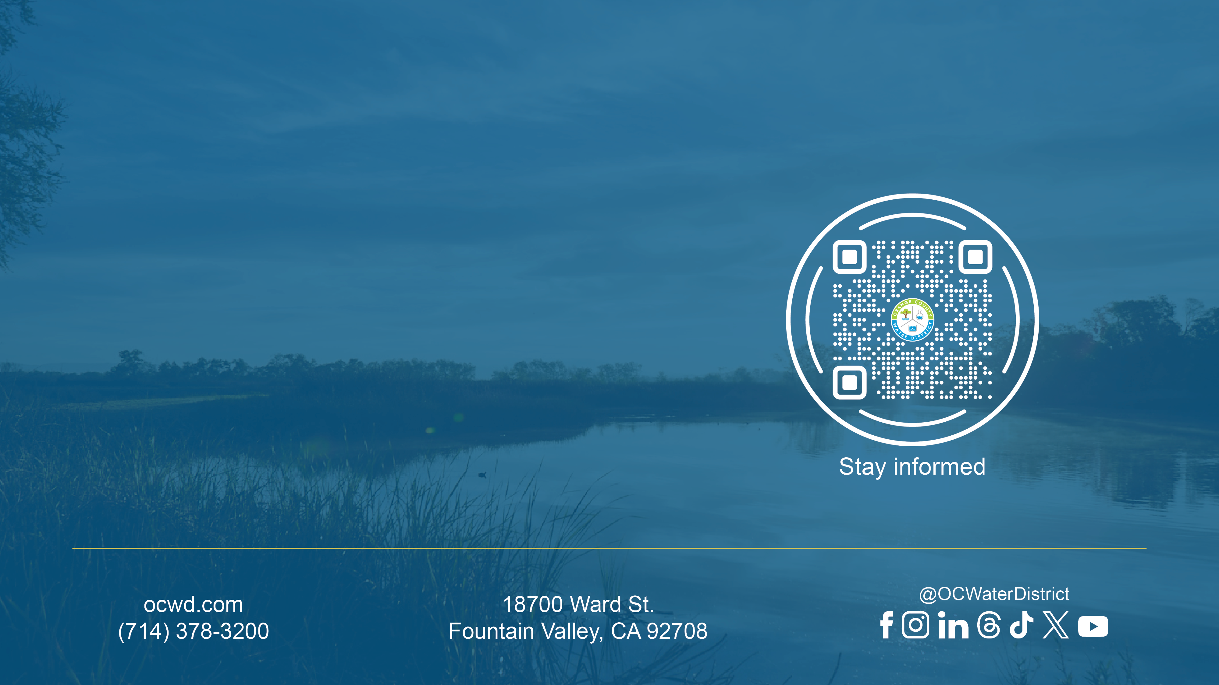
Thank You!
Sheryl Parsons
Director of Natural Resources
Orange County Water District
sparsons@ocwd.com
Notes:
External presentations – use this closing slide. Updated May 29, 2024 with the addition of the QR code (newsletter sign-up)
This is sized to fit and scan in the OCWD board room

