Slide 1
PFAS Treatment Systems Update
Design and Construction

Slide 2
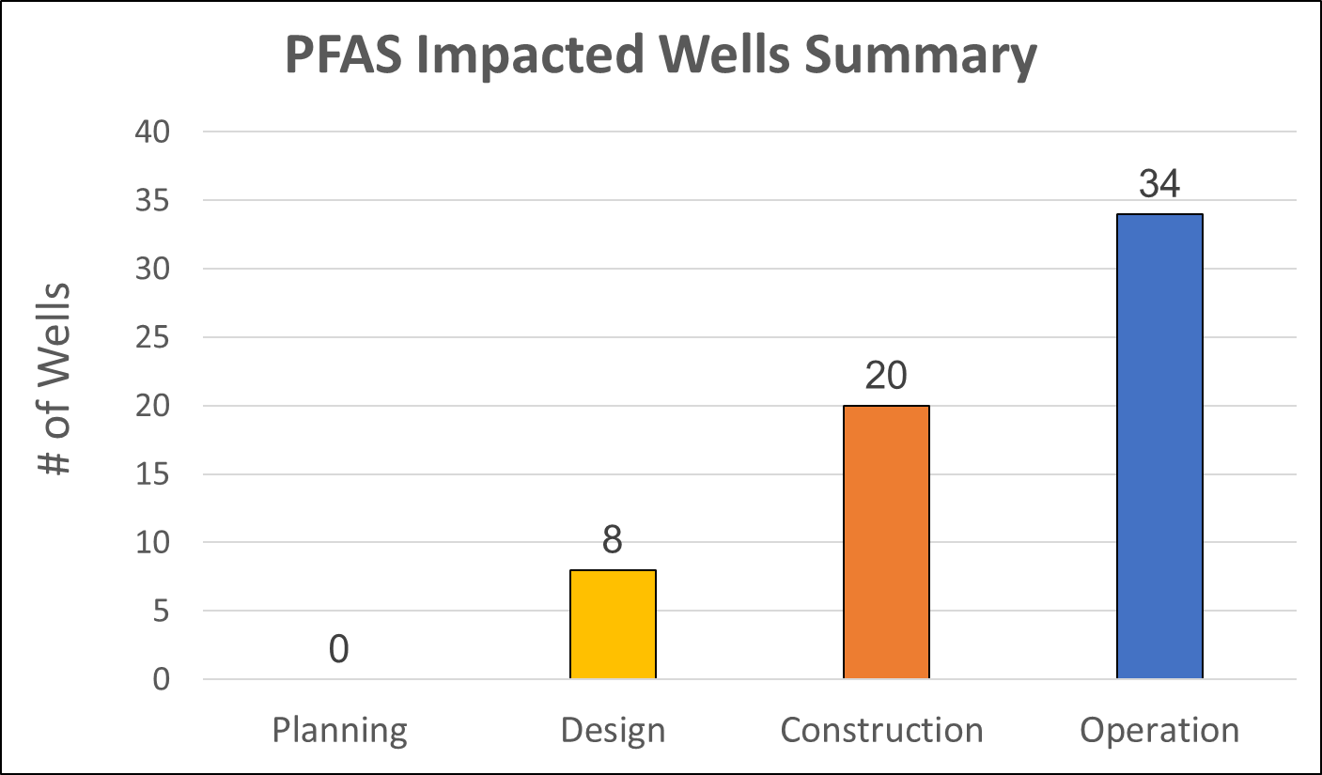

Slide 3
62 Wells : 34 Operational and 28 Design/Construction
Design
Construction
Out to bid

Slide 4
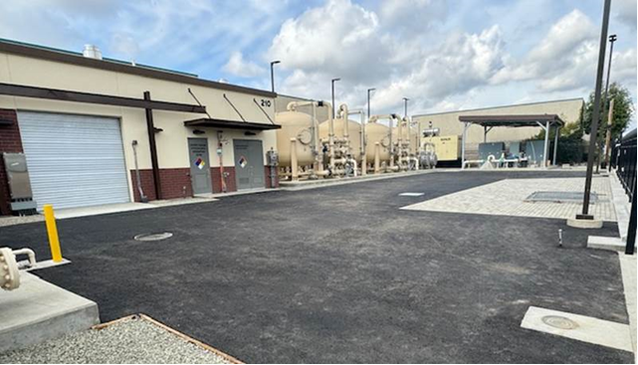

Slide 5
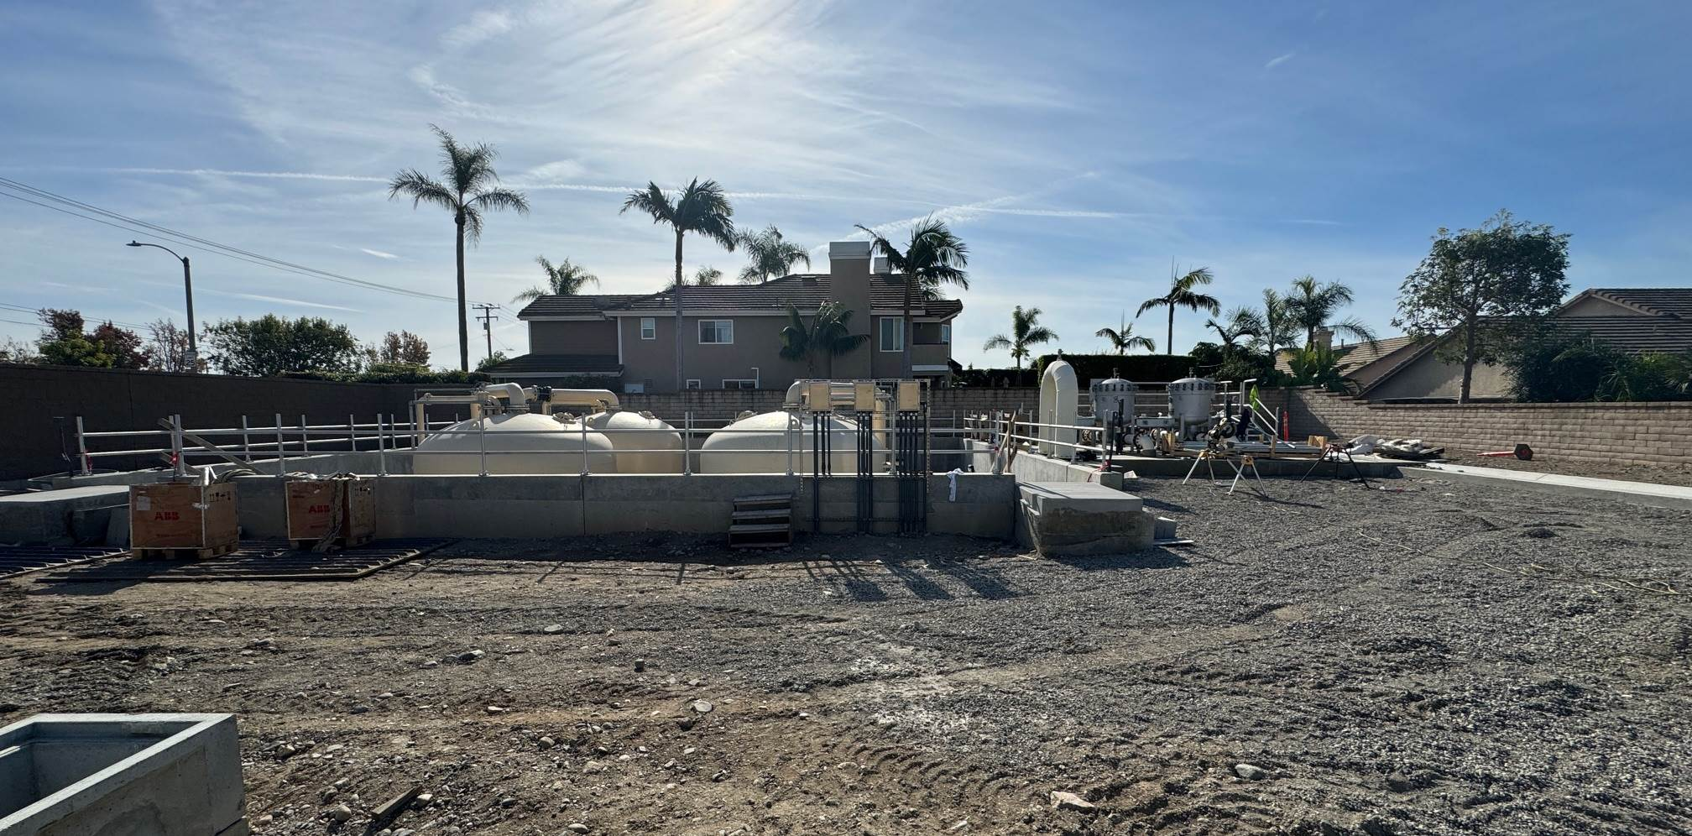
Need irwd pic

Slide 6
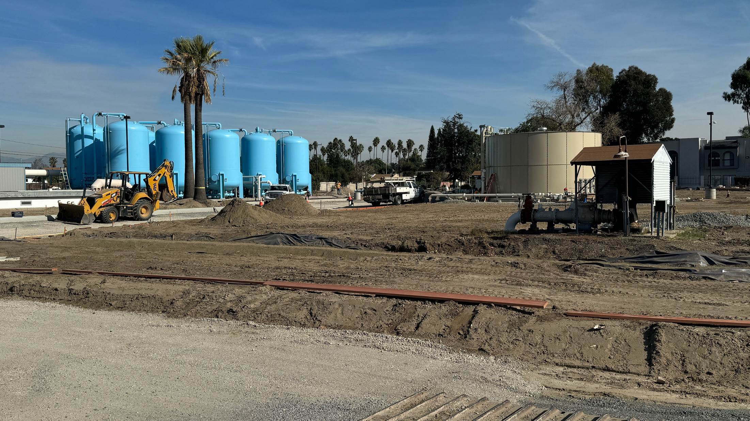

Slide 7
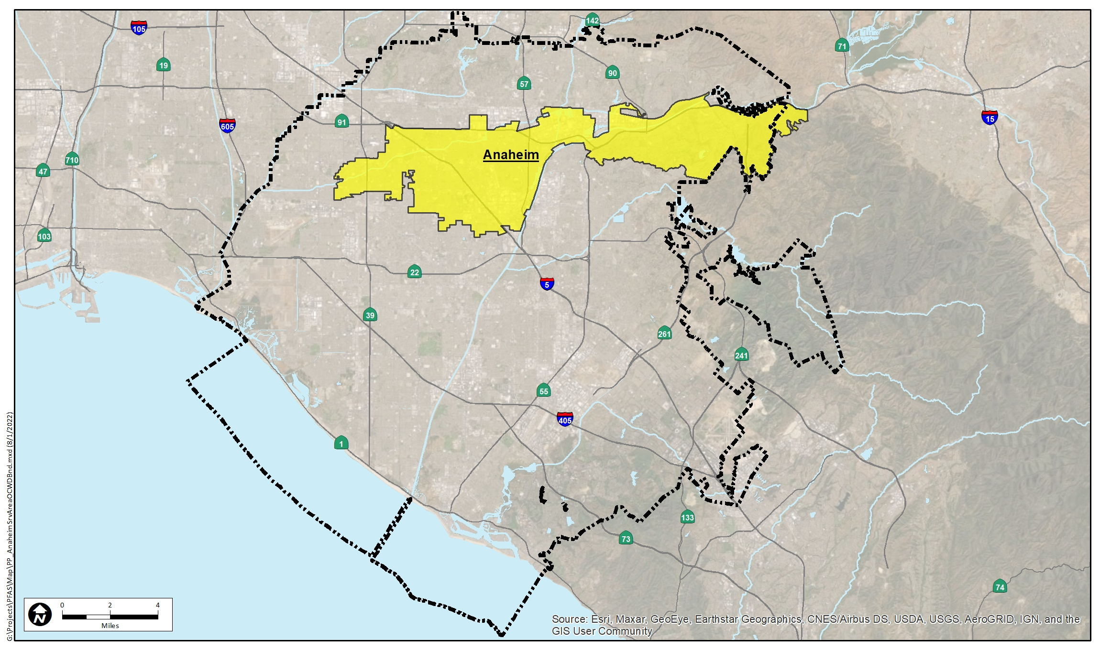

Slide 8
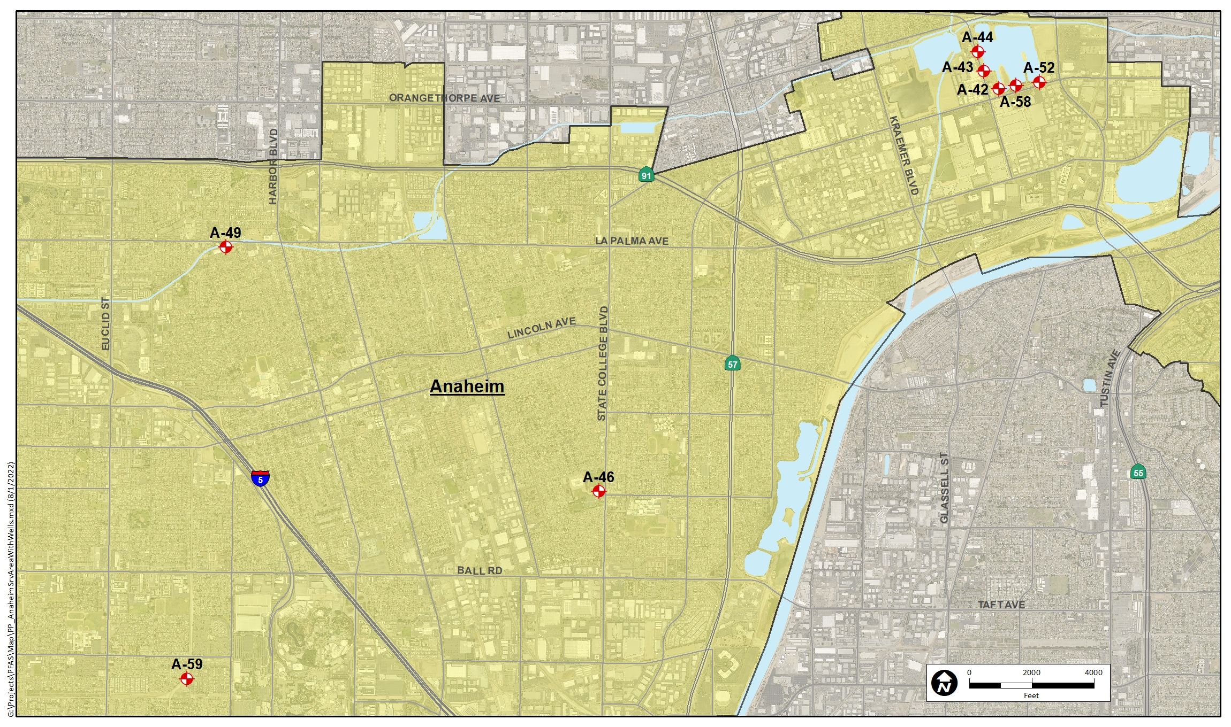
Linda Vista
La Palma
Boysen Park
Anaheim Phase A
Energy Field

Slide 9
Boysen Park
Well 46 rehab is expected to be completed this month and the VFD is expected to arrive then as well. CDM is working on electrical in order to install the VFD when it arrives. Commissioning to begin in December.

Slide 10
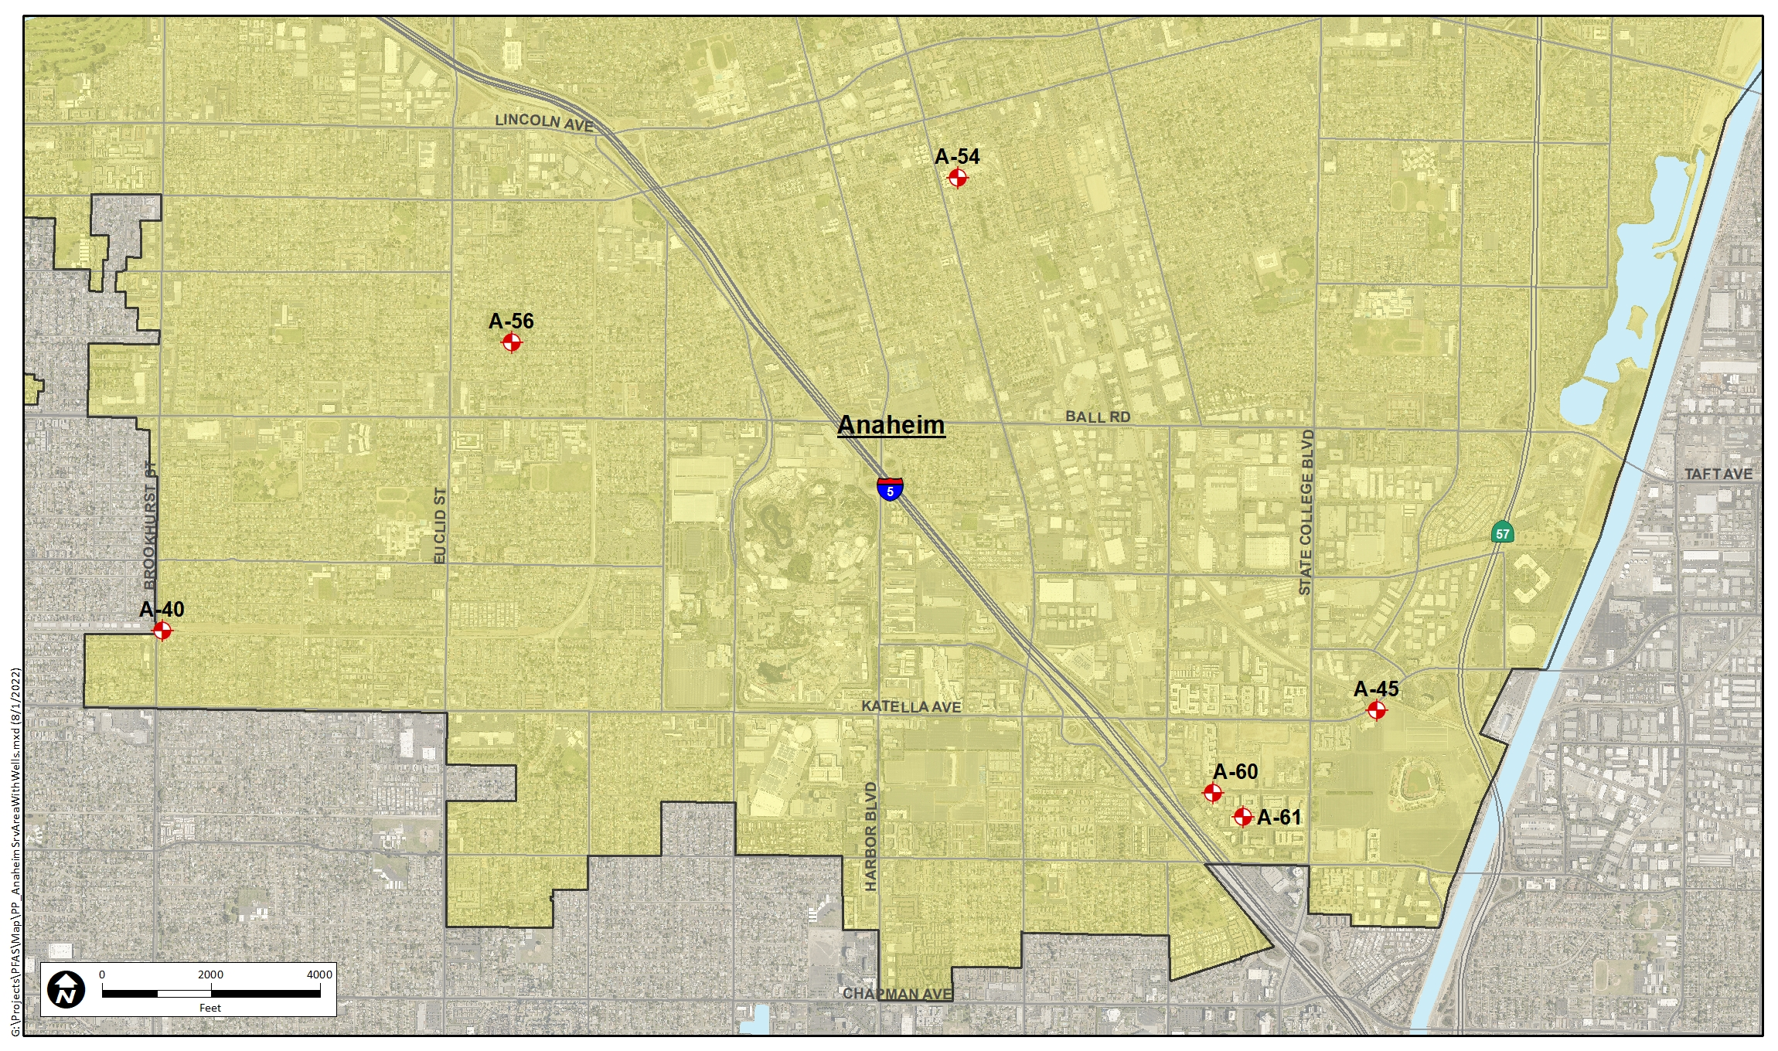
Downtown
Willow Park
Brookhurst
Katella
Santa Cruz
Anaheim Phase B

Slide 11
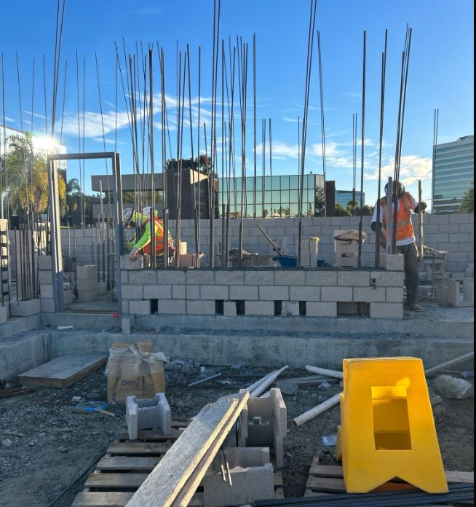
Santa Cruz
Wells 60 and 61 building construction is underway and installation of electrical equipment continues. Work on the 24-inch Orangewood pipeline continues.

Slide 12
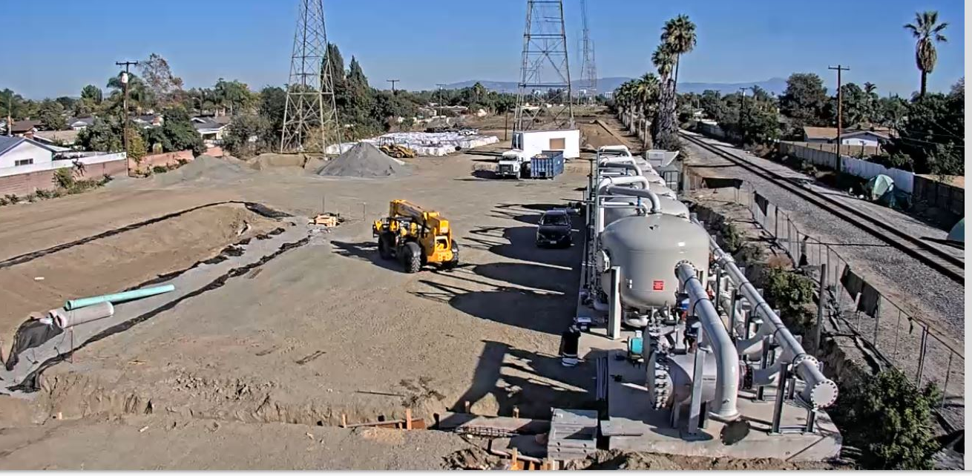
Brookhurst
Well 40 rehab has begun. Installation of underground utilities and work on the building modifications continues
Well 40 rehab has begun. Installation of underground utilities and work on the building modifications continues.

Slide 13
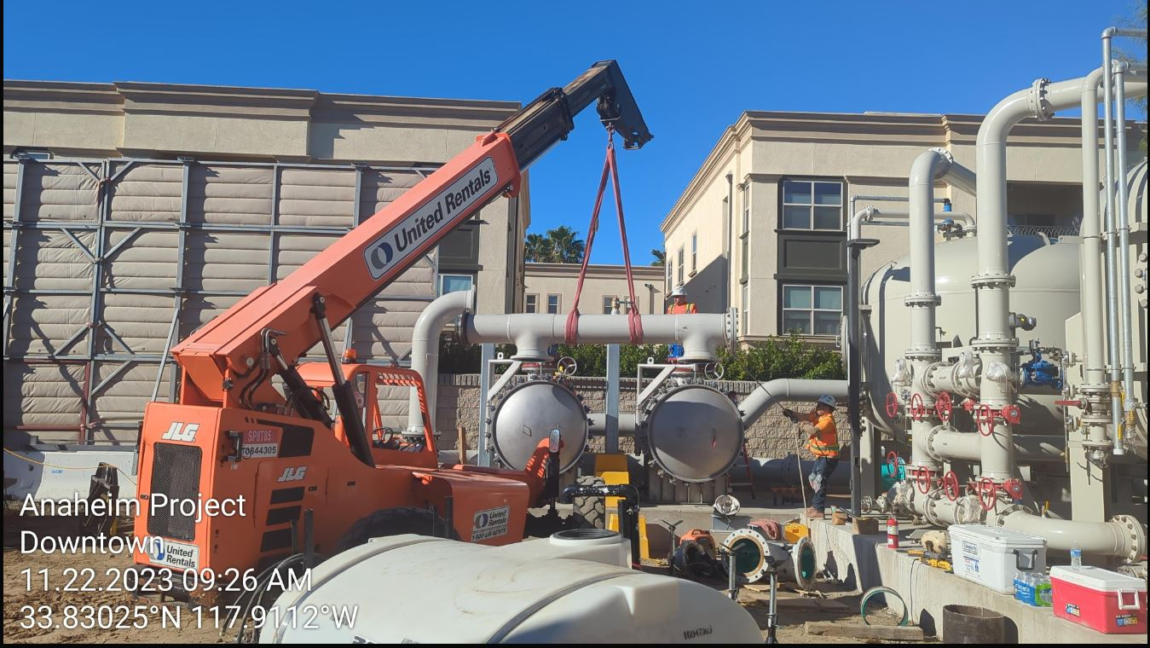
Downtown
Above ground piping and appurtenance installation continues. Electrical work continues.

Slide 14
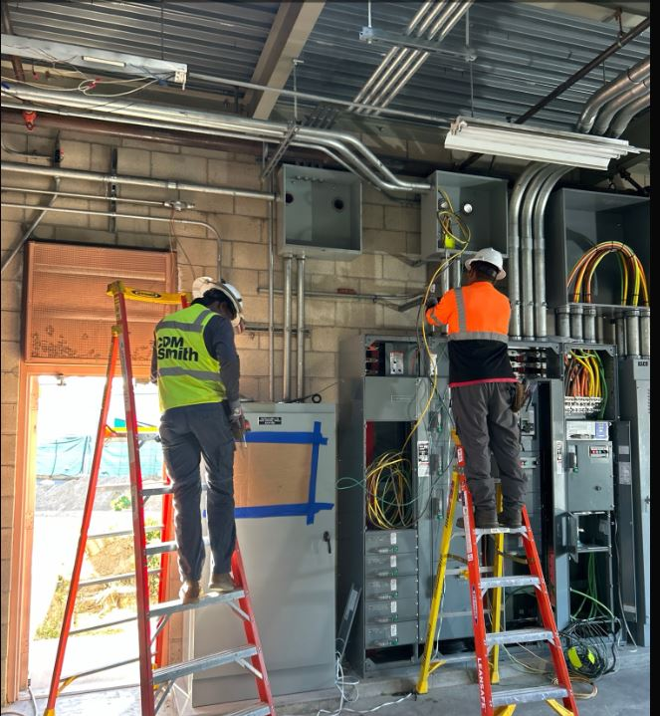
Katella
Installation of electrical equipment and other utilities continues.

Slide 15
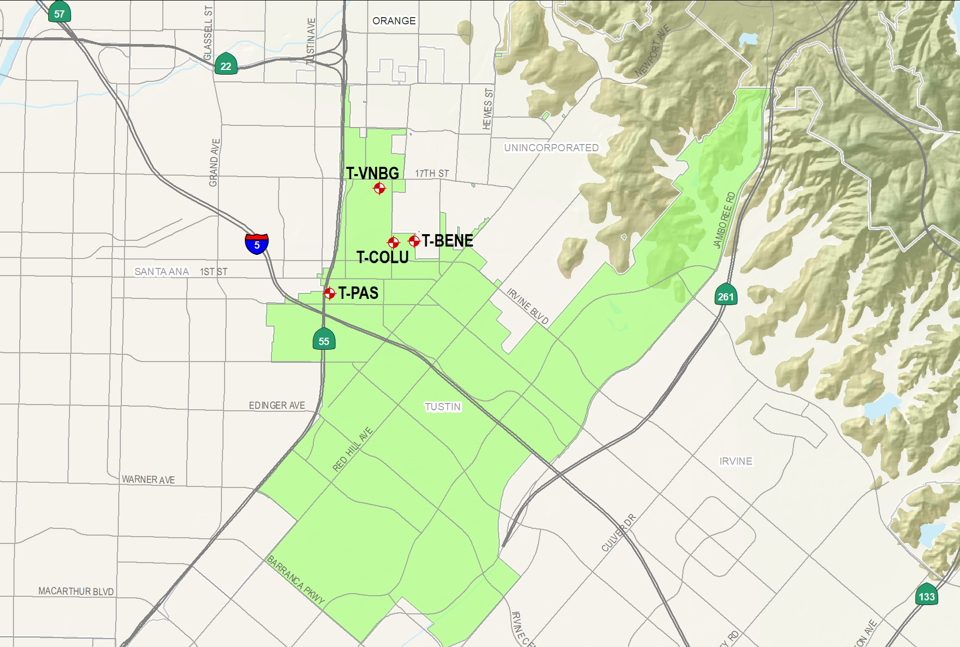
Tustin Wells

Slide 16
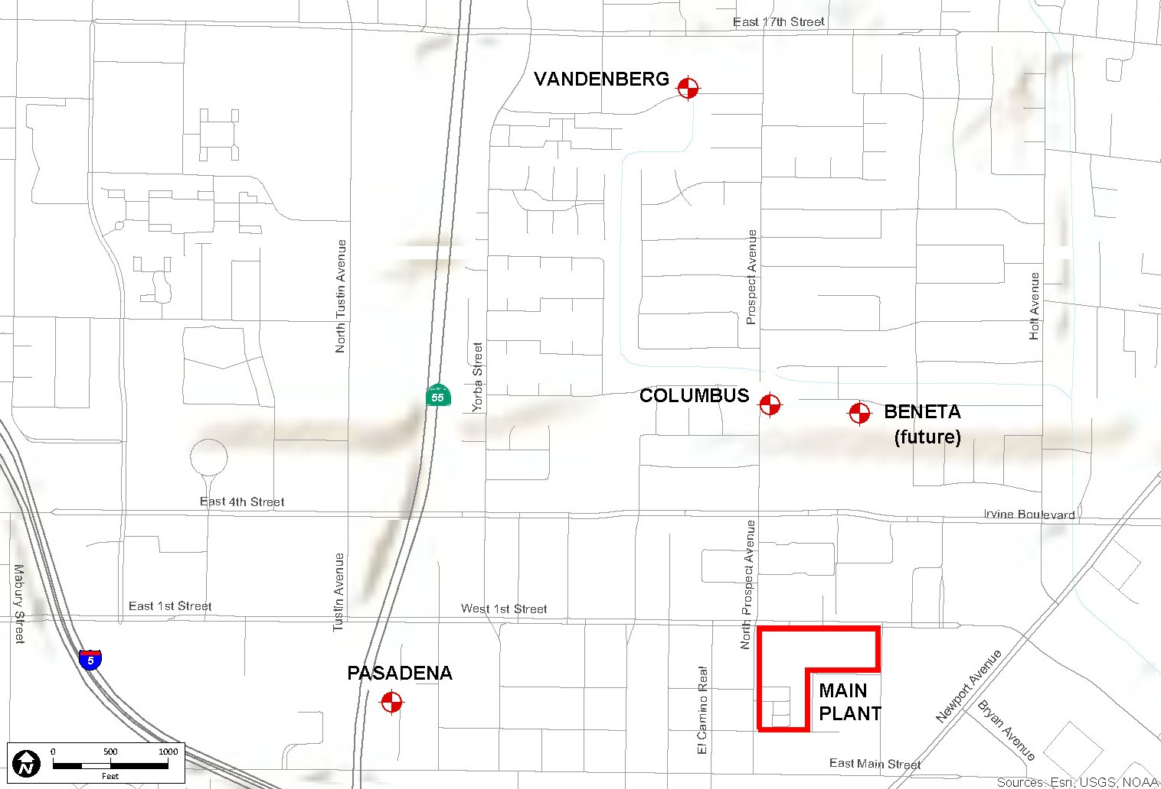
Conveyance Pipeline
Distribution Pipeline

Slide 17
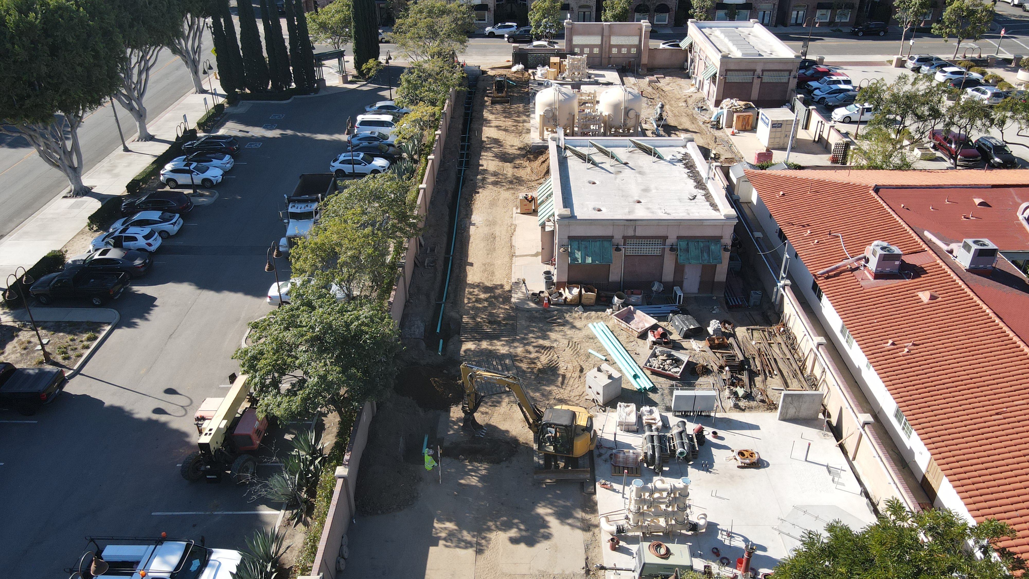
Contractor continued primarily with underground electrical.

Slide 18
Questions?

Slide 19
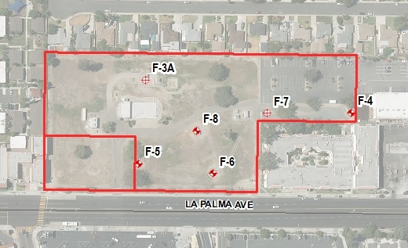
Fullerton Main Plant
F-7A

Slide 20
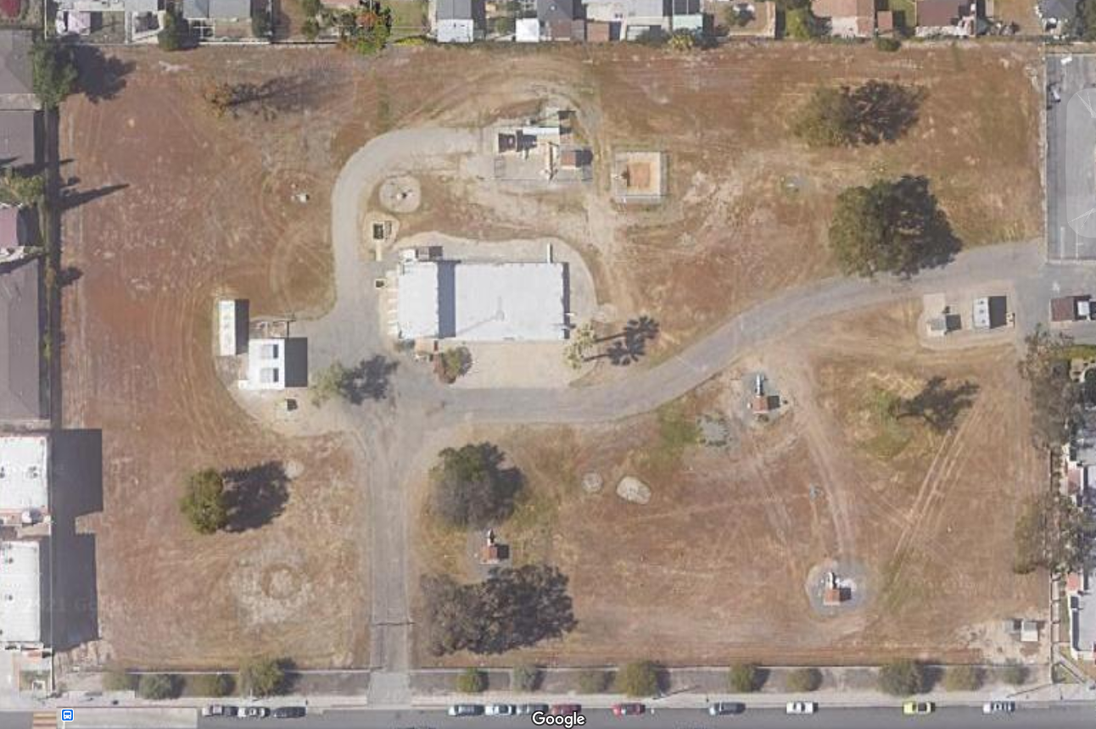
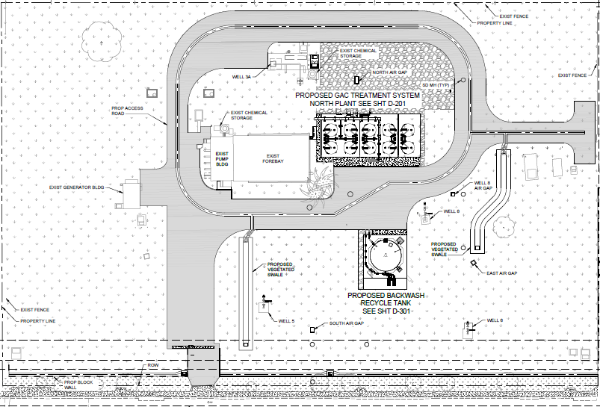
Distribution
F-3A
Distribution
F-7
F-6
New Well 7A
(Separate City Project)
F-5
F-8

