Slide 1
From Strategy to Operations: Asset Management in SCWO & BDWI
Rob Thompson
General Manager
Orange County Water District Board Meeting
February 18, 2026
Notes:
Introduction
Overview

Slide 2
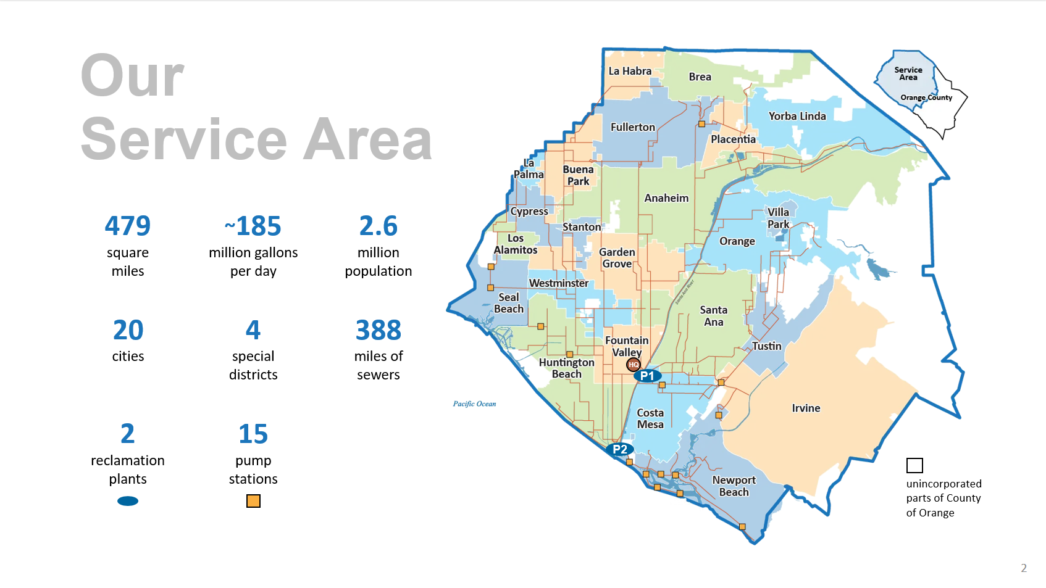

Slide 3
Notes:
OC San has two reclamation Plants: Plant No. 1 in Fountain Valley and Plant No. 2 in Huntington Beach.
We are so proud of our newest accomplishment. The completion of the Headquarters, which took place last spring.
This feat brings together OC San staff from nine different office locations across Plant No. 1 in Fountain Valley into one state-of-the-art building.
The new facility, located across the street from our Plant No. 1, incorporates sustainable elements such as mass timber construction and solar energy, reflecting our commitment to environmental stewardship.
A 220-foot pedestrian sky bridge, the first open-air pedestrian bridge in Fountain Valley, connects the Headquarters to the Plant. This enhances accessibility and operational efficiency.

Slide 4
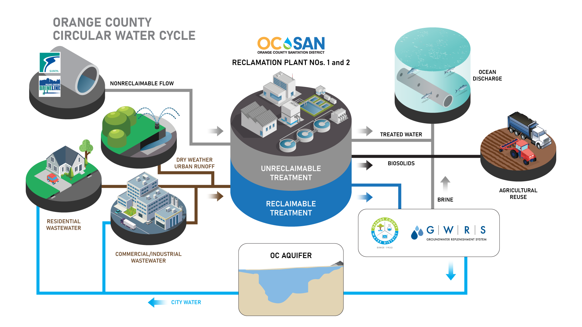

Slide 5
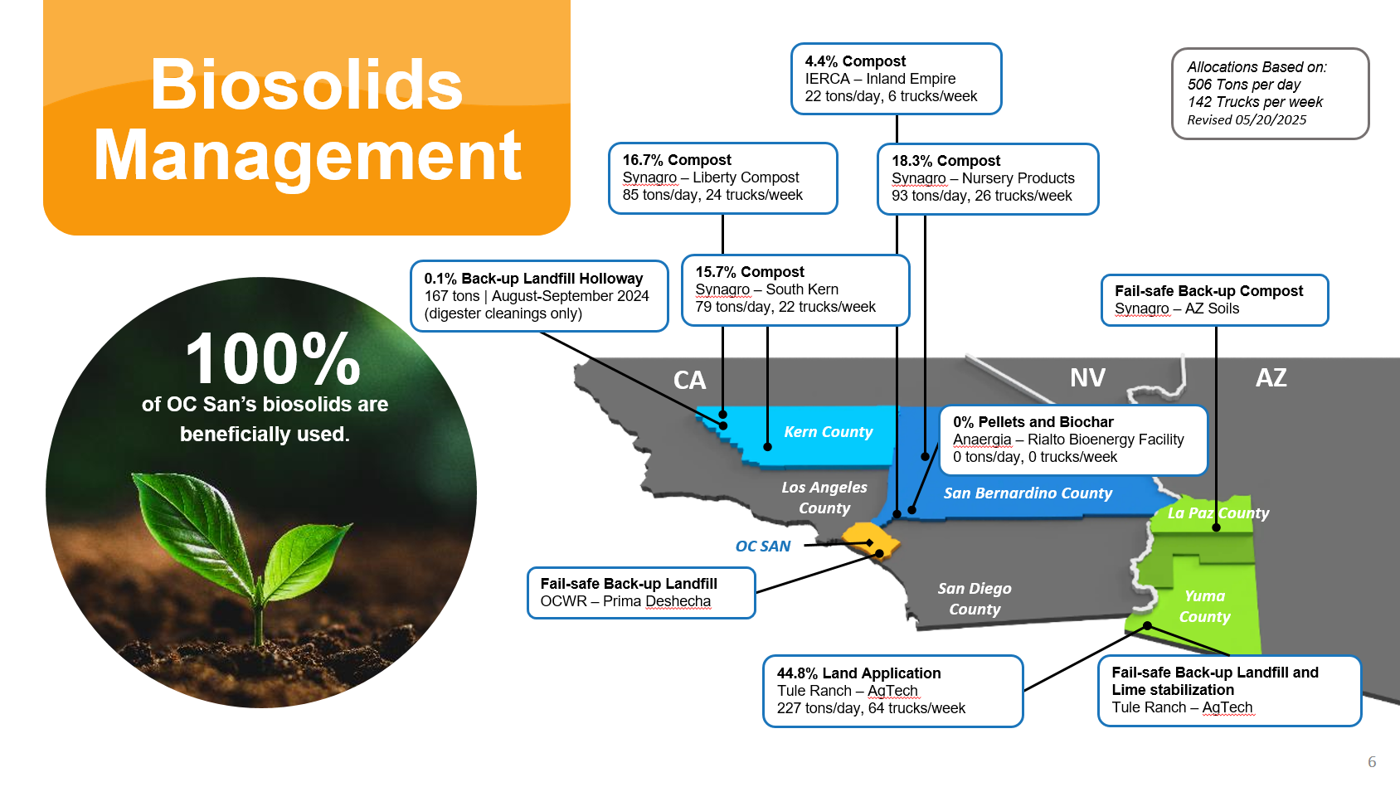

Slide 6
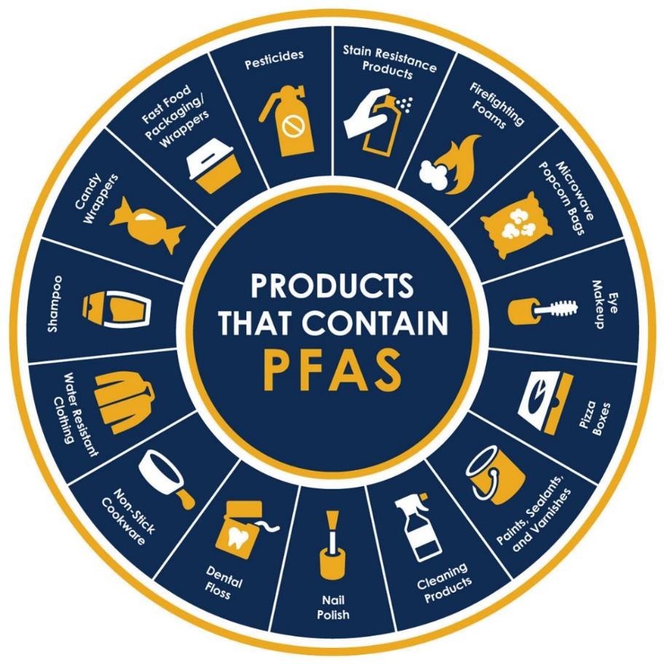
Treatment Challenges
PFAS
Microplastics
Methane
Brine
Electric Haul Trucks
*Image Source: City of Riverside

Slide 7
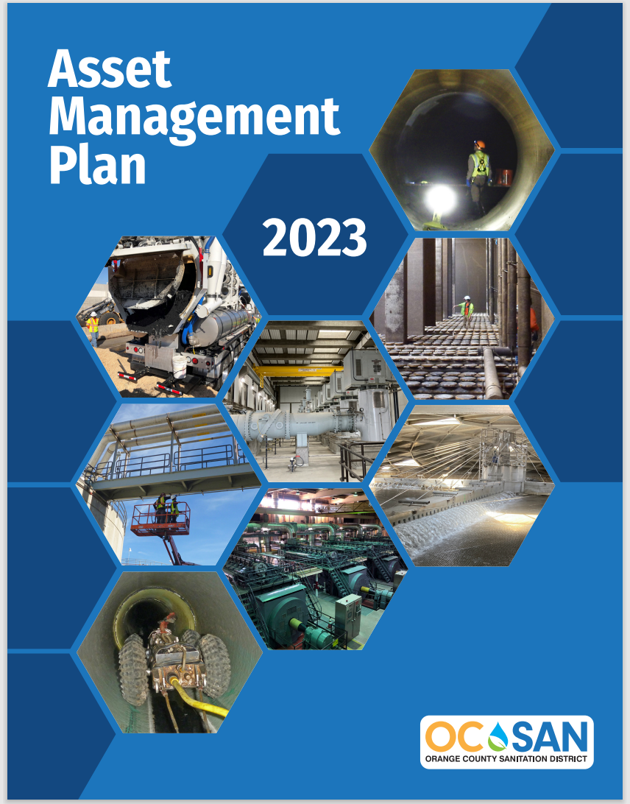
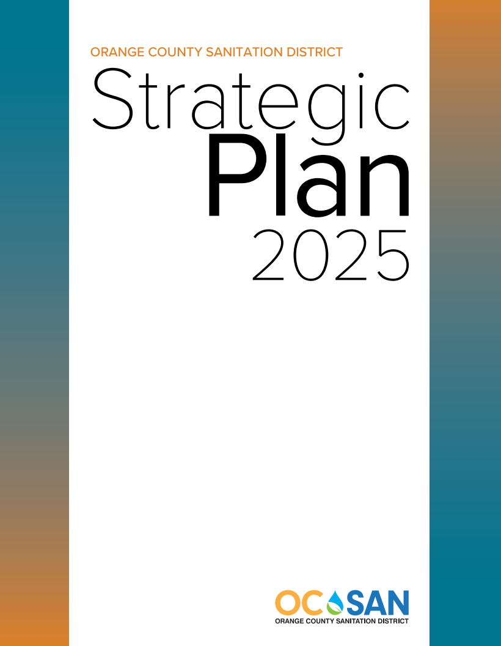
Intentionally Decide What To Do
Policy Areas:
Business Principles
Environmental Stewardship
Wastewater Management
Workforce Environment
Notes:
Preparing and planning for the future of OC San and the community we serve is the essence of who we are. As a part of the planning process, OC San creates a guiding document — the Strategic Plan. The four-step strategic planning process begins with defining OC San’s ability to have people and assets in the right place at the right time to meet its agreed upon mission and levels of service. The second step is budget development. The budget document lays out the tactical planning and resource allocation based on the adopted plan. The third step is the budget execution which is the day in and day out delivery of services to the public we serve. The final step is reporting on our levels of service, including what we have achieved. These four steps are repeated every two years adjusting as needed based on the Board of Directors input, legal and regulatory changes, and the needs of the communities we serve. The most recent plan is scheduled to go to the OC San Board of Directors in November 2025 for adoption

Slide 8
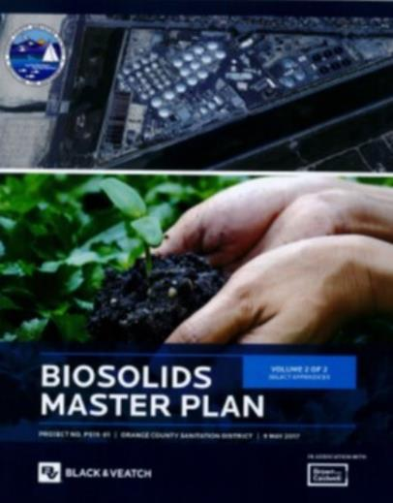

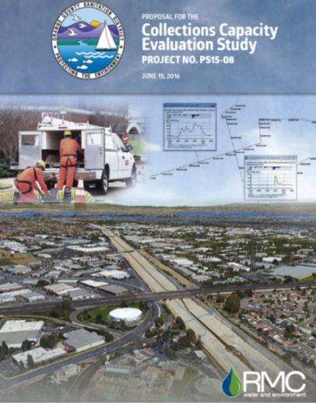

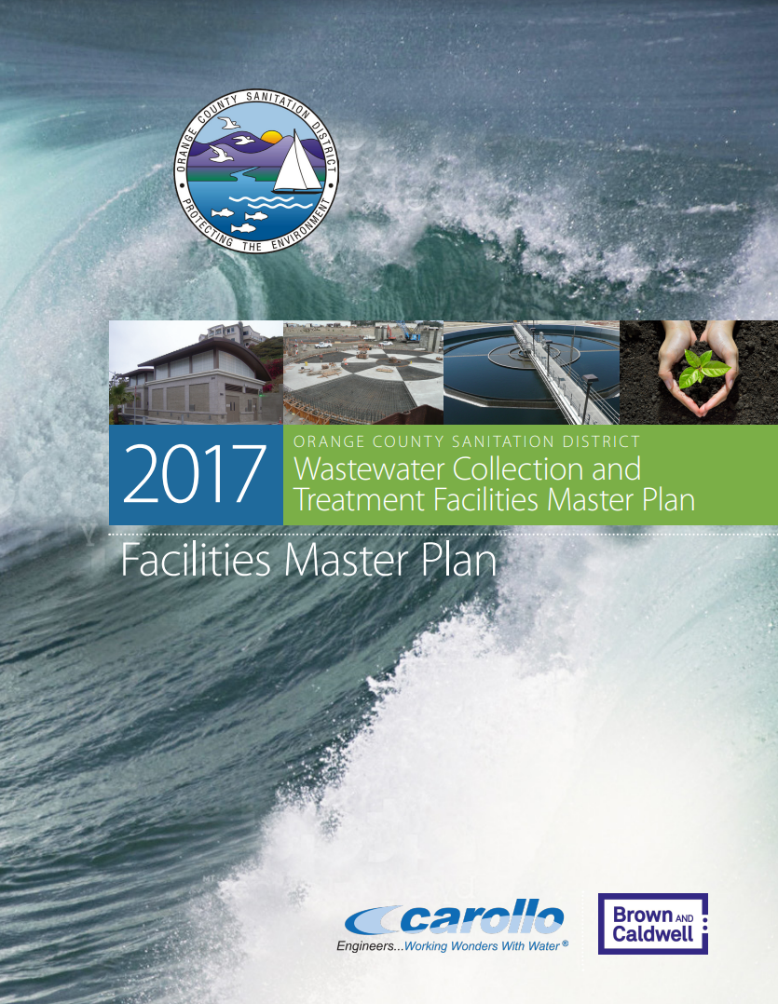
Intentionally Decide What to Do/Become
Notes:
Update images. Combine 16 & 17
Tie-In Planning Study Documents, these are not bookcase decorations

Slide 9
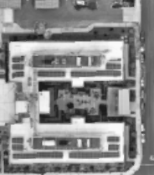
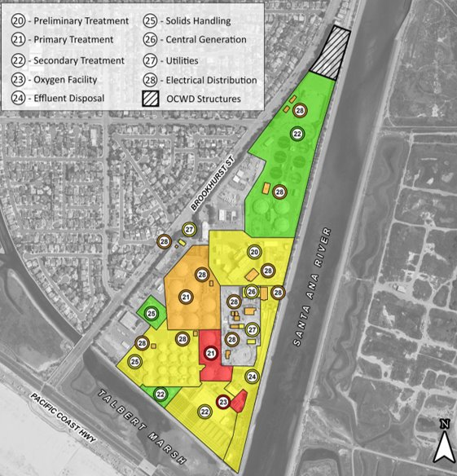
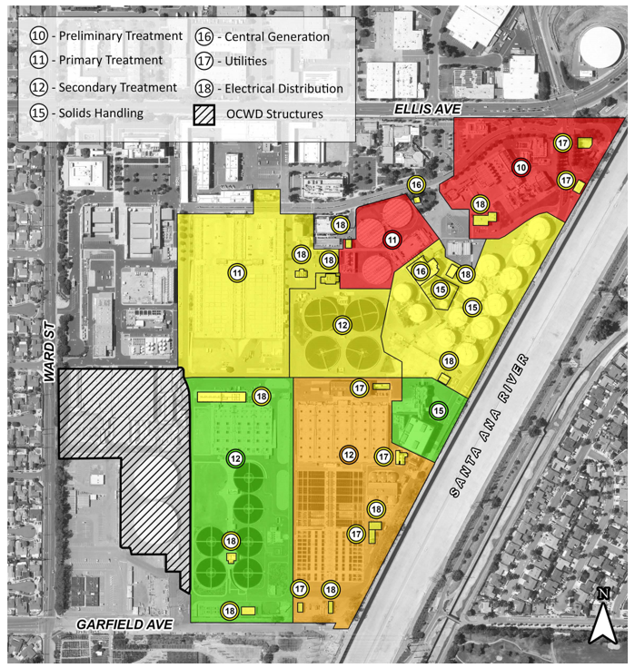
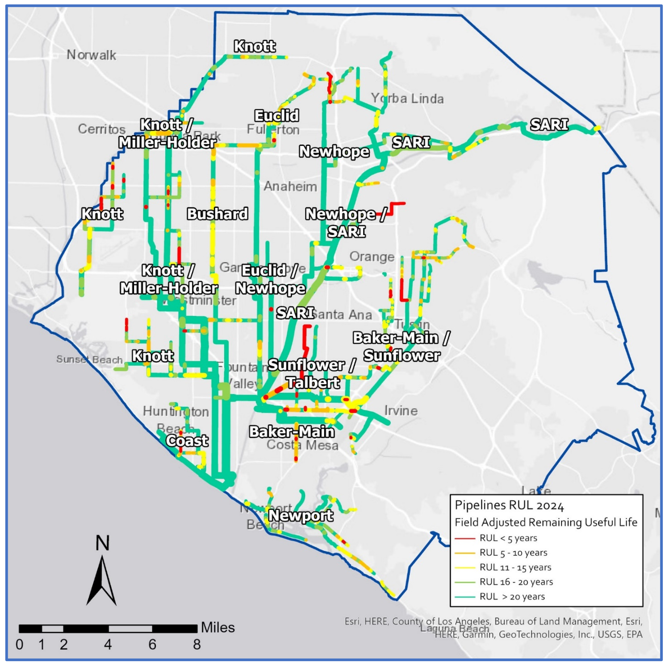
Every Process Renewed Every 25 Years
Plant No. 1
Plant No. 2
Collections
Notes:
Efficient, Planned Delivery of Projects and Maintenance Maximizes the Dollars You Already Spend!

Slide 10
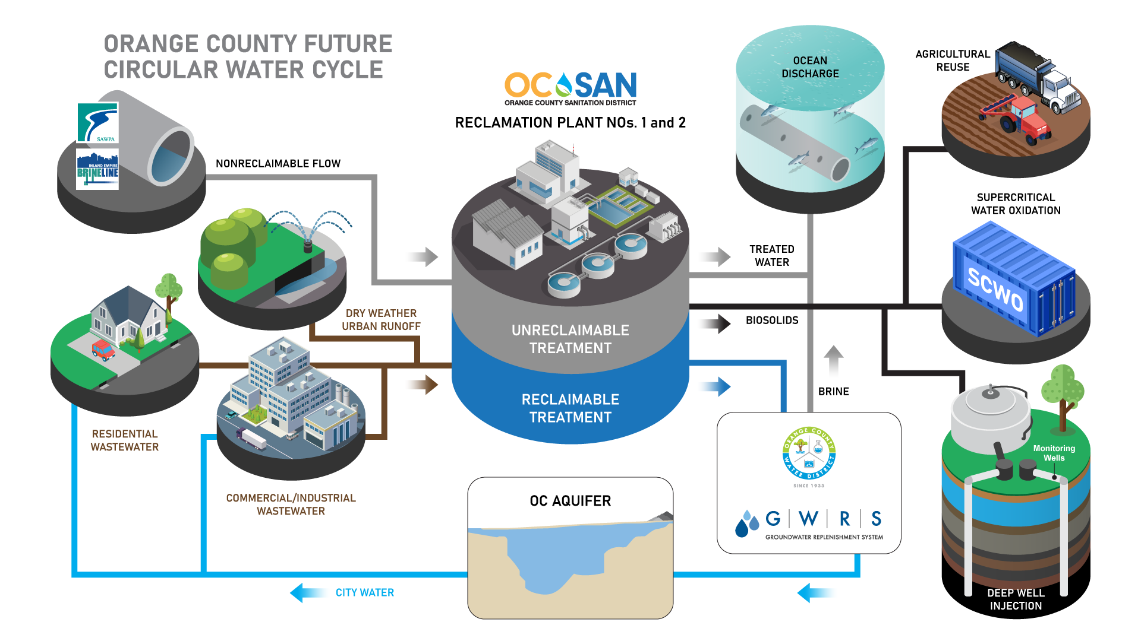

Slide 11
What is Supercritical Water
Properties of H₂O change significantly above:
218atm (3200 psi)
374C (705F)

Slide 12
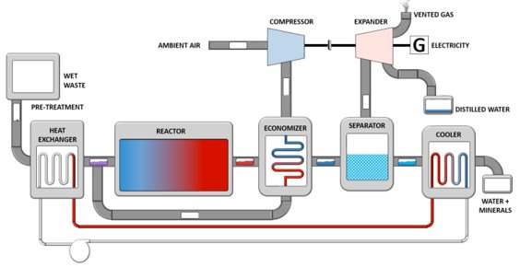
Tomorrow's Solids Solution
OC San and 374Water° have partnered to build a six-ton-per day demonstration project called AirSCWO 6. This process uses high temperature and pressure to oxidize and break down complex compound materials like PFAS.
Notes:
OC San is always looking for and exploring technology to be utilized as part of wastewater treatment. We are testing the potential to convert the energy of the organic compounds from wastewater into additional heat or electricity.
This technology can potentially replace energy-intensive processes of anaerobic digestion, biogas cleaning/compression/storage, and residual solids dewatering, in addition to reducing the need for onsite or offsite management. This technology may also address the pressing challenges created by the demand to develop effective treatments for the forever chemicals known as Per- and Polyfluorinated Substances (PFAS).
OC San and 374Water have partnered to build a six-ton-per day demonstration project called AirSCWO Nix6. This process uses water at a high temperature and pressure to oxidize and break down complex compound materials like PFAS. Once treated, we expect that the compounds are transformed into more fundamental and benign compounds and ensure enhanced public health, including exposure to water and air that would otherwise contain PFAS. Once operational, AirSCWO Nix6 may provide opportunities to solve other challenges facing OC San and other clean water agencies throughout California.

Slide 13
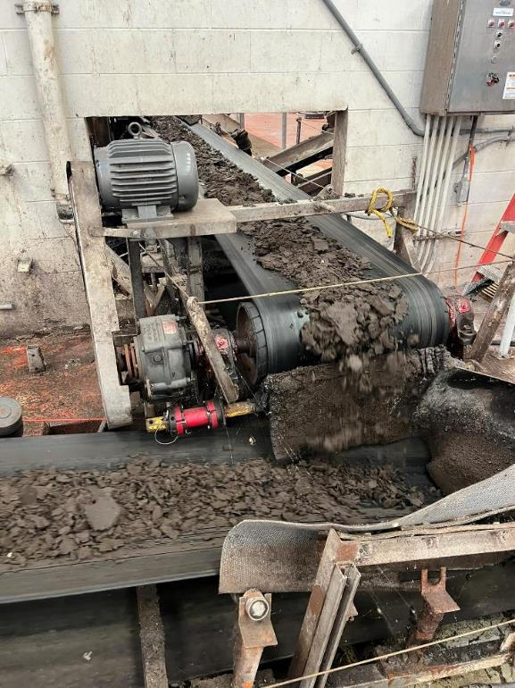
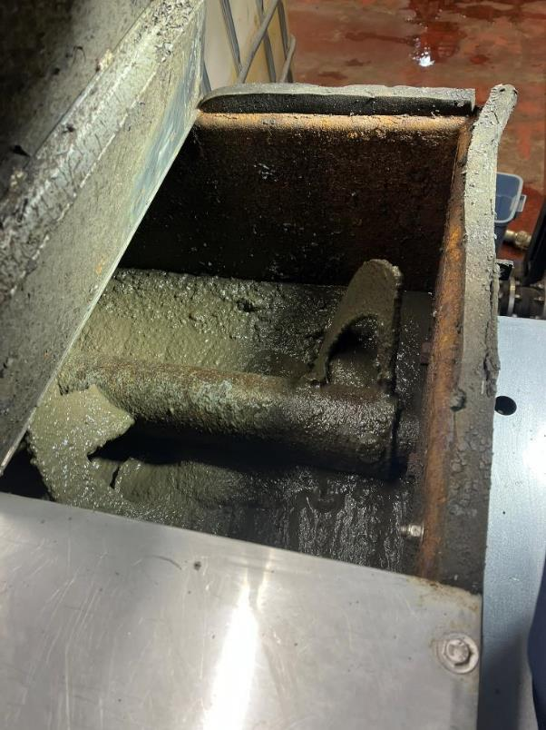
The Process…
Sludge Cake to the Preprocessing Unit
Preprocessed Sludge

Slide 14
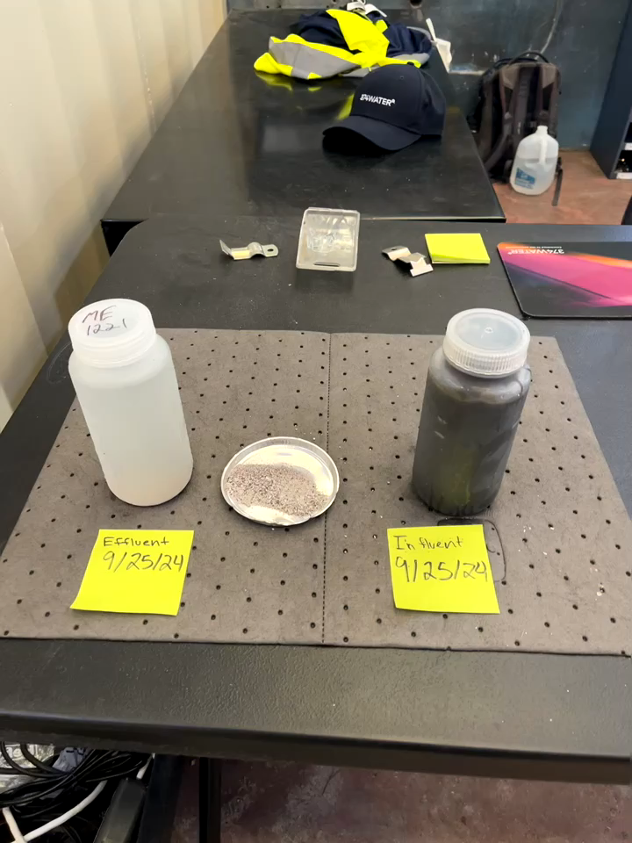
The Process…
Effluent/Minerals/Influent

Slide 15
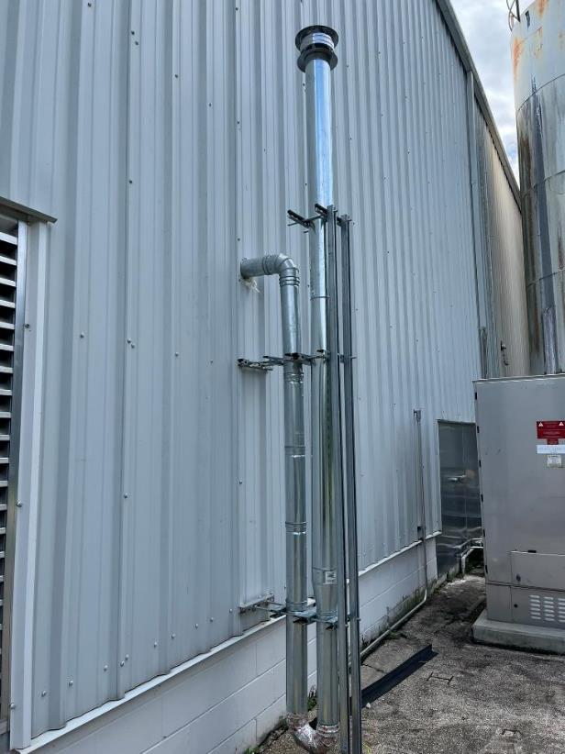
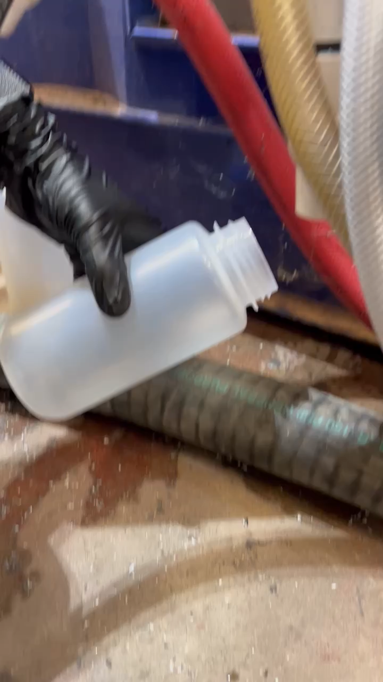
What’s Left
Clean Gas Effluent
Effluent Water After Processing

Slide 16
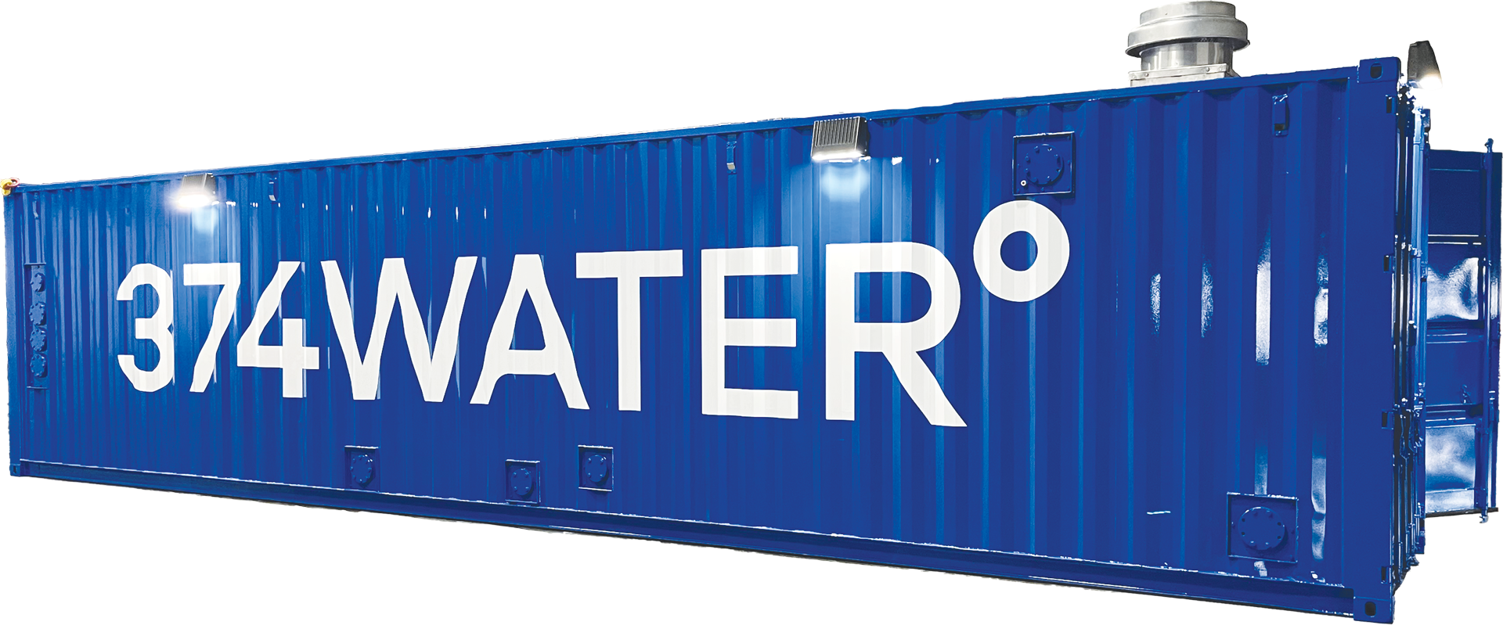
Next Steps…
Complete Factory Testing (Spring 2026)
Install and operate at OC San (2026)
Investigate 30 ton/day unit with energy recovery.
How can we concentrate problem compounds?
What path do we take to a 100 ton/day unit?
What else might SCWO help with?
Leachate
Food waste
GAC/Ion Exchange Resin

Slide 17
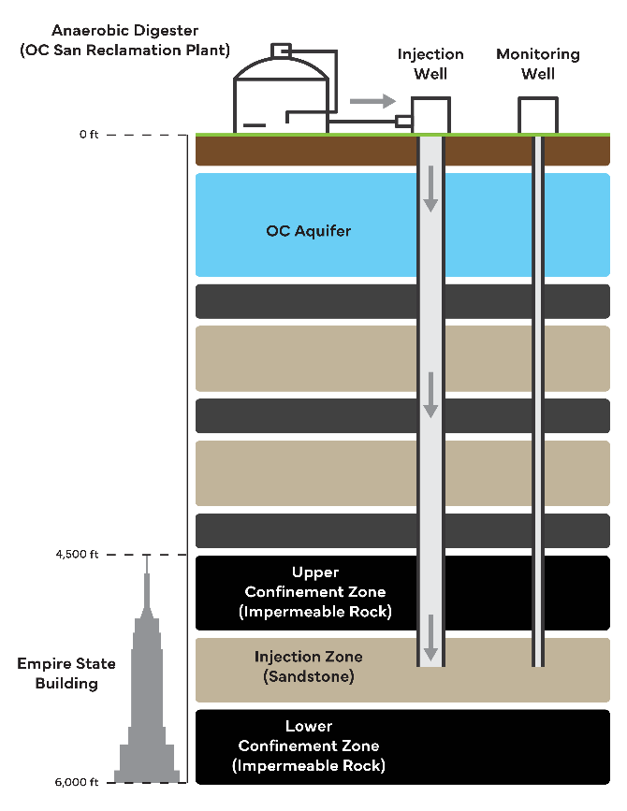
Deep Well Injection
Reduce/eliminate transport costs/carbon
Reduce treatment costs
Reduce greenhouse gas emissions
Long-term carbon sequestration
PFAS/microplastic/pharmaceuticals forever home
Notes:
PS24-01 - Deep Well Injection Feasibility Study
The Orange County Sanitation District (OC San) is interested in exploring deep-well injection as a method to dispose of slurry mixtures of treated, non-hazardous municipal sludge, brine and effluent. Deep well injection is a process that involves injecting treated or untreated fluid streams into geologic formations far below and separated from potable water aquifers by an impermeable confining layer.
Reduce/eliminate transport costs/carbon
Reduce treatment costs
Reduce greenhouse gas emissions
Long-term carbon sequestration
PFAS/microplastic/pharmaceuticals creates a forever home

Slide 18
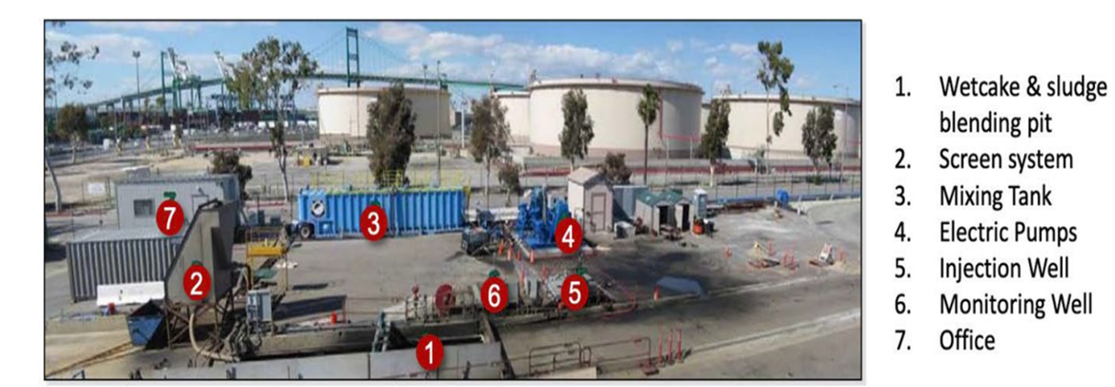
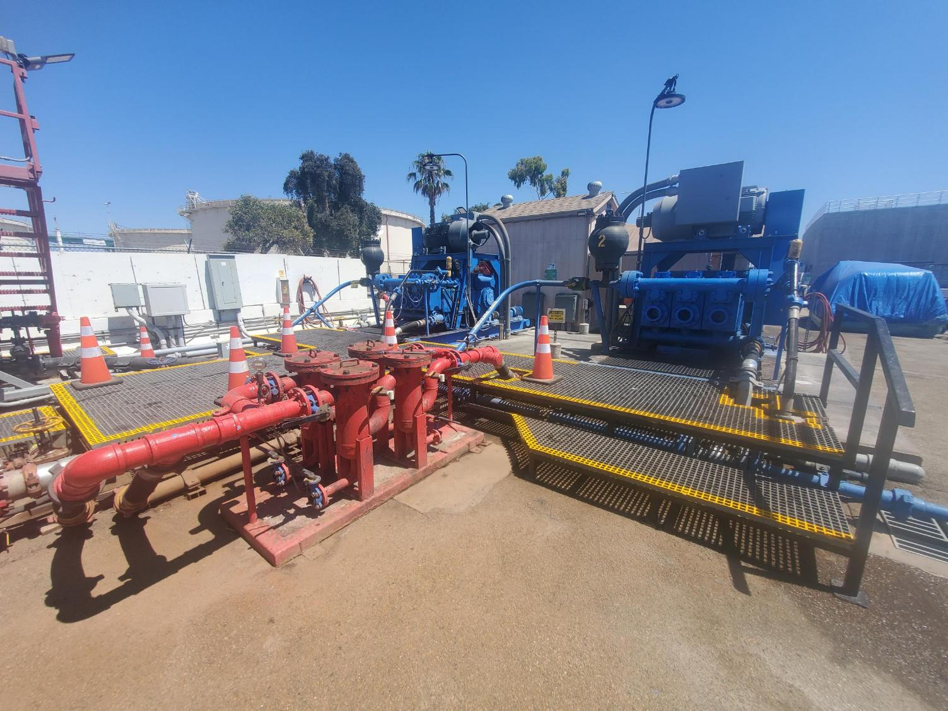
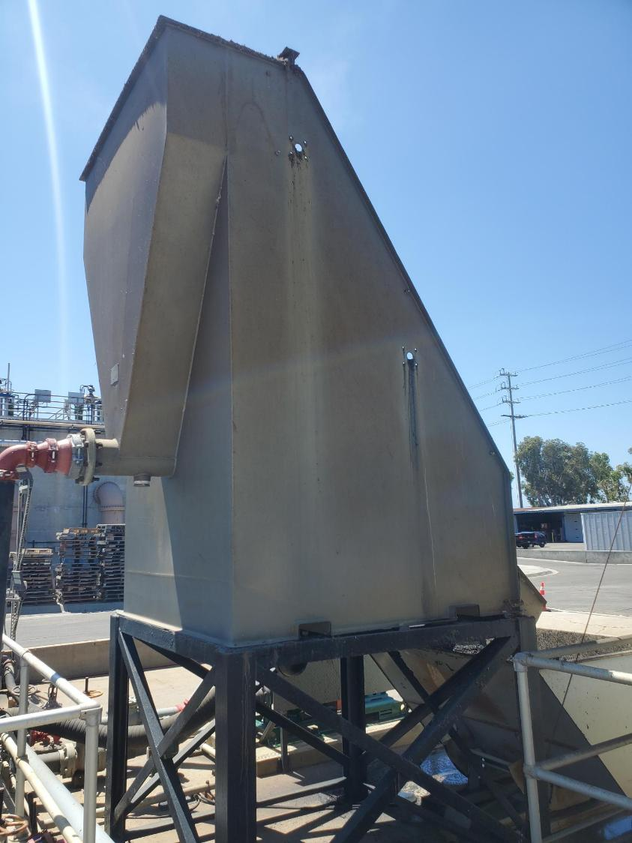
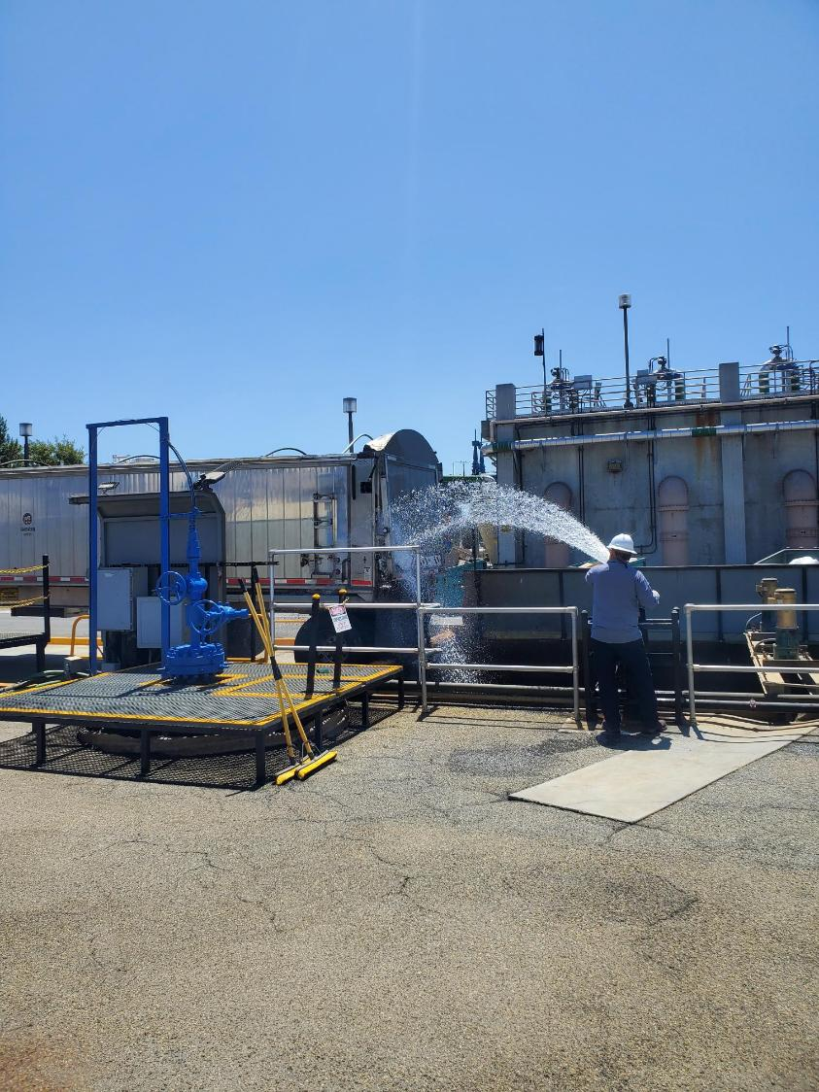
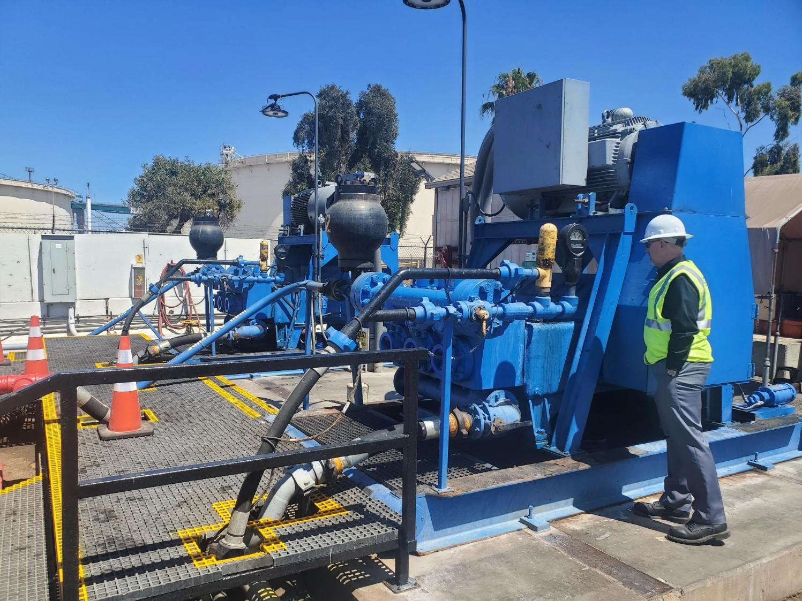
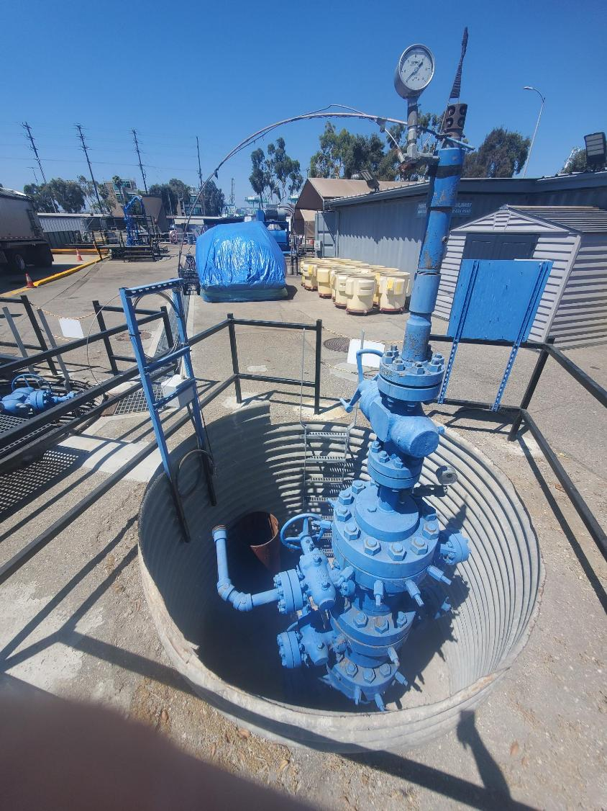
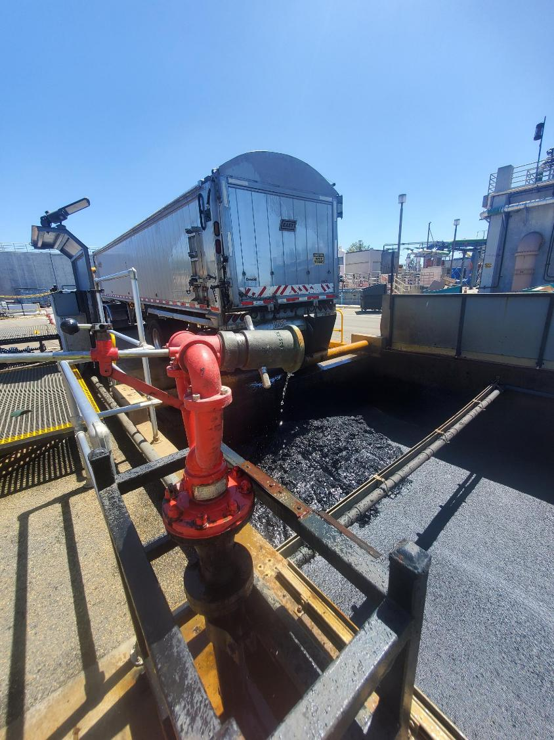
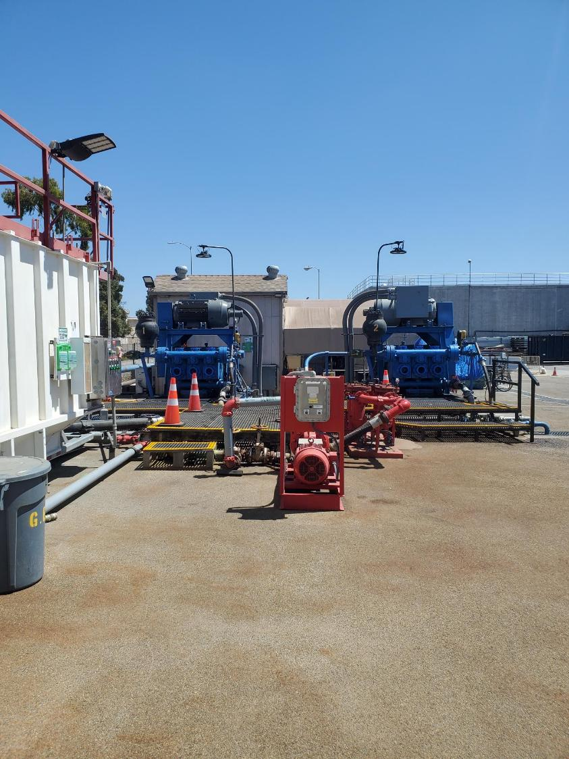
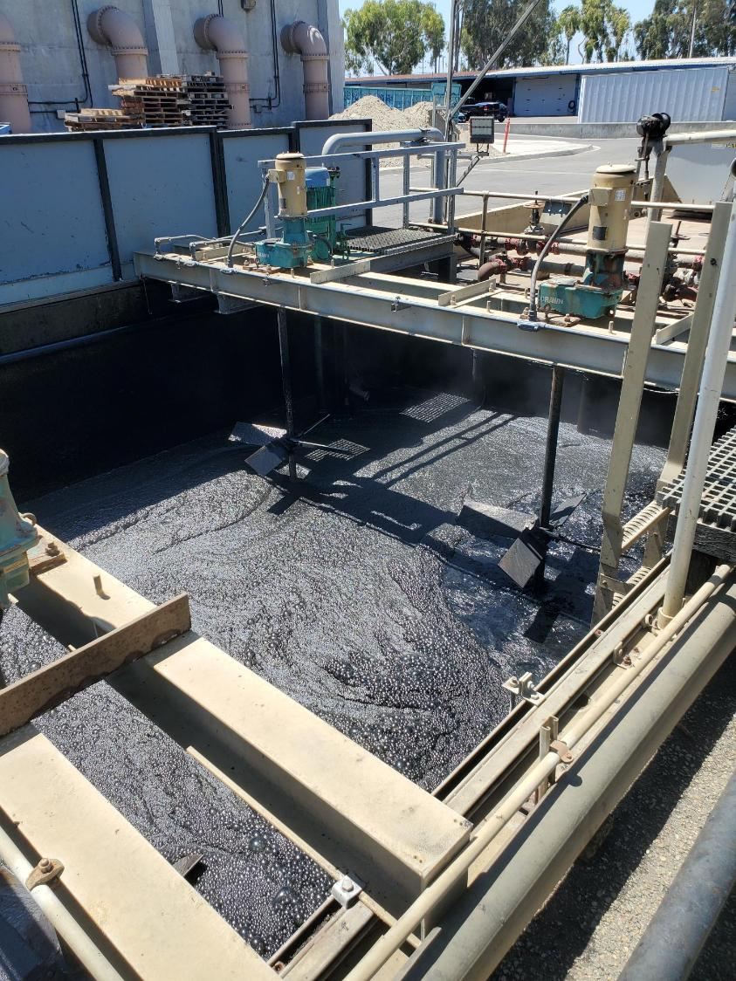
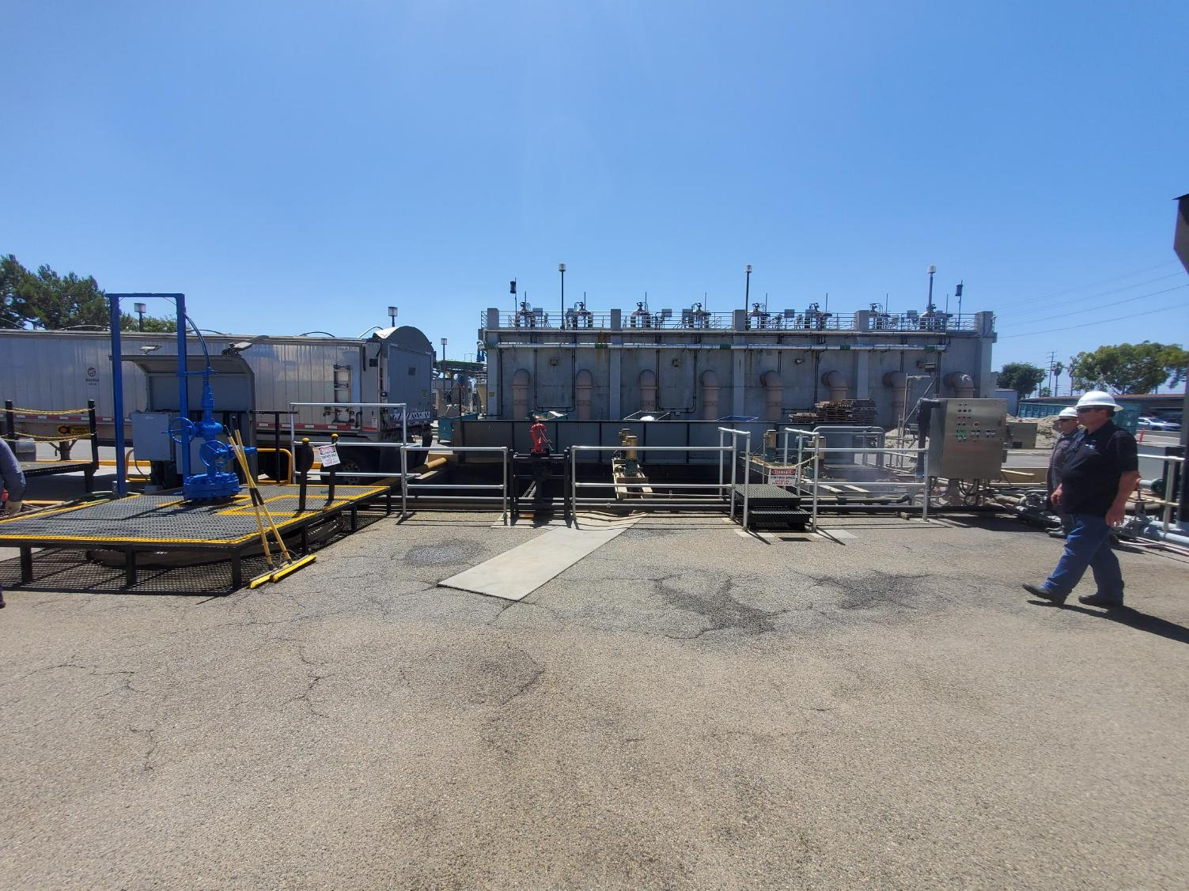
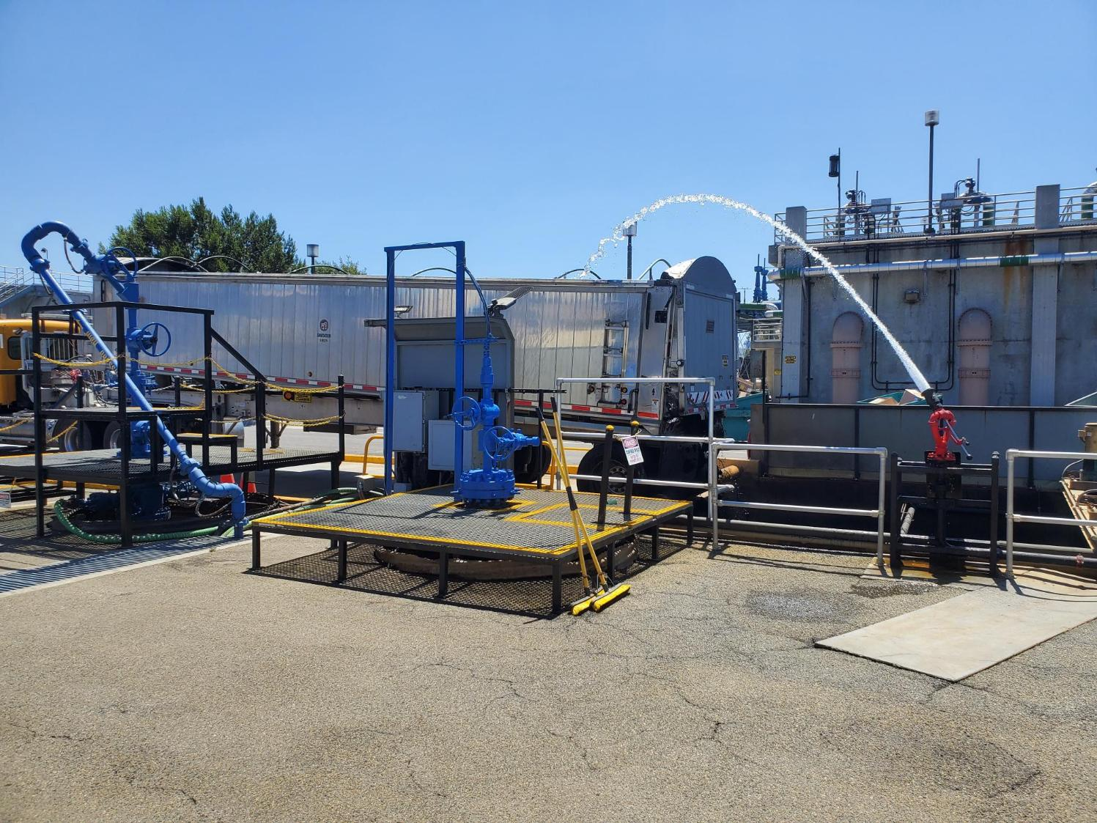
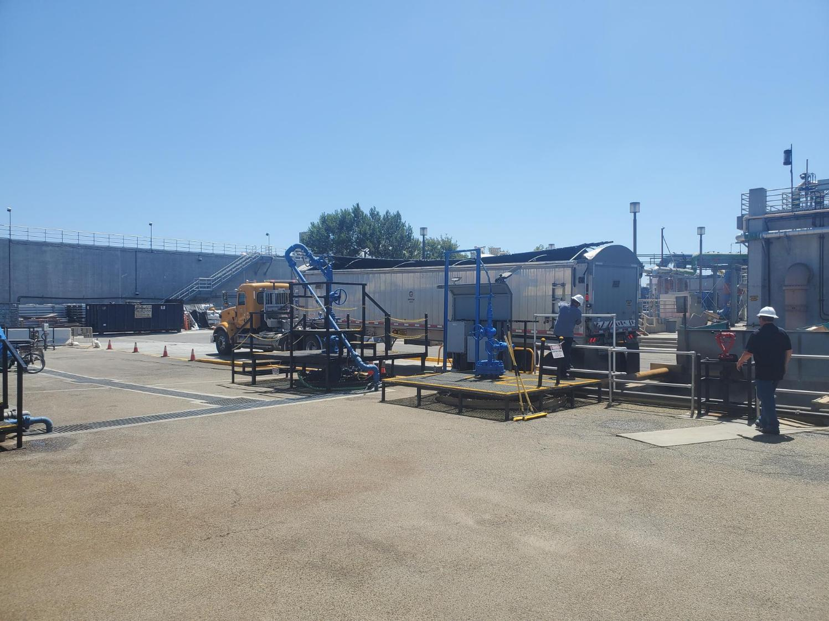
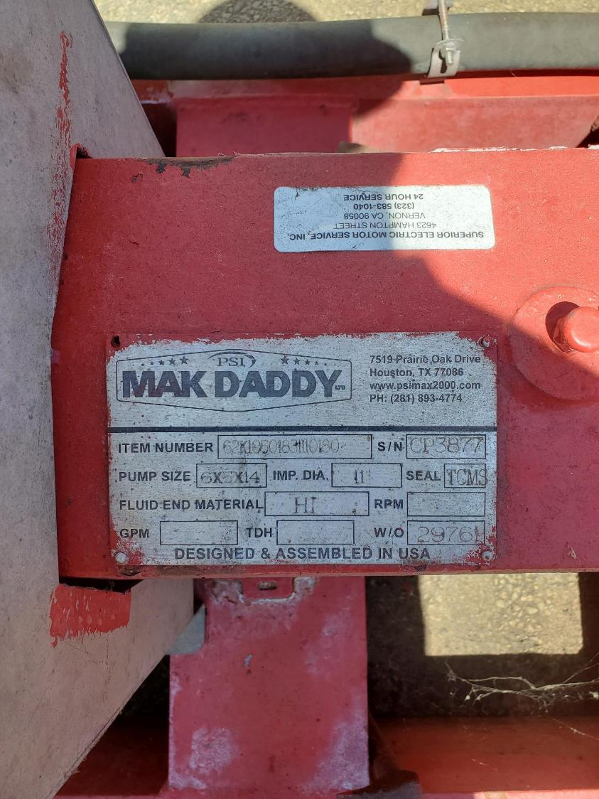
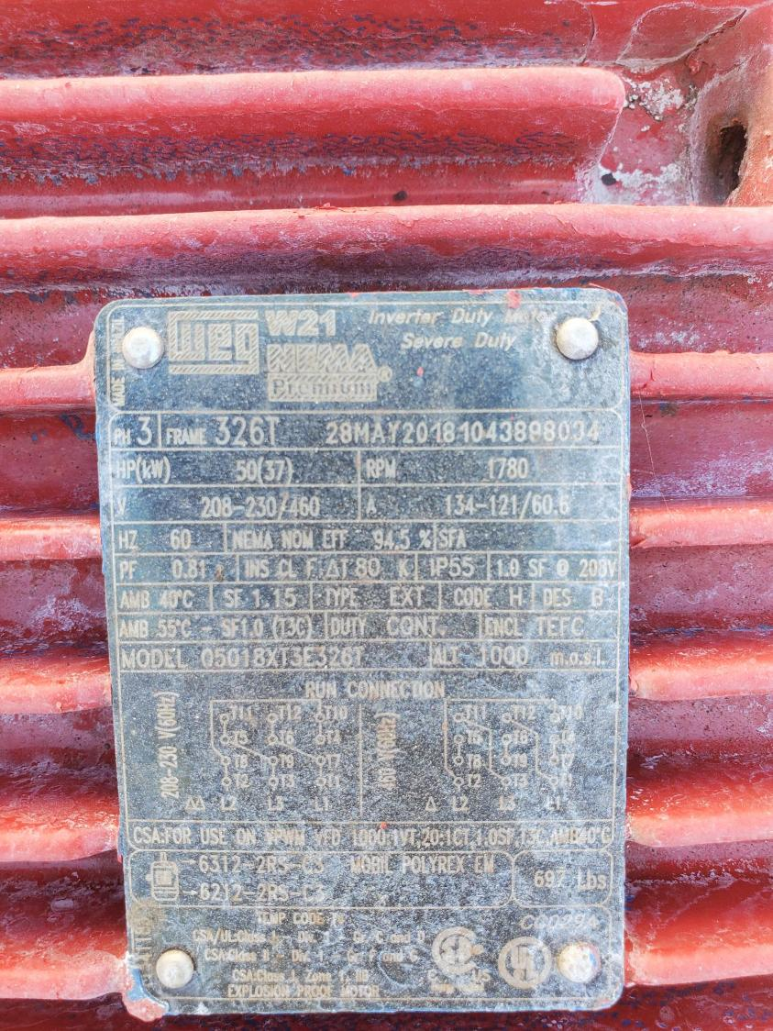
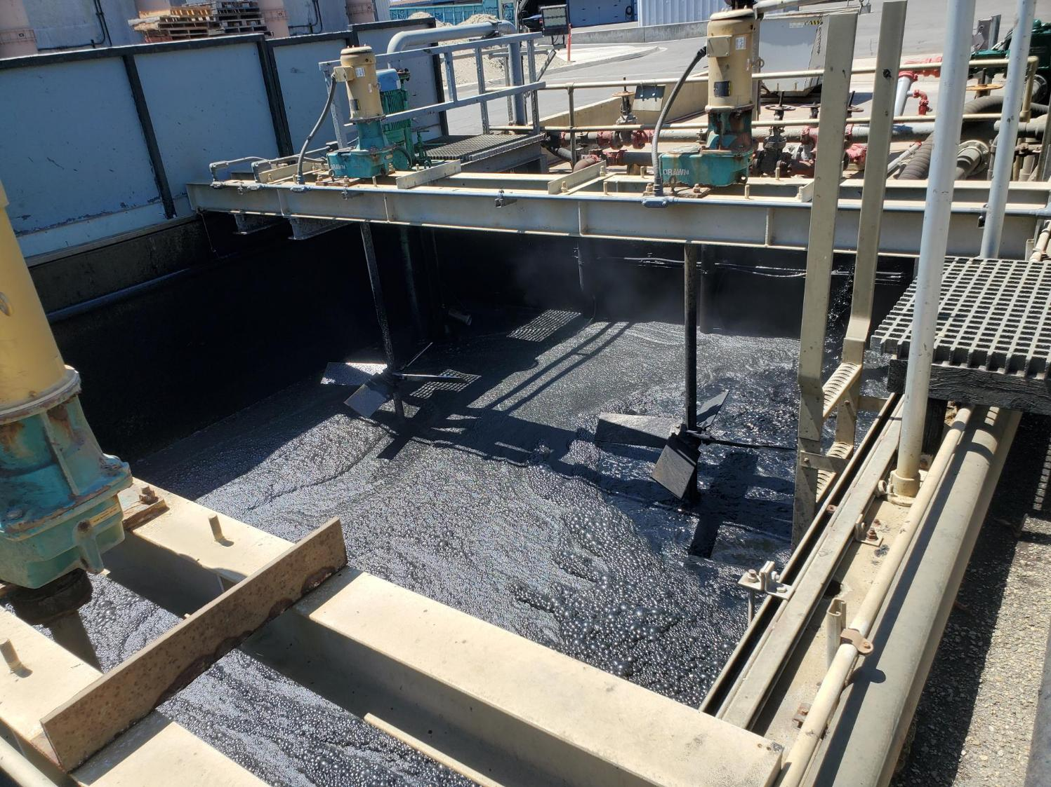
LASAN Terminal Island Renewable Energy Facility
Operating since 2008 under EPA Class V Underground Injection Control Permit
1 high pressure injection well – 400 gallons per minute
3 monitoring wells
Injects all of Terminal Island and a portion of Hyperion sludge
Notes:
Build off LA SAN effort, with a facility suited to our process and geological constraints
TIRE is minimal in infrastructure
1 well, permitted typically 10 (400 gpm)
3 monitoring wells
3 pumps
Receiving facility to take Hyperion sludge
OC San facility intended to be similar in function but larger in size to fit our process and location
Due to our location within residential areas, require processes be enclosed in buildings w/ odor control, which requires a large capital investment
Additional photos on adjacent slides
*****************************************************************************************
While there are wastewater injection wells, only other similar application of deep well injection of biosolids is the LA SAN TIRE facility.
TIRE takes Terminal Island digested sludge (15 MGD plant) and 16% of Hyperion biosolids (~7 trucks from Hyperion/day).
Permit allows for flexibility to increase pumping with additional monitoring, and allows for disposal of sidestream wastes in addition to biosolids.
Proposed OC SAN facility would be similar and would initially be targeted to handle up to all P1 biosolids, similar to TIRE, with future expansion potential to handle P2.

Slide 19
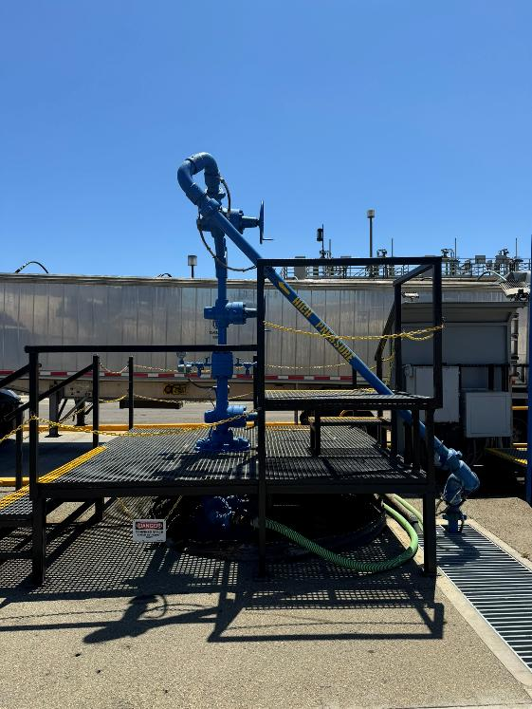
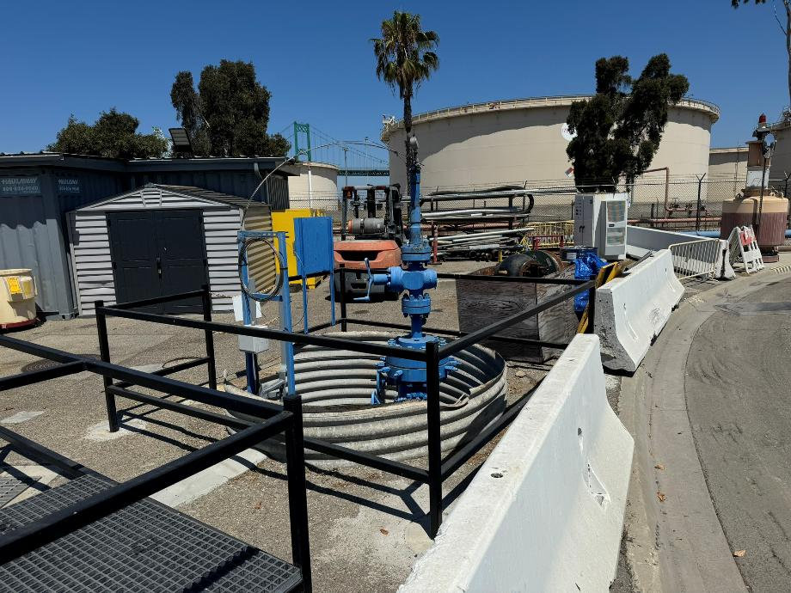
LASAN Terminal Island Renewable Energy Facility
Typical Injection Well
Monitoring Well

Slide 20
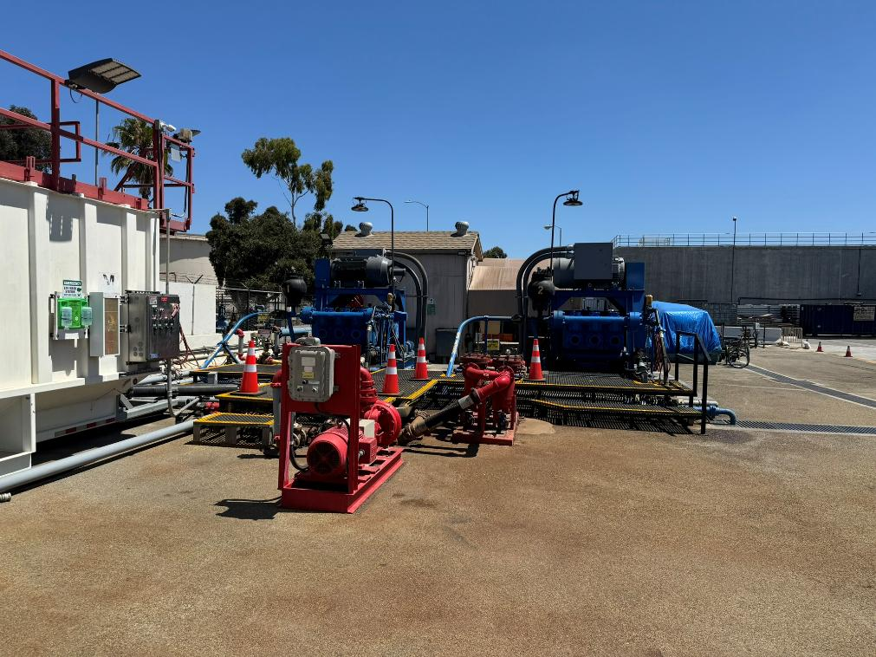
LASAN Terminal Island Renewable Energy Facility
Typical Injection Pumps

Slide 21
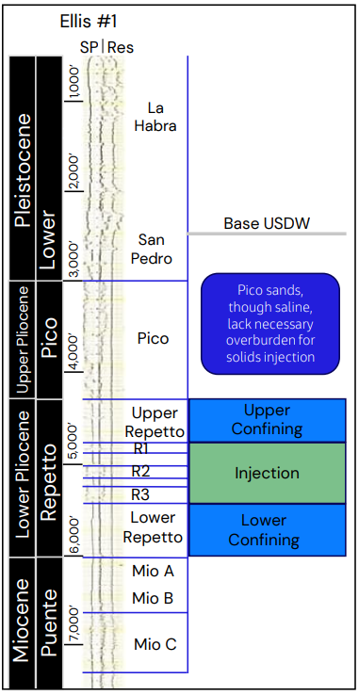
Geophysical Analysis
Permeable ‘R2’ and ‘R3’ Repetto sands, with containment between impermeable shales
Injection interval at ~ 5,000 ft
Max bottomhole pressure 3,900-4,100 psi
Capacity up to ~ 1,000 gpm
OCWD Production Wells
Base of Viable GW
Confining Shales
Injection in R2, R3 Sandstones
Confining Shales
Notes:
Geophysical analysis and modeling was conducted to determine geological conditions and estimate injection parameters
Injection Zone:
Within Repetto formation approximately 5,000 ft
Three sandstone layers separated by shales
Only R2 (130 ft) and R3 (200 ft) viable. R1 too thin (40 ft). Separation between R2 and R3 (100 ft). Injection intervals have high porosity (>20%). Confining layers have low porosity (<10%).
Upper and lower confining shale layers (500 ft upper). Primary confining layers, not relying on R2 and R3 separation. 25 bpm (~1000 gpm) possible. Max bottomhole pressure 3,900-4,100 psi.
Base of EPA definition of aquifer (Underground Source of Drinking Water) is ~2,600 ft below surface. Defined as water with < 10,000 mg/L TDS (based on potential to be used for drinking water). However, OCWD extraction wells are in the range of 400-700 ft.
Bottomhole pressures ~ 4,000 psi
Injection capacity up to 25 bpm (~1,000 gpm) could be supported

Slide 22
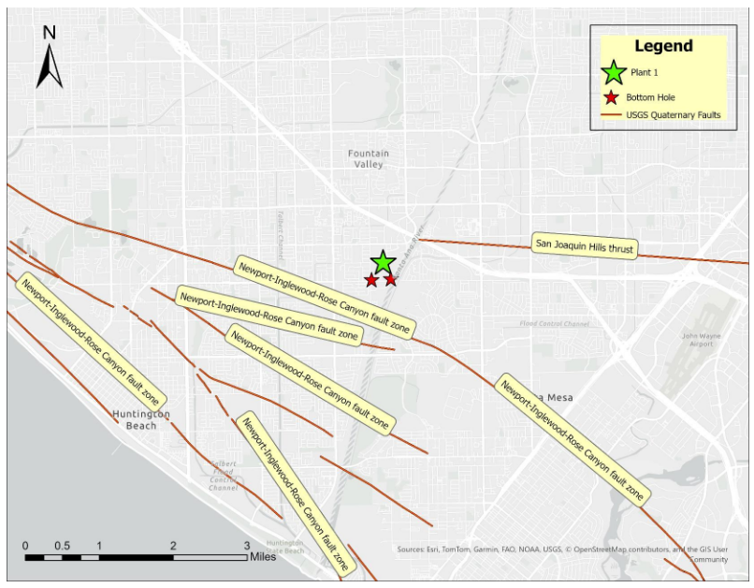
Seismicity Analysis
Local faults do not intersect with injection zone
San Joaquin Hills Thrust Fault
>7,400 ft deep, isolated from injection zone
Newport-Inglewood-Rose Canyon Fault
Main strand offshore
Secondary faulting not within injection zone
Induced seismicity highly unlikely
Monitoring for micro seismicity required by EPA permit
Notes:
Induced seismicity risk is anticipated to be very low at P1
Two faults in the area:
San Joaquin Hills Thrust Fault – Planar thrust fault feature inclining down towards the ocean. Below P1, the fault is > 7,400 ft deep, > 2,600 ft below injection depth.
Crystaline basement (solid rock below the sedimentary rock layers) is 2 miles deep. Earthquakes typically occur in the basement depths.
Newport-Inglewood-Rose-Canyon to the south.
Faults do not crosscut the injection or confining intervals in the injection zone.
Earthquakes occur in basement rock depths (2+ miles below injection zone)

Slide 23
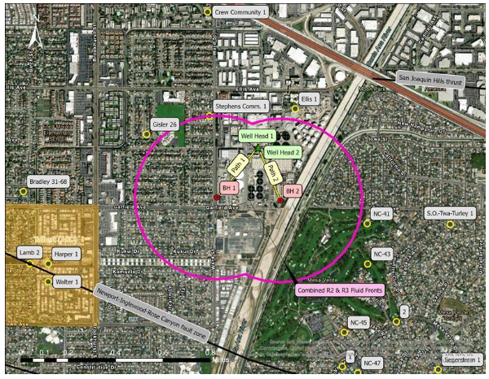
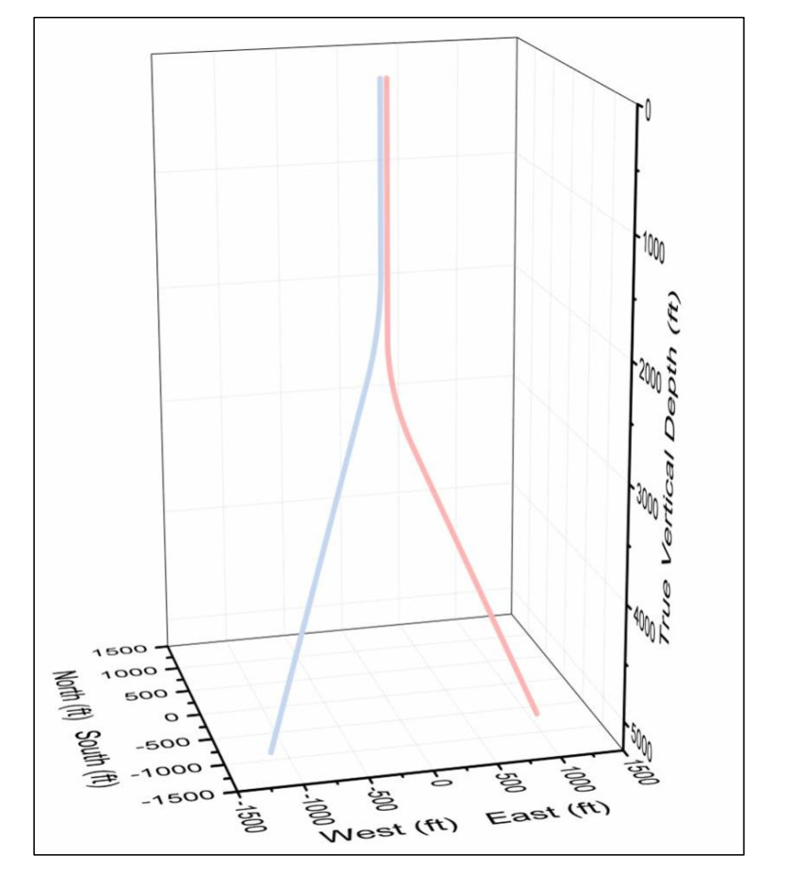
Injection Zone Boundary
Two injection wells within P1 boundary
Long term injection confined to 1,800 ft
Approach avoids impacts to local abandoned oil wells
Injection area boundary
Notes:
Intent is to be able to operate this facility long term
Continuous injection would involve having two wells cycling, to allow for rest operations between each pumping cycle. This allows for pressures to subside between each pumping operation and promotes longer well life.
Pumping facility would be located in a central location at P1, with slant wells and bottom holes on P1 property.
Modeling results show 10 year operation at continuous pumping of 25 bpm would have critical fluid and pressure fronts not intersecting with old oil wells (meaning that pressure increases within the boundary are confined below a critical threshold). Long term operation beyond 10 years would not likely exceed the boundaries shown as long as pressures are maintained (pumping capacity may be reduced).
*Well life expected to be 14 years pumping all P1 solids (each well). Well life estimates are sensitive to assumptions on porosity and permeability.

Slide 24





Permitting
EPA Class V Underground Injection Control (UIC) Permit
Public outreach/notifications
Proper abandonment of wells
CalGEM Notification
City Well Installation Permit
NPDES Permit Requirements
SCAQMD Air Permit
Odor scrubbers
Sewage Treatment Plant Permit
CEQA – IS/MND
Notes:
For deep well injection, permitting is a key driver of both schedule and project success.
First, we will need an EPA Class V UIC Permit. This will require a strong technical submittal and coordination with EPA throughout the review process.
Public outreach and notifications are also critical since community understanding and acceptance will be part of the permitting effort.
We must also plan for proper abandonment of any existing wells to comply with state and federal standards.
While the EPA UIC Class V permit governs deep well injection at the federal level, a notification to CalGEMS is required to ensure compliance with California’s groundwater protection standards.
At the local level, we understand that the City Well Installation Permit will be required for drilling and construction activities (which is why we are meeting today).
NPDES permit requirements may apply if there are any discharges associated with well development or testing.
Air permits from SCAQMD will be needed for odor control systems (such as scrubbers) and our overall Sewage Treatment Plant Permit would need to be modified to incorporate these new aspects.
Finally, CEQA compliance is required
Together, these permits form the foundation of the regulatory pathway and will guide our schedule and stakeholder engagement moving forward.

Slide 25
Project Progress
Planning Study
Geophysical analysis
Formation modeling
Surface facility design criteria
Surface facility layout
Cost Estimate
Community Engagement
Permitting
Design
Notes:
Summary of current of future efforts:
We are currently completing the planning-level analyses, including geophysics, formation modeling, surface facility layout, and cost estimating.
Geophysical analysis and formation modeling will guide the facility design.
Community engagement and detailed permitting will subsequently follow.

Slide 26
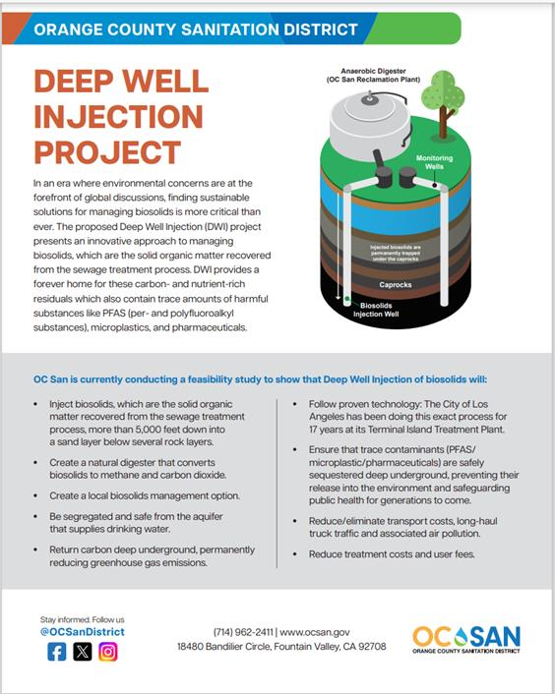
Community Engagement
Multi-year Public Outreach Program
Inform and educate on process, benefits and reasons for deep well injection
Early engagement
Hiring third-party outreach consultant to support messaging, materials, and stakeholder coordination
Notes:
A multi-year public outreach program that has a multi-pronged approach is central to this effort: community meetings, advisory committees, plant tours, newsletters, website
Similar to GWRS
Our goal is to educate the community early about the process, benefits, safety, and environmental safeguards.
We plan to bring on a third-party outreach consultant to support messaging, materials, and stakeholder coordination.

Slide 27
Schedule
Activity | Date
Outreach Consultant Award | June 2026
Design-Builder Procurement | September 2026
Preliminary Design | June 2027
Permitting | November 2028
Well Installation & Testing | November 2028 to August 2029
Final Design | December 2029
Construction Completion | August 2031
Notes:
This slide outlines the overall project delivery timeline based on our current planning and feasibility work.
We anticipate beginning the Progressive Design-Build procurement as soon as the planning study is complete so we can overlap permitting and early design (2/26-8/26).
EPA’s Class V permit application will begin early since it has a 2-year review process and will run in parallel with preliminary and final design, which will be key to accelerating the project schedule forward (11/28).
Once permitting is secured, the project will start with installing and testing one injection well (11/28-8/29).
Once testing of this initial well has determined the projected capacity and longevity of the proposed system, the project would move into detailed final design, construction, and ultimately commissioning (8/31).
Community engagement will continue throughout the schedule, from planning through permitting and into design, ensuring transparency and ongoing dialogue with the City.

Slide 28
Next Steps
Complete Planning Study
Hire Outreach Consultant
Select Design-Builder
Permitting & Design
Notes:
We’re in the process of finalizing the planning study that evaluates the technical, regulatory, and operational feasibility of deep well injection. This includes cost estimates, siting analysis, injection fluid characterization, and risk assessments. The study will serve as the foundation for the next steps with the project. Based on the planning outcomes, we will define the initial scope of work for the proposed system at Plant 1.
We’ll move forward with the procurement of a design-builder under a progressive design-build model. This approach allows for early collaboration during design, improves cost control, and provides flexibility to address permitting and constructability challenges as they arise.
Throughout the process, we will engage in interagency coordination and public outreach to ensure transparency, address concerns, and build support. This includes presenting to regulatory partners, responding to CEQA comments, and conducting public meetings as needed.
In parallel with design development, we will begin the multi-agency permitting process, including coordination with CalGEMS, EPA, local water agencies, CEQA compliance, as well as the City of FV well installation permitting (which is what we are doing today). The design-builder will support preparation of technical submittals and ensure that the design reflects permit conditions.

Slide 29
Rob Thompson
(714) 593-7110
rthompson@OCSan.gov

